Slide 1
Web Advisory Meeting Spring 2018

Slide 2
Agenda
Ruffalo Noel Levitz and Branding (KH)
Program Pages (KW)
Update: CMS Migration (JS)
Update: Mega Menu/Secondary Pages (CR)
Update: Mobile (ES)
Full-Width Templates (ES)
Future Changes/Features
Web: Site menus, full-width templates
Mobile: banner

Slide 3
Program Pages
Goals of the program pages:
A consistent look and feel
Provide updated information to users
Request Info and have it trackable through Target X

Slide 4
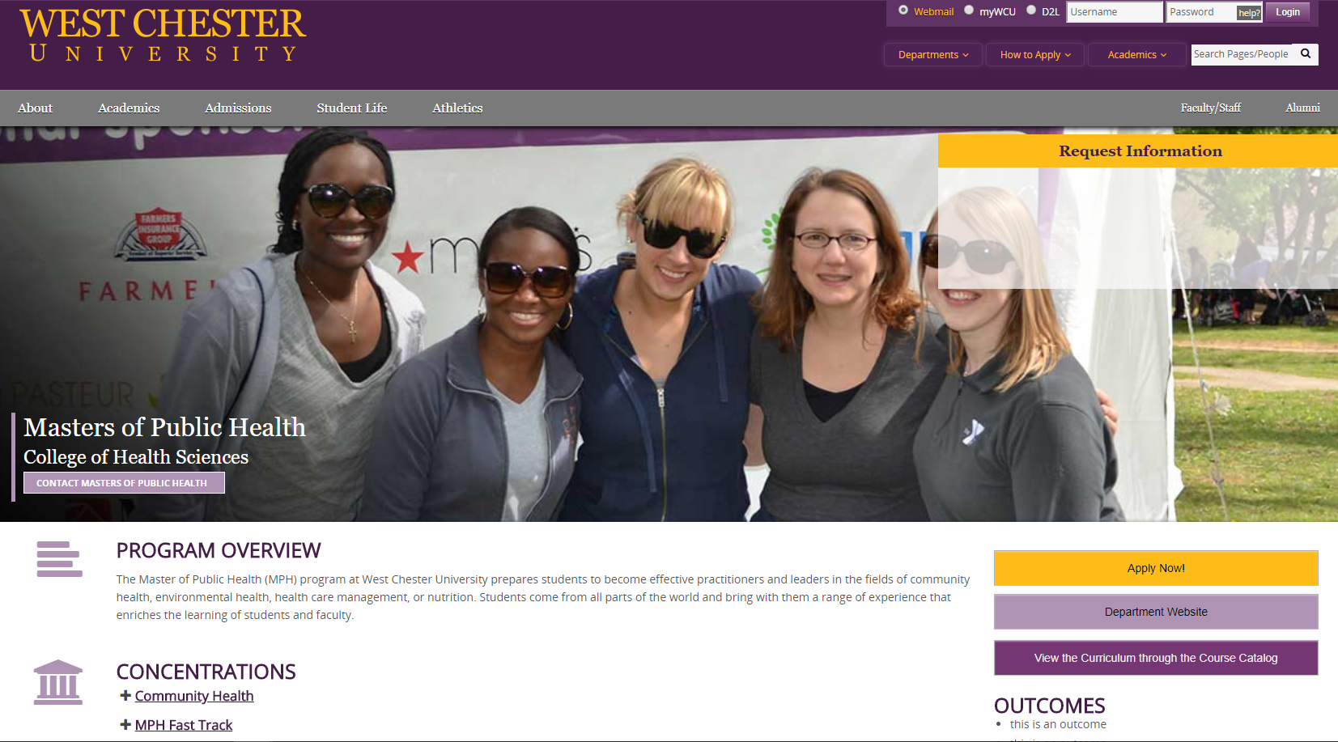

Slide 6
Questions

