Slide 1
WCU OFFICE OF STUDENT SUCCESS
Dr. Loretta Rieser-Danner
Interim Associate Provost for Student Success
Courtney Kaiser
Staff Support
610-436-2908
studentsuccess@wcupa.edu
Notes:
April 11, 2017

Slide 2

MINDSET

Slide 3
GROWTH MINDSET vs
FIXED MINDSET
https://www.youtube.com/watch?v=Xv2ar6AKvGc

Slide 4
Does This Sound
Familiar to Any of You?

Slide 5
Is there any area in which you think you might have a Fixed Mindset?

Slide 6
GROWTH MINDSET
RESEARCH
https://www.youtube.com/watch?v=TTXrV0_3UjY&list=PLOF8Wy_T_riisC56BnCsX-rbmQpWS_gf0
Notes:
Where do you think this comes from? How do you develop a fixed or a growth mindset?
We learn it . . . Let’s look at some of the research on the development of growth mindset and its implications.

Slide 7
LET’S COMPARE
https://www.mindsetworks.com/Science/Impact
Notes:
Let’s compare the fixed vs growth mindset in specific ways . . . . What does the research say? Here’s an example.

Slide 8
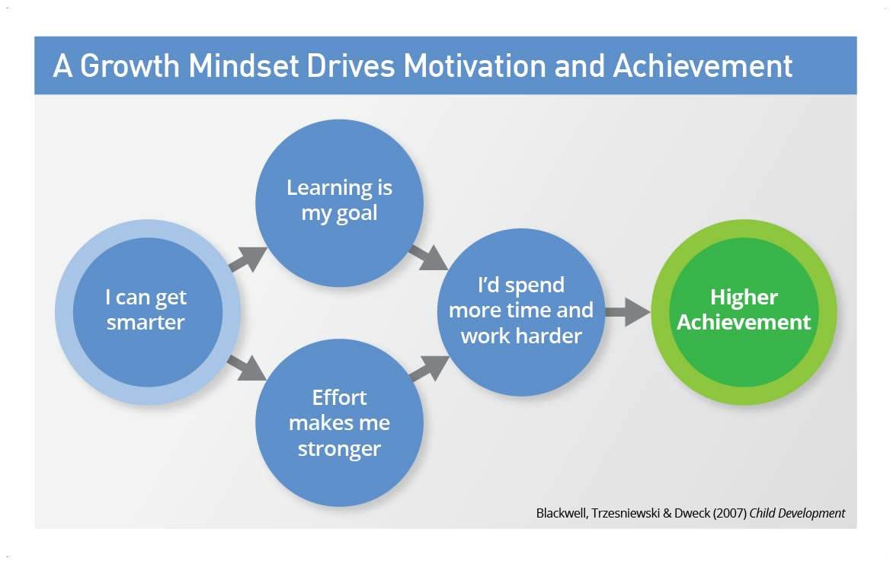
Notes:
How does mindset affect learning and/or performance? Let’s go back to something we saw in the last slide: Mindset affects our BELIEFS ABOUT EFFORT. . . . EFFORT affects ACHIEVEMENT

Slide 9
So, our attitude about effort affects our learning?
  Yes
    Is it just about attitude?
      No
        Attitude affects our behavior.
          Our behavior actually affects our brain, and therefore, our learning and achievement.
        Let’s take a very quick peek at what we know about the science of learning and performance.

Slide 10
SCIENCE OF LEARNING
https://www.youtube.com/watch?v=GWSZ1DKjNzY
Notes:
Sal Khan . . .Khan Academy

Slide 11
What does this mean for you?
What does this mean for us (WCU) as a learning community?

Slide 12
SMALL GROUP DISCUSSION
(See Discussion Questions)

Slide 13
What can you do to develop a growth mindset?
What can we do to cultivate a growth mindset at WCU?

Slide 14
SOME GROWTH-MINDSET PRACTICES
When you’re feeling stuck, remember . . . .
THE POWER OF “YET”
Remember to:
Focus on effort
Choose difficult tasks
Focus on strategies
Reflect on different strategies that work and don’t work
Focus on learning and improving
Seek challenges
Work hard
Notes:
See two handouts: Some Growth-Mindset Practices & 25 Ways to Develop a Growth Mindset

Slide 15
25 WAYS TO DEVELOP A GROWTH MINDSET
Sara Briggs http://www.opencolleges.edu/au/informed/author/saga/
See Handout
Notes:
See two handouts: Some Growth-Mindset Practices & 25 Ways to Develop a Growth Mindset

Slide 16
THANK YOU!!!
FOR YOUR ATTENTION AND YOUR PARTICIPATION
Office of Student Success
610-436-2908
studentsuccess@wcupa.edu

