Slide 1
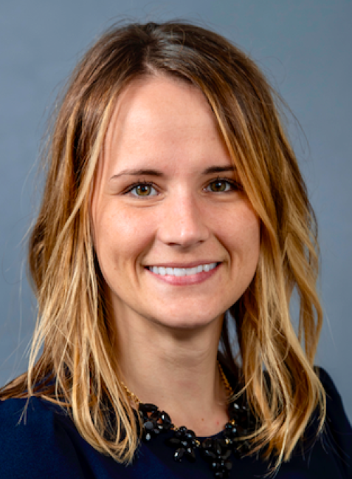
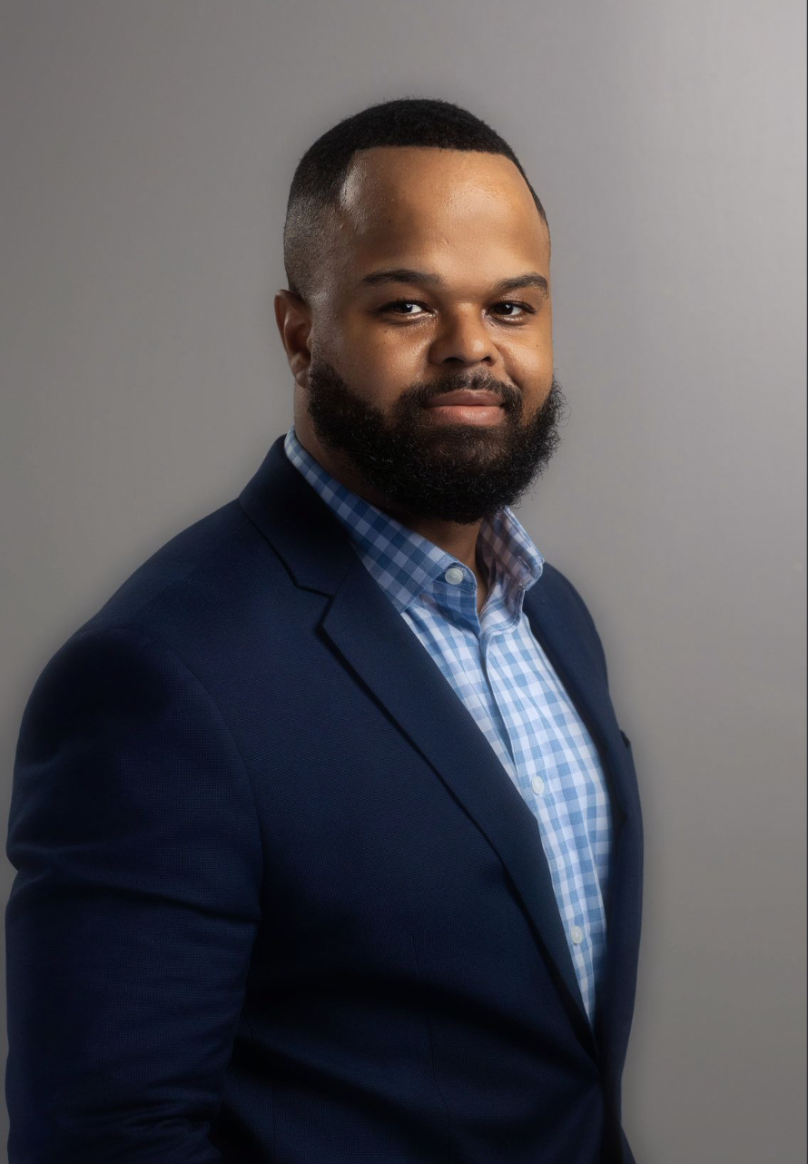
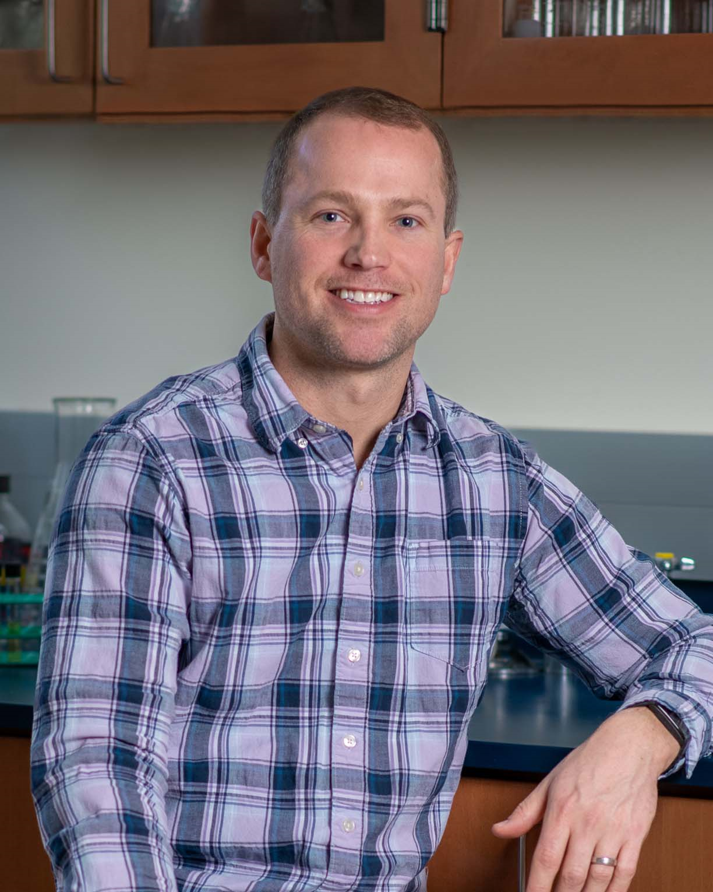
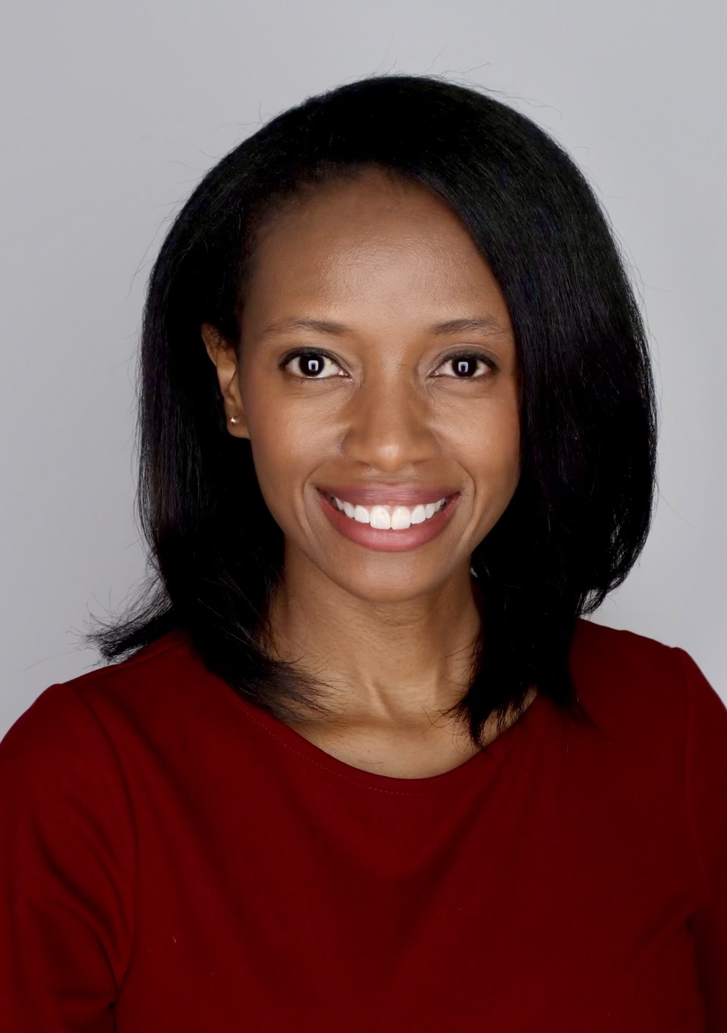
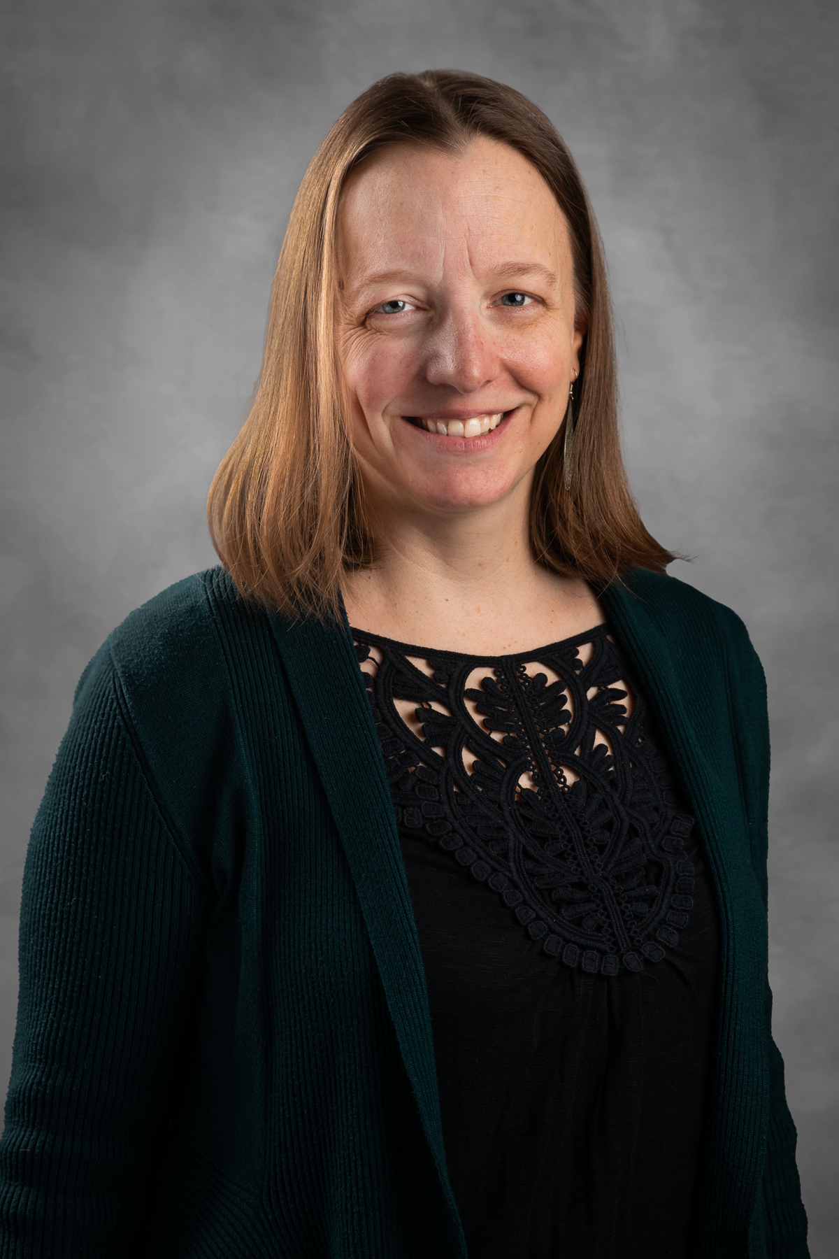
WCU FACULTY FORUM
Collaboration in Research
Tuesday, November 7th
11:30am-1:00pm
Philips Lower Level Conf. Room
RSVP by Oct. 31, 2023 to facultyresearch@wcupa.edu
Presenters:
1. Stevie Grassetti, Psychology
2. Daris McInnis, Literacy
3. Sean Buskirk, Biology
4. Chiwoneso Tinago, Gerontology
5. Megan Heckert, Geography & Planning
Office of Research & Sponsored Programs
610-436-3557

