Slide 1

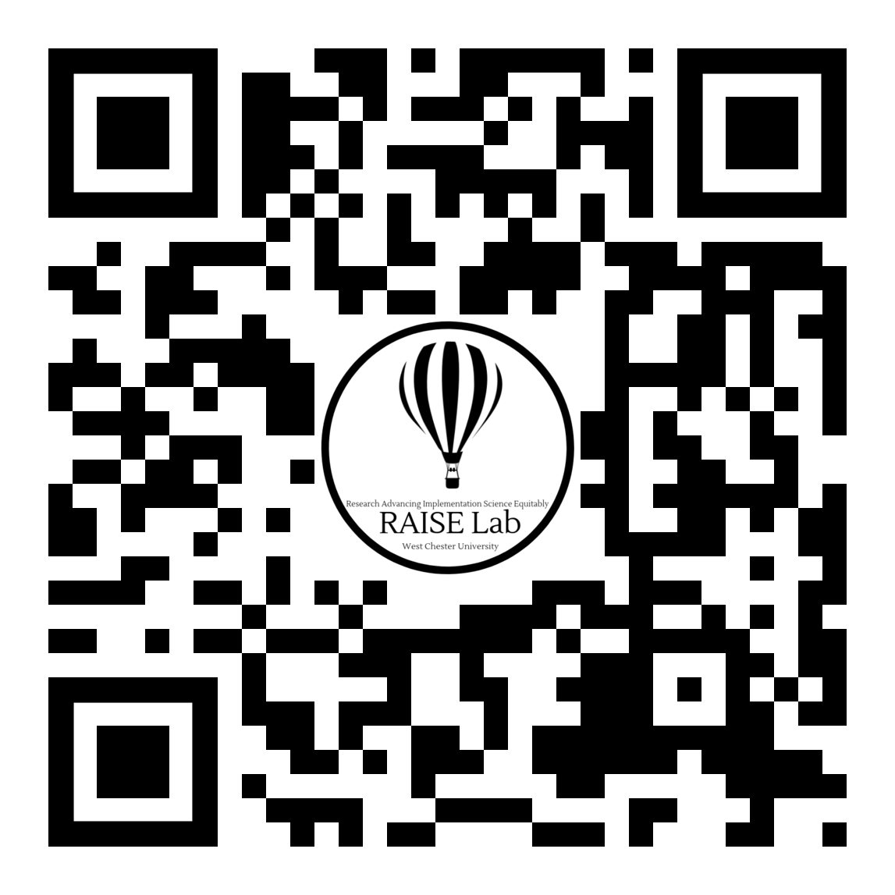
Targeting Youth’s Motivation to
Change Substance Use Behaviors:
Feasibility & Preliminary Outcomes from an Open Trial Of The Free Talk Program in a Short-Term Juvenile Detention Facility
Cassidy Tennity, B.A.
Stevie N. Grassetti, PhD
Department of Psychology
West Chester University

Slide 2
Introduction & background
Adolescent substance use contributes to an increased risk for a variety of negative outcomes, including delinquency and justice system involvement (Put, Creemers & Hoeve, 2014)
The high prevalence of substance use disorders (SUDs) within the juvenile justice system has been consistently demonstrated in research
Half of incarcerated boys and almost half of incarcerated girls met the diagnostic criteria for a SUD (Teplin, Abram, McClelland, Dulcan, & Mericle, 2002)
81.4% of incarcerated youth met the diagnostic criteria for a SUD and for many of these youth, substance use persists into adulthood (Welty et al., 2002)

Slide 3
Introduction & background
One one hand, involvement with the juvenile justice-system may create a risk for continued problems with SUDs
On the other hand, it is also possible that involvement with the juvenile justice system facilitates an opportunity for underserved youth to access treatment
Intervention science has established several interventions to prevent substance use problems in general populations of adolescents, including motivational interviewing.

Slide 4
Introduction & background
Motivational interviewing (MI) is a collaborative, goal-oriented conversation style for building a person’s motivation and commitment to behavior change (Miller & Rolnick, 2012)
May be particularly helpful for juvenile-justice involved youth who may be less likely to respond to more directive approaches (Clair-Michaud et al., 2016)
  Studies of MI to reduce adolescent substance use have yielded promising results (Jensen et al., 2011)

Slide 5

Introduction & background
Free Talk (FT) is a six-session manualized group intervention that aims to increase motivation for substance use cessation (D’Amico, Chan Osilla, & Hunter, 2010)
  Developed for at-risk adolescents participating in a diversion program with a first-time drug charge
  Uses a motivational interviewing approach
Preliminary evaluation of FT revealed reduced substance use at 3 months (D’Amico et al., 2012)

Slide 6
Objectives & Hypotheses
The current open-trial implementation study aimed to:
Evaluate the feasibility of FT within a short-term juvenile detention facility as part of universal health curriculum.
Determine whether incarcerated youth participating in FT within the juvenile detention center reported expected changes in motivation to change substance use
  We hypothesize that the youth participating in FT would report a significant increase in motivation to change substance use

Slide 7
Methods
N=49 youth aged 12-18 (M age=15.31, SD=1.56) who were detained in a short-term juvenile detention center
  Primarily African American and male-identifying
Notes:
Primarily African American and male-identifying

Slide 8
Measures
Construct | Motivation to Change Substance Use
Measures | Contemplation Ladder (Biener & Abrams, 1991; Slavet et al.. 2006) | URICA (DiClemente, Schlundt, & Gemmel, 2004)
Items | 1-item self-report visual analog measure | 24 items on a 5-point Likert scale from strongly disagree to strongly agree Example Item: “I have a problem and I really think I should work on it.”
Administered | Pre- & Post-intervention | Pre- & Post-intervention

Slide 9
Results & Discussion
H1: The youth participating in FT would report a significant increase in motivation to change substance use
Paired samples t tests revealed:
  There was no significant difference between pre-treatment (M=8.10, SD=2.86) and post-treatment (M=8.19, SD=2.96) motivation to change substance use as measured by the Modified Contemplation Ladder scores, t(20)=-0.28, p=.785, d=0.33.
  There was a significant decrease between pre-treatment (M=6.71, SD=2.74) and post-treatment (M=5.74, SD=2.95) motivation to change substance use as measured by the URICA, t(23)=3.23, p=.004, d=0.35
H1: Contrary to our hypothesis, the youth participating in FT did not report a significant increase in motivation to change substance use

Slide 10
discussion
Group treatment can be contraindicated
Networking with peers who display deviant and delinquent behavior can influence the socialization of youth and contribute to iatrogenic treatment effects (Dishion, 1994)
The results from the current study provide no evidence to suggest that FT is a helpful program when implemented as a universal program
  It may be that group treatment as a universal program such as FT negatively impacted substance use outcomes
  Due to the high-risk population and setting, it’s possible that deviancy training occurs during the intervention, and when youth learn of other youth whose substance use is worse, they may view their own use as less problematic

Slide 11
feasibility
Barriers to alliance
  Support for implementation of the intervention varied within the detention center
  absence of familiar staff members to co-lead groups led to a barrier of rapport building between youth and the therapist
Planning for future implementations should ensure that a trusted staff member is trained in delivering the intervention and available to lead groups

Slide 12
feasibility
Scheduling Barriers
  Groups took place during visitation and many youth were absent for varying amounts of time during sessions
  The schedule at the facility changed daily and detention center staff were not able to share the schedule prior to the day of the session
Planning for future implementations should ensure that a comprehensive schedule and protocol for sessions should be developed and shared between the clinical/research team and detention center staff prior to implementation

Slide 13
feasibility
Intervention Barriers
  Although FT requires several clinical materials for games and activities during sessions, the treatment manual does not include these materials
  FT focuses on discussing the use of a variety of different substances, some of which youth did not endorse using.
Planning for future implementations should tailor discussions and handouts to relevant substances.
Treatment developers could consider creating printable templates for materials or including instructions for clinical materials in the manual.

Slide 14
Limitations& Future Directions
Limitation: No comparison group
Future Direction: Randomized controlled design
Limitation: Reliance on self-report data while incarcerated
Future Direction: Collect parent/guardian report data, long-term follow up after release
Limitation: Did not measure session fidelity
Future Direction: Measure fidelity of sessions
Limitation: Attendance
Future Direction: Create plan for makeup sessions and abbreviated sessions prior to intervention

Slide 15
references
Biener, L., & Abrams, D. B. (1991). The Contemplation Ladder: Validation of a measure of readiness to consider smoking cessation. Health Psychology, 10(5), 360-365.
Clair-Michaud, M., Martin, R. A., Stein, L.A.R., Bassett, S., Lebeau, R., & Golembeske, C. (2016). The Impact of Motivational Interviewing on Delinquent Behaviors in Incarcerated Adolescents. Journal of Substance Abuse Treatment, 65, 13–19.
D’Amico, E. J., Osilla, K. C., & Hunter, S. B. (2010). Developing a Group Motivational Interviewing Intervention for First-Time Adolescent Offenders At-Risk for an Alcohol or Drug Use Disorder. Alcoholism Treatment Quarterly, 28(4), 417–436.
D’Amico, E. J., Hunter, S. B., Miles, J. N., Ewing, B. A., & Osilla, K. C. (2013). A randomized controlled trial of a group motivational interviewing intervention for adolescents with a first time alcohol or drug offense. Journal of Substance Abuse Treatment, 45(5), 400–408.
Diclemente, C. C., Schlundt, D., & Gemmell, L. (2004). Readiness and Stages of Change in Addiction Treatment. American Journal on Addictions, 13(2), 103–119
Dishion, T. J., Duncan, T. E., Eddy, J. M., Fagot, B. I., & Fetrow, R. (1994). The world of parents and peers: coercive exchanges and childrens social adaptation. Social Development, 3(3), 255–268.
Grisso, T., Barnum, R., Fletcher, K. E., Cauffman, E., & Peuschold, D. (2001). Massachusetts Youth Screening Instrument for Mental Health Needs of Juvenile Justice Youths. Journal of the American Academy of Child & Adolescent Psychiatry, 40(5), 541–548.
Jensen, C. D., Cushing, C. C., Aylward, B. S., Craig, J. T., Sorell, D. M., & Steele, R. G. (2011). Effectiveness of motivational interviewing interventions for adolescent substance use behavior change: A meta-analytic review. Journal of Consulting and Clinical Psychology, 79(4), 433–440.
Miller, W. R., & Rollnick, S. (2012). Motivational Interviewing: Helping People Change. New York: Guilford Publ.
Put, C. E. V. D., Creemers, H. E., & Hoeve, M. (2014). Differences between juvenile offenders with and without substance use problems in the prevalence and impact of risk and protective factors for criminal recidivism. Drug and Alcohol Dependence, 134, 267–274.
Slavet, J. D., Stein, L. A. R., Colby, S. M., Barnett, N. P., Monti, P. M., Golembeske, C., & Lebeau-Craven, R. (2006). The marijuana ladder: Measuring motivation to change marijuana use in incarcerated adolescents. Drug and Alcohol Dependence, 83(1), 42-48.
Substance Abuse and Mental Health Services Administration. (2017). Key substance use and mental health indicators in the United States: Results from the 2016 National Survey on Drug Use and Health (HHS Publication No. SMA 17-5044, NSDUH Series H-52). Rockville, MD: Center for Behavioral Health Statistics and Quality, Substance Abuse and Mental Health Services Administration. Retrieved from https://www. samhsa.gov/data/
Teplin, L. A., Abram, K. M., Mcclelland, G. M., Dulcan, M. K., & Mericle, A. A. (2002). Psychiatric Disorders in Youth in Juvenile Detention. Archives of General Psychiatry, 59(12), 1133.
Welty, L. J., Hershfield, J. A., Abram, K. M., Han, H., Byck, G. R., & Teplin, L. A. (2017). Trajectories of Substance Use Disorder in Youth After Detention: A 12-Year Longitudinal Study. Journal of the American Academy of Child & Adolescent Psychiatry, 56(2), 140–148.

