Slide 1
Democratization Prospects In The Arab World
Duncan Espenshade

Slide 2
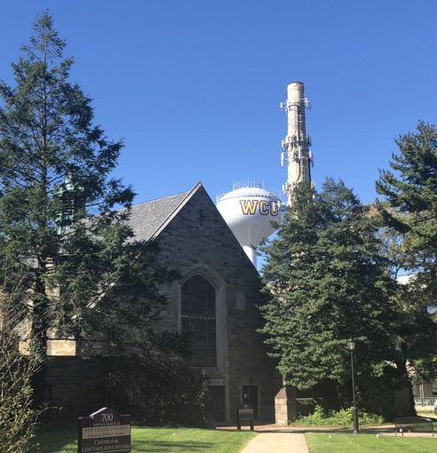

Slide 3
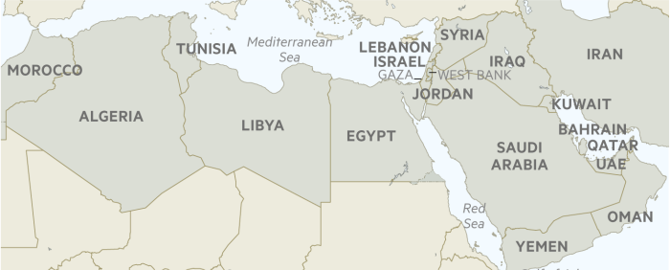
What is the Arab Spring?

Slide 4
Methodology
Questions Pursued in this Literature Review:
Is Islam antithetical to democracy?
If not, what explains the repressive policies of Islamic states?
What explains Islam’s prominent role in the society of MENA states?

Slide 5
632-661 CE
Period of the Rightly Guided Caliphate
Ruled by the four Caliphs directly proceeding the death of Muhammed
Considered the period of governance that most accurately reflects Islam
Included practices that could be considered democratic
Shura-consent of the governed
Iktalif-pluralism
al-Huquq al-Shar’iyya-human rights
632-661
1300-1940
1960-2000s
2010-2012
Post Arab Spring

Slide 6
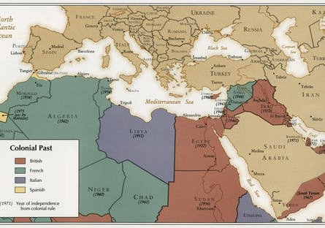
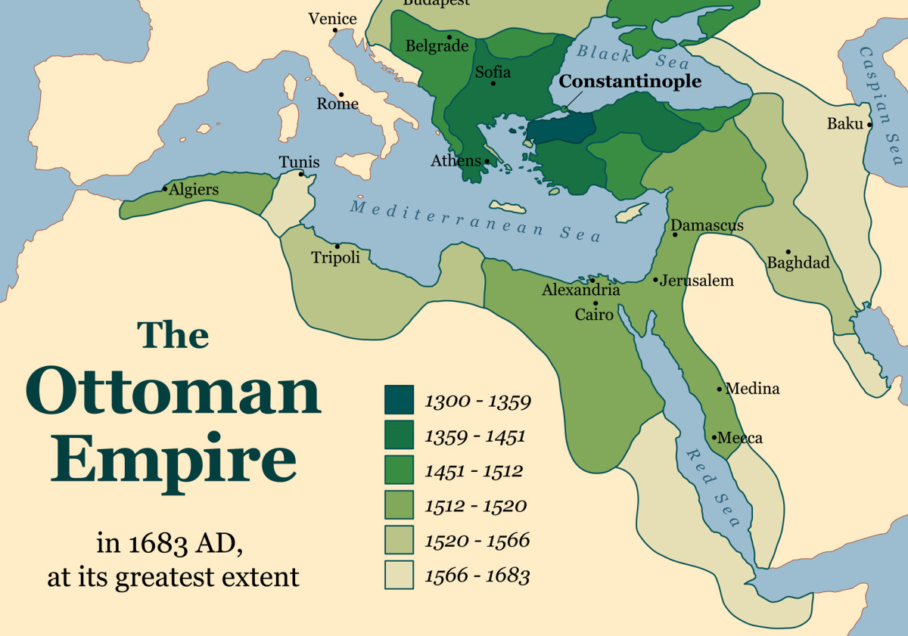
1300-1940s
632-661
1300-1940s
1960-2000s
2010-2012
Post Arab Spring
Period of Ottoman and European Colonialism: Rise of Islamism

Slide 7
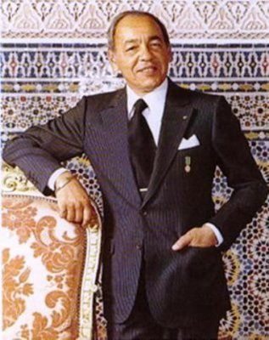
1960-2000s
Period of Post Colonialism
Fragile states
Islam as a societal system
Suppression of Islamist Movements
632-661
1300-1940s
1960-2000s
2010-2012
Post Arab Spring

Slide 8
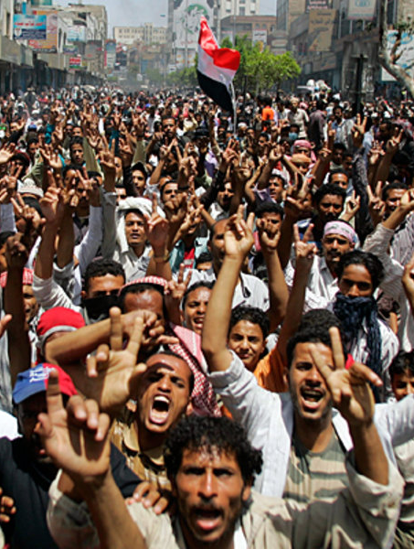
2010-2012
Arab Spring Protests
Overthrew several authoritarian heads of State
Economically based
Muslim population supportive of democracy as a means to remove an unpopular leader
Challenged existing political science literature
632-661
1300-1940s
1960-2000s
2010-2012
Post Arab Spring

Slide 9
Post-Arab Spring
Islamist movements in power throughout area
Tunisia is the only full-fledged democracy to emerge from the protests

Slide 10
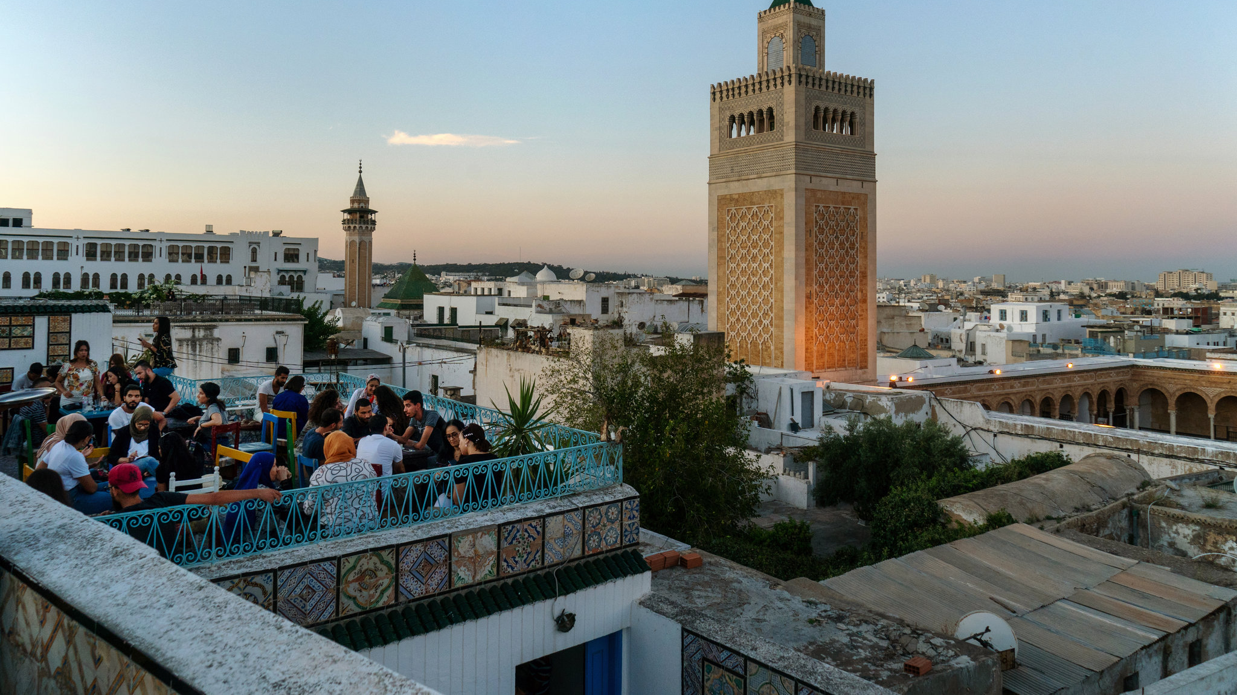
Why Tunisia?
Modernization
Secularization
Socialism
MTI
Economic Distres

Slide 11
Literature Questions
Is Islam antithetical to democracy?
If not, what explains the repressive policies of Islamic states?
What explains Islam’s prominent role in the society of MENA states?

Slide 12
Research Questions & Variables of Interest
1.) What factors led to the Arab Spring?
01
2.) What factors led to Tunisia being the only democracy to result from the Arab Spring?
02
3.) How should western states support democratization efforts in the Arab World?
03
Variables of Interest:
Levels of Rentierism
Islamism
Economic Factors
Political Openness
Modernization
Levels and Types of Democracy Assistance
Human Rights Protections

Slide 13
Questions?

Slide 14
References
Basora, A., Marcyzk, A., & Otarashvili, M. (2017). Does Democracy Matter? The United States and Global Democracy Support. Philadelphia: Rowman & Littlefield.
Beyer, P. (2006). Religions in Global Society. Routledge.
Dabashi, H. (2012). The arab spring : The end of postcolonialism. Retrieved from https://ebookcentral.proquest.com
Fattah, M. (2006). Democratic values in the Muslim world. Boulder, Colo.: Lynne Rienner.
Haas, M. (2013). The United States and the Arab Spring threats and opportunities in a revolutionary era (Westview press spotlight). Boulder: Westview Press.
Huntington, S. (1991). The third wave : Democratization in the late twentieth century (Julian J. Rothbaum distinguished lecture series ; v. 4). Norman: University of Oklahoma Press.
Huntington, S. (1997). The clash of civilizations and the remaking of world order (1st Touchstone ed.). New York: Touchstone
Kamrava, M., & Georgetown University. Center for International Regional Studies. (2016). Fragile politics : Weak states in the greater Middle East.
Khakee, A. (2017). Democracy aid or autocracy aid? Unintended effects of democracy assistance in Morocco. The Journal of North African Studies, 22(2), 238-258.
Mawṣililī, A. (2001). The Islamic quest for democracy, pluralism, and human rights. Gainesville: University Press of Florida
Scott, J., & Carter, R. (2016). Promoting democracy in Latin America: Foreign policy change and US democracy assistance, 1975-2010. Third World Quarterly, 37(2), 299-320.
Tibi, B. (2013). The sharia state : Arab spring and democratization. Retrieved from https://ebookcentral.proquest.com
Willis, M. (2012). Politics and Power in the Maghred - Algeria, Tunisia and Morocco from Independence to the Arab Spring. New York: Columbia University Press.

