Slide 1
Democratization Prospects In The Arab World
Duncan Espenshade

Slide 3
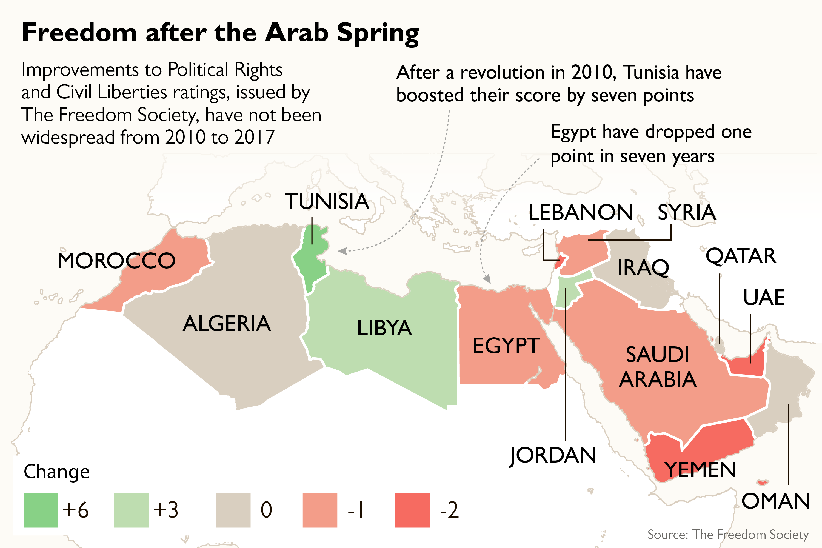
What is the Arab Spring?

Slide 4
Research Questions
1.) What factors led to the Arab Spring?
2.) What factors led to Tunisia being the only democracy to result from the Arab Spring?
3.) How should western states support democratization efforts in the Arab World?

Slide 5
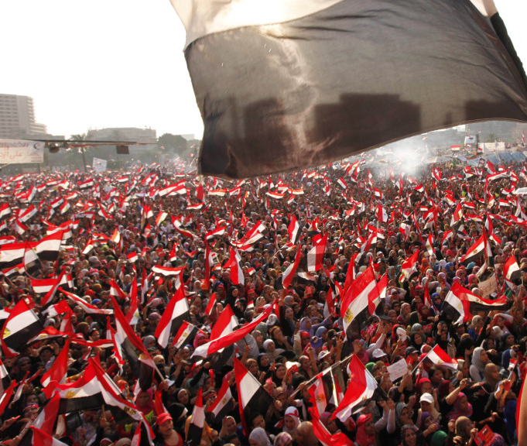
Why is Understanding the Arab Spring Important?
Third Wave
Clash Of Civilizations Paradigm
Democratic Peace Theory
Religious Demography
Democracy Assistance Programs

Slide 6
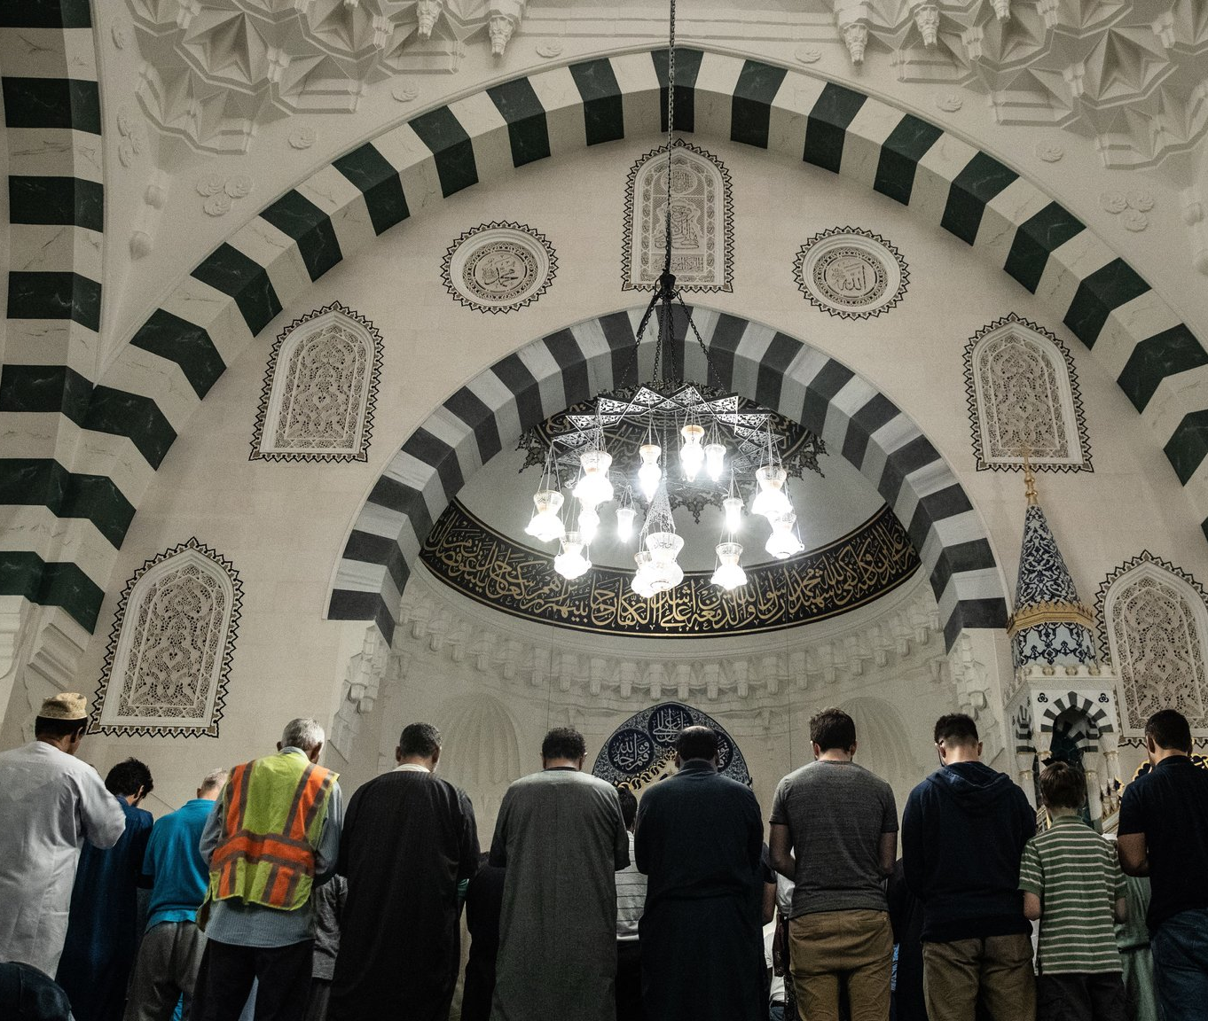
The role of Islam
Conflictual against other civilizations?
Antithetical to Human Rights?
Antithetical to Democracy?
Religion as a Global System

Slide 7
Post-Colonialism
Strong central states
Legitimacy based from nascent national identity
“Stabilitocracy”
Arab vs. Berber

Slide 8
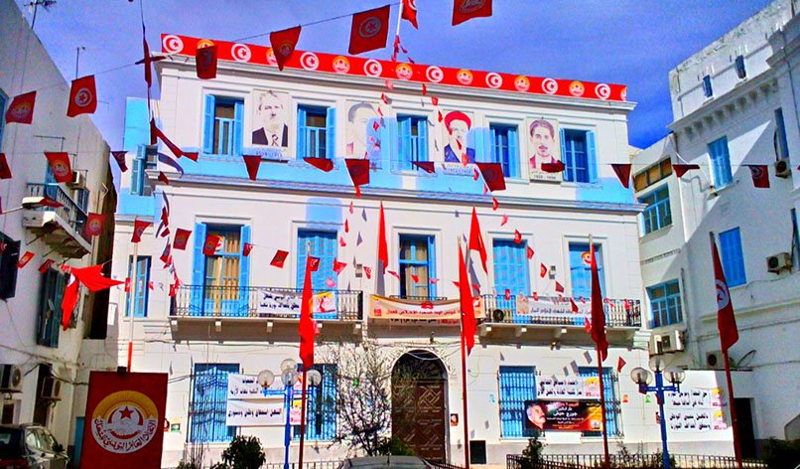
Why Tunisia?
Modernization
Secularization
Socialism
MTI
Unpopularity of Ben Ali

Slide 9
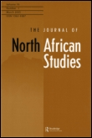
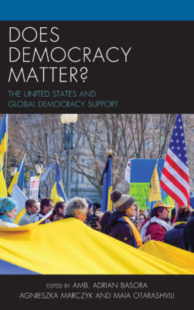
Democracy Assistance
Is it effective?
Is it subversive?
What leads to democracy?

Slide 10
Variables of Interest for this study
Levels of Rentierism
Islamism
Economic Factors
Political Openness
Modernization
Levels and Types of Democracy Assistance
Human Rights Protections

Slide 11
Questions?

Slide 12
References
Basora, A., Marcyzk, A., & Otarashvili, M. (2017). Does Democracy Matter? The United States and Global Democracy Support. Philadelphia: Rowman & Littlefield.
Beyer, P. (2006). Religions in Global Society. Routledge.
Dabashi, H. (2012). The arab spring : The end of postcolonialism. Retrieved from https://ebookcentral.proquest.com
Fattah, M. (2006). Democratic values in the Muslim world. Boulder, Colo.: Lynne Rienner.
Haas, M. (2013). The United States and the Arab Spring threats and opportunities in a revolutionary era (Westview press spotlight). Boulder: Westview Press.
Huntington, S. (1991). The third wave : Democratization in the late twentieth century (Julian J. Rothbaum distinguished lecture series ; v. 4). Norman: University of Oklahoma Press.
Huntington, S. (1997). The clash of civilizations and the remaking of world order (1st Touchstone ed.). New York: Touchstone
Kamrava, M., & Georgetown University. Center for International Regional Studies. (2016). Fragile politics : Weak states in the greater Middle East.
Khakee, A. (2017). Democracy aid or autocracy aid? Unintended effects of democracy assistance in Morocco. The Journal of North African Studies, 22(2), 238-258.
Mawṣililī, A. (2001). The Islamic quest for democracy, pluralism, and human rights. Gainesville: University Press of Florida
Scott, J., & Carter, R. (2016). Promoting democracy in Latin America: Foreign policy change and US democracy assistance, 1975-2010. Third World Quarterly, 37(2), 299-320.
Tibi, B. (2013). The sharia state : Arab spring and democratization. Retrieved from https://ebookcentral.proquest.com
Willis, M. (2012). Politics and Power in the Maghred - Algeria, Tunisia and Morocco from Independence to the Arab Spring. New York: Columbia University Press.

