Slide 1
Carnegie Classification of Institutions of Higher Education & Perceived Biases in Funding Review Processes
Emily Devereux, MPA, CRA
DPA Student, College of Business & Public Management

Slide 2
Problem Statement
Disparities of federal and philanthropic funding distribution across institutions of higher education results in social inequities at multiple levels, jeopardizing opportunities for the institution’s development and impairing the development of its communities and individuals. Closing the gap on funding distribution by identifying elements of bias in the funding process is crucial to the professions of public administration and higher education for social equity performance in federal and philanthropic funding.

Slide 3

Background
Forty-one percent of all federal research and development funding went to 20 academic research institutions prior to 1982, therefore leaving the remaining fifty-nine percent distributed between the remaining 570 institutions according to a study conducted by the California Institute of Technology (McGarity, 1994).

Slide 4

Background
The most recent National Science Foundation’s Higher Education Research and Development Survey (NSF HERD), based on FY2016 data, reports that 71% of all national research and development expenditures are generated from research universities of very high research activity, leaving all other universities and colleges representing the remaining 29% of expenditures
(Gibbons, 2018).

Slide 5

Background
Previous research on social equity performance in the distribution of funding mechanisms in institutions of higher education has found administrative capacity and reputation to be significant contributors considered by peer reviews and panels during the funding process (Collins & Gerber, 2008).

Slide 6
Background
Higher education administrators have also been found to correlate financial resources linked to college rankings, especially administrators at research universities.
Resource dependency theories of organization, combined with the impacts of university rankings on external actors, suggests that third-party resource providers are sensitive to shifts in rankings over time.

Slide 7
Background
Bastedo and Bowman (2011) conducted an empirical study of the influence of US News rankings on future research and development giving by government, foundations, and industry, and if alumni more readily donated to their alma mater.
Predictions were tested using structural equation models and found published college rankings had significant impact on future giving by resource providers, independent of organizational change in quality and performance.

Slide 8

Background
Further research is necessary to identify what contributes to perceived administrative capacities by review panels. This will enable administration and public entities to work toward qualifying institutions affected by the funding distribution disparity.

Slide 9

Research Question
Does an institution’s ranking in the Carnegie Classification system contribute to perceived administrative capacity bias considered by review panels and philanthropic sponsors during the sponsored funding process?
The Carnegie Classification of Institutions of Higher Education ®

Slide 10

Hypothesis
An institution’s Carnegie Classification ranking is a contributing factor to perceived administrative capacity and an institution’s success during the sponsored funding process.

Slide 11
Study
An analysis of research expenditures and secured foundation gifting reported by institutions, focusing between Carnegie Classifications and research administrative capacity, will assist in uncovering the contributing elements of reputation and administrative capacity used in research and private funding decisions. The end goal is to assist in developing better frameworks for social equity performance of funding mechanisms.

Slide 12
Research Methods
A quantitative analysis will be used to analyze data from publicly available datasets for exploring the relationship between Carnegie Classification rankings, institutional control types, administrative capacity, and funding levels of institutions of higher education.
Sample: Carnegie classifications of 4-year institutions classified as Doctoral Universities, Master’s College and Universities, Baccalaureate Colleges, & Special Focus 4-Year.
Includes the U.S. higher education institutions who have voluntarily reported to NSF HERD and CASE VSE

Slide 13

Data Sets & Resources
Carnegie Classification (CC) of Institutions of
Higher Education (2018 Reclassification Report;
Reflects FY2016 Data)
Dominant classification system for higher education research
One of the oldest consistently published rankings recognized in classifying university programs and reputations for doctorate-granting universities (Kosar & Scott, 2018).
Bases its methodology on publicly available data, including research expenditures, conferred eligible doctoral degrees, faculty composition, and research staffing.

Slide 14

Data Sets & Resources
National Science Foundation’s Higher Education
Research & Development Survey (NSF HERD)
FY2016
Primary government source of information on separately accounted for research and development expenditures within higher education institutions in the United States
The FY2017 survey cycle collected FY2016 data from 903 institutions between the months of November 2017 through June 2018 (Gibbons, 2018).
Data is solicited under the authority of both the National Science Foundation Act of 1950, as amended, and the America COMPETES Reauthorization Act of 2010.

Slide 15

Data Sets & Resources
Voluntary Support of Education FY2016 report
(VSE, 2016) managed by the Council for
Advancement and Support of Education (CASE)
Data is pulled from the VSE Survey and Data Miner, a web-based benchmarking service that provides access to more than 350 variables about charitable giving to educational institutions.
Data is queried for variables of size, location, control, and giving totals across different engagement categories.
Considered the definitive source of information on private giving to education institutions in the United States.

Slide 16

Data Sets & Resources
Integrated Postsecondary Education Data Systems
(IPEDS)
Data from institutions of higher education detailing enrollment, degree conferral, and human resources infrastructure.
The National Center for Education Statistics (NCES) is the primary federal entity for collecting and analyzing IPEDs data.
NCES is a fulfillment of a Congressional mandate to collect, collate, analyze, and report complete statistics on the condition(s) of U.S. education; validate, conduct, and publish reports; and review and report on education activities at both at the national and global levels.

Slide 17
Study Concepts
Institutions of higher education: public or private educational institutions in the U.S., including universities, colleges, and institutes of technology. Must be accredited in any state to provide a program of education beyond secondary education.
Classification ranking: within the Carnegie Classification of Institutions of Higher Education is considered the “dominant classification system” for higher education research and is one of the oldest consistently published rankings that is recognized in classifying university programs and reputations for doctorate-granting universities (Kosar & Scott, 2018).

Slide 18
Study Concepts
Administrative capacity: an institution’s ability to carry out administrative responsibility necessitated by a sponsored program or project with adequate human infrastructure, organizational structure or processes, and resources for achieving outcomes.
Control type: categorized into public, private not-for-profit, and private for-profit institutions.
Review panels: agency appointed panels or boards made up of individuals of expertise or mission consensus to review and critique funding proposals and rank or recommend them for funding to the federal or state funding agencies. This also includes foundation agencies.

Slide 19
Study Concepts
Administrative capacity: an institution’s ability to carry out administrative responsibility necessitated by a sponsored program or project with adequate human infrastructure, organizational structure or processes, and resources for achieving outcomes.
Control type: categorized into public, private not-for-profit, and private for-profit institutions.
Review panels: agency appointed panels or boards made up of individuals of expertise or mission consensus to review and critique funding proposals and rank or recommend them for funding to the federal or state funding agencies. This also includes foundation agencies.

Slide 20
Study Concepts
Philanthropic sponsors: includes organizations or individuals that make gifts, such as foundations and donors, to an institution of higher education to support research, programming, or institutional desires, causes, or needs.
Sponsored funding process: the organized process in which funding is obtained by institutions responding to a funding opportunity released by an agency or foundation. It is carried out by submission of a funding proposal or application to the sponsor, a review process carried out by the review panel, and the rejection or awarding of funds to the institution. The process also incorporates the steps in which foundations or individuals engage with an institution to gift or to endow funds.

Slide 21
Methods & Analysis
Independent Variables:
  Carnegie Classification
  Administrative Capacity
  Control Type
Dependent Variables:
  Research Expenditures
  Foundation Funding
  Administrative Capacity
Statistical Analysis:
  Pearson’s Correlations
  ANOVA
  2X2 MANOVAs

Slide 22
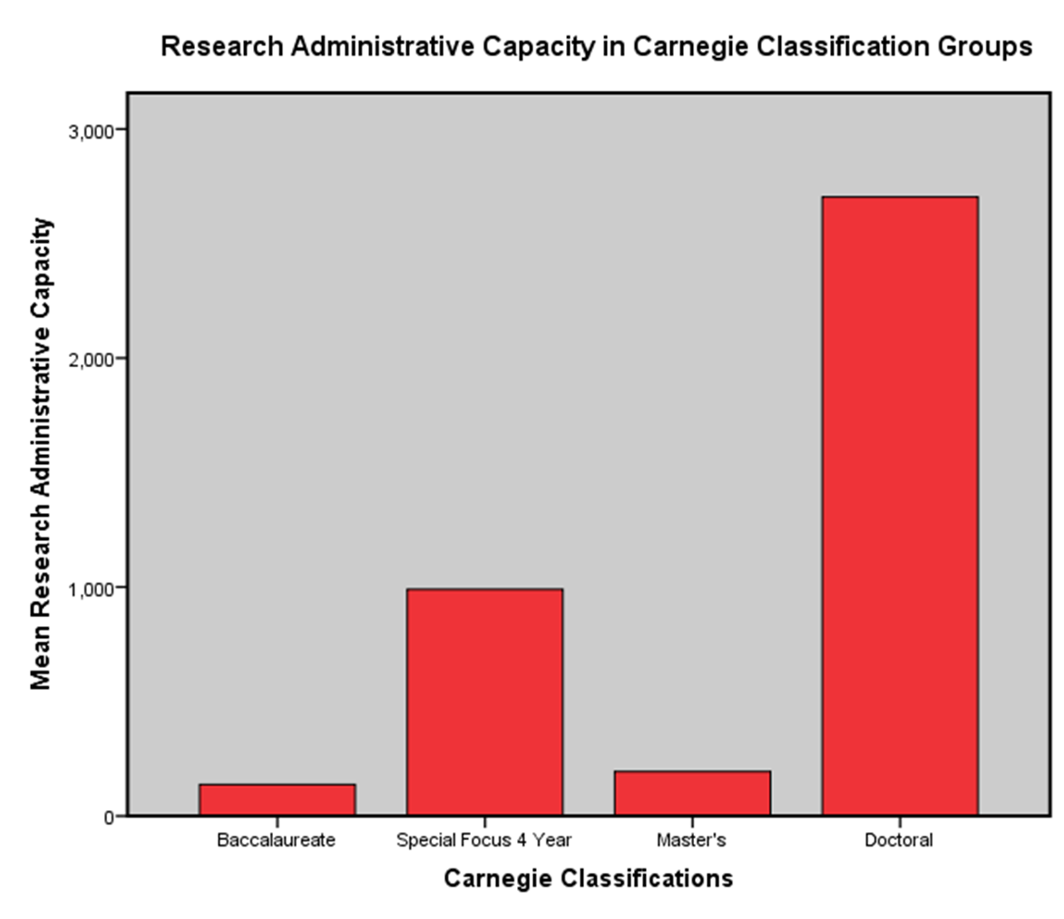
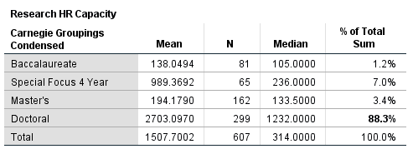
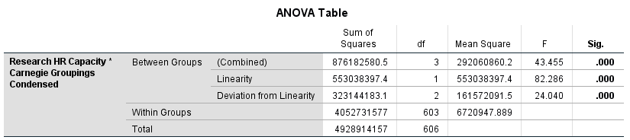
Relationship of Carnegie Classifications & Research Administrative Capacity

Slide 23
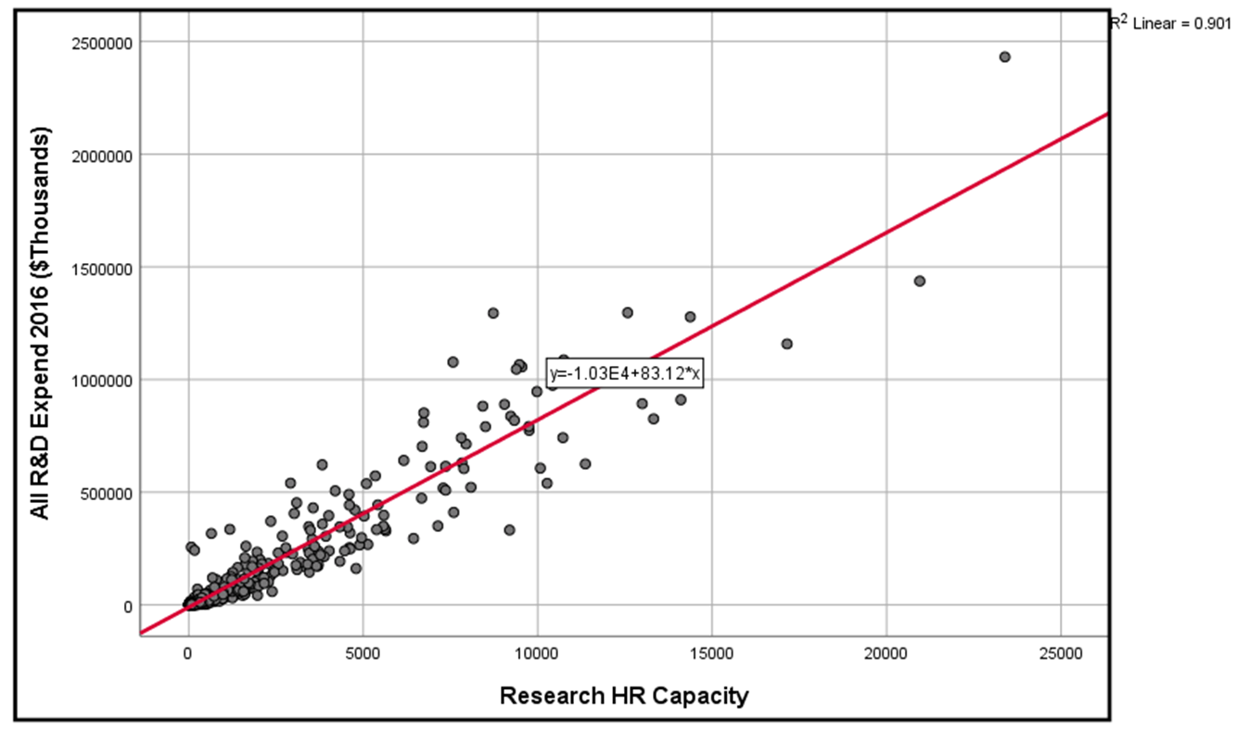
Relationship of Research Administrative Capacity & Research Funding
Correlation is found:
Administrative Capacity & Research Funding (Expenditure) Levels
r = .949** p < .05

Slide 24
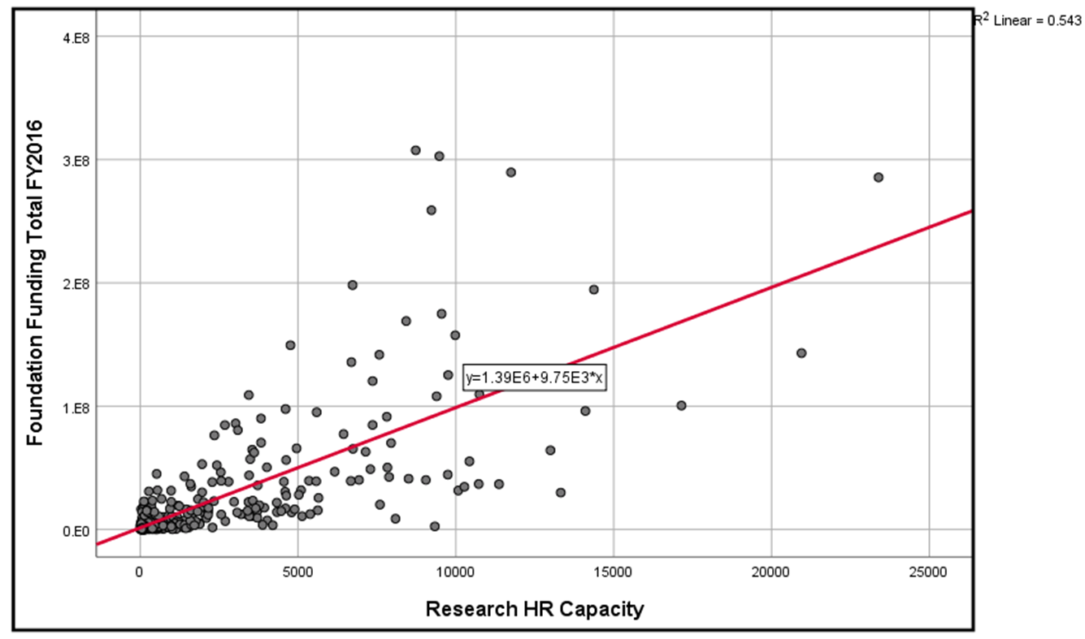
Relationship of Research Administrative Capacity & Foundation Funding
Correlation is found:
Administrative Capacity & Foundation Funding Levels
r = .737 p < .05

Slide 25
Effects of Institutional Control on Admin Capacity/ Research Funding
No Significance Found for Institutional Control
A 2x2 MANOVA is utilized to examine mean differences between Carnegie Classification and Control of Institution on Research Funding Expenditures and Administrative Capacity.

Slide 26
Effects of Carnegie on Admin Capacity/Research Funding
Significant difference in means is found:
Carnegie & Research Funding Expenditures
Carnegie & Administrative Capacity

Slide 27
Findings
Correlations and linear relationships are found between:
Carnegie Classifications of 4-year institutions & administrative capacity
Administrative Capacity & Research Funding Levels
Administrative Capacity & Foundation Funding Levels
The 2x2 MANOVA model tells us there is a statistically significant difference in means between Carnegie Classifications and both administrative capacity and research funding levels, but there is not a significant difference in means from the institutional control variable.
**Doctoral Classifications show a significantly higher means than the other Carnegie 4-year classifications.

Slide 28
Interaction of Carnegie & Control on Admin Capacity/Foundation Funding
Significant difference in means is found:
Carnegie & Foundation Funding
Interaction Effect of Carnegie & Control on Foundation Funding
A 2x2 MANOVA is utilized to examine mean differences between Carnegie Classification and Control of Institution on Foundation Funding and Administrative Capacity.

Slide 29
Effects of Carnegie on Admin Capacity/Foundation Funding
Significant difference in means is found:
Carnegie Doctoral Classifications Mean Differences in Administrative Capacity are higher than the other 4-year classifications except for Special Focus 4-year
Carnegie Doctoral Classifications Mean Differences in Foundation Funding are higher than Masters and Baccalureates, & Special 4-year is higher than Masters.
** See chart on next slide

Slide 30
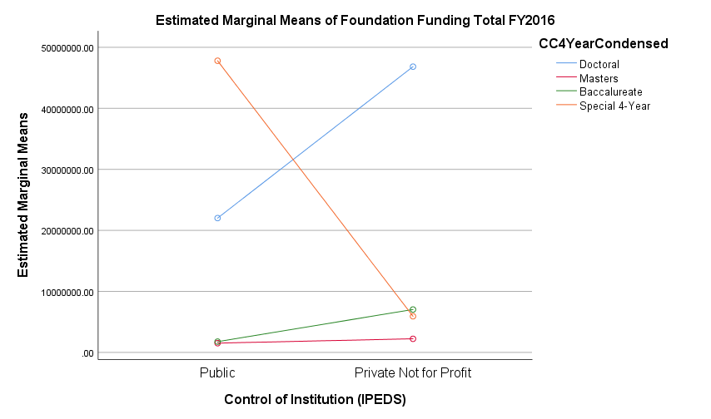

Slide 31
Findings
The 2x2 MANOVA model tells us there is a statistically significant difference in means between Carnegie Classifications and foundation funding levels, as well as an interaction effect of Carnegie and institutional control on foundation funding.
Carnegie Doctoral classifications have means in administrative capacity that are significantly higher than the other 4-year classifications except for the Special Focus 4-year institutions.
Carnegie Doctoral classifications have means in foundation funding that are higher than the Masters and Baccalaureate classifications, but not the Special Focus 4-year institutions.
**Note the intersection point of the Doctoral and Special Focus classifications.

Slide 32
Conclusion
Carnegie Classifications and research administrative capacity are correlated. Finding within this study supports the hypothesis that an institution’s classification ranking is a contributing factor to perceived administrative capacity and an institution’s success during the sponsored funding process.
Closing the gap on funding distribution by identifying competitive elements to better qualify institutions that have less resources for funding competitiveness is crucial for social equity performance.
Sustainability of higher education institutions over the next two decades is dependent on social equity performance of competitive funding models and processes.

Slide 33
Conclusion
Next steps include a survey to chief research officers and chief fundraising officers of 2018 Carnegie reclassifications to gain insight of perceptions on capacity, funding levels, and institutional change. This should follow with a focus group of select institutions to further identify a framework for institutions to address administrative capacity in anticipation of classification changes such as Carnegie and research designations.

Slide 34
References
Bastedo, M. N., Bowman, N. A. (2011). College rankings as an interorganizational dependency: Establishing the foundation for strategic and institutional accounts. Research in Higher Education, 52(1), 3-23.
Collins, B. K., Gerber, B. J. (2008). Taken for granted? Managing for social equity in grant programs. Public Management Review, 68, 1128-1141.
Gibbons, M. T. National Science Foundation. (2018). National Center for Science and Engineering Statistics, Higher Education Research and Development Survey, FY2016. (Science and Engineering Indicators, 2018). Publisher: National Science Foundation.

Slide 35
References
Kosar, R., Scott, D. W. (2018). Examining the Carnegie Classification methodology for research universities. Statistics and public policy, 5 (1), 1-12.
McGarity, T. O. (1994). Peer review in awarding federal grants in the arts and sciences. High Technology Law Journal, 9 (1), 1-91.
The Carnegie Classification of Institutions of Higher Education (n.d.). About Carnegie Classification. Retrieved (April 2019) from http://carnegieclassifications.iu.edu/.
The Voluntary Support of Education. (2016) The Voluntary Support of Education Survey. Retrieved from https://www.case.org/resources/vse-data-miner

Slide 36
Contact Information:
Emily Devereux
ED920082@wcupa.edu
Dr. Kristen Crossney, Advisor
Kcrossney@wcupa.edu

