Slide 1
Demographics of
Opioid Prescriptions
Isaac Linton
Faculty Mentor: Dr. Simon Condliffe
Department of Economics and Finance
West Chester University of Pennsylvania

Slide 2
Research Question
What?
Do/how do race and socioeconomic status predict opioid abuse? How do prescription and overprescription, and poverty and unemployment interact across race and SES?
How do racial and socioeconomic factors affect initial prescription?
Why?
Opioid epidemic is a pressing issue (spiking overdose deaths)
Missions trips Spring and Summer 2018 in Philadelphia
Understanding the gravity of the issue
Interested in working on the issue, to improve quality of life and find solutions

Slide 3
Literature Review
Journal of Health Economics: Macroeconomic Conditions and Opioid Abuse (2017)
Unemployment rate: proxy for macroeconomic conditions
Emergency Department visits and mortality data
Change in drug deaths has affected whites, while hispanic and black overdose rates held constant
“1% increase in unemployment increases predicted opioid-involved mortality rates by [3.6%]”
Strength
Demographics
Limitation
Mortality data → symptom, not cause
Prescription: source of epidemic, gateway

Slide 4
Literature Review (cont’d)
Brookings Papers on Economic Activity: Where Have All the Workers Gone? (2017)
Declining labor force participation rate “has fallen more in U.S. counties where relatively more opioid pain medication is prescribed”
Prime-age men are not in the labor force due to pain that causes them to miss work
Strength
Demographic affected: working males
Limitation
Drills down to counties, but not individual demographics
Need for more demographic info to determine causal link between opioids and labor force
See if the same demographics out of labor force are the ones receiving opioids

Slide 5
Methods
Yp = f(Xa, Xa2, Xs, Xr, Xi, Xreg, Xe, Xm, Xpov)
Where Yp = Patient received Opioid Prescription
X= Age, age^2, sex, race, insurance status, region, educ. attainment, military status, poverty index
Prediction: differences in opioid prescriptions across races and income levels
Expect to see white, low education, low income
Looking at a cause of the opioid epidemic to stop it at the source
Data Set: Medical Expenditures Panel Survey (2017)
Nationwide, representative cross-section
Prescribed Medicines
Variable: Poverty Index: essentially income per capita for households
Regression Models
Linear Probability Model: adults; similar to Ordinary Least Squares, for binary dependent variable
Logistic Regression: all survey participants

Slide 6
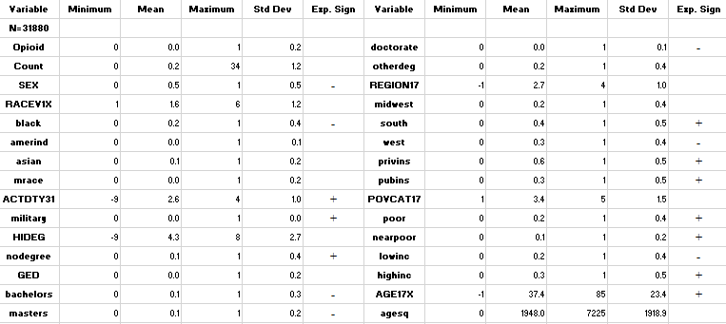
Descriptive Statistics

Slide 7
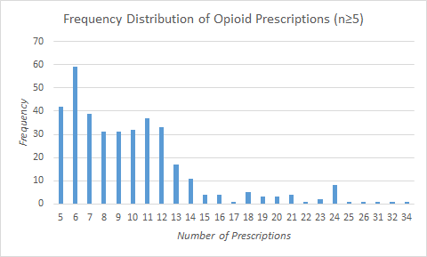
Descriptive Statistic Observations
One outlier in the data set had 34 opioid prescriptions in the year 2017
Average: 0.2 prescriptions
Relative spike at 24; could be explained by allocation of two prescriptions/month

Slide 8
Regression Statistics (Linear Probability Model)
Dependent Variable: Received Opioid Prescription (Y/N) (Dummy Variable)
Observations: Adults only
R-square: can be explained by cross-sectional data
More years of data would dramatically improve R-square

Slide 9
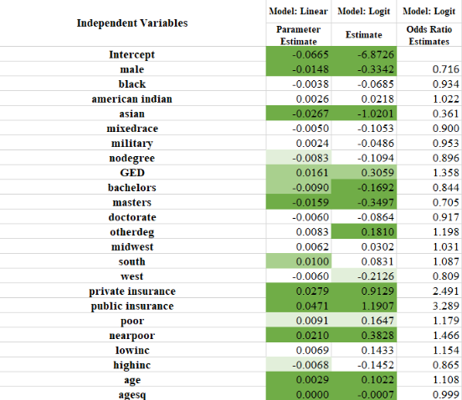
Results

Slide 10
Interpreting Results (Linear Probability Model)
Gender: males are 1.5% less likely than females to receive an opioid prescription
Surprising as the opioid epidemic has been reported as mainly a white male problem
Race/Ethnicity: Asians are 2.67% less likely than whites to receive a prescription
Educational attainment: Bachelor’s degree 0.9% less likely, Master’s 1.59% less likely
Region: South 1% more likely to receive opioid prescription than Northeast

Slide 11
Interpreting Results cont’d (Linear Probability Model)
Military Service: positive but not significant
Poverty Category: Near-poor 2.1% more likely than middle income to receive Rx
Age: Positive and significant; aging people might have more need for opioids
Public Insurance: 4.71% more likely to receive opioid prescription than someone without insurance
Private Insurance: 2.79% more likely to receive opioid prescription than without
Insurance coverage gives greater access to doctors and prescriptions
Potential need to review insurance prescription policies

Slide 12
Interpreting Results (Logistic Regression)
Vast majority of same variables significant
Regression statistics (model fit)
Akaike Information Criterion: 10395.4
Schwarz Criterion: 10403.77
Insurance variables again significant at 1% level
Odds Ratio Estimates: Private Insurance 2.491; Public Insurance 3.289
To find the change in odds, subtract 1 from odds ratio estimates
Interpretation: the odds that someone with private insurance will receive an opioid prescription are 149% higher than someone without insurance; public insurance 229% higher than without

Slide 13
Conclusions
Key takeaways
Public Insurance holders more likely to be prescribed an opioid
Demographics of those receiving opioids are largely white
Questioning assumption of problem largely being male
Further research
Multiple years of data to include fixed effects over time
Drill down into high-frequency patients (34)
Add more variables (unemployment, pain level experienced)
Look state- or county-level for specific local demographics
Applications
Government and healthcare sectors as they try to combat the opioid epidemic: knowing who is at risk will allow for better preventive care and more careful prescribing
Insurance providers evaluate opioid prescription policies

Slide 14
References
Hollingsworth, A., Ruhm, C. J., & Simon, K. (2017). Macroeconomic conditions and opioid abuse. Journal of Health Economics, 56, 222–233.
Krueger, A. B. (2017). Where Have All the Workers Gone? An Inquiry into the Decline of the U.S. Labor Force Participation Rate. Brookings Papers on Economic Activity, 1–59.
Tong, S. T., Hochheimer, C. J., Brooks, E. M., Sabo, R. T., Jiang, V., Day, T., … Krist, A. H. (2019). Chronic Opioid Prescribing in Primary Care: Factors and Perspectives. Annals of Family Medicine, 17(3), 200–206.
April 19, 2020

