Slide 1
More Than A Score: The Test-Optional Movement in Higher Education
Dr. Lisa M. Montgomery
April 27, 2020

Slide 2
Agenda
Current State – Test-Optional Institutions
Theoretical Framework
Research Questions
Type of Study
Population and Sample
Instruments
Qualitative Analysis

Slide 3
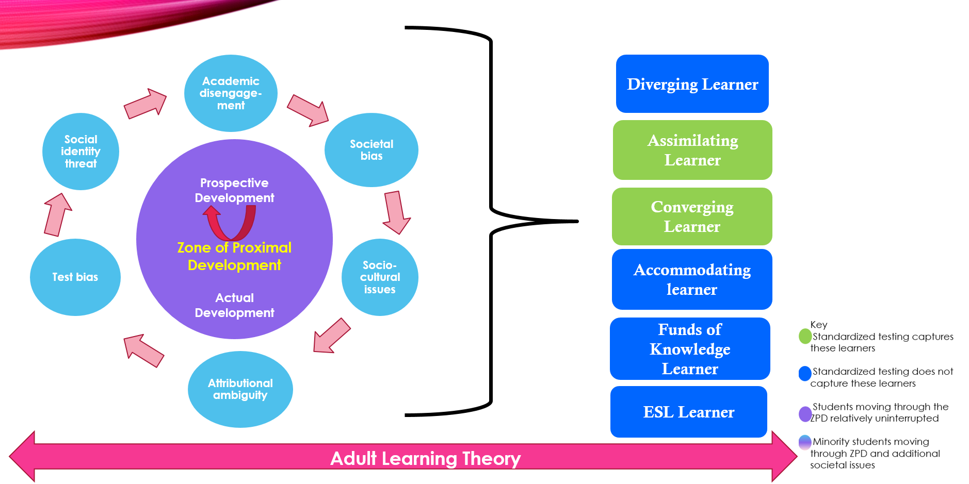
Theoretical Framework

Slide 4
Research Questions
Overall question – Why have many higher education admissions policies evolved to include a test-optional component for incoming students?
Sub Questions
  1. What was the decision-making process for schools implementing test-optional policies?
  2. How did the higher education institutions implement the test-optional admissions policy?
  3. What is/are policies the higher education institutions are utilizing to make an admissions decision?
  4. What do admissions officers perceive to be the benefits and drawbacks of test-optional policies?

Slide 5
Type of Study
QUAL qual
Survey Design
Survey
Case Study Design
Interview

Slide 6
Population and Sample
All test-optional higher education institutions (public and private) in the United States that offer four-year Bachelor of Science and/or Bachelor of Arts degrees and a test-optional admissions process
    For colleges and universities with multiple campuses, only the largest campus was included
Admissions Officers from rural, urban and suburban settings
  Titles of admissions officers: Chief Enrollment Officer, Undergraduate Director of Admissions, Vice President for Admissions and Enrollment

Slide 7
Results – The Numbers
673 surveys sent to test-optional higher education institutions
11 surveys returned completely answered
  Several other surveys in Qualtrics had approved consent but were not completed by the admissions officer
4 interviews conducted via Zoom
  Interview participants answered “yes” to the follow up question on the survey sent out

Slide 8
Qualitative Analysis
Analysis broken down into the following categories:
    Category 1 - Decision to move to test-optional admissions process
    Category 2 - Implementation of test-optional admissions
    Category 3 - Policies informing test-optional admissions decisions
    Category 4 - Perceived benefits/drawbacks to test-optional practices

Slide 9
Category 1 - Decision to Move to Test-optional Admissions Process
Diversity
  Identified in surveys and during interviews
      “We also have a desire to grow in students of color and low economic groups to benefit from this type of education and we know that SATs and ACTs are not exactly running in their favor these days.” (Admissions Officer 7, survey)
Access
    Geographically
      Taking students to SAT/ACT testing may cause a family hardship due to transportation
    Financially
      Some students lack resources to pay for SAT preparatory courses and/or books
    Equity of Instruction
      Some high schools include test preparation into their daily schedules and/or offer seminars for students to attend which may or may not involve a cost

Slide 10
Category 1 - Decision to Move to Test-optional Admissions Process
  High School GPA
  Research and study findings reflect high school GPA is a determinant of a student’s ability to be successful in higher education
    Research
      Allensworth & Clark (2020)
      Syverson, Franks, & Hiss (2018)
      Hiss & Franks (2014)
        Study reflected only a 0.6% difference in graduation rate between submitters and non submitters
        GPA between submitters and non-submitters 0.05 difference in GPA at graduation
  Current Study
    Admissions officers shared:
      HSGPA is a better determinant of a student’s ability to be successful
        “Some students simply don’t test well – we believe this to be true based on univariate HS GPA analysis. Yes, the two (test and GPA) are often related and relate to student success but we have enough examples of low test/high GPA success that we feel it more appropriate to put more weight on GPA.”

Slide 11
Category 1 - Decision to Move to Test-optional Admissions Process
Attraction to University/College
Admissions officers shared the following:
  Students seek a good fit for themselves and skill set
  Returning control/empowerment to the student by offering test-optional policy
Alignment with University Mission
Admissions officers shared:
  Need to realign/recalibrate to return to the original mission/vision of the college/university
  Not having a test-optional policy created violations in student success definitions

Slide 12
Category 2 - Implementation of Test-Optional Admissions Practices
Student Applications
Survey Question – Where are increases in applications from?
  Largest increase was from first-generation and under-represented minority groups
GPA
Two questions asked to obtain information on this topic
    1. What is the average GPA of students at the end of their freshmen year?
      81% respondents indicated – 2.6 – 3.5
    2. What is the average GPA of students at graduation?
        54% - 2.9 – 3.1
Application Volume
Regarding whether or not institutions noticed an increase in application volumes since implementing a test-optional policy
  55% - application volume remained the same
  36% - applications increased
    1 institution reported a decrease in volumes since the implementation of test-optional policy

Slide 13
Category 3 - Policies Informing Test-Optional Admissions Decisions
Institutions in my study use different items to make an admissions decision (3 main):
    High school transcript
    Letters of recommendation
    Essays
90% of the survey respondents indicated that the high school GPA is the major factor in the decision to admit a student applying test-optional
“We serve a large percentage of first-gen students, and historically underserved student populations. Many of these students have not been deemed “college bound” by their high schools and subsequently, are not prepared for standardized tests.” (Survey)

Slide 14
Category 3 - Policies Informing Test-Optional Admissions Decisions – Financial Impacts of Test-Optional Admissions
Scholarships – varied results
54% survey respondents – scores not required for scholarship consideration
Some officers indicated scores do influence award
3 interview participants indicated scores do not influence scholarship decisions
Admissions Officer 3 – scores are a factor in the amount of merit received
  One of top awards ($35K) – students who achieve 1220 or greater
    “Aptitude for testing”
  Students within the top 5% of their graduating class and/or those with 1300 or greater on SAT ($40K)

Slide 15
Category 4 – Benefits of Test-Optional Policies
Benefits
Diversity and access
Appeals to various types of students
Non-Cognitive Factors
  Expectancy Value Theory (Wigfield, 1994) – student’s motivation to succeed (intrinsic factors)
  Academic and Social Integration – Tinto (1993) – student needs to be fully engaged socially and educationally to thrive and persist to graduation
Drawbacks
Measurement
  Admissions officers find it difficult to ignore when the scores are sent in
      This drawback generally came from survey respondents (2)
Grade inflation concerns
    This drawback generally came from survey respondents (2)
Making an admissions decision using students’ written responses

