Slide 1
Professional Quality of Life: An examination of Compassion Fatigue and Compassion Satisfaction in Athletic Trainers
Tina e. Riordan, lat, atc
April 24, 2020

Slide 2
Thesis Committee Members
Chairperson
Lindsey Keenan, PhD, LAT, ATC
Committee Members
Emily Duckett, MS, LAT, ATC
Alison Gardiner-Shires, PhD, LAT, ATC

Slide 3
Compassion satisfaction
The positive aspect of helping
Pleasure and satisfaction derived from recognizing impact of client change (Radey & Figley, 2007)
Cornerstone of quality healthcare
Job satisfaction influences the outcome of patient care and quality of work (Singh, 2017; Stamm 2010)
Impacts career outcome, health, and personal relationships with co-workers
Notes:
Compassion satisfaction is further described as the pleasure and satisfaction derived from working in helping, care giving systems.
This concept is considered the cornerstone of quality health care as it influences an employers work quality and outcome of patient care.
Overall, this encompasses the pleasure one derives from being able to do ones work. Fore example, one may feel pleasure to help others, or may feel positively about ones colleagues, or ones ability to contribute to the work setting through his or her ability to work with people who need care.

Slide 4
Compassion fatigue
The negative aspect of helping
“The physical, emotional, and spiritual fatigue or exhaustion that takes over a person and causes a decline in his or her ability to experience joy or to feel and care for others” (Worley, 2005)
CF is connected to the relationship between the healthcare provider and the patient (Aycock & Boyle, 2008; Sabo, 2011)
Professions that fit the definition of a ‘first responder’ are at an especially high risk for CF (Bellolio et al., 2014; Boyle, 2011; Lombardo & Eyre, 2011).
Notes:
Compassion fatigue is considered the “cost of caring”. This concept is marked by the physical, emotional and spiritual fatigue or exhaustion that takes over an individual. This causes a decline in ones ability to experience joy personally and overall ability to care for others.
First established in 1992
This concept is seen between the relationship between the health care provider and patient. Professions that fit the definition of a “first responder” tend to present with a higher risk of developing CF.
“that ultimately ends with an inability to attain a healthy balance of empathy and objectivity” (Aycock & Boyle, 2009, p. 184).
-

Slide 5
Professional quality of life
Notes:
First I’d like to start off with some background information on compassion in order to familiarize you with the foundation of this topic and help demonstrate the importance of compassion within the proposed study. Compassion is considered to be a characteristic that is deep rooted within an individual as it intrinsically creates a desire to help on behalf of others. Compassion has ben further marked by 5 elements including: the recognition of suffering, the understanding of the humanity of ones suffering, emotional connection to the individual suffering, being able to tolerate the difficult feelings that may arise from helping one who is suffering, and being motivated to help the individual.
The professional quality of life depicts the quality one feels in relation to their work as a helper (Stamm, 2000)
Within the workforce, individuals offer skills to accomplish tasks and improve the working environment he or she is in. Many employees begin to experience negative and positive impacts due to the job and the work it entails. . In order to better understand this phenomenon, the professional quality of life can be considered.

Slide 6
What about athletic trainers?
Compassion Satisfaction
Words that describe the profession: Unique, dynamic, fun, fulfilling, connectedness, growing, dedication, challenging, caring, and important (Benes, 2015)
Burnout
AT’s experience burnout through: role conflict, high time commitment, limited opportunities for career advancement, low salary and poor working conditions” (Capel, 1990)
Secondary Traumatic Stress
There were 120 sports-related deaths of young athletes in 2008-2009; 49 in 2010; 39 in 2011; 33 in 2012, 32 in 2013 (NATA) More than 1.35 million children were seen in an emergency department for sports-related injury in 2012(Ferguson, 2013)
Notes:
As part of the healthcare profession, athletic trainers utilize their knowledge and skills to improve the quality of life of others, with the possible consequence of affecting their own quality of life.
PROBLEM STATEMENT: Specifically, compassion fatigue is prevalent in many health care professions, however prevalence in athletic trainers has not yet been examined.

Slide 7
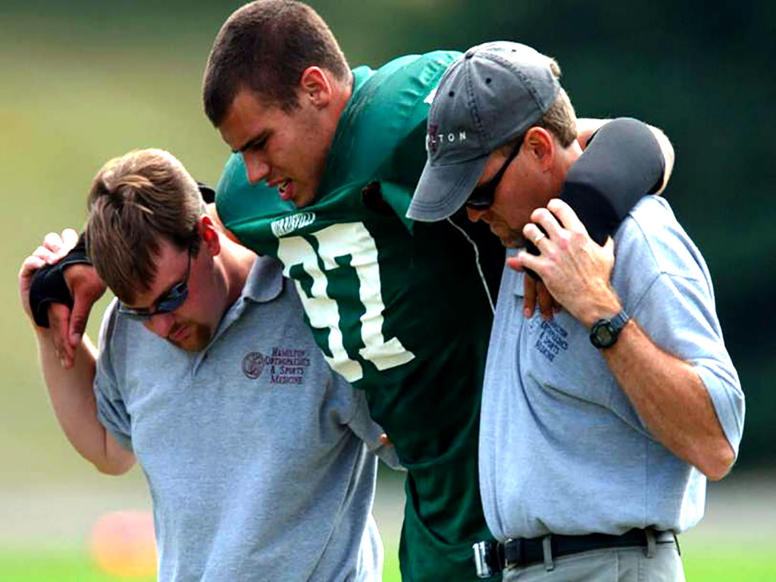
Purpose
The purpose of this study is to examine the professional quality of life among athletic trainers, including compassion fatigue and compassion satisfaction

Slide 8
Research Questions and Hypotheses
What is the prevalence of compassion fatigue in clinically-active athletic trainers?
Athletic trainers experience a average level of compassion fatigue.
What is the prevalence of compassion satisfaction in clinically-active athletic trainers?
Athletic trainers experience a high level of compassion satisfaction.
What is the relationship between the components of the Professional Quality of Life and years of athletic training experience?
There will be a positive relationship between compassion fatigue and years of athletic training experience.
There will be a negative relationship between compassion satisfaction and years of athletic training experience
Is there a difference in the components of the Professional Quality of Life between athletic training settings?
There will be a difference in compassion fatigue between athletic training settings
Is there a relationship between the Professional Quality of Life components in clinically-active athletic trainers?
There is a negative relationship between compassion fatigue and compassion satisfaction in athletic trainers.

Slide 9
Methods
INSTRUMENTATION:
2 Part Survey
Demographics
ProQOL- 21
3,000 certified athletic trainers whom maintained an active National Athletic Trainers’ Association (NATA) membership were invited to participate
293 certified athletic trainers
Mean age 33.08 ± 9.21
66.6(n = 195) female
33.4% (n = 98) male
Response rate:10.8 %
Notes:
ProQOL – 21 Measure: Self reported scale measurement of compassion satisfaction (CS) and compassion fatigue (CF)
21 Item instrument
5 Point Likert Scale
1=Never, 2=Almost Never, 3=Sometimes, 4=Often, 5=Very Often
Total Possible Score Ranges:
Compassion Satisfaction: 10 – 36
Compassion Fatigue: 11 - 46
Item Reliability:
CS and CF Scale: Cronbach a = .90

Slide 10
Demographics
White Ethnicity: 87.7%
EMPLOYMENT SETTING
YEARS OF EXPERIENCE
Employment Setting | N (%)
Secondary Schools | 158 (53.9)
Elite Athletics | 72 (24.6)
Clinic/Hospital | 37 (12.6)
Non-Traditional | 26 (8.9)
Years of Experience | N (%)
1-5 | 84 (28.6)
6-10 | 140 (47.8)
11-20 | 46 (15.6)
21+ | 23 (7.4)
Notes:
The final data set consisted of 293 (9.8%) surveys, which were analyzed using statistical analysis.
Descriptive statistics were computed for all demographic variables included in the survey measurement.
Females comprised 66.6% of participants, while the remaining 33.4% identified as male.
Ages of participants ranged from 22-84 years, with an average age of 33 however, 37 (12.6%) individuals skipped the age question. More than half of the participants ages ranged from 26-35 years (62.9%, n = 184).
The majority of the sample, consisting 87.7% were of the white ethnicity.
The majority of the sample (88.1%) were employed full time and specified having a further degree (74.1%)

Slide 11
Results
Prevalence of Compassion Satisfaction and Compassion Fatigue Among Athletic Trainers
Compassion Satisfaction
Compassion Fatigue
Levels of CS | N | Frequency
Low | 0 | 0.0 %
Average | 14 | 4.8 %
High | 279 | 95.2 %
Levels of CF | N | Frequency
Low | 31 | 10.6 %
Average | 150 | 51.2 %
High | 112 | 38.2 %
Notes:
The total scores of the compassion satisfaction component ranged from 22-50 with a median total score of 40.3 ±5.711
The total scores of the compassion fatigue component ranged from 11-45 with a median total score of 24.05 ± 5.711

Slide 12
Results
Relationship between CF and years of experience in clinically-active athletic trainers
The relationship between these two variables showcased a significant, weak, negative correlation.
r = -.182, n = 293, p = .002.
Relationship between CS and CF scores
The relationship between these two variables indicated a significant, moderate, negative correlation.
r = -.400, n = 293, p = .000.

Slide 13
Discussion
Athletic Trainers experience high satisfaction in their clinical compassion when providing care to patients.
Similar findings in previous conducted studies (Cavanagh et al, 2019)
Years of experience may influence compassion fatigue levels
Consistent findings within other health care professions (F. Cocker & N. Joss, 2016; Salmond et al, 2017)
Relationship between compassion satisfaction and compassion fatigue
interventions directed toward increasing compassion satisfaction may also decrease compassion fatigue (Fahey & Glasofer, 2016)
Notes:
As years of experience increase, overall compassion fatigue may decrease. This is consistent with other findings among other health care professions (F. Cocker & N. Joss, 2016; Salmond, Ames, Kamienski, Watkins, & Holly, 2017) A possible explanation for the negative relationship between compassion fatigue and years of experience in athletic trainers could be that as an athletic trainer increases their experience in the field, the experience of compassion satisfaction becomes more evident.
The results of this study indicated a significant moderate, negative linear relationship between these two variables. Based on these results, it is unlikely ATs will experience high CF AND high CS, though the correlation between these variables was moderate and may be influenced by numerous factors. Some of these factors, as described in the discussion above, may include setting, years of experience, and potentially other demographics that were not analyzed for the scope of this study such as age, race, and gender of the ATs.

Slide 14
Limitations and Future Research
Limitations
Future Research
Further validation of the ProQOL-21 tool
Longitudinal study over the course of athletic trainers’ careers
Mixed methods approach – Interviews
Explore other factors that may have a relationship with CS and CF
Future research may have the opportunity to enhance the positive aspects of athletic trainers’ ability to care, and minimize the negative effects that may be experienced through this profession.
Self-report measure response bias
Small sample size
Utilization of a newly established assessment tool
Notes:
The sample size that was utilized in this study was low. The timing of the data collection may have served as a contributing factor to the low response rate (10.8%) and small participant sample size (n = 293).
The low response rate proved difficult when conducting analyses, as it may have contributed to the unequal distributions between groups. This also restricts the ability to make assumptions about a population in totality. The data of the total participants (n = 293) may not be representative of the athletic training profession as a whole.
Another limitation in this study was utilizing a newly established assessment tool for the components of the Professional Quality of Life among athletic trainers. The lack of research utilizing this tool serves as a limitation, as there was not a cemented foundation to the measurement and still renders the need for further application within research. Although there was a lack of this ProQOL-21 tool within the literature, it held the highest validity compared to other measures, as to why it was utilized for this study.

Slide 15
Conclusion
Athletic trainers experience both compassion satisfaction and compassion fatigue due to their caregiving role.
Additional research is warranted to further investigate this relationship in athletic training and examine both prevention and causes of compassion fatigue.
Notes:
Athletic Trainers experience high satisfaction in their clinical compassion when providing care to patients; however, compassion fatigue is also prevalent in this profession.

