Slide 1
Army ROTC
Dauntless Battalion
West Chester University (C Company)

Slide 2
Army Reserve Officers’ Training Corps (ROTC)
Campus Leader Development Program
First 2 years open without military obligation
Potential to earn a full tuition scholarship
Graduates commission as Army Officers in the Active or Reserve component
Military Science training right here on campus at West Chester University

Slide 3
Army ROTC – U.S. Army Cadet Command
Mission
Facts
USACC partners with universities to recruit, educate, develop, and inspire Senior ROTC Cadets in order to commission officers of character for the Total Army
6,000 new officers per year
Active and Reserve Components
Army Nurse Corps via ROTC
Educational Delay for Medical School, Law School, Seminary
Largest source of Scholarships
goarmy.com/rotc

Slide 4
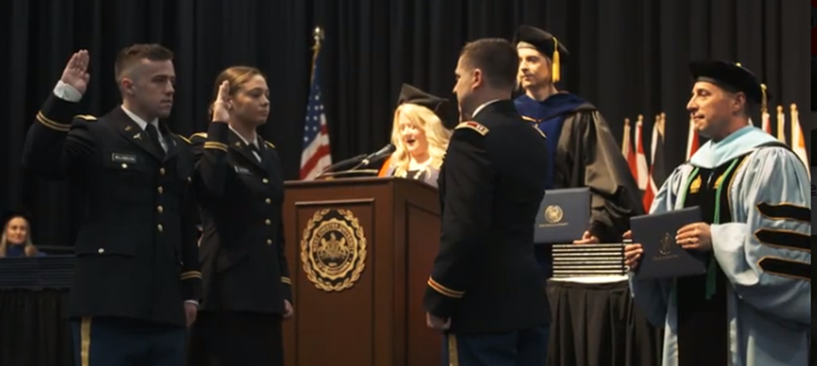
Military Science Instruction
Classroom
Values & Ethics Track
Tactics & Techniques Track
Officership Track
Personal Development Track
Leadership Track
Physical Training
Leadership Labs
Field Training Exercises (FTX)
Cadet Summer Training (CST)

Slide 5
How to Enroll
Add Military Science Instruction 101 to fall semester course schedule
Complete a few non-binding enrollment forms with the ROTC office
Who to Contact
Mr. Keith Karbel, Recruiting Operations Officer, (610) 490-7035, keith.r.Karbel.civ@mail.mil
Sergeant First Class Brian Souders, Instructor, (610) 430-4403, bsouders@wcupa.edu
https://www.wcupa.edu/universityCollege/rotc/

