Slide 1
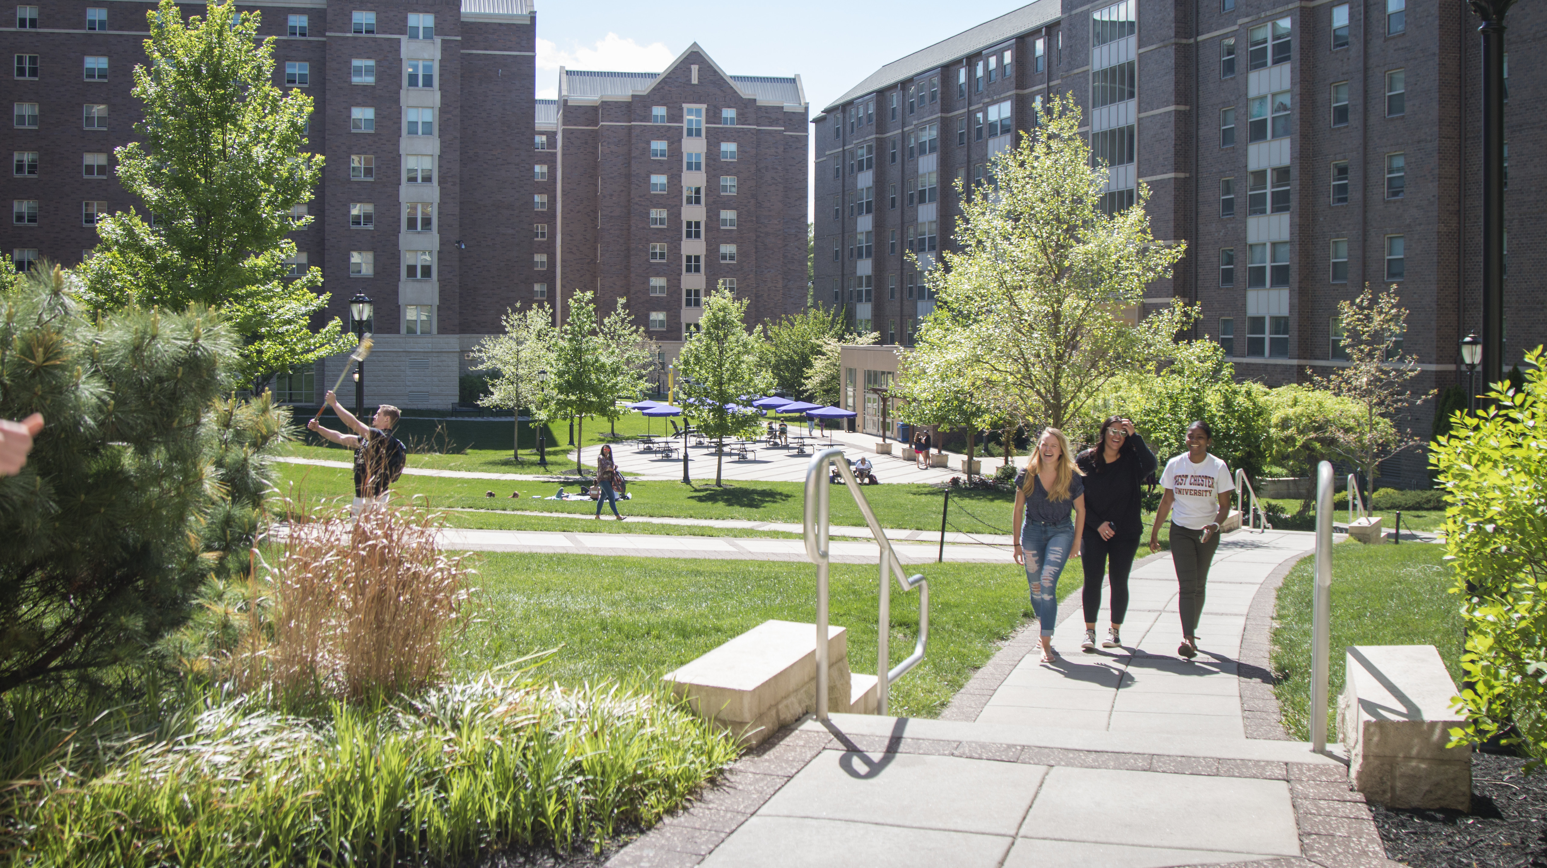
University student housing (USH) also known as ush affiliated housing

Slide 2
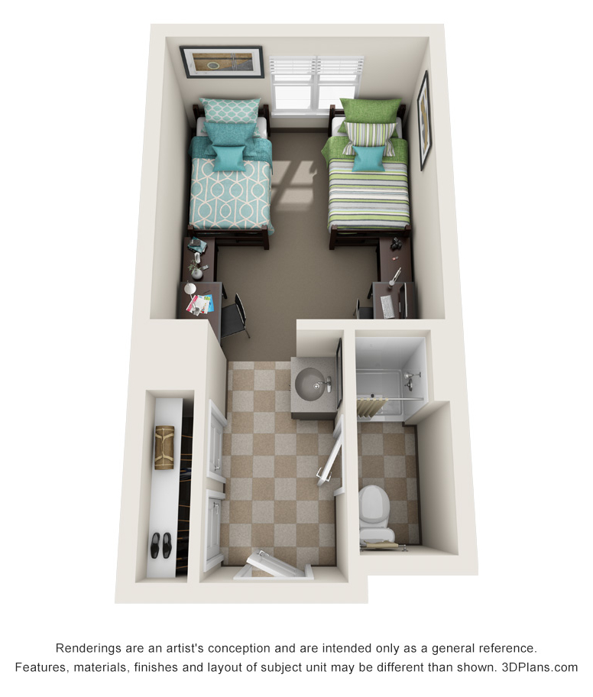
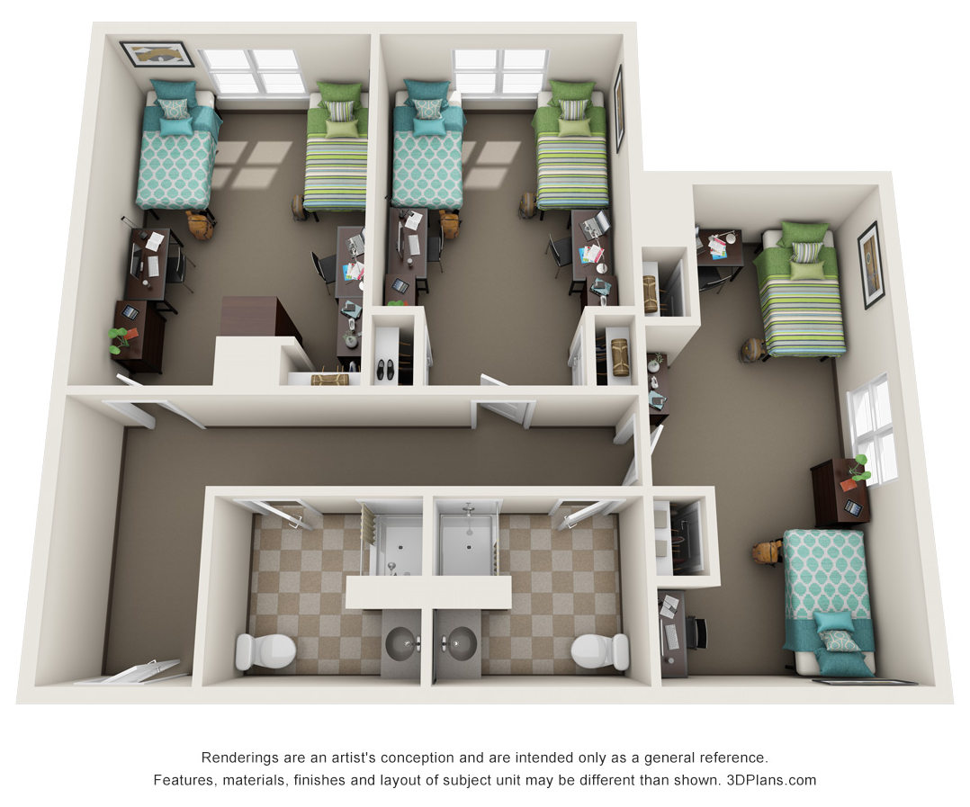
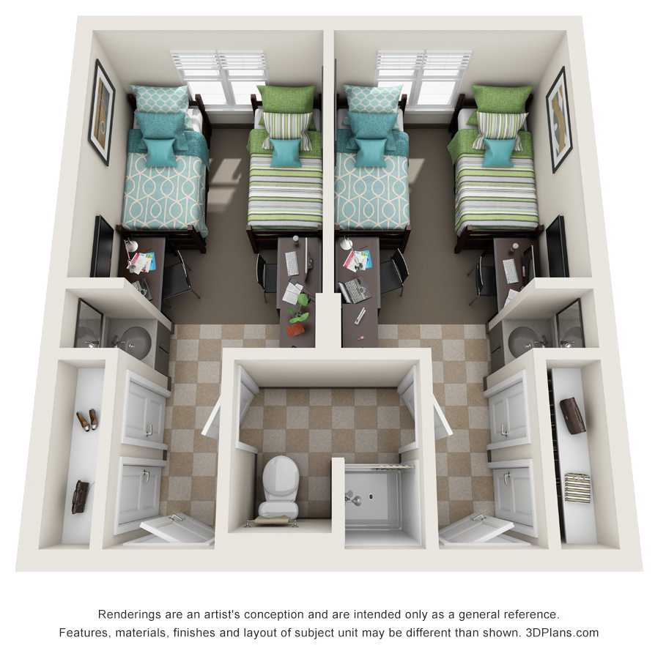
On Campus Housing
First Year Students
(North Campus)
1X1 (One Bedroom Double) Brandywine Hall, Commonwealth Hall, Allegheny Hall
3X2 (Three Bedroom Double) Brandywine Hall, Commonwealth Hall, Allegheny Hall
4x1 (Two Bedroom Double with Shared Bath) Commonwealth Hall
See Virtual Tours
Visit our Website

Slide 3

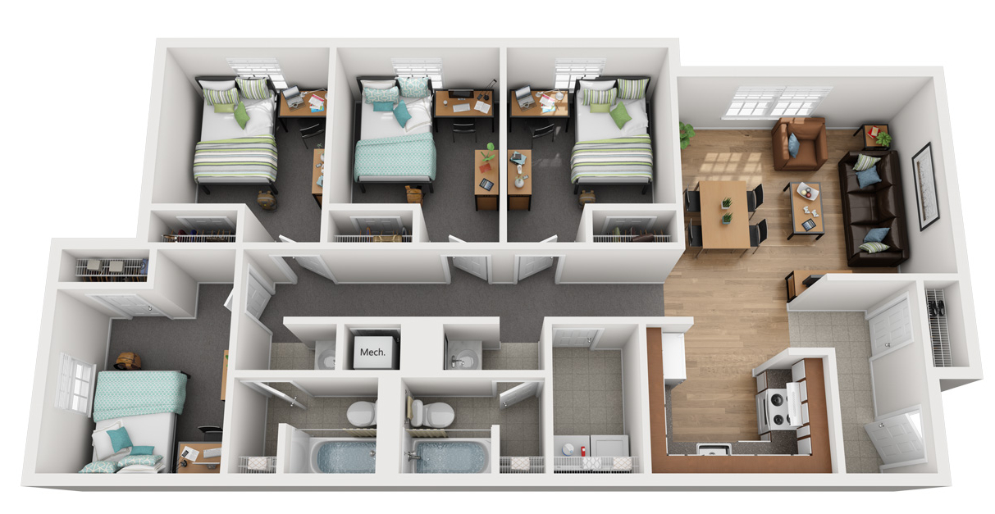
On Campus Housing
Transfer Students
(South Campus)
Village 4X2
Included:
Full Kitchen
Desk & Desk Chair
Bed Frame & Mattress
Living Room Furniture
Dining Table & Chairs
Washer & Dryer
See Virtual Tours
Visit our Website

Slide 4

Application Process
Pay the $200 non-refundable application fee and complete all documents.
Fill out your roommates matching information and search for roommates
You will receive application instructions to your WCU email. Follow these steps to begin your application for your preferred housing.
Room assignments and invoices mailed mid-June.

Slide 5


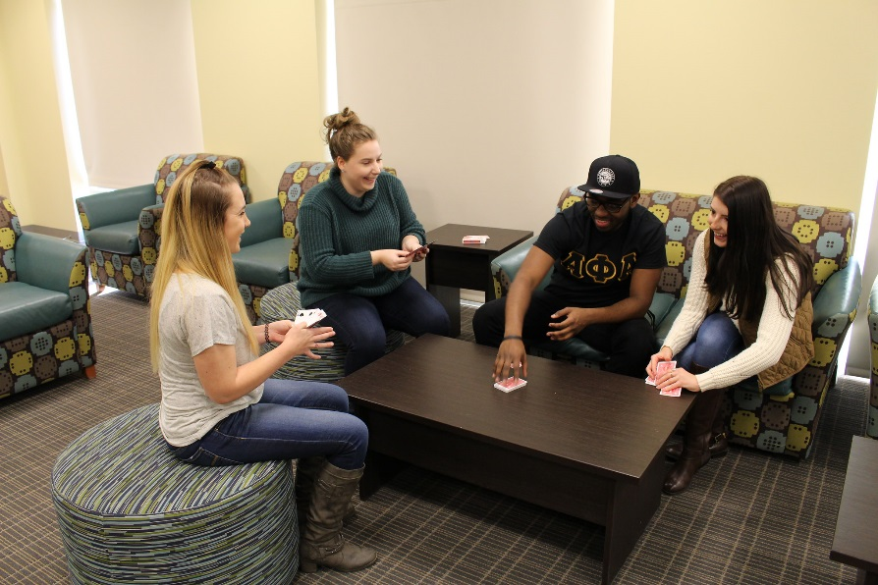
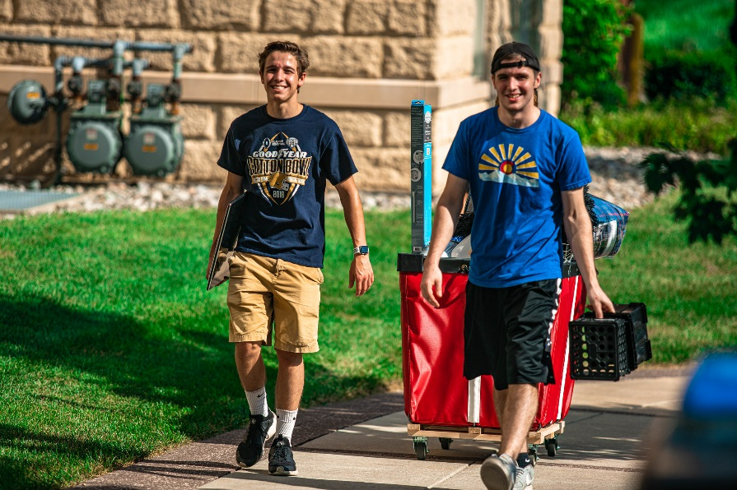
Tips For Roommate Matching
Fill our your Roommate Matching Profile
Search for Roommates
Create a Roommate Group
USH will assign you and your roommate(s) to a room

Slide 6
Gender Inclusive Housing
A student can identify gender as neutral in the Affiliated Housing Application.
By selecting neutral, you will be shown other students who have selected neutral as well when utilizing the roommate matching functions of the resident portal.
You can search and connect directly with another student who has selected neutral, or USH will work to assign you to a room with another gender-neutral student.
If you would like to change your selection from gender-neutral to a different option, please contact the USH Leasing Team at (610)430-4988 or leasing@ushcommunities.org.

Slide 7
Financial Aid Process
Students are able to apply financial aid funds to their USH Affiliated Housing bill.
The student is responsible for requesting enough financial aid to cover the cost of housing.
This process must be completed prior to the start of each semester. Details regarding the process are on the USH website.
The student is responsible for paying the remaining balance by the due date outlined by USH
For more detailed information on this process, please contact the below offices or visit our website.
WCU Financial Aid Office USH Resident Accounts Office
Phone (610) 436-2627 Phone (610) 430-4980
Email Finaid@wcupa.edu Email residentaccounts@ushcommunities.org
Visit Financial Aid Website
Visit USH Affiliated Housing Website

Slide 8
Questions?
Please contact the USH Leasing Center.
Phone (610) 430-4988
Email leasing@ushcommunities.org

