Slide 1
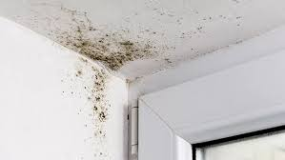
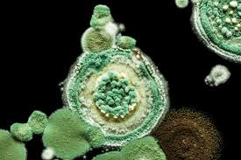

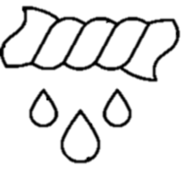







Stop Mold Growth
Before It Starts
What Mold Loves:
Warm Temps: 77-86° F
Humidity: Over 70%
Food Sources:
- Wet Towels & Clothing
- House Plants
- Rugs & Carpets
- Soft Fabrics
- Books & Papers
Prevention Tips:
    Keep it dry; don’t ignore damp clothes or towels. Hang them up or toss in the washer.
    Use the exhaust fan and open bathroom door after showering to let moisture escape.
    Wipe down wet surfaces like shower walls, floors, and mirrors with a squeegee or cloth.
    REPORT leaks and suspect mold or musty odors IMMEDIATELY!
For more information, contact EHS at ehs@wcupa.edu or scan our QR Code!

