Slide 1

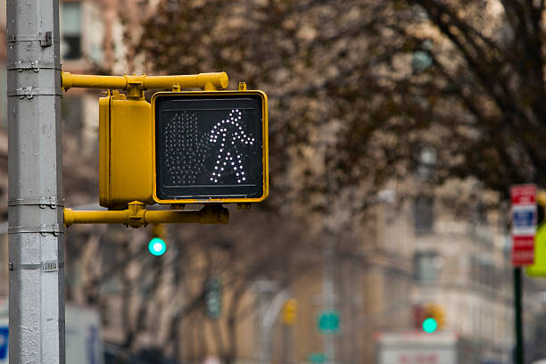


Prepare for Back-to-School Traffic Safety!
As fall semester begins, traffic gets busy! Follow these tips to stay safe while traveling WCU!
Foot Traffic:
Always use crosswalks when crossing the street
Only cross when traffic signs indicate you’re able to
Never rely on cars to stop for you
Don’t let your phone distract you
Street Traffic:
Stay alert for student traffic while driving
Be cautious for wet leaves on the road!
Always yield to students crossing the street
Avoid using your phone while driving
For more information, contact EHS at ehs@wcupa.edu or scan our QR Code!

