Slide 1
Motor Pool
Vehicle Policies & Procedures
WCU Motor Pool | 610-436-2434 | Autoshop@wcupa.edu

Slide 2
Authorization to Drive University-Owned Vehicles
If you will be driving a University vehicle you are required to review this information in its entirety. This must be completed in order to be authorized to operate University-owned vehicles.
After reviewing this information, you must submit the Driver Authorization Form located on the Motor Pool website. Once processed, you will be notified via email of your approved status.

Slide 3
Vehicle Policy
The purpose of WCU's Vehicle Policy is to establish guidelines regarding the use of University-owned vehicles to ensure WCU is compliant with the Commonwealth of Pennsylvania’s code for the Operation of Commonwealth Motor Vehicles. To mitigate risks with insurance and liability, guidelines include authorized drivers, appropriate use of vehicles, driving rules, and accident and damage reporting.
Failure to comply with any aspect of the Vehicle Policy could invalidate the University’s insurance coverage and may have financial consequences. This may include the driver being held legally liable to pay any damages suffered by the injured parties, including damages to vehicles or other property.

Slide 4
Acceptable Driver License:
WCU Driving Policy Definitions
A regular, temporary, or commercial license that is: Lawful, current, and valid; issued by the state or country where the driver resides.
Authorized Drivers:
Authorized Drivers are defined as individuals who possess a valid state driver's license, are University employees in a current paid status, and individuals who are operating vehicles pursuant to their employment responsibilities.
Student employees or graduate assistants must complete the Student Driver Form and be approved by the Vice President of Finance and Administration.
All Authorized Drivers defined above must review the Motor Pool Vehicle Policies & Procedures slide deck and submit the Driver Authorization Form on the Motor Pool website.
University Vehicle
University vehicles include all vehicles owned by WCU as well as any vehicle rented or borrowed for University use.

Slide 5
Driver Requirements
Drivers must possess a valid driver's license
If a valid driver's license is listed in the job description as a condition of employment at WCU, all suspensions or revocations of driving privileges must be self-reported to Human Resources.
Proof of a valid driver's license is always required when picking up Motor Pool Rentals.

Slide 6
Driver Requirements
Drivers must be employed, in a paid status, by WCU
Volunteers are NOT permitted to operate university vehicles.
Faculty members, who are on PAID sabbaticals, may use university vehicles for official university business.
Student employees or graduate assistants employed by WCU may drive university vehicles. with authorized Student Driver Form.
This does NOT include College Work Study appointees.

Slide 7
Student Driver Form
Required for ALL student employees and
graduate assistants
STUDENT-DRIVER FORM
Must be completed and endorsed by the appropriate cost center authorizer, supervising Dean, or University VP and approved by the VP of Finance and Administration.
No vehicle will be released unless the Student Driver From is received.
Part-Time Student Employee or Grad Assistant to Drive a University Vehicle
This form needs to be completed in addition to a WCU Trip Sheet Form
Date Prepared:
Type of University Vehicle (Fleet Vehicle or Motor Pool Rental):
WCU Fleet Vehicle #:
car/minivan
if applicable
15 pass-van/
box truck
Supervisor Name:
Office | Department Cost Center (employing student):
Student Employee or Graduate Assistant Name:
Date of Birth:
Signature
Driver License #:
State:
Date(s) student is requested to drive:
TO
Purpose of driving assignment (Assignment must be part of the student employee's normal job duties):
Signature / Endorsements (All Three Blocks are Required)
As the supervising sponsor, I confirm that this student employee or graduate assistant meets all of the following criteria:
Possesses a current valid driver's license.
Is at least 21 years of age.
Is in a paid status of WCU student employee or graduate assistant (NOT a college work study appointee).
The driving assignment listed above is part of this student employee's or graduate assistant's normal University job duties.
Will be paid by the University while performing driving duties.
Has received, reviewed and accepted all vehicle use policies and guidelines.
Supervising Sponsor
Title:
Printed Name:
Signature:
Date:
Divisional Vice President
Printed Name:
Signature:
Date:
Vice President for Finance and Administration Authorization:
Printed Name:
Signature:
Date:

Slide 8
Driver/Passenger Requirements and Responsibilities
Official University Business
University Vehicles should be only operated pursuant to an individual's specific responsibilities with WCU. NO PERSONAL USE!
Comply with all applicable motor vehicle laws
Drivers should always use safe driving principles, practices, and techniques while complying with all Federal, State, and local motor vehicle regulations and laws. Drivers can be held liable for any damages or costs caused by carelessness, negligence, or actions beyond the scope of authorized use.
Passengers participating in university business
All passengers should be limited to employees, students, or individuals participating in university business, sponsored activity, or event at the time of traveling. Family members, who are not WCU employees, are not permitted as passengers.

Slide 9
Driver Responsibilities
No Idling
Back to Agenda Page
If in one place for more than three minutes, turn off the engine. At no time should a vehicle be left running while unattended.
Medications, alcohol, drugs
Direct Route
No drivers, before or during trips, are permitted to use medications, alcohol, drugs, or other substances that cause drowsiness or other physical or mental impairment. The driver of the vehicle must not be under the influence of illicit drugs and/or alcohol at any time.
On trips, drivers need to use the most direct route to the destination.
Inspect Vehicles
Prior to operating a University vehicle, inspect the vehicle for safety concerns and report any defects to the Motor Pool Office immediately.
Clean Vehicles
Drivers are responsible for keeping the interior and exterior of vehicles clean. Vacuums are onsite at Motor Pool Maintenance Garage as well as a card to use at local car wash.

Slide 10
Driver Responsibilities
Back to Agenda Page
Mobile Devices
No Smoking, alcohol or illegal substances
No Modification to Vehicles
The use of mobile devices for texting and voice calls while driving university vehicles is prohibited. Drivers should pull over and find a safe place to park prior to using a mobile device.
Smoking or use of tobacco products, alcohol, or illegal substances is prohibited in university vehicles. Alcohol may not be transported in university vehicles.
No modification of university vehicles shall be made without the approval of the Motor Pool Office. This includes but is not limited to affixing signs, stickers, antennas, ladders, etc.

Slide 11
Cargo Restrictions
Back to Agenda Page
No Animals except for License Service Animals or Prior Approval is Obtained by emailing the Motor Pool Office at autoshop@wcupa.edu
Animals are prohibited in university vehicles, except for licensed Service Dogs or in instances where the appropriate intended use of the vehicle has been approved for transporting animal(s).

Slide 12
Fines, Violations, Citations, Misuse
Back to Agenda Page
Drivers are personally responsible for fines or citations resulting from their actions.
Drivers should pay all parking and moving violation fines that occur while driving university vehicles immediately. No University funds should be used.
Any fines, violations, or citations received while driving a university vehicle, including rental vehicles may result in suspension or revocation of privileges to drive a university vehicle, as well as other disciplinary action.

Slide 13
Vehicles Off-Campus
University Vehicles should only be operated in pursuant to an individual's specific responsibilities with WCU. NO PERSONAL USE!
This includes trips to local convenience stores, picking up lunch, or running personal errands Off-Campus.
WCU

Slide 14
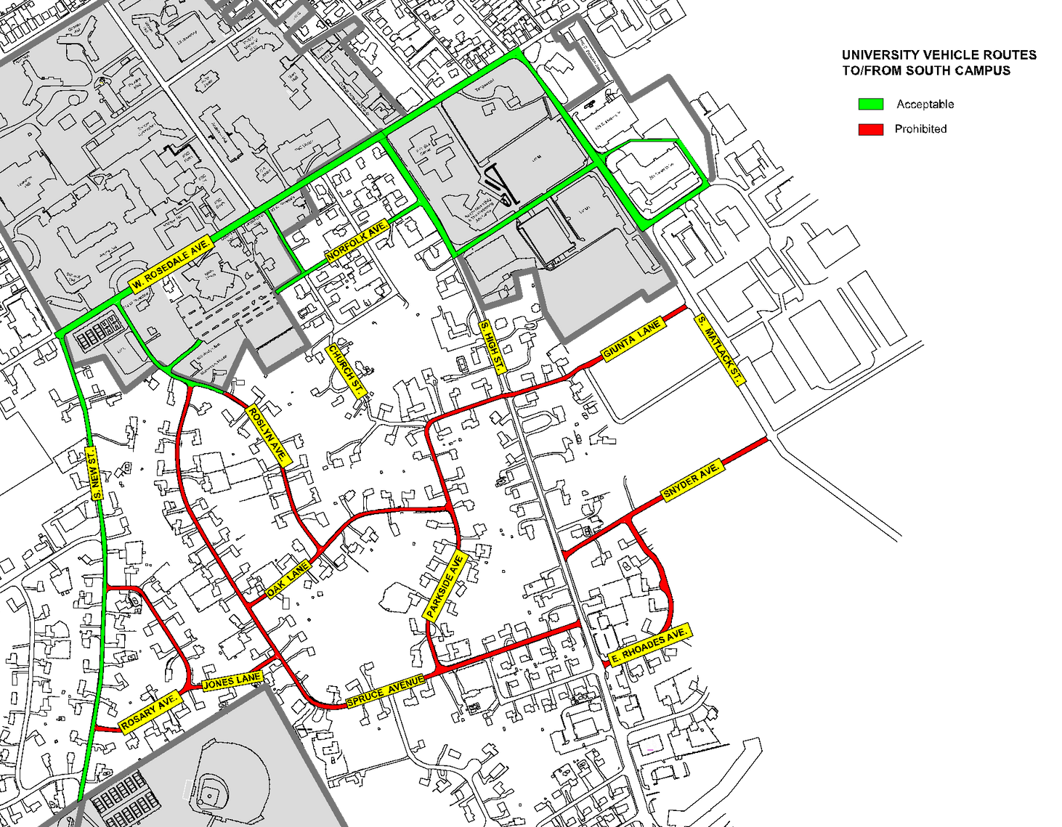
Residential Roads
University Vehicles must avoid driving in residential areas around Campus.
West Goshen Township has approached the University several times about the large amount of University traffic that drives through the suburban residential neighborhoods that surround the WCU campus. This additional traffic is very upsetting to the residents of these neighborhoods and has become a safety concern. WCU has been asked to curtail all vehicular traffic by staff, faculty, students, vendors, and visitors through these neighborhoods. WCU has committed to stopping the traffic by University vehicles and the commercial vendors that supply us in an effort to help improve our relationship with our neighbors.
WCU
This map shows the streets of most concern in West Goshen Township

Slide 15
Any incident/accident involving any WCU-owned vehicle
must be reported to the Motor Pool Office
Support it with a brief explanation.
Motor Pool Office
Back to Agenda Page
610-436-2434 | autoshop@wcupa.edu

Slide 16
Accident/Damage Reporting
All WCU-owned vehicles have an Accident Report Packet located in the glove box.
All University vehicles contain a copy of the vehicle's registration card and WCU's insurance verification card in the glove box.
Instructions for reporting accidents are found in the Accident Report Packet also located in the glove box of every WCU-owned vehicle.
Any Accident or damage to WCU-owned vehicles needs to be reported to the Motor Pool Office within 24 hours of the incident.

Slide 17
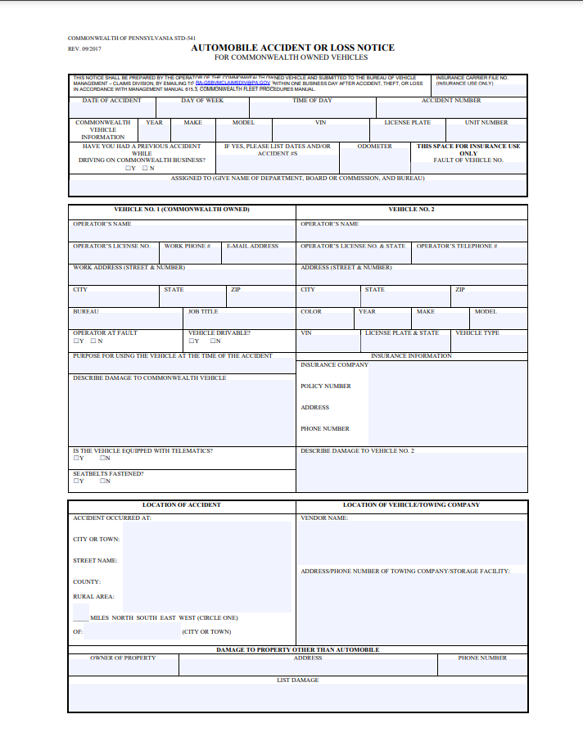
STD-541 Form
Automobile Accident or Loss Notice
**All Accidents or Damage Require a STD-541 Form**
The STD-541 Form is known as the Automobile Accident or Loss Notice, which is required for all damage to Commonwealth-owned vehicles.
Copies of the STD-541 forms can be found in the Accident Report Packet, Motor Pool Office, or on the Motor Pool website.

Slide 18
Accident/Damage Reporting
Yes
Render first aid and call an ambulance as needed.
Report serious accidents, including those that result in injuries, immediately to the Motor Pool Office and Human Resources
No
Does the Accident involve injury?
Does the Accident involve damage to another car or property?
Contact nearest Police and request an Accident Report be filed.
Yes
No
Fill Out STD-541 Form
(Supervisor signature required)
COLLECT:
License numbers of all vehicles involved
Names and contact info of all parties
Witness contact info and names
Pictures of accident/scene
Remember! Never discuss the accident or any implication.
Contact Motor Pool Office
Turn all forms into the
Motor Pool Office
within 24 hours of incident
Contact Motor Pool Office
after hours contact Public Safety
Fill Out STD-541 Form (Supervisor signature required)

Slide 19
Accident/Damage Reporting
Take Pictures of Damage/Scene
Take pictures of damage/scene whether it involves other vehicles or property.
STD-541 Form: Copies of the form can be located in the Accident Report Packet as well as on the Motor Pool website.
Accident Report: If an accident involves another vehicle or damage to property an Accident Report must be filed by the Police. NEVER leave the scene of an accident or damaged property without contacting Police.
Theft or vandalism to WCU-owned vehicles must be reported immediately to Police and the Motor Pool Office.
Complete STD-541 Form & Request Accident Report (If Necessary)
Every accident requires an STD-541 form to be filled out. The STD-541 form is found in the Accident Report Packet in every vehicle's glove box. If the accident involves another vehicle or property call Police to request an accident report be filed.
Notify Your Supervisor / Manager
Notify your Supervisor / Manager of the accident/damage and have them sign off on the STD-541 Form.
Report Accident to Motor Pool Office
Report the Accident with 24 Hours to the Motor Pool Office. Turn in all forms and pictures.

Slide 20
Damage Reporting
Damage to University-owned vehicles should be REPORTED to the Motor Pool Office in a timely manner.
The Motor Pool Department documents all damage sustained to University vehicles.
If damage occurs while driving a University vehicle a STD-541 Form should be filled out and submitted to the Motor Pool Office within 24 hours.
If damage to a University vehicle is noticed and is unknown in origin, bring the vehicle to the Motor Pool Office to report the damage.

Slide 21
Roadside Assistance
On-Campus Breakdown
Contact the Motor Pool Office at 610-436-2434. If the vehicle cannot be operated safely, Motor Pool staff will arrange for the repair and/or removal of the vehicle. If the vehicle can be legally and safely driven, take it directly to the WCU Motor Pool Maintenance Garage.
Off-Campus Breakdown
If a university vehicle requires emergency road service, then consult with the WCU Motor Pool Office for guidance on how to proceed and obtain authorization for repairs.
Non-business hours, contact WCU Public Safety to reach the Motor Pool Office.
In the event the Motor Pool Office is unreachable, then use the WEX card or personal card to pay for necessary repairs. Report to the Motor Pool Office as soon as possible with documentation and receipts.

Slide 22
Refueling Procedures
Fueling WCU-Owned Vehicles
University vehicles must be fueled or charged at university-owned and operated sites whenever possible. Other fuel purchases may be done with a Wright Express (WEX) fuel credit card. Motor Pool staff are available to assist during normal business hours.
Location | Fuel | Hours
WCU Maintenance Garage (821 S. Matlack St.) | Unleaded, diesel, CNG | 24/7
Carter Drive (201 Carter Drive) | EV Charging | 24/7
Instructions for fueling WCU-Owned Vehicles can be found on the Motor Pool website.

Slide 23
Thank you for reviewing the Motor Pool Vehicle Polices & Procedures Training.
Please submit the Driver Authorization Form found on the Motor Pool website.
Motor Pool Office
Back to Agenda Page
610-436-2434 | autoshop@wcupa.edu

