Slide 1
Mindfulness-Based Self-Care
This presentation was created by Tammy Ahn Hock, MS, LPC, CAADC

Slide 2
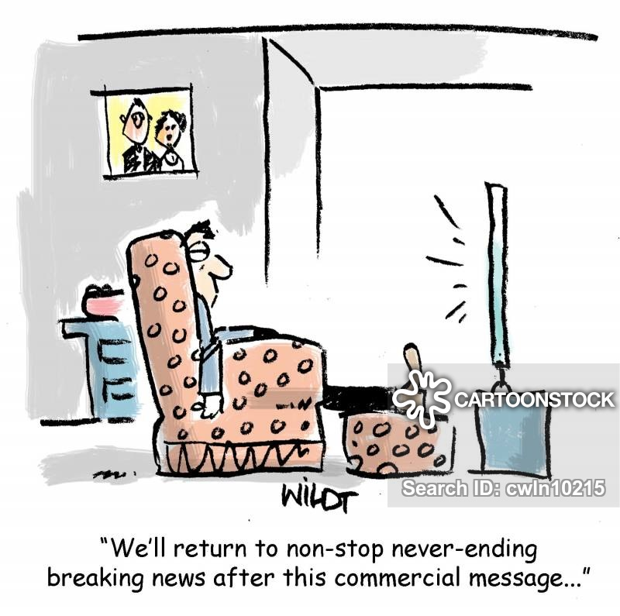
Question:
What boundaries have you been attempting to maintain when it comes to reading/watching the news? (i.e. choice of news sources, time limitations)?

Slide 3
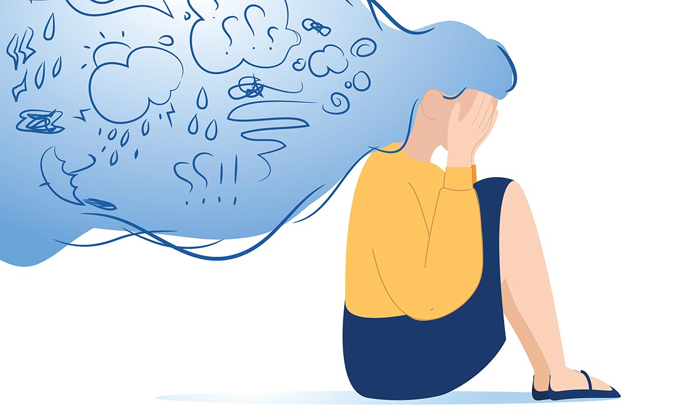
Question:
What do you notice feeling (physically, emotionally) after hearing or seeing news?

Slide 4
Question:
What boundaries have you been attempting to maintain regarding conversations about politics and current events/issues with others?

Slide 5
Question:
What coping strategies have you been using lately? Do you feel they’re healthy? Effective? Why/why not?

Slide 6
Question
What activities help you feel positive, joyful and empowered?
.

Slide 7
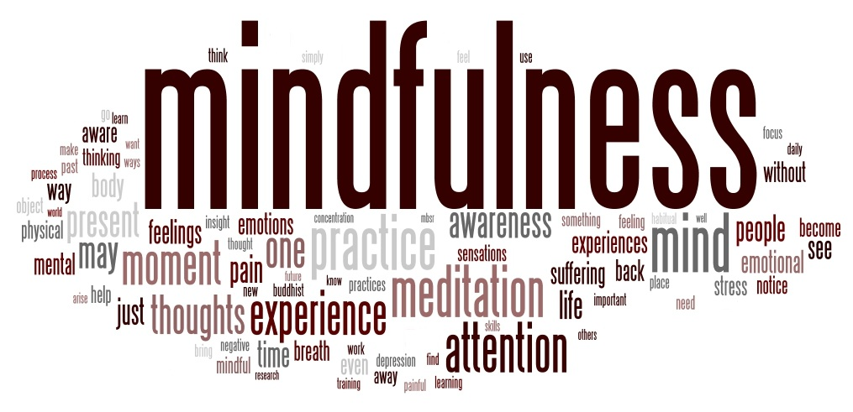
Welcome to PowerPoint
5 tips for a simpler way to work

Slide 8
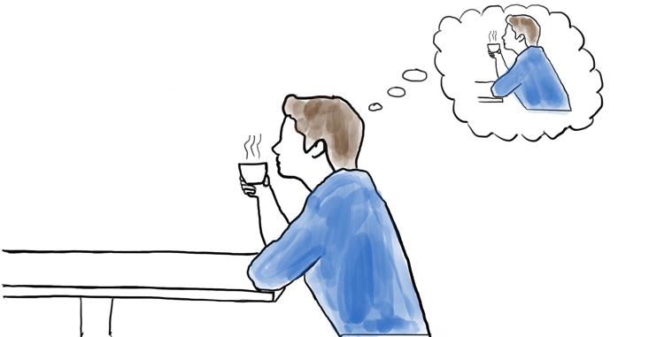
Mindfulness
What is it Mindfulness?
The practice of maintaining a nonjudgmental state of heightened or complete awareness of one's thoughts, emotions, or experiences on a moment-to-moment basis (https://www.merriam-webster.com/dictionary/mindfulness). Mindfulness can be practiced anywhere, anytime.

Slide 9
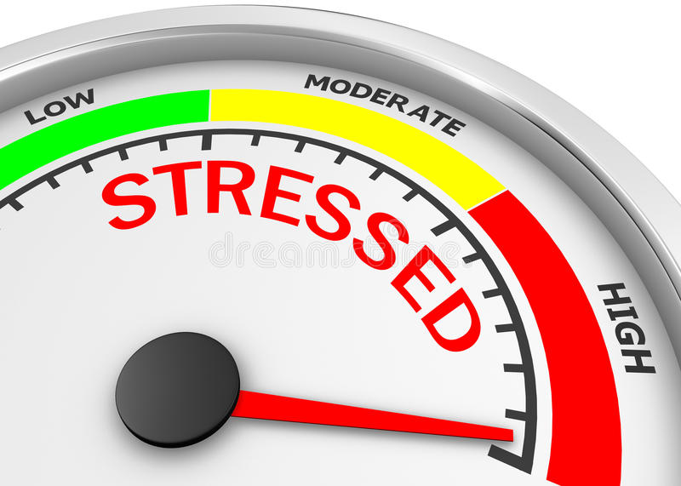
Benefits of Mindfulness
Decreased Stress, anxiety and depression!

Slide 10
People who regularly engage in mindfulness practices are more likely to experience…
Higher brain functioning
Increased immune function
Lowered blood pressure
Lowered heart rate
Increased awareness
Increased attention and focus
Increased clarity in thinking and perception
Increased ability to regulate emotions
Lowered anxiety levels
Increased calmness and internal stillness
Increased feelings of connectedness with others
https://positivepsychology.com/benefits-of-mindfulness/

Slide 11
This sounds great, but how do I do it?
Mindful breathing, such as the 4-7-8 technique*, focused or “belly” breathing.
Mindful eating, watching, touching, smelling, hearing
Mindful Exercise (i.e. yoga, walking, running)
Guided mediation*
(*See “resources” slide for more information)

Slide 12
I’ve tried to be more mindful and I wasn’t very good at it. Does that mean I just can’t do it?
Mindfulness is a PRACTICE! The more you do it, the better you get at it.
People can experience a greater feeling of calmness and relaxation even after only a few minutes of engaging in a mindfulness practice.
Again, people who regularly engage in mindfulness practices are generally less anxious, less stressed and less depressed.

Slide 13
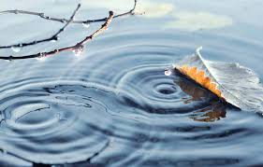
Anyone Can Be Mindful
Mindfulness is not about perfection. Mindfulness is about noticing. Notice your thoughts and think of them as leaves floating on a stream. Let them flow away from you and bring your focus back to your breath.

Slide 14
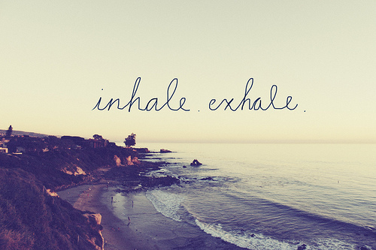
Your Breath
is always with you
is your anchor to the present
is something you can control

Slide 15
Helpful (and free!) resources:
Guided Meditation:
https://www.youtube.com/watch?v=rUwA13_T5Ew&feature=youtu.be
https://self-compassion.org/guided-self-compassion-meditations-mp3-2/
https://www.youtube.com/watch?v=W19PdslW7iw&vl=en
https://www.mindful.org/a-15-minute-meditation-for-patience-and-resolve/
4-7-8 Breathing Instructions:
https://www.cordem.org/globalassets/files/academic-assembly/2017-aa/handouts/day-three/biofeedback-exercises-for-stress-2---fernances-j.pdf

Slide 16
Literature:
Practicing Mindfulness by Matthew Sockolov
The Power of Now by Eckhart Tolle
Mindfulness: An Eight-Week Plan for Finding Peace in a Frantic World by Mark Williams and Denny Penman

