Slide 1
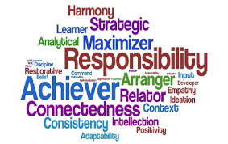
Understanding
Strengths and Talents!
Faculty and Staff Mentor Training
West Chester University
November, 2014

Slide 2
Jacqueline Hodes, Asst. Professor
  Department of Counselor Education
  Program Coordinator, Higher Education Counseling/Student Affairs
  Learner, Strategic, Achiever, Input, Relator
  Lance Collier, Resident Director
  Residence Life and Housing
  Relator, Maximizer, Positivity, Input, Strategic

Slide 3
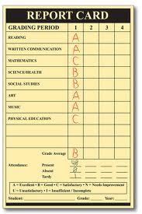
What would happen if we studied what was right with people versus what’s wrong with people? ~Dr. Don Clifton

Slide 4
What is StrengthFinders®?
Talent Identification
Measures the presence of talent in 34 general areas or “themes”
Identifies your top 5 talent themes; the presence of talent in you!
Top 5 strengths—path of least resistance

Slide 5
TALENT
(a natural way of thinking, feeling, behaving)
X
INVESTMENT
(time spent practicing and building your talent base)
=
STRENGTH
(the ability to provide a near perfect performance)

Slide 6
You cannot be anything you want to be –
but you can be a lot more of who you already are.
Tom Rath
StrengthsFinder 2.0®

Slide 7

By The Numbers…..
Notes:
400 Talent Themes = 34 Strengths
33,390,720 possible combinations of the top 5 strengths
1 in 278,256 people share you top 5 themes
1 in 3 have achiever, learner, relator or strategic in their top 5
1 in 20 have discipline, self-assurance, significance, or command in their top 5
TK

Slide 8


SO WHAT????
Notes:
People who focus on their strengths are 3x more likely to report having an excellent quality of life
People who focus on their strengths are 6x more likely to report being engaged in their job.

Slide 9

Understanding Your Strengths

Slide 10
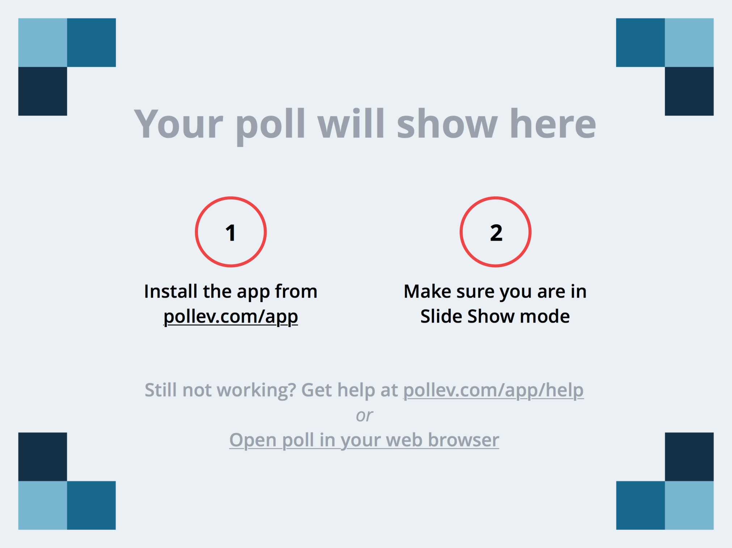
Notes:
What is your number 1 strength?
https://www.polleverywhere.com/free_text_polls/zkB91nEdlMXo78m

Slide 11
THE STRENGTHS PROCESS
Awareness
Development
Application
Notes:
Awareness: Becoming aware of and learning about your natural talents
Development: The work you do to develop your talents so that their potential is maximized and they become strengths
Application:applying your strengths to desired outcomes.

Slide 12
What Would Happen……
Fully recognize their talents and build on them to develop their strengths
Develop their strengths through daily practice
Apply their strengths to their achievement tasks and more
Notes:
What would happen if we helped students to:

Slide 13
Gallup Student Success Model
Notes:
The more you know, develop and apply your strengths, the more engaged and hopeful you will be. The more hopeful and engaged you are, the greater your well-being and academic success.
College students who learned their strengths and how to use them showed increased self-confidence, direction, hope, and altruism. (Hodges & Clifton, 2002).
Students whose strengths and talents were identified perceived they had more control of their academic futures than students who did not know their strengths or talents (Louis)
Strengths are important because: Reciprocity: As you focus on your unique talents, you will begin to see the talents of others
A Different Perspective: Behaviors that irritated you in the past you can see from a different angle; may help you understand and resolve conflict.

Slide 14
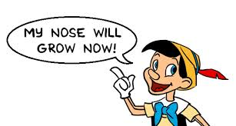
The Paradox of Strengths
Notes:
* We can take them for granted
* We do not see them as being particularly great or
distinctive
* We often are not able to see our own strengths
* Our strengths can also get us in trouble
* We can use strengths to overcome our weaknesses

Slide 15

A Strengths-Based Conversation
Notes:
Understand your own strengths
Become familiar with the other strengths
*videos
Have your mentee send you their top five strengths before meeting
Use the handout to guide your discussion

Slide 16
READ MORE……
http://www.strengthsquest.com/content/141365/Resources.aspx

