Slide 1
Talking With College Students: Conversations That Work
Brief Alcohol Screening and Intervention
for College Students
BASICS Training
West Chester University
Fall 2016
Mary Jane Rogan, CRNP
Coordinator of AOD Programs
mrogan@wcupa.edu
Do not reproduce or distribute.
Slides may be used for personal reference.
Notes:
Intro
My background
Slides: many sources
MINDFUL INTENTION

Slide 2

Video- Modern Family

Slide 3

Motivational Interviewing
Inter-view:
looking at something together
A particular style of conversation
about change
Notes:
Define INTER-VIEW:
Beginning level definition of MI
Style sets us as allies
MINDFUL INTENTION

Slide 4
Practice: MINDFULNESS
Mindfully Present
Notes:
Mindfulness: newer element, eases into the person-centered focus and minimizes stress for clinician
Aligns with my training on Compassionate conversations
WHEN IN YOUR ROUTINE WOULD THIS BE FEASIBLE?
Do with handwashing….opening door

Slide 5
TODAY’S AGENDA
Brief Interventions and BASICS : What are they?
Change Theory (Trans-theoretical Model)
Motivational Interviewing (MI): Style and micro-skills
Developing your own tool-kit/script.
Practice components of BASICS and MI
Evaluation
Notes:
Emphasis on MI
Once understood, should be able to use to talk about anything
Will practice components. Putting it all together will take observations, feedback, peer review

Slide 6
Objectives
Identify core components of each BASICS session
Apply basic MI principles of R-U-L-E in conversations
Begin to use OARS micro-skills in practice sessions
Identify “what next” with MI/BASICS training
Self-monitor MI style over the next few weeks.

Slide 7
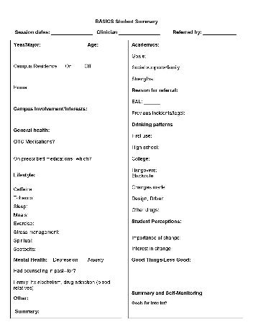
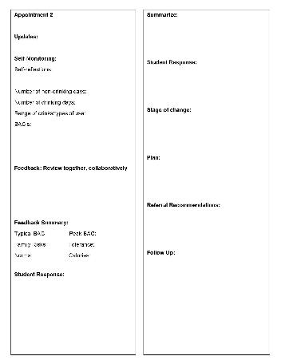

Slide 8
“I have already been trained in MI/BASICS!”
Most trained clinicians do not use MI appropriately, effectively or consistently after one day of training
MI is more difficult than clinicians expect
Clinician self-report of MI/EBT is overly favorable…believe they are using MI when they are not
High confidence. Low competence.
Need for ongoing supervision/audio recordings and coding.
Notes:
EBT: EVIDENCE BASED TREATMENTS
Like learning a musical instrument
-NEED STRUCTURED SUPERVISION AND FEEDBACK not simply self-report

Slide 9
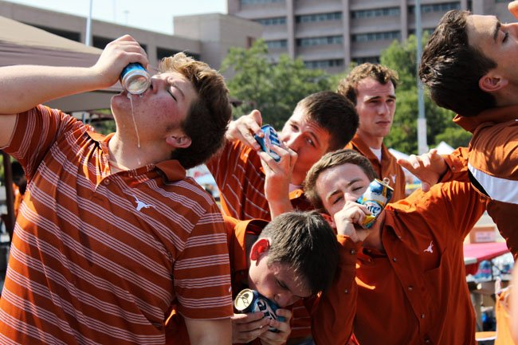
College Alcohol Use: Consequences
West Chester Riots
Images college parties

Slide 10
HEAVY DRINKING IS DANGEROUS TO STUDENTS
1825 deaths from alcohol-related causes
599,000 unintended injuries
696,000 physical assaults
97,000 sexual assaults (ages 18-24)
2.1 million students drive a car while impaired
400,000 unprotected sexual encounters
100,000 cases where students report not knowing whether they consented to a sexual encounter
Hingson et al., NIAAA 2009
Notes:
Monitoring the Future: 30 day Alcohol use rate among 12th graders:
2015: 38%
2000: 48%
Marijuana use: 12 month use--38% among 12th graders http://www.monitoringthefuture.org/data/15data/15drfig3.pdf
CORE 2013
81% annual prevalence
69% monthly prevalence
32% annual marij use
19% 30 day marij use 15% with NCHA

Slide 11
What Isn’t Said
Not every student drinks heavily
Not all heavy drinkers drink frequently—19% drink heavily and frequently.
Heavy drinking in college, for the most part, does not lead to chronic problems later in life.
Notes:
Originally noted 1/3 do not drink at all…..
20% drink 3 or more times a week (CORE 2013)
43% “binge” in past 2 weeks
40% no alcohol in past 30 days

Slide 12
ACADEMICS
25% report academic consequences: missing class, falling behind, doing poorly on exam or papers and receiving lower grades
32% report public misconduct in the past year
Campus data: critical for talking with administration
CORE data 2013
NCHA 2015
Learn More
Notes:
CORE
32% public misconduct in past year
22% “serious personal problem” (suicidal, hurt, injured sexual assault)
29% argument or fight
20 % performed poorly on test or project
26% missed class
3% self report that ETOH interfered with academics (NCHA fall 2015 19,861 respondents)
NCHA (19,800 students 2015 fall)
3% self report alcohol impact on academics
40% no alcohol in past 30 days
30% BAL <.08
22.5% <.10

Slide 13

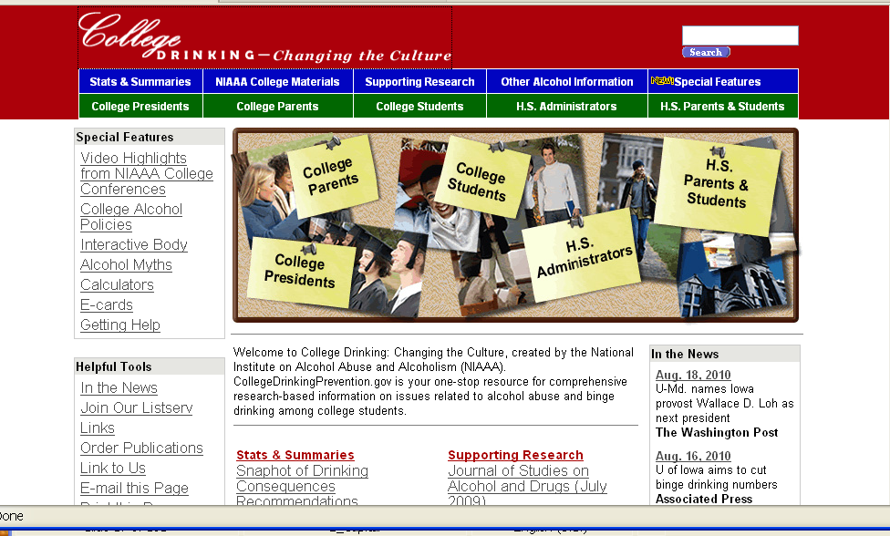
Notes:
Meta analysis of data related to college alcohol use and interventions. Resulted in comprehensive report and recommendations in 2002

Slide 14
This Does NOT Work
Just say "no”
Educational programs not linked to other methods
Inconsistent policies and procedures
Required courses

Slide 15
Tiered Recommendations
Tier 1: Evidence of Effectiveness Among College Students
BASICS (Strategy: Combining cognitive-behavioral skills with norms clarification and motivational enhancement interventions.
Notes:
CBT: client centered, directive, structured, uses socratic method,
based on cognitions, assumptions, beliefs, and behaviors, with the aim of influencing negative emotions that relate to inaccurate appraisal of events.
Based on idea that Thoughts cause our feelings and behaviors, not external things, like people, situations,
and events. The
Follow-up assessments over a 2-year period showed significant reductions in both drinking rates and harmful consequences, favoring students receiving the intervention.

Slide 16
Continuum of risk and change
HIGH RISK
MODERATE RISK
LOW RISK

Slide 17
How Does Behavior Change?
Behavior A Behavior B
Notes:
What do we typically say to a student who…..?

Slide 18
Stages of Change
Preparation
Contemplation
Action
Relapse
Pre-contemplation
Maintenance
Notes:
Original observations with tobacco users. Non compliant replaced with Relapse

Slide 19
PRACTICE Identifying Stage of Change
“I am going to make some changes-I need to start acting like an adult”
…“I will do it when I graduate”
“There is only a certain time of life when partying like this is OK”
“My parents are going to pull me out if my grades do not improve. I do not want to have to leave here”
“I hate not being able to remember…and being the guy they laugh at the next day”

Slide 20

WHAT MAKES PEOPLE CHANGE?
Most people change without formal
assistance
For most, it’s a gradual process.
“Stages of change” describe how people progress in thinking about change.

Slide 21
CHALLENGES TO CHANGE?
What are the challenges to working with adolescents and changing their lifestyle behaviors?

Slide 22
The Adolescent Brain
  Adolescent brain is “half-baked”--Higher-order regions mature after lower-order regions**
  Lateral temporal lobes mature last
  Last to mature area includes functions for integrating information.
  MIT Young Adult Development Project
Notes:
reflective judgment, moral development, or cognitive
structural development.
Functions such as self-control, judgment, emotions, abstract reasoning, estimation of consequences and organization occur between puberty and adulthood (13 to 25)
Accounts for poor decision-making, recklessness, and emotional outbursts.
http://hrweb.mit.edu/worklife/youngadult/brain.html

Slide 23
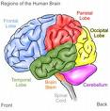
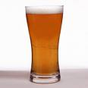
+
Changes in the frontal lobes and other areas are influenced by experience
Decisions that kids make can have a big impact on how their own brains develop!
Healthy choices = healthy brains and
garbage in = garbage out.
Tobacco and alcohol: unique risk for teens
NPR Interview with Dr. Aaron White

Slide 24
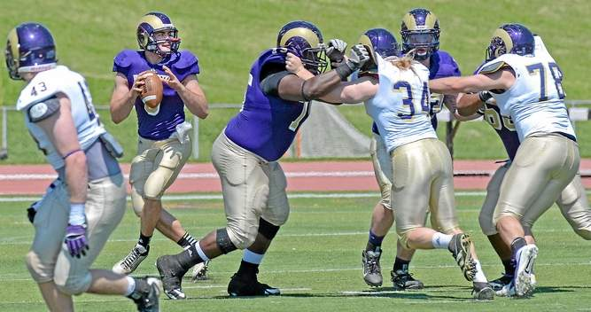
Notes:
How does that happen?
Who do you avoid when you are in a crunch ?
Who do you go to? Exampled of best teacher. What made them approachable?

Slide 25

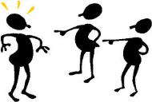
Starts with traps
Question-answer trap
Taking sides
Expert trap
Labeling trap
Premature-focus trap
Blaming trap

Slide 26
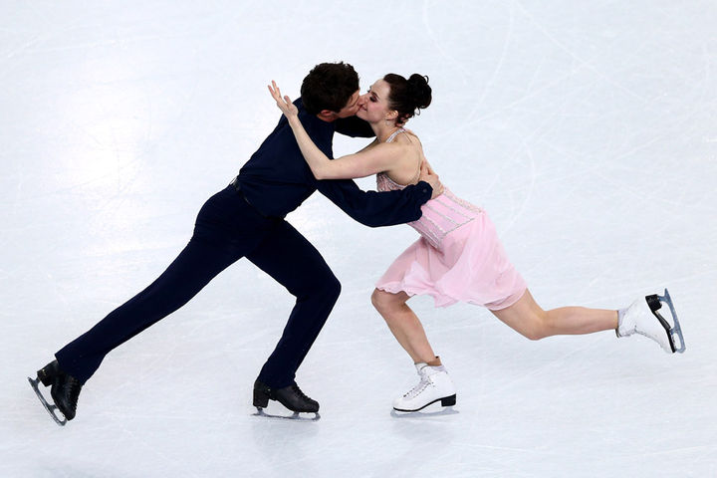
Notes:
Mutual, no surprises

Slide 27
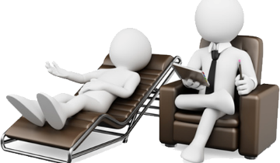
Miller & Rollnick
Research on effective therapists

Slide 28
Simply…..
Inter-personal skills are more important than professional training or experience for positive outcomes
Establishing rapport is key
Respect
Affirmation
Empathy
*(MI Spirit will detail this)
Notes:
Research: primary care settings, conversation interrupted after 30 seconds (Prochaska, July 2004)
Match: ideas, mood, body language
Counseling Skills: Reflective listening
Relationship most important factor in counseling outcomes.
Techniques grease the wheels.
Early guiding principles and importance of empathy and having client rather than counselor voice arguments for change.

Slide 29
MI: Early Research-
Unexplained outcomes –brief therapy for addiction
Therapist empathy during treatment predicted 2/3 of the variance in client drinking 6 months later and 50% at 12 and 24 months.
Early guiding principles and importance of empathy and having client rather than counselor voice arguments for change.
Notes:
Bill Miller---
Unexplained outcomes with brief psychotherapy for addictions 1980
Miller trained 9 counselors in techniques of behavioral self control and client centered accurate empathy.
Observed by three supervisors and ranked
Later research showed same effect for other behaviors
Kirkley: An important first step in the group brief intervention is to
develop rapport with the students and seek to dissolve any resistance
that students may harbor about addressing alcohol use. The
facilitators give the students nothing to resist and simply start the
process by “coming along beside them.” Facilitators communicate
to students that they are not judging students’ alcohol use and have
no intention of telling students what decisions they should make.
The students’ autonomy and self-efficacy are reinforced through
acknowledging awareness that the students have reached a stage of
independence and budding adulthood and are thus responsible for
making many of their own decisions.

Slide 30

Change talk and resistance (sustain talk)
Highly responsive to counselor style
Low empathy/confrontation
= More resistance
= more drinking
*Style of conversations with conduct officer
is critical
Notes:
Palmer research “intervention defensiveness” with mandated students.
http://www.ncbi.nlm.nih.gov/pubmed/20817410
Resistance and "denial" are seen not as client traits, but as feedback regarding therapist behaviour. Client resistance is often a signal that the counsellor is assuming greater readiness to change than is the case, and it is a cue that the therapist needs to modify motivational strategies.
KILMER RESEARCH DEFENSIVENESS with mandate referrals. Caution with conduct officers….defensiveness -----increased drinking

Slide 31
Stages of Change + MI
=
Trans-theoretical model
People do not enter the conversation in a state of readiness to change….
Straightforward advice giving is of limited value and lead to …non-constructive dialogue
Arguments for change are met with resistance

Slide 32
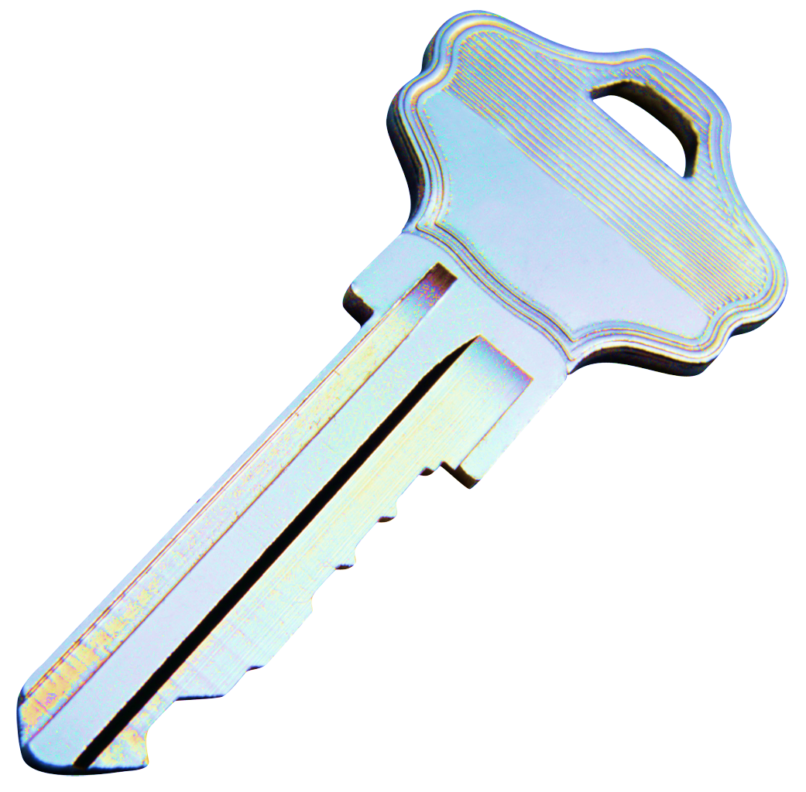
PHASING INTERVENTIONS
“SAYING the right thing at the right time
IN THE RIGHT WAY”
People respond to brief interventions according to their stage of change
How we talk about it makes a difference
Strategies that are “out-of-phase” increase resistance leading him or her to move back to an earlier stage of change
Notes:
32
Speaking Points:
The stages-of-change model provides motivational interviewing with a conceptual road map for assessing a student’s present position and his or her course.
Effective motivational enhancement strategies assist movement from one stage of change to the next.
Motivational Interviewing meets the client wherever he or she is with stage-appropriate strategies.
Non-compliant is not a diagnosis! It is a mismatch

Slide 33
CHANGE
“People are usually more convinced by reasons they discovered themselves than by those found by others.”
Blaise Pascal

Slide 34
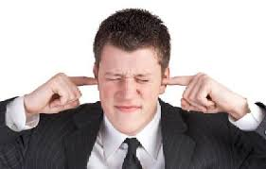
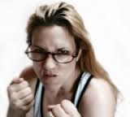
Resistance
A reflection on the facilitator style

Slide 35

Motivational Interviewing
Meet the student where they are
Spirit
Principles
Skills
Notes:
MI_about arranging a conversation so people talk themselves into change, based on their own values and interests

Slide 36
Spirit of MI:
A way of being “with”
PARTNERSHIP NOT CONFRONTATION
EVOCATION NOT IMPOSITION
ACCEPTANCE NOT AUTHORITATIVE
COMPASSION NOT JUDGMENT
Notes:
MIND-SET AND HEART-SET (MILLER AND ROLLNICK)
A way of being WITH the student
Partnership: MI done for and with the student, who does most of the talking. Focus on student goals and aspirations
EVOCATION: Knowledge does not equal behavior change. People have own internal debate. Facilitator guides to uncover
Acceptance: worth, empathy, respect autonomy. ROGERS: Positive Regard
Compassion: priority to student needs
Client-centered therapy operates according to three basic principles that reflect the attitude of the therapist to the client:
The therapist is congruent with the client.
The therapist provides the client with unconditional positive regard.
The therapist shows empathetic understanding to the client.

Slide 37
Principles: Person-centered
We do not need to make change happen.
Cannot make it happen.
Motivation is not installed, it is evoked.
Change is fundamentally self change. Services/conversation facilitate natural process (or not).
Facilitator cannot revoke peoples choice about own behavior. It is not a change goal until the student says so.
Notes:
Person Centered counseling style: Carl Rogers

Slide 38

R-U-L-E
Resist the RIGHTING REFLEX
Understand your client motivations
Listen
Empower
Notes:
RIGHTING REFLEX: Righting Reflex: desire to fix what seems wrong with others
Helpers want to help. Persuasion often has a paradoxical effect—human tendency to resist persuasion. SO WE TURN UP THE VOLUME
UNDERSTAND: their concerns, priorities, values, motivations
LISTEN: Keep quiet long enough to hear replies. PROCHASKA: Interruptions after 30 seconds
EMPOWER: energize/explore own solutions and possibilities. Affirmations

Slide 39

A pragmatic MI definition
(Why would I use it?):
A person-­‐centered conversation/relationship style for addressing the common problem of ambivalence about change.
Notes:
http://www.motiverandesamtal.org/ICMI/What%20Makes%20It%20MI
Who is thinking about making a change?

Slide 40
Doing it RIGHT
You are speaking slowly,
Student talking more than you,
You are listening more than talking,
Student is working, not passive, asks for information

Slide 41
BASICS Development
Designed by Alan Marlatt and researchers at the University of Washington
Provide colleges and universities with a flexible, affordable, user friendly, and effective individual alcohol abuse prevention program to reduce hazardous drinking and its harmful effects in college students
Predecessor was ASTP

Slide 42

BASICS RESEARCH Summary
Significant reductions in frequency and quantity of alcohol use.

Slide 43
BASICS Characteristics
Tailored to the student’s unique risk factors, life circumstances, and severity of alcohol problems
Can be delivered by caregivers with a wide range of clinical experience
Designed to reduce drinking rates and associated
alcohol-related problems
Stepped Care Approach

Slide 44
Ingredients of Brief Interventions (MET)
F-R-A-M-E-S
Feedback: behavior and consequences
Responsibility: for change is students’
Advice: regarding health/safety/changes
Menu: of options
Empathetic Style: MI, genuine interest and concern
Self-efficacy: supporting confidence/competence

Slide 45
Brief Interventions Goals
The primary goals of brief interventions are to:
  1. Reduce alcohol use to low-risk levels (harm reduction)
  2. Reduce alcohol-related harm to self and others
  3. Encourage abstinence in persons who are alcohol-dependent
Notes:
TRAINER:
Read this slide.
Speaking Points:
There is a growing body of evidence that brief interventions also are effective in reducing drinking when delivered by mail, via computer, and online, but with little effect on alcohol-related problems.

Slide 46

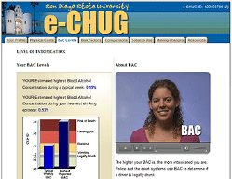
Research
Project TrEAT
eecheckup:
Notes:
Project TrEAT (Trial for Early Alcohol Treatment, a large-scale clinical trial conducted in primary care practices), involves two brief face-to-face sessions scheduled 1 month apart, with a followup telephone call 2 weeks after each session. Patients participating in this intervention reported reduced alcohol use, fewer days of hospitalization, and fewer emergency department visits compared with control-group patients. This intervention may be especially useful with patients who are experiencing alcohol-related problems but who do not necessarily need to be referred to an addiction treatment specialist and may not need to stop drinking completely. This intervention was found to be effective up to 4 years later (13).
Primary Care: 20% drink above recommendations
Up to 31 percent of all patients who are treated in an ED and as many as 50 percent of severely injured trauma patients (i.e., patients who require hospital admission, usually to an intensive care unit) test positive when screened for alcohol problems (22).

Slide 47
References: SBIRT
The College Drinking Prevention Curriculum for Health Care Providers
National Institute of Alcoholism and Alcohol Abuse
Alcohol Screening and Brief Interventions for Trauma Patients
American College of Surgeons Committee on Trauma
Effectiveness of Brief Alcohol Interventions in Primary Care
American Academy of Family Practice

Slide 48
BASICS Structure
Two 50-minute sessions
1. Debrief incident, quantity/frequency of use, consequences of use, interest/importance of change, ID students with possible addiction or health/mental health need
2. Review drink monitoring and feedback.
Identify/develop discrepancies, assess importance/interest in change, advice regarding use in relation to health/safety in order to minimize risks.
Drink monitoring
Feedback tool

Slide 49
Focus on Alcohol--
Notes:
Tobacco Cessation
Alcohol/drug use
Exercise
Stress management
Sleep
Nutritious eating
Medication use
Magic wand: you could change 1-2 lifestyles for your students. Which ones?
HOW OFTEN FRUSTRATED: student KNOWS AND DOES NOT DO?

Slide 50
BASICS Live

Slide 51
BASICS Overview
Session I Gather Information about student behaviors*
Clarify needed facts (BAC, drink sizes, etc)
Identify Stage of Change
Decisional balance (if indicated): good/not so good things
Identify acute need for referral: depression, dependence.
Assign: drink monitoring and survey to generate feedback.
Session 2
Individual Feedback Session/build motivation/plan
Referral if needed

Slide 52
First Few Minutes: Rapport
Assume defensiveness
Greet, thank for coming
Confidentiality (including Title IX)
RAPPORT

Slide 53
Session One
Establish rapport*
Debrief referral reason
Ask an open-ended question.
  “Tell me a little bit about your drinking.”
  “From your perspective, what happened to bring you here?”
Typical drinking pattern, and atypical or episodic for past 30 days
Symptoms of dependence
History of conduct disorder
History of alcohol and/or MH problems
Family history of ETOH other use problems/MH

Slide 54
Talking about (possibility of) Change
Look for signs of readiness.
Test the waters.
  “What are you thinking about this?”
  “Where does this leave you in terms of your drinking?”
Leave the responsibility for change with the student.

Slide 55
Change Talk vs Sustain Talk
CHANGE: positives of making changes, downsides of no change
SUSTAIN: positives of no change.

Slide 56
Personal Took-Kit

Slide 57
Setting the Tone: Session 1
Peter is a 1st year student who was sent to BASICS after being cited for underage alcohol use in early September.
You are meeting him three weeks later. He looks nervous and shifts around in his chair a lot.

Slide 58
Establishing Rapport (Pg. 1)
How can you set the tone?
Script two-three open questions/statements that could be used to establish rapport with Peter.

Slide 59

Core MI Strategies
Four Early Strategies
OARS
  Open-Ended Questions
  Affirming
  Reflective Listening
  Summarizing
OARS
Elicit Positive “Change Talk”
Notes:
Primary care settings: conversation interrupted after 30 seconds (Prochaska, July 2004 talk Natl Wellness Institute)

Slide 60
OARS
Strategic use to identify where student is
Foster “change talk”: discrepancy between where they are and where they want to be (AMBIVALENCE)

Slide 61
Open ended questions
How….
Tell me about…
What..
When….
  NOT Why
  NOT leading questions
Notes:
Draws out concerns, prevents simple confirmation

Slide 62
Ask Open-Ended Questions
Encourage drawing out of concerns
Keeps student talking
Prevent simply confirming the interviewer.
Facilitates analytical thinking
Adapted from Talking with College Students about Alcohol: Motivational Strategies for Reducing Abuse by Scott T. Walters and John S. Baer.
© 2006 The Guilford Press. Permission to display this slide is granted to purchasers of this book for personal use only. All rights reserved.
Notes:
62
Avoid Why questions:

Slide 63
Open-Ended
“Did you stop drinking since the incident?”
“Were your parents upset about you getting in trouble?”
“Isn’t college supposed to be about learning, not partying?”
“Didn’t you hear what was said during orientation about the conduct policies?”
“What kind of problems do you have with studying?”

Slide 64
PRACTICE:
Scripting OARS Pg. 2
General health/medications
Nutrition
Sleep
Exercise/activity
Stress levels
Social supports
Mental health
Academics
Family history of addiction
Strengths

Slide 65
REFLECTIVE LISTENING
Listen carefully : Especially complaints, criticisms, objections.
Ask yourself: What is the meaning
Reflect your understanding of the meaning back to the student, with acceptance and empathy.
Check the accuracy of your understanding
Notes:
65
Do not use “I hear you saying” or “It sounds like”

Slide 66
Listen Reflectively
To UNDERSTAND, UNDERSCORE, DIFFUSE hostile emotions.
Initiate conversation with an open question and reflect the response.
Listen and reflect back what they said, verbally and nonverbally.
Try to use more reflections than questions.
Adapted from Talking with College Students about Alcohol: Motivational Strategies for Reducing Abuse by Scott T. Walters and John S. Baer.
© 2006 The Guilford Press. Permission to display this slide is granted to purchasers of this book for personal use only. All rights reserved.

Slide 67
Reflections say-
I am listening
I am interested
Tell me more
No judgment

Slide 68
Levels of Reflection
Sustained Reflective Listening
  Repeating – Repeats what patient says
  Rephrasing – Begins to add new meaning
  Paraphrasing – Extends what patient is saying
  Reflecting Feeling – Reflects a deeper level/emotions
Begin with simpler reflections and delve into deeper reflections as understanding increases.
Notes:
There are different levels of reflection, and it’s important to start off with the simplest form, as you are getting to know the person
As you learn more information, you can use higher levels such as rephrasing and paraphrasing to summarize and enhance the conversation.
The deepest level of reflection is reflecting feeling, which often lies underneath what the patient is saying. Reflecting feeling helps to deepen the provider-patient relationship and serves to help patients connect with what’s most important to them..

Slide 69
Levels of Reflection:
“I probably should quit smoking”
Repeat
Rephrase
Paraphrase
Reflect Feeling
Notes:
“I probably should quit smoking”
YOU THINK YOU SHOULD QUIT
YOU SEE POSITIVES TO QUITTING
SMOKING HELPS YOU MANAGE STRESS AND YOU ALSO KNOW IT WOULD BE GOOD FOR YOU TO QUIT
YOU DO NOT WANT TO BE OR SEE YOURSELF AS A PERSON WHO RELIES ON TOBACCO/marijuana

Slide 70
Video-Puppet Master

Slide 71
Reflections
“My stress levels are very high when I have a lot of school work and during exam weeks.”
“I felt better in the summer when I was running 5 times a week. Now I feel sluggish”
“I try to work out at least 3 times a week”
“I probably don’t eat as well as I should”
“I probably wear my seatbelt about 85% of the time.”

Slide 72
Reflections …..open ended
“I don’t really smoke”
“I am trying to wear my seatbelt, but I figure I am a safe driver”.
“I had a low spell in high school and my mom sent me to counseling”.

Slide 73
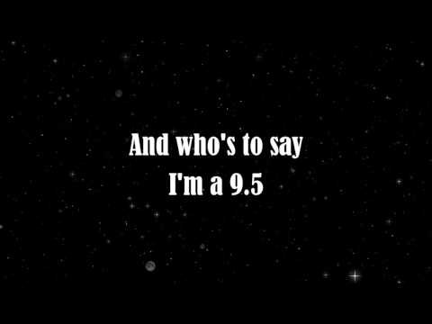
PRACTICE Pageant Material

Slide 74
Summarize
Are larger reflections that underscore several comments .
Indicate listening
Point out a theme
Encourage further elaboration
Good way to transition from one topic to another
Notes:
74

Slide 75
Summarize
Feed back information to let student hear what they said and your understanding.
  “Let me pull together what you’ve said and you can tell me if I’ve missed anything.”
  “What I get so far is that . . .”
  “You said . . .” “You thought that . . .”
  “How accurate was that summary? What else?”
  “We’ve talked about . . .”
Adapted from Talking with College Students about Alcohol: Motivational Strategies for Reducing Abuse by Scott T. Walters and John S. Baer.
© 2006 The Guilford Press. Permission to display this slide is granted to purchasers of this book for personal use only. All rights reserved.
Notes:
75

Slide 76

Partner Practice: Lifestyle
  SPEAKER:
  Use real responses if comfortable. Do not overshare ☺
  FACILITATOR:
  Open ended questions from your toolkit
  Reflect on positives and possible areas of ambivalence
  Summarize at the end

Slide 77
Summarize and Transition
Craft a transition to shift from discussing academics and lifestyle to the reason for the referral

Slide 78
Reason for referral
Start with positives/strengths
Debrief referral reason-student view of situation
Typical drinking pattern, and atypical or episodic for past 30 days
Symptoms of dependence
Changes since incident
Importance of change

Slide 79

Video: Debrief of incident
Jonathan 7 minutes

Slide 80
Simple Reflections
“I drank most weekends in high school. I am from a small town, and there is nothing else to do.”
“I never drank in high school. I was on the soccer team. Once I came to college it seemed to be time to try it out.”
I hardly drank in high school
I only drink on weekends

Slide 81
Reflections/Affirmations
“I do not drink on Thursdays because I have a class at 9AM on Fridays”.
“I got arrested last weekend, and my parents wanted me to talk with you. I have not heard from judicial affairs yet”.
“I used to have blackouts at least twice a month, but I have not had one in a few months. I have started to pace myself

Slide 82
I spent time in Iraq and I do not understand why I have to be in trouble with the school because I got arrested for being drunk”. (diffuse hostile emotion)
“Everyone drinks like I do. I am not going to stop partying”. (Try a “rolling with resistance” response to this)
“Those cops are always sneaking up on their bikes. Don’t they have anything more serious to deal with”? (diffuse hostile emotion)

Slide 83
Decisional balance
Good/Not-So-Good Things
Good Things/things you like?
Less good things/things you don’t like?

Slide 84
Video: Decisional Balance
Scott Walters: Eric 3:50

Slide 85
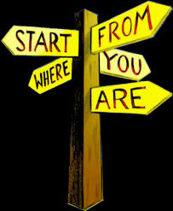
Readiness to Change
Where is the student ?

Slide 86
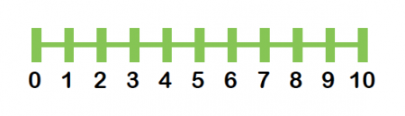
Change talk
Scaling: importance, interest, readiness
Notes:
How important is it to….
What makes it----- and not ----
READINESS: What would have to happen to take the 3 to a 5 or 6?

Slide 87
Video: Change Ruler
Scott Walters: Eric then Travis

Slide 88
Talking about Change
Look for signs of readiness.
Test the waters.
  “What are you thinking you’d like to do about this?”
  “Where does this leave you in terms of your drinking?”
Leave the responsibility for change with the student.

Slide 89
Reflections/Change Talk
Double Sided Reflection: highlights ambivalence
“I like to be with my friends, but I don’t like having blackouts. I hear about things the next day from my friends.” (KEY: USE THE WORD “AND” TO JOIN THESE REFLECTIONS).

Slide 90
Preparatory Change Talk
- use OARS to explore
Desire (I want to change)
Ability (I can change)
Reason (It’s important to change)
Need (I should change)
Self Efficacy: confidence
OARS

Slide 91
Change or Sustain?
I might get better grades if I smoked less
I did well with classes last fall even with smoking 3 times a week.
I only smoke 3-4 times a week. It helps me relax and forget things for a while.
I don’t like being that guy who is stumbling

Slide 92
Pre-contemplative Traits
“I don’t have any problems with _________”
Reluctant
Resigned
Rationalizing
Rebellious
Reveling
OARS to increase awareness of the ways in which alcohol use or other behavior may be hazardous and/or problematic. OR what could be positive about a change.

Slide 93
Contemplative Traits--Maybe (more aware of benefits and acutely aware of costs)
Increased problem recognition
More distressed or troubled about drinking
Ambivalent about changing drinking habits
Weighing the Pros and Cons of change
Guide to looking at change vs no change.
“If you did decide to make one change, what would it be?”

Slide 94
Preparation Traits (Benefits>Costs…..and figuring out how)
Increased commitment
Ready to make choices
Sharing plans for change
Change becomes a priority
OARS to guide in practical problem solving

Slide 95
Action Stage Traits:
(it is working and I am sticking with it).
Change strategies are chosen and pursued
Active modification of behavior, thoughts, feelings, and the environment
Treatment and/or self-help
Persistence and completion or drop out?
Affirmations
OARS : coping skills

Slide 96
Maintenance Stage Responses
Attempting to sustain new attitudes and habits
Working to prevent relapse
Watching out for risky people, places, things, thoughts and feelings
Taking personal responsibility and credit for changing
Moving toward a more balanced lifestyle
Affirmations
OARS: relapse prevention

Slide 97
Strategies for Motivating College Students in Relapse Stage
OARS
Look at stage before relapse: what was making it work?
Debrief the relapse episode(s) and identify its predictable and controllable causes
Interest/readiness to renew the processes of change by starting a new cycle.

Slide 98
Assess for Alcohol Dependence
Loss of control
Preoccupation with use
Continued use despite negative consequences
Tolerance or morning withdrawal
Making rules to control drinking
Compulsive use
Notes:
http://pubs.niaaa.nih.gov/publications/dsmfactsheet/dsmfact.pdf

Slide 99
The Last Few Minutes
Offer a brief summary.
Affirm desire or plans to change.
Self Monitoring: End on a positive note!
  “Thanks for talking with me. You came up with a number of really good ideas.”
  “It seems to you that things are okay. I do have some concerns about . . .”
  “Thanks for thinking about this.
  Referral, if indicated
  Recommendation for abstinence

Slide 100
Special Considerations
Sarah is a student on psychotropic medication for OCD. She says: “I know how much I can drink with my medication.”
The student with a medical issue: IBS, Celiac disease, Crohn’s disease, diabetes

Slide 101
Partner Practice: Lifestyle
If you were going to make a change, what would have a positive impact?
What would be positive about this change?
How might you go about it successfully?
What are the best reasons for you to do it?
How important is it for you to make this change?
SUMMARIZE
So, what do you think you will do?

Slide 102
Brain and BAL

Slide 103


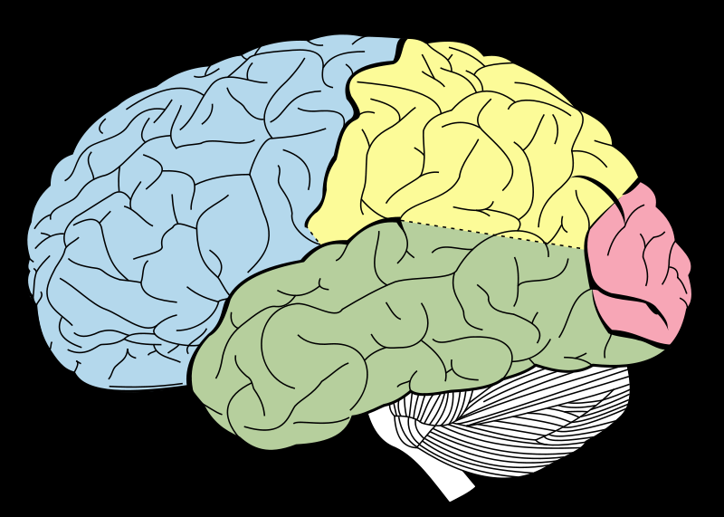

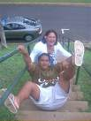




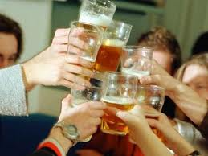
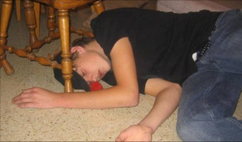
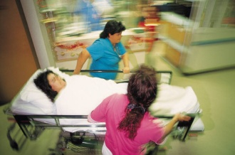
Stage 2: Excitement
Stage 3: Buzzed/Drunk
Stage 4: Very drunk
Social
Intelligence
Motor
coordination
Starts .03-.06
Starts .08-.09
Sensory
Coherence
Inhibitions/Judgment
Starts .14-.17
Starts .01-.03
Stage 1:
Relaxed/
Euphoria
Memory
Creation
Balance,
breathing, heartbeat
Starts .20
Starts .30
Stage 6:
Coma,
Death
Stage 5:
Stupor/
blackout
Notes:
ALL BEHAVIORS DUE TO ALCOHOL EFFECTS ON Central Nervous System. Alcohol=depressant=slowing/depression of CNS
Stage 1: First site of alcohol action: pre-frontal cortex (also still developing in a big way through age 25). May want to discuss briefly: executive function: planning, organizing, synthesizing. This is the “super ego”- keeps an eye on us and prevents doing and saying stupid things.
With a drink or 2:Relaxed
Effects are progressive and cumulative, moving from front to back (high level/complex thinking to lower level and automatic like breathing)
Stage 2: BAL ~.03-.06
Increased Sociability, talkativeness
Increased self-confidence
AND
Decreased inhibitions
Decrease in attention, judgment and control
Beginning of sensory-motor impairment
Loss of efficiency in finer performance tests
Generally do not do anything stupid or regrettable. Frontal lobe still working.
STAGE 3: BAL ~.08-.09 Remember, this is cumulative. Alcohol is loading from the front.
(can vary per individual)
Emotional highs and lows
Loss of critical judgment
Impairment of perception,
memory and comprehension
Decrease sensory response; increase reaction time
Vision may start to blur
Impaired balance and coordination
Drowsiness
IMPORTANT to note that the pre-frontal area (that usually helps us keep an eye on ourselves) starts shutting down.
STAGE 4 .14-.17
Disorientation & Dizziness
Exaggerated emotional states
Loss of critical judgment to figure out what is safe/not safe OR good idea vs. not
Disturbances of vision
Increase pain threshold
Decreased muscular coordination; staggering gait; slurred speech
Apathy, lethargy
STAGE 5 .20 -.25 BLACKOUTS COMMON. All mental, physical, and sensory functions are severely impaired. The person is emotionally numb. There's an increased risk of asphyxiation from choking on vomit and of seriously injuring yourself by falling or other accidents. Vomiting and incontinence can occur.
STAGE 6 ~.30 +
.35 is level of surgical anethesia.
All conscious activity is blocked. Breathing and heart rate are slowed due to depression of these brain areas by alcohol
Danger of cardiac and/or respiratory arrest (death)

Slide 104
Stage 2: Excitement
Stage 3: Buzzed-Drunk
Stage 4: very drunk
Social
Intelligence
Motor
coordination
Starts .03-.06
Starts .08-.09
Sensory
Coherence
Inhibitions/Judgment
Starts .14-.17
Starts .01-.03
Stage 1:
Euphoria/
Buzzed
Memory
Creation
Balance,
breathing, heartbeat
Starts .20
Starts .30
Stage 6:
Coma,
Death
Stage 5:
Stupor/
blackout
Notes:
Use this slide to discuss:
We talked about good things and less good things. Which part of the brain do you think is related to each?
When you drink, which part of your brain do you want to completely protect? Which part are you OK with being affected by alcohol?

Slide 105
BASICS SESSION 2
FEEDBACK SESSION GOALS
    Provide personalized feedback on drinking
    Increase accurate information about alcohol
    Increase motivation to change based on discrepancies/ambivalence
    Offer harm reduction strategies
    Screen for alcohol dependence and co-occurring disorders
    Refer for Stepped-Care as indicated
Notes:
> Provide students with personalized feedback about their pattern of alcohol use and risks associated with drinking.
> Debunk myths and increase the student's level of accurate information about alcohol and its effects, to encourage better decision making.
>Increase motivation and commitment to change current risky behavior and problem-solve about potential barriers that might compromise initiation or maintenance of change.
>Offer advice and recommendations about changing the student’s current pattern of drinking, tailored to the student’s stage of change.

Slide 106
Brief Interventions Goals
The primary goals of brief interventions are to:
  1. Reduce alcohol use to low-risk levels (harm reduction)
  2. Reduce alcohol-related harm to self and others
  3. Encourage abstinence in persons who are alcohol-dependent
Notes:
TRAINER:
Read this slide.
Speaking Points:
There is a growing body of evidence that brief interventions also are effective in reducing drinking when delivered by mail, via computer, and online, but with little effect on alcohol-related problems.

Slide 107
Session 2
Reorient/recommit

Slide 108
Self-Monitoring Cards (2nd visit)
  “How did the drink tracking go?”
  How many days did you drink?
  How many did you not drink? What did you do?
  “In general, what times of the week do you drink the most?”
  What is the difference between the times you drank ____ and the times you drank ____ (contrast between lower and higher use episodes , if present).

Slide 109
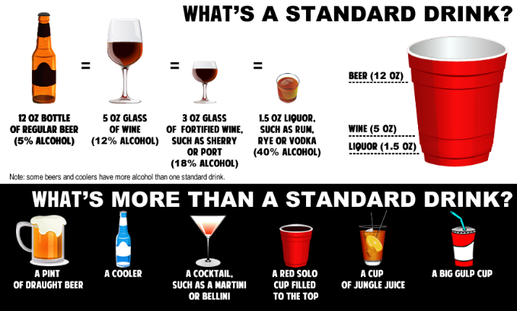

Slide 110
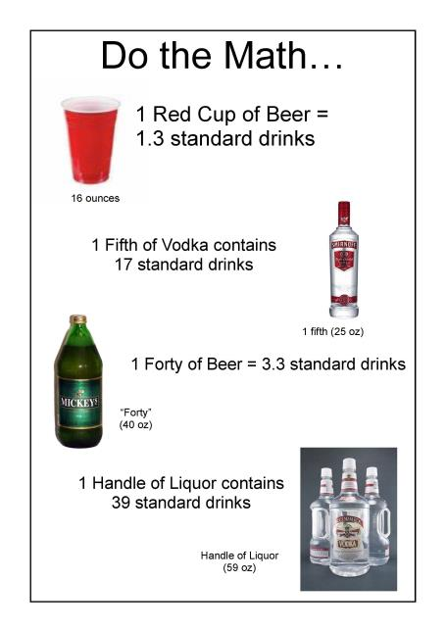

Slide 111
Presenting Feedback
Present each section slowly, giving background information necessary to interpret results.
Let the feedback speak for itself; do not argue with the student or defend the information.
Reflect and summarize the student’s reaction.
“What do you think”

Slide 112
Motivational Feedback
Drinking profile
  - Amount consumed in week and month
  Amount and percent of income spent on alcohol
  Comparison to adult drinking norms
Peak weekly and monthly BAC
Risk factors
  - Tolerance, dependence, risk of alcoholism
  - Drinking and driving
Drinking compared to peers (Normative Data)
Drinking perception compared to actual amounts
Campus and community resources

Slide 113
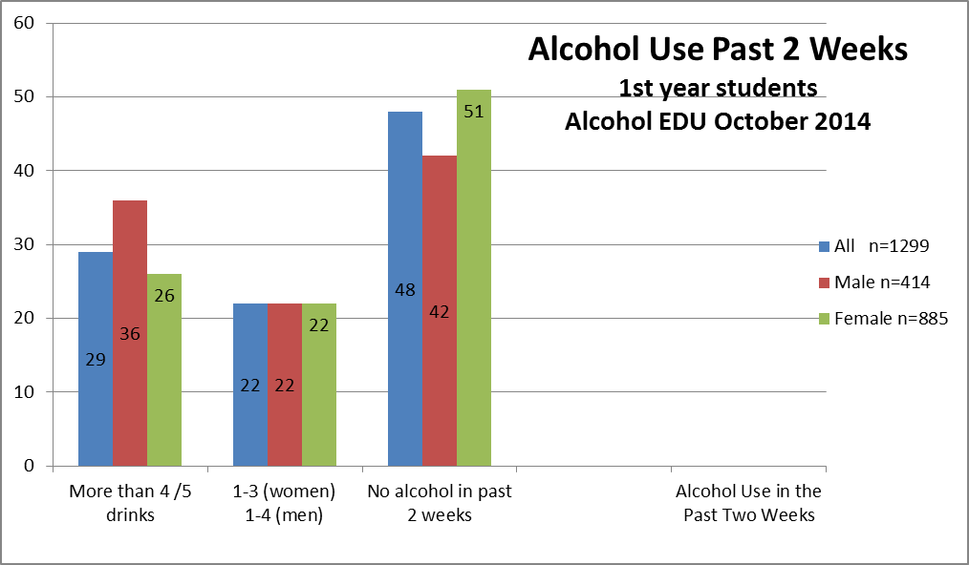

Slide 114
BASICS FEEDBACK SESSION:
GUIDELINES GIVING FEEDBACK
Take a pragmatic and realistic stance
Avoid “should’s” and other demands
Remember that motivation and insight are not always required for behavior change to occur
Treat the student as a collaborator in a process of exploration, discovery, and problem-solving
Get specific commitments for behavioral action steps from the student when possible given student motivation

Slide 115
Reflections
“Sometimes I just pass out at my buddies if I have to be at class early in the morning.” (understanding what is said)
“My parents know that I drink, but they were really upset that I ended up in the hospital.” (understanding)
“Yeah, I am drinking differently. Its good that I am getting to class-things are harder. (with a wry laugh) And that is what I am here for” (Underscore)

Slide 116
“PHASING” INTERVENTIONS BY STAGE OF CHANGE
“Doing the right thing at the right time”
and in the right way
People respond to brief interventions according to their stage of change
How we talk about it makes a difference
Strategies that are “out-of-phase” increase resistance leading them to move back to an earlier stage of change
Notes:
116
Speaking Points:
The stages-of-change model provides motivational interviewing with a conceptual road map for assessing a student’s present position and his or her course.
Effective motivational enhancement strategies assist movement from one stage of change to the next.
Motivational Interviewing meets the client wherever he or she is with stage-appropriate strategies.
Non-compliant is not a diagnosis! It is a mismatch

Slide 117
VIDEO: Feedback Clip
Scott Walters

Slide 118
ASSUMPTIONS
Behavioral issues are common AND Ambivalence is often a trademark
Change often takes a long time
The pace of change is variable
Knowledge is usually not sufficient to motivate change
Relapse can be part of the process
Notes:
May want outcome AND have difficulty/be overwhelmed/ambivalent with all that it would take
CONFIDENCE

Slide 119
VIDEO
Follow Up Brief Intervention for Possibly Dependent Alcohol Use

Slide 120
Resistance
A reflection on the facilitator style
Mismatch between stage and approach

Slide 121
Beyond OARS

Slide 122
Pearls
Asking permission
May I tell you about…?
Giving information
Keep it short
Elicit—provide---elicit
The experts tell us….
Shared suggestions
I have some ideas from other students/people.
I can share and you can see what may work for you?

Slide 123
Broaching the Subject
Share your concerns
  “I noticed that . . . I wonder if . . . ”
  Use clear language and specific examples.
  Avoid pejorative terms.
  Do not assume initial readiness.
Ask about the student’s own concerns
  “What concerns do you have about
  your . . .?”
  Include a screening or checklist.

Slide 124
Giving Advice and Suggestions
Ask for permission.
  “There’s something that concerns me. Would it be okay if I asked you about . . .?”
Preface advice with permission to disagree.
  “This may or may not apply to you, but . . .”
Give a small amount of essential information.
  “The main thing I’m concerned about is . . .”

Slide 125
Asking Evocative Questions
“What concerns you about your drinking?”
“What would be some good things about quitting/cutting down?”
“Who could offer you helpful support?”
OPEN QUESTIONS

Slide 126
Change in the abstract
Where do you want to see yourself with this in.. (6 months, 1 year, 3 years)
What would your life be like then if you do make changes soon?

Slide 127
Exploring Change in the Abstract
Conditional Statement | Plan of Action
“If you wanted to . . .” “If you decided you wanted to . . .” “If the time were right . . .” | “How would you do it?” “How would you go about it?” “What would you do?”

Slide 128
Video- Jill: HTN, alcohol

Slide 129
CHANGE TALK: WHAT TO LOOK FOR
Discomfort/disadvantages of status quo
  Consequences, personal concerns, others’ concerns
Advantages of change
  Good things (or reduction in negatives) about change
Optimism/ability to change
  Personal resources, skills, confidence
Intention/commitment to change
  What change would look like; concrete or hypothetical plans

Slide 130
Doing it RIGHT
You are speaking slowly,
Student talking more than you,
You are listening more than talking,
Student is working, not passive, asks for information

Slide 131
Video-
Modern Family
Commitment to change
OARS
Puppet Master
Effective SBIRT
SBIRT Brief Intervention Pre-Contemplative Stage, Moderate Risk Client
Follow Up Brief Intervention for Possibly Dependent Alcohol Use
http://pubs.niaaa.nih.gov/publications/clinicianGuide/guideCC/case1/index.htm

Slide 132
Resources
Scott Walters: MI: Maximizing Brief Interactions with College Drinkers

Slide 133
Alcohol Physiology
National Institute for Health: Teachers Guide

Slide 134

Alcohol 101
Organ that detoxifies alcohol:
Liver
Ratio of alcohol in blood
BAL or BAC
Needing more to feel the same
Tolerance

Slide 135

Alcohol 101
Alcohol is what type of drug?
Depressant
Gender that is more sensitive
Females (hormones, less water, less ADH)
Notes:
Clarify: depressant means CNS depression
Less ADH in stomach leads to higher concentration

Slide 136
Sex (biologic) Differences
Women are more sensitive to alcohol
Less water (higher fat ratio)
Less ADH in stomach (slower breakdown)
Hormonal variations

Slide 137


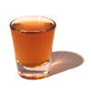

What is a drink?
=
=
=
1 Drink
5 ounces wine
1 shot of 80
proof liquor
12 ounces beer
=
15 oz = 1.3 drinks
1 Drink= ½ ounce pure alcohol
Notes:
What is a drink? To get the good, a person needs to know what he/she is drinking.
ASK: how about jungle juice- how many drinks is that?

Slide 138
HOW IS ALCOHOL ABSORBED?
20 % in the stomach
80 % in the small intestines
Notes:
Alcohol does not effect the body until it is absorbed into the bloodstream.
A nominal amount is absorbed in the mouth.
A little is absorbed in the stomach, most in the small intestine. When a person eats within the hour before drinking the food absorbs some of the alcohol, letting it ease into the system (“helps you have a better night”).
need to touch on time between eating dinner and starting drinking as this is often several hours and the dinner food is no longer in stomach

Slide 139
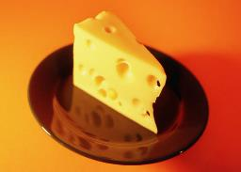
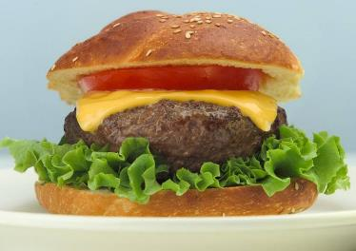


High Fat and High Protein Foods
Moderate absorption
Notes:
Choose high fat and high protein foods which take longer to digest.

Slide 140

Carbonation
FIZZ
= faster
Notes:
Carbonation =faster absorption (opens valve from stomach to small intestine)

Slide 141



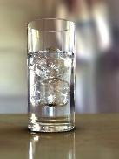
Which Absorbs Fastest?
Vodka
Vodka and tonic
Vodka & water
Vodka & OJ
Notes:
Shot vodka: most concentrated
vodka tonic: carbonation increases absorption (pyloric sphincter opens)
vodka water
Vodka OJ: food substance moderates a bit

Slide 142
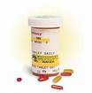
Alcohol Effects and Medication
Accentuated by:
Antihistamines (i.e. benadryl, tagamet)
Antidepressants (paxil, prozac)
Anti-anxiety medications (xanax, ativan)
Antibiotics (erythromycin)
Pain Medications
Notes:
Many students are taking medication. Some medications push the effect of the alcohol but does not change BAC (?)

Slide 143
BAL
Ratio of alcohol to blood (how many milligrams of alcohol are present in 100 milliliters of blood)
.08% BAL: has 8 parts alcohol for every thousand parts of blood
Influenced by:
  Quantity: how much
  Rate: how fast
  Body weight
  Gender
  Medication

Slide 144

Sobering Up
Metabolized more slowly than absorbed
Time is only cure
Sobering up = decreased BAL
.08 0 takes 5 hours
.20 0 takes 14 hours
Notes:
Ask: what have you heard helps?
Differentiate between sobering up (BAL returns to 0) and decreasing hangover effects

Slide 145

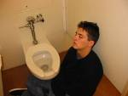
Tolerance
Sensitivity to alcohol
Increased tolerance=
need for increased amount to reach the same level of buzz
High tolerance does not
affect BAL
Notes:
Experienced drinkers may not show signs appropriate to BAL

Slide 146

Sleep Alertness
Sleep more soundly first half; more lightly second half
Overall reduction of deep restful sleep time
Intoxication can have a negative impact on cognitive functions (concentration, memory, attention) for 48 hours
Notes:
Interferes with restorative nature of sleep

