Slide 1
Facts on Tap
Suggestions
  Title: use the title below or come up with a creative title of your own.
  Be sure to post slides 2, 3, and 4 in succession. The 12oz of beer, 4-5 oz of wine, and 1.5 oz of liquor all equal 1 drink.

Slide 2
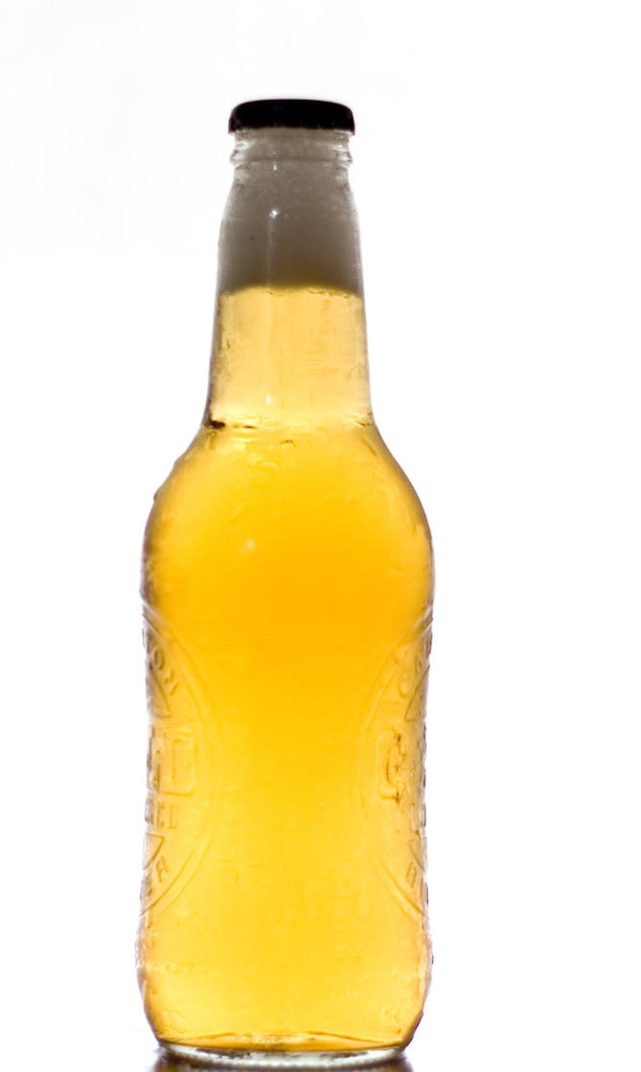


12oz of beer =

Slide 3
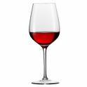
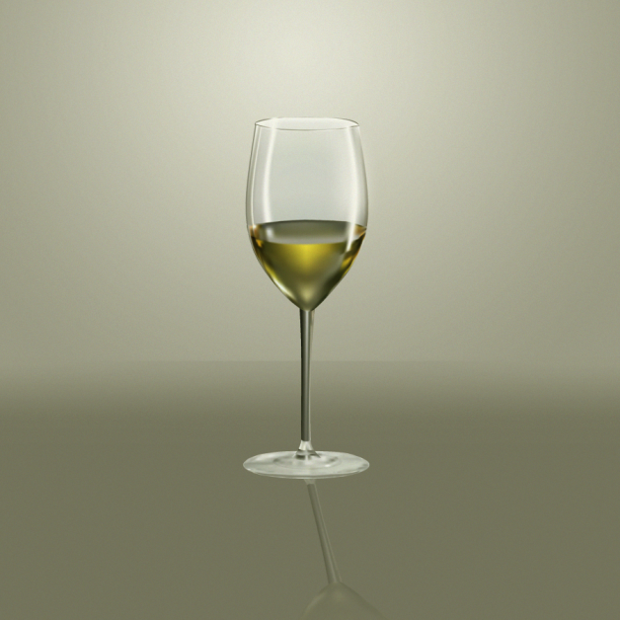
What is a Standard Drink?
4-5oz of wine=

Slide 4
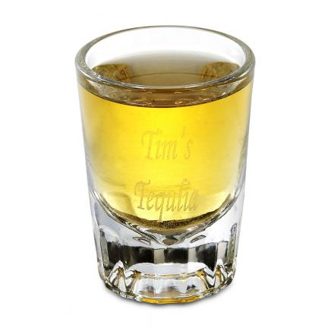
1.5oz 80 proof liquor

Slide 5
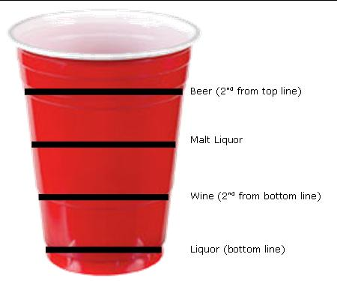
The
“Red Cup” Guide to Standard Drinks

Slide 6
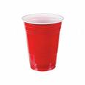
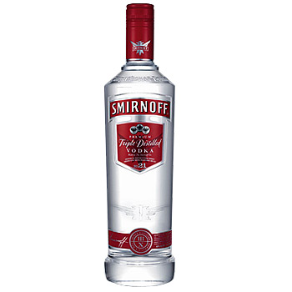
Do the Math
1 red cup = 1.3 Standard Drinks
1 Fifth of 80 Proof Liquor = 17 Standard Drinks

Slide 7
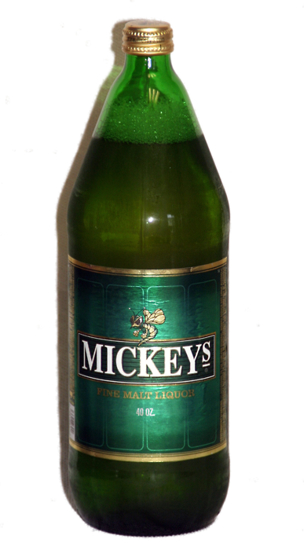
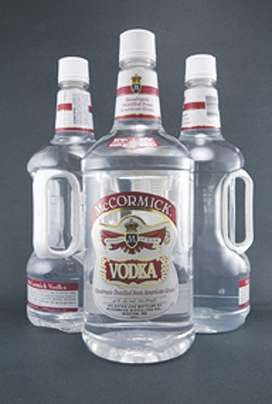
Do the Math
1 forty =
3.3 Standard Drinks
1 handle of 80 proof liquor =
39 Standard Drinks

Slide 8
Why a standard Drink?
Each standard drink contains the same amount of pure alcohol.
One standard drink will raise the blood alcohol level of a 150lb male .02.
Blood alcohol level is the concentration of alcohol in your blood. The legal limit in PA is .08.
Find out more about blood alcohol level at www.bloodalcoholcalculator.org

Slide 9
95.5% of WCU Students report usually doing or always doing one or more of the behaviors below when drinking alcohol.
Set a limit for the number of drinks to have each night.
Alternate alcoholic with non-alcoholic beverages.
Using a designated driving.
Eating right before and during drinking.
Pace drinks to 1 or fewer per hour.
Avoiding drinking games.

