Slide 1


Navigate Add/Drop Attendance Report

Slide 2

Add/Drop Attendance Report
What is it?
A tool to collect information about student attendance patterns, including which students attended class and the date of their last attendance.
Run at the start of the semester to comply with Federal Financial Aid requirements.

Slide 3
Timeframe and Delivery
The Add/Drop Attendance Report :
When: Within the first two weeks of the semester.
An email will be sent to instructional faculty coordinated with the classes they are teaching for the semester with an embedded link to the report.
There is no need to log in to Navigate, the link will take the faculty member directly to the report.

Slide 4
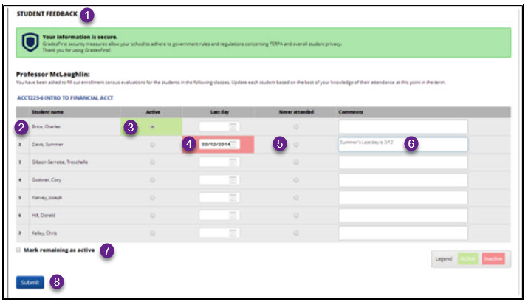
Sample Report
Header
List of Student Names (each student needs to have an entry whether Active/Last Day or Never Attended)
“Active” Status – mark if the student is in good attendance
Last Day (enter date student last attended class)
Never Attended (mark if the student is on your roster, but never attended)
Comments - add comments if needed
Mark remaining as active – shortcut to mark multiple students active (in good attendance)
Submit – once the report is complete, click submit to submit your attendance for the course.

Slide 5
Attendance Tips & Tricks
Once the Attendance Rosters are created, any changes in enrollment won’t be update.
Add/Drop attendance data informs university enrollment estimates. We appreciate your timely feedback on student engagement.
You can only record attendance for a student once. So while you can submit partial rosters, once you submit student data it can’t be edited.
If you have questions email us at navigate@wcupa.edu

