Slide 1
Capc kick-off meeting
Fall 2021

Slide 2
How CAPC Works

Slide 3
WHAT IS “CAPC”?
CAPC is the Curriculum and Academic Policies Council
  CAPC is a faculty legislative body, the only such body with authority to recommend changes to (or creation of) the curriculum and/or academic policies
  CAPC is a recommending body; the Provost has sole authority other the curriculum and academic policies

Slide 4
Why are we here?
…because CAPC is the curricular body mandated by the CBA (Article 31 section E):
  “There shall be a curriculum committee at each University, which shall be selected as determined by the FACULTY, but which may include at least one (1) administrator if designated by the President.”

Slide 5
Why are we here?
APSCUF runs elections for CAPC, which involve both at-large and department-specific members.
Members are elected to do the following:
  participate in CAPC’s decision-making processes around curriculum and academic policies
  report back to their constituencies (department, college, etc.) about CAPC processes and actions
  department-specific members also provide support and guidance for colleagues developing curriculum proposals for submission to CAPC, e.g., about learning outcomes, CIM, etc.

Slide 6
How CAPC Works
Participation in decision-making processes happens through:
  work on committees and subcommittees
  monthly CAPC General Assembly meeting where decisions are made on the proposals sent up by the committees

Slide 7
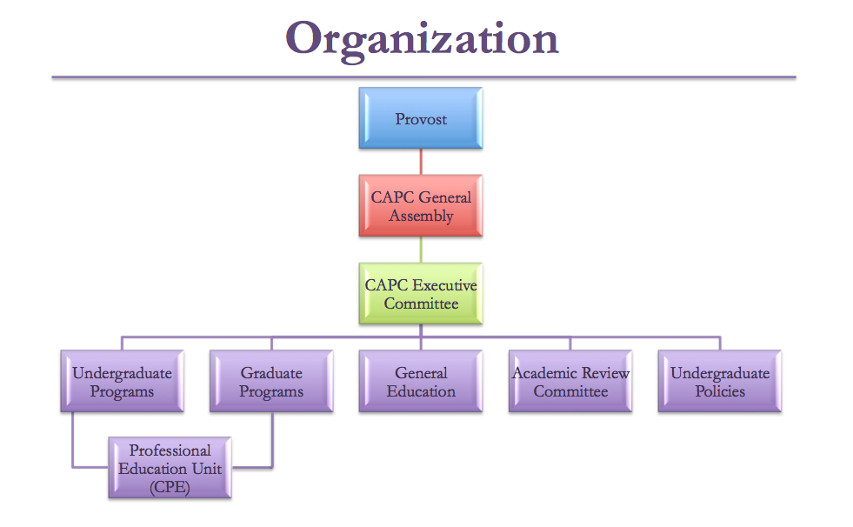
How CAPC Works

Slide 8
How CAPC Works
Several CAPC Committees have subcommittees:
  General Education
    Distributives
    Diverse Communities
    Ethics
    Interdisciplinary
    Speaking Emphasis
    Writing Emphasis

Slide 9
How CAPC Works
Several CAPC Committees have subcommittees:
  Academic Review
    Course Review and Revalidation
    Low Enrollment Advisory
    New Programs Advisory
    Program Review
  Undergraduate Programs
    Culture Cluster

Slide 10
2021-22 CAPC Executive committee
  Chair: Susan Johnston, Anthropology & Sociology
  Vice Chair: Josh Auld, Biology
  Secretary: Francis Atuahene, Undergraduate Studies & Student Support Services
  Undergraduate Programs: Scott Heinerichs, Dean of the College of Health Sciences
  Undergraduate Policies: Giovanni Casotti, Biology
  Graduate Programs & Policies: Vanessa Johnson, Interim Dean of the Graduate School
  General Education: Karen Mitchell, Psychology
  Academic Review: Elizabeth Pfaffle, Applied Music
  CAPC Support: Patrick Richard, Academic Affairs

Slide 11
How CAPC Works
You should know your assigned committee(s) by now. If not, they can be found at the CAPC website
Committees should meet on a regular schedule
Your service on CAPC includes attendance at both Assembly meetings and committee meetings
If you cannot attend, your proxy should attend on your behalf – applies to both Assembly and committee meetings
  The bylaws require all CAPC members to have a proxy identified in advance of meetings

Slide 12
How CAPC Works
Article 4.A.1.c.
“Each CAPC member will submit to the CAPC Secretary written notification of that member’s proxy. In the case of members elected by constituency, the proxy must be selected from the same constituency. Proxies should be identified no later than the first scheduled Assembly in the fall. Should the proxy require an alternate, the proxy or member should notify the Recording Secretary in writing prior to the Assembly in which the alternate is to serve.”

Slide 13
How CAPC Works
Your service on CAPC also includes the following:
  preparing for committee and sub-committee meetings by reading in advance and reflecting on all documents on the agenda
  preparing for CAPC Assembly by reviewing in advance those items on the agenda that did not come from your committee
  ensuring that you are fully acquainted with the requirements for course and program proposals, including the relevant policies (syllabi, course evaluations, etc.)

Slide 14
How CAPC Works
Part of your duty as a CAPC member is to represent your constituency, and this means reporting back about CAPC Assembly and its procedures, debates, and recommendations.
  This includes CAPC decisions about courses, programs, or policies that may have impact on your department (or your other constituencies), whether or not they originated in your department or college
  You should also let your constituents know when an item of theirs appears on the Assembly agenda and remind them that they are invited to attend the relevant assembly meeting to respond to questions that might arise

Slide 15
How CAPC Works
  NOTE: When a committee has sent an item forward for the Assembly agenda, it is with that committee’s approval (unless explicitly stated otherwise).
  Similarly, when a department chair, dean, or CAPC officer ‘signs off’ on a proposal in CIM, it indicates approval (not simply acknowledgment)
    That said, deans may assume they are leaving curricular decisions to the departments and to CAPC, and are only approving the availability of resources and other non-curricular issues

Slide 16
How CAPC Works
Motions passed by CAPC are submitted to the Provost for approval. She makes the ultimate decisions regarding curriculum and academic policy.
  There is a procedure for dialogue in the event that the Provost does not approve CAPC recommendations. This is rare, however.
  The Provost’s approvals are circulated by Patrick Richard and are available on the CAPC website.

Slide 17
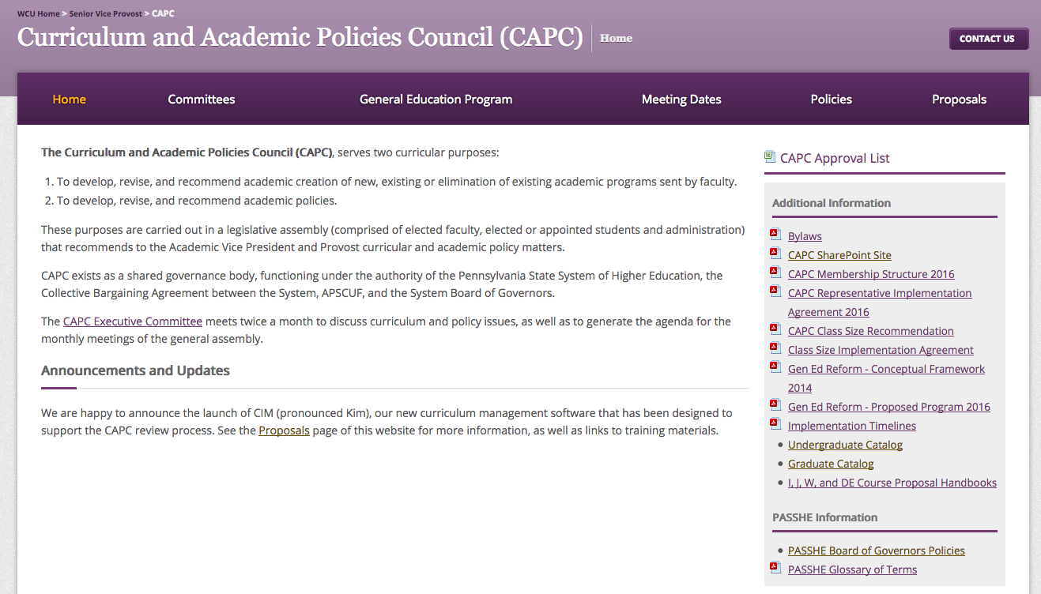
CAPC website
https://www.wcupa.edu/viceProvost/capc/

Slide 18
REMEMBER…
  In summary:
  CAPC is a contractually mandated representative body that gives faculty significant control over the curriculum.
  At WCU, we have it a lot better than many other places, including some in PASSHE
  As CAPC representatives, we have an obligation to responsibly carry out our mandate on behalf of the faculty and departments we represent

Slide 19
How cim Works

Slide 20
CIM: Course inventory management
https://www.wcupa.edu/viceProvost/capc/

Slide 21
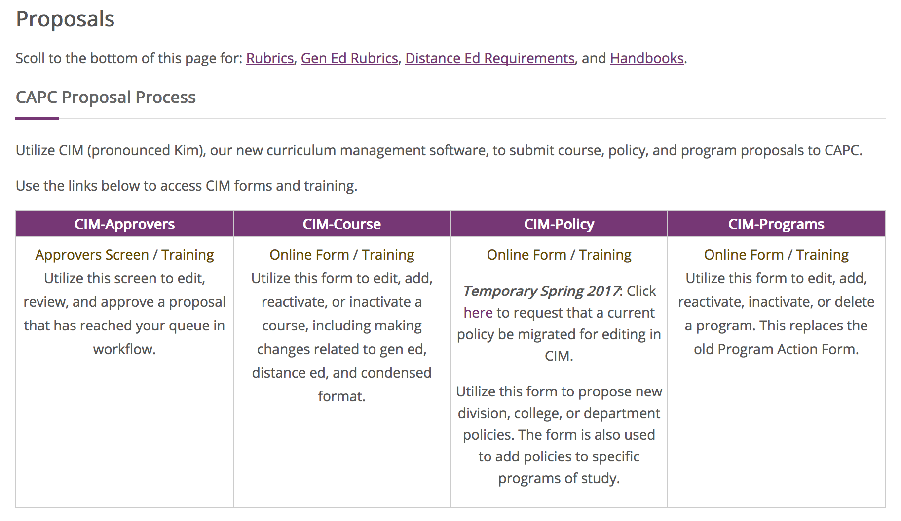
HOW CIM WORKS

Slide 22
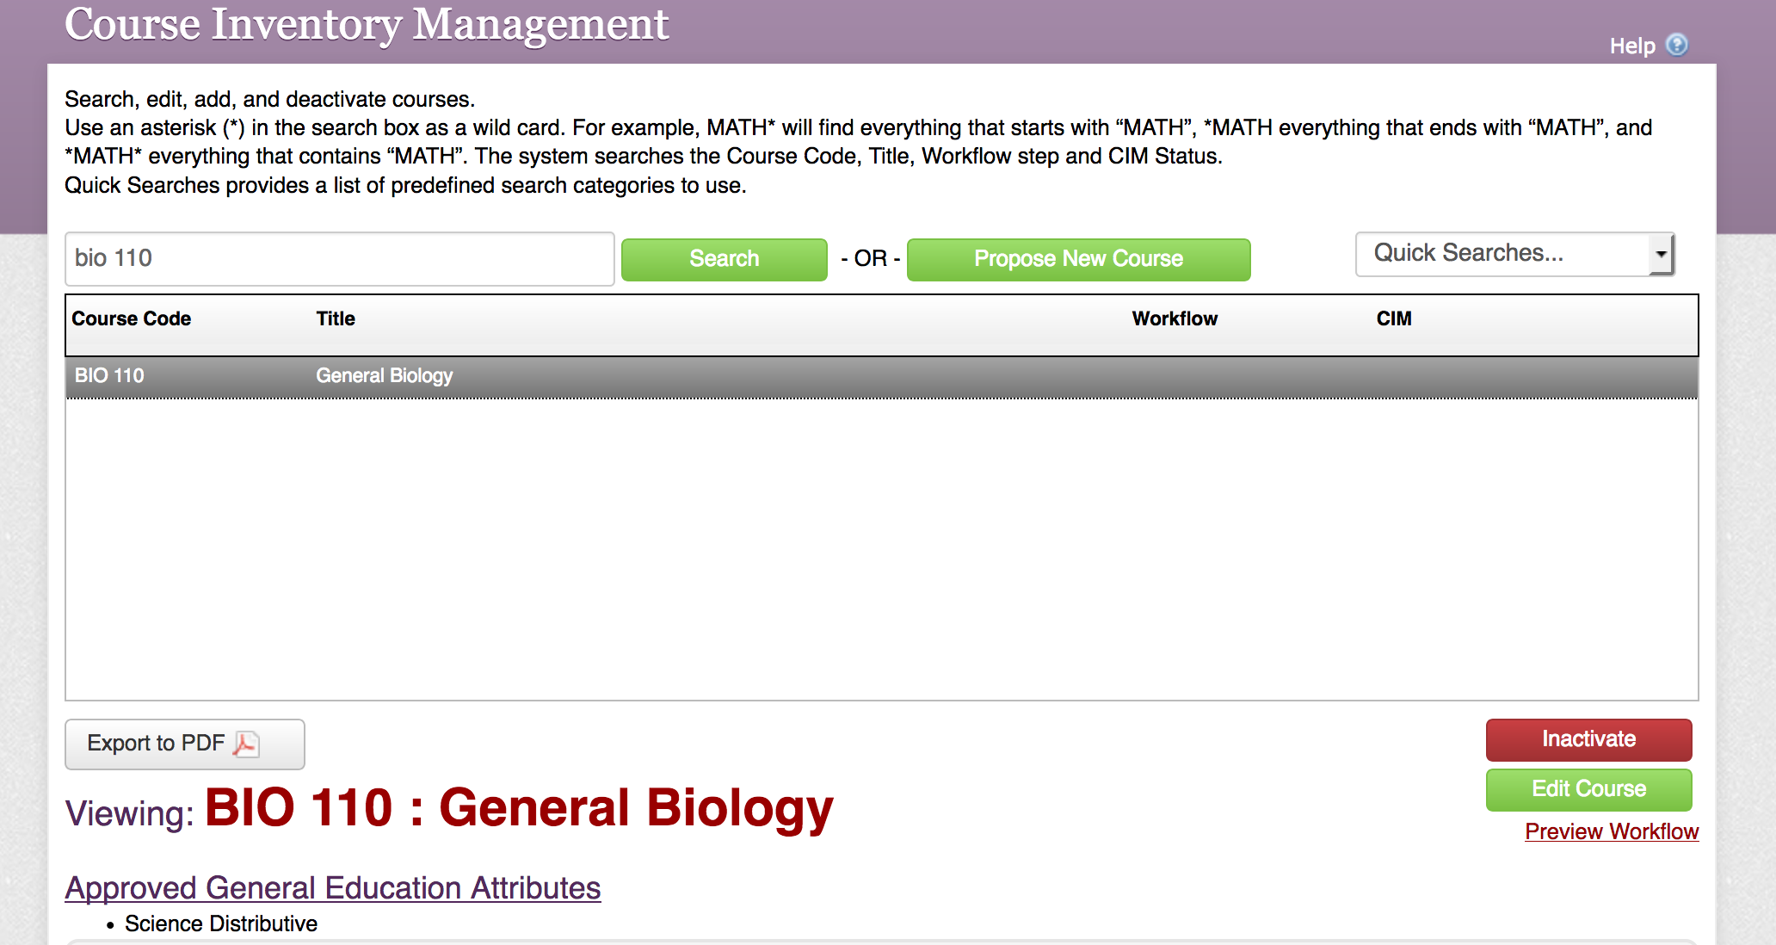
HOW CIM WORKS

Slide 23
HOW CIM WORKS

Slide 24
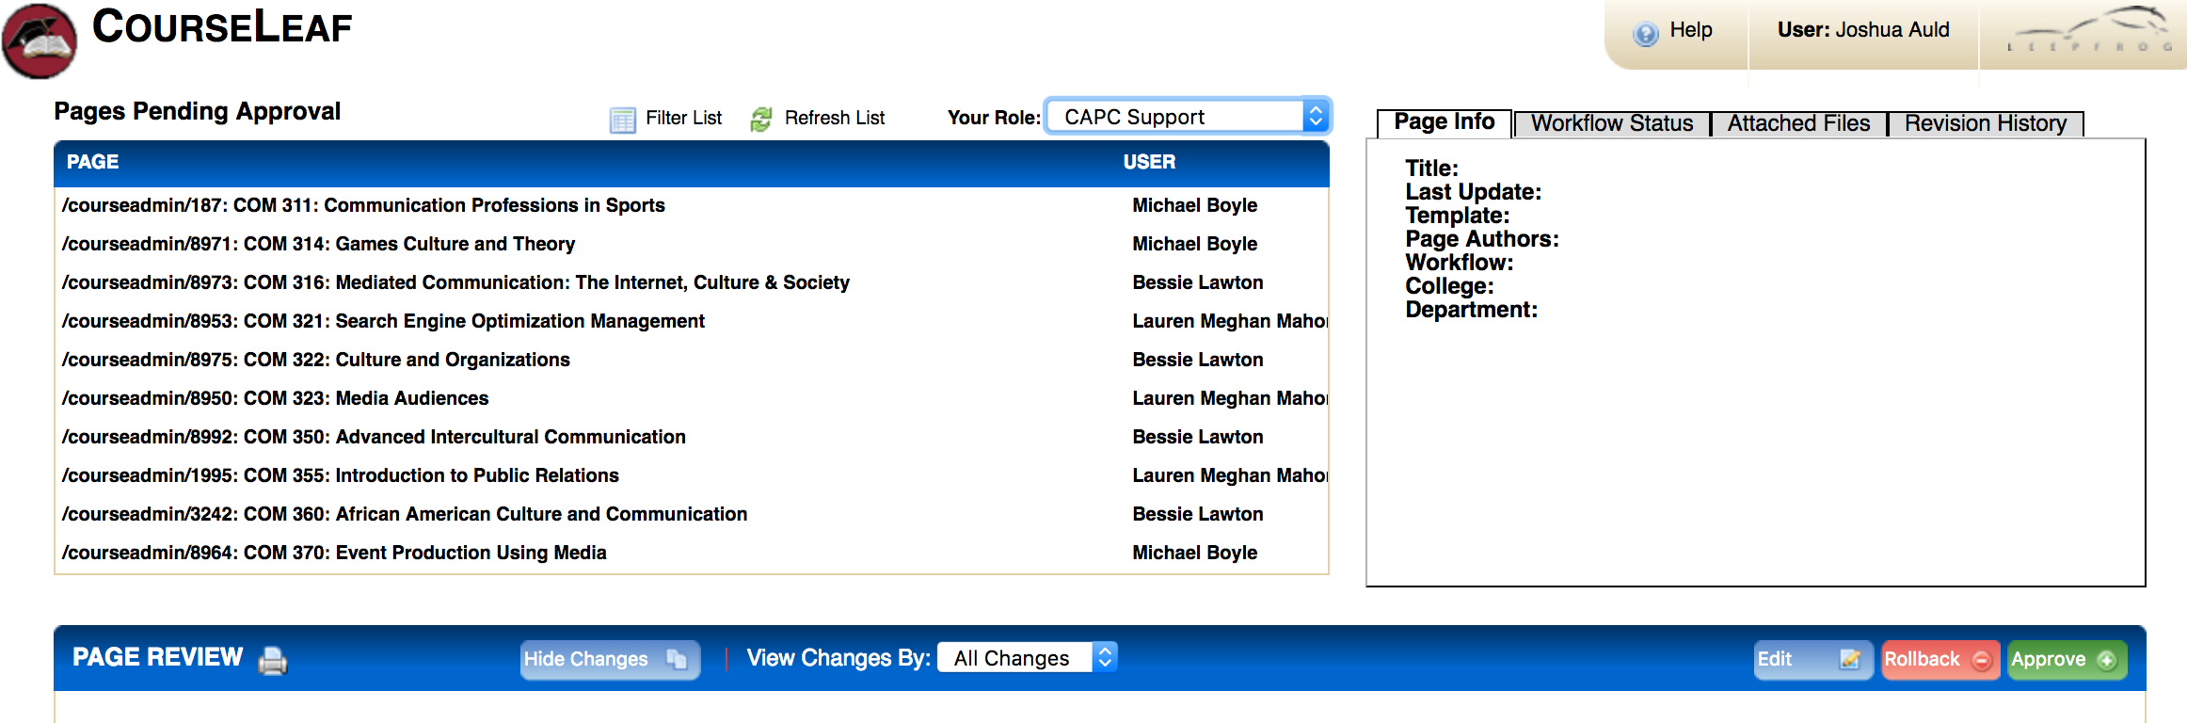
HOW CIM WORKS

Slide 25
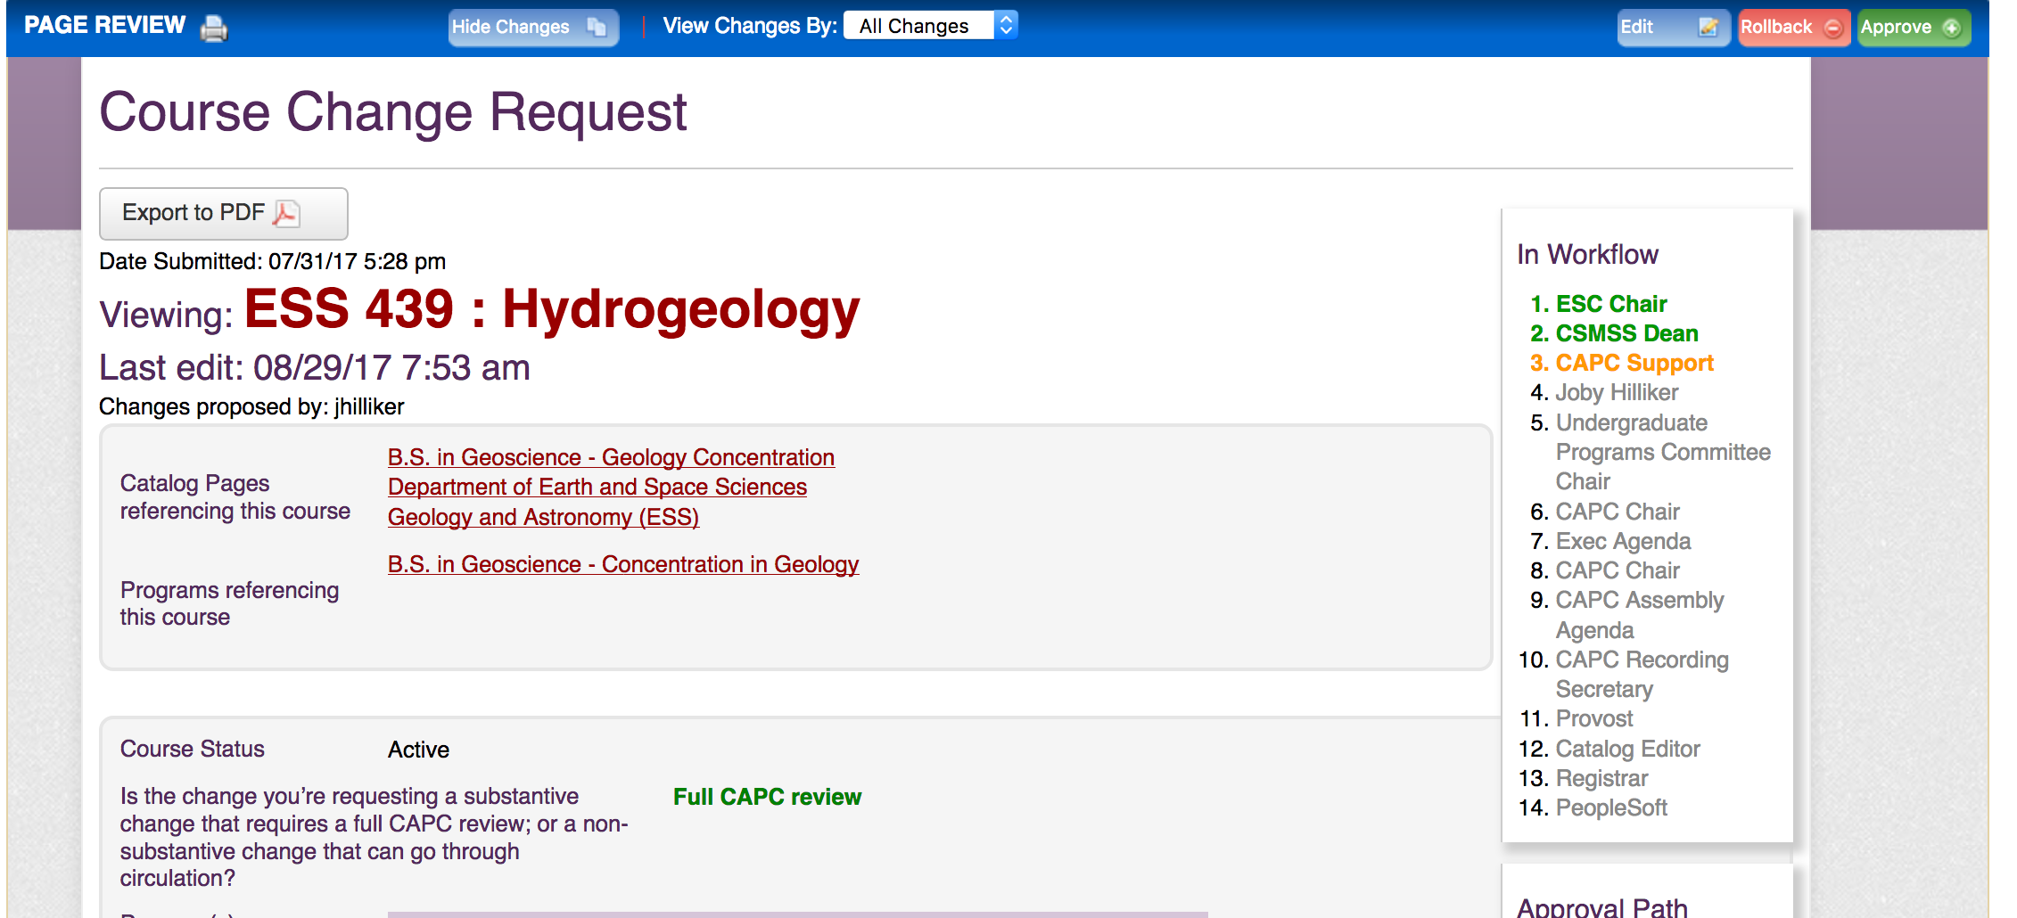
HOW CIM WORKS
Note: Email notifications (approval requests & notifications) come from “Patrick Richard”

Slide 26
HOW CIM WORKS

Slide 27
CIM OPEN LABS
Tuesday, Sept. 7, 1:30-3:30, Philips Lower-Level Conference Room
Wednesday, Sept. 15, 11:00-1:00, BPMC 115

Slide 28
Efforts for this year

Slide 29
Efforts this year
General Education
  Pilot new e-portfolio platform (Google Slides) in FYE courses
  Plan schedule for continued review and revalidation of additional attribute courses under the ‘new’ Gen Ed program over the next few years
  Continue faculty development (through the Gen Ed Council) to support creation of courses meeting the “new” or revised attributes
  Gen Ed courses that come through the full review process, regardless of rationale, will be reviewed under the current goal and SLO structure

Slide 30
Efforts this year
Diverse Communities Task Force
  Was appointed and began work last spring
  Continuing work this AY with anticipated report to CAPC Exec by spring
Informal Caucus Process
  Caucus formed to assist tightly scripted programs with incorporating general education learning outcomes within curricula
  Rodney Mader appointed as liaison from CAPC to these programs

