Slide 1
General education reform

Slide 2
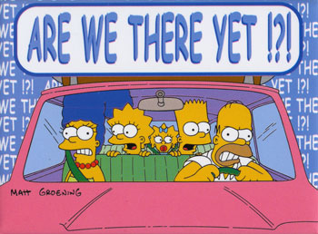
Gen Ed Reform
The revised General Education program launches Fall 2018
This year we have to: 1) Build First Year Experience courses
2) Review all Distributive courses

Slide 3
Gen Ed Reform
Approved by CAPC 12/15/16
Four Significant Parts
  First‐year course, with shared content
  Electronic Portfolios
  Certificate pathways utilizing Gen Ed distributive requirements
  Universal implementation of capstone courses and culminating reflective synthesis of GE and major/minor programs
  Proposal is on the CAPC Webpage

Slide 4
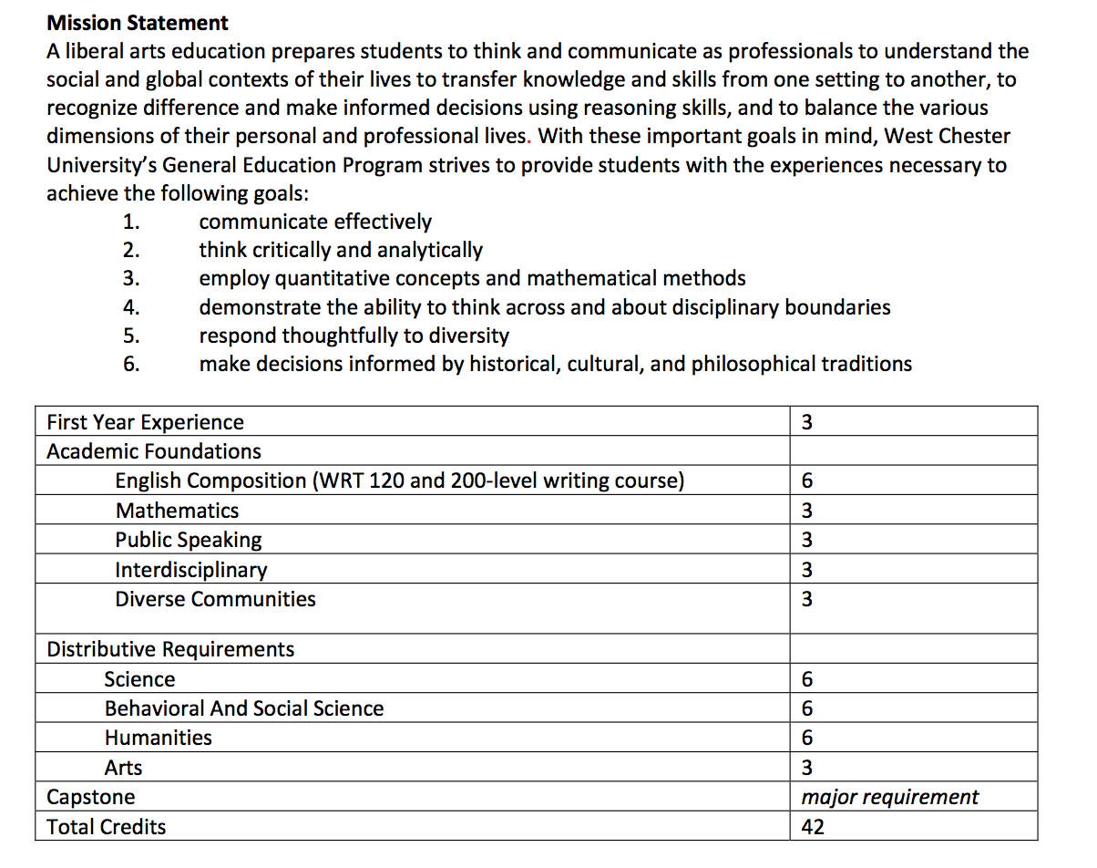
REVISED General education PROGRAM
NOW WITH ELECTRONIC PORTFOLIOS FOR INTEGRATIVE LEARNING!

Slide 5
First Year experience Focus Areas
FYE – Integrative Health
FYE –
STEM
FYE –
Social Sciences
FYE –
Business
West Chester University
FYE –
Culture and Communications
FYE – Humanities
FYE –
Arts
FYE –
Education

Slide 6
Development of First-Year Courses
Common Core
Focus Areas
First Year Courses
Integrative Health
STEM
Social Sciences
Humanities
Arts
Business
Education
Culture & Communication
Define components of common core
Develop FY common core SLOs
Develop FY common core content
Develop common core assessment plan
8 Focus Area teams
Develop FY focus area course SLOs
Develop FY focus area common content
Develop common content assessment plan
Individual team members develop recitation section content with their department

Slide 7
Sample FYE course
Common content
Metadisciplinary content

Slide 8
CERtificate pathways
Global Engagement
(GE)
Each of these is a 12-credit undergrad certificate, the attribute overlays the course based on learning outcomes
The Toolkit and
General Education
  Civic discourse
  Diverse communities
  Writing emphasis
  Global awareness
Co-curricular transcript
Digital Literacy
(DL)
Social Justice (SJ)
Community Engagement (CE)
Sustainability
(S)

Slide 9
Overlay of Certificates to FYE Course
First-year courses (and other courses) get the designation, such as Social Justice (SJ), based on learning outcomes
FYE – Integrative Health
(SJ, CE)
FYE –
STEM
(S, GE)
FYE –
Social Sciences
(GE, SJ)
FYE –
Business
(GE, S)
West Chester University
FYE – Humanities
(SJ, GE)
FYE –
Culture and Communications
(GE, DL)
FYE –
Arts
(CE, DL)
FYE –
Education
(DL, CE)

Slide 10
CERtificate pathways
Arts distributive
Interdisciplinary course
Science distributive
All courses in a pathway address the goals of that pathway, but from different perspectives
FYE
Humanities distributive
Diverse Communities course
Behavioral/Social Science distributive
The President’s Toolkit &
General Education
  Civic discourse
  Diverse communities
  Writing emphasis
  Global awareness
Co-curricular transcript

Slide 11
Planning for this year
Review and approval of Gen Ed distributive courses
  Required information is on CAPC Gen Ed page
  Courses must address goals 1-2; 3-6 apply to distributive areas
  Identify SLOs and how they are measured
FYE courses
  Development of meta-disciplinary, team-taught sections
  Large lecture format with small break-out sections
Certificate pathways

Slide 12
Planning for the next years
Review and approval of other Gen Ed components
  Capstones with capstone assignments
  I, J, & W courses
  Academic foundation courses
Certificate pathways
Electronic portfolios

Slide 13
Role of CAPC members in process
Liaisons to constituents
Gen Ed distributive courses
Feedback on FYE courses
Capstones & Electronic portfolios

