Slide 1
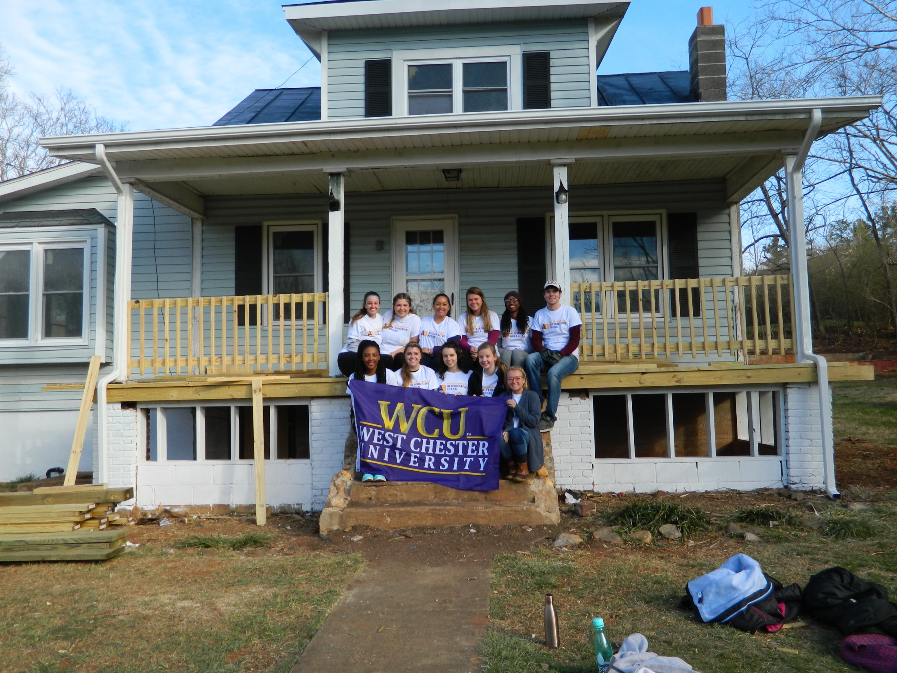

Slide 2
Service-Learning is…
a teaching method.
includes community service that addresses a community need.
enhances curricular goals and meets learning outcomes goals.
includes critical, reflective thinking.
develops students sense of civic responsibility and commitment to the community.

Slide 3
Faculty Support
Faculty Consultations
Creating an integrated SL curriculum
Workbook
community partnerships
Finding community partners
Connecting your teaching to research and scholarship
Service-Learning Faculty Work Group
Connect with SL practitioners in your discipline/college
Assistance with:
risk management
financial needs
recording service-learning hours

Slide 4
Finding Partnerships:
Collaborate with staff in the Service-Learning & Volunteer Programs department
Use OSLVP Website
Look for opportunities in the “Service Corner”
Send students to the Volunteer Fair
Partner with on-going programs at WCU

Slide 5
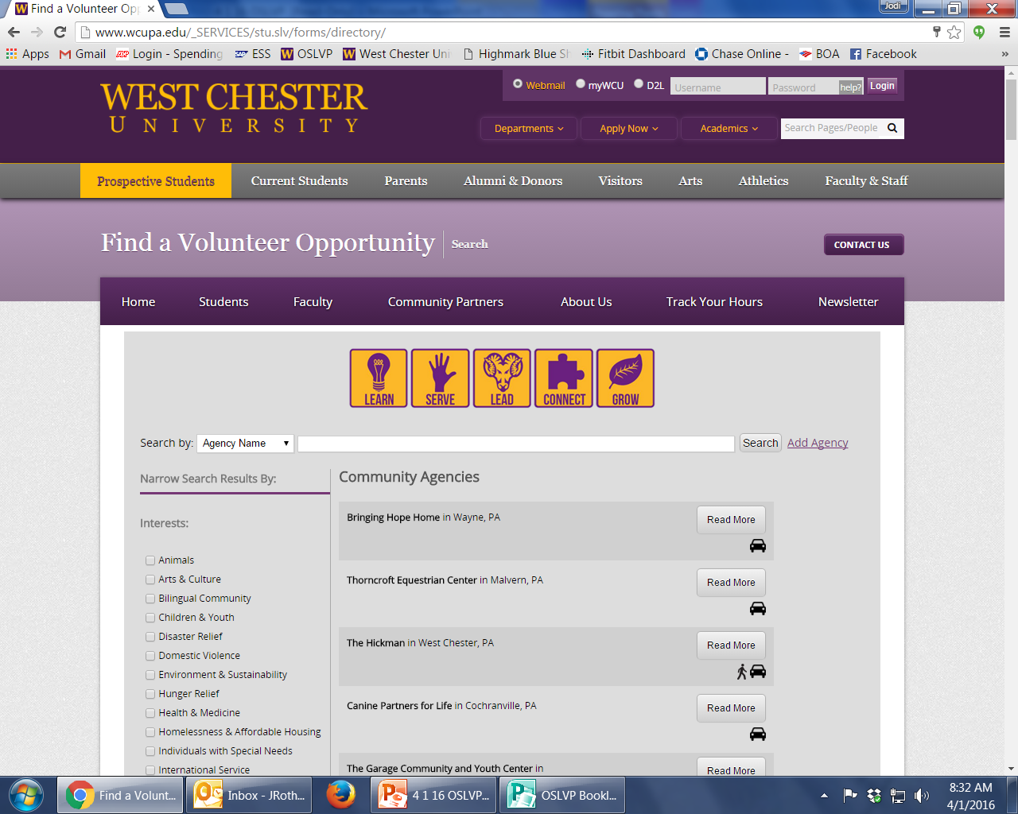
www.wcupa.edu/volunteersearch

Slide 6
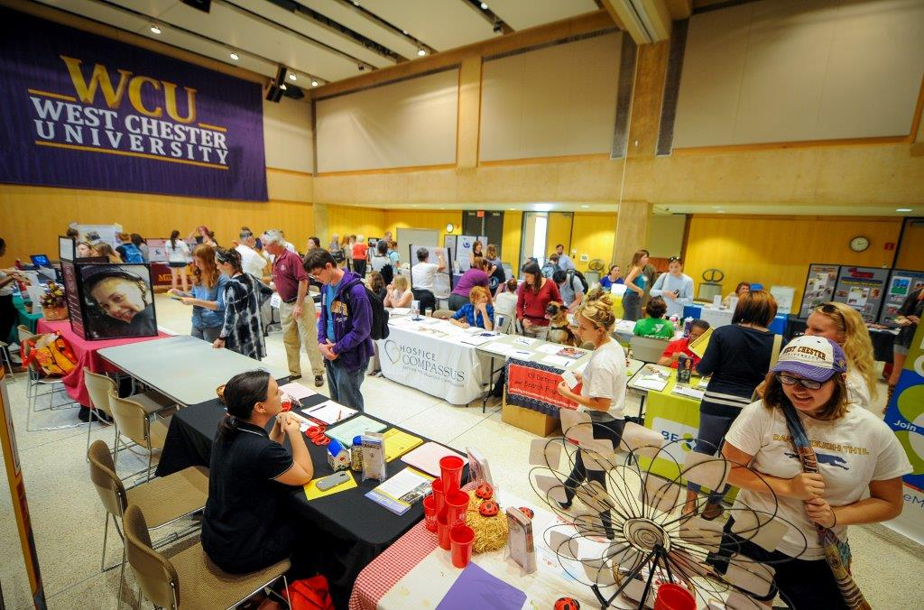
Volunteer Fair
September & February
11am-2pm
Sykes Ballrooms
Meet 55+ non-profit organizations to learn about volunteer opportunities!

Slide 7
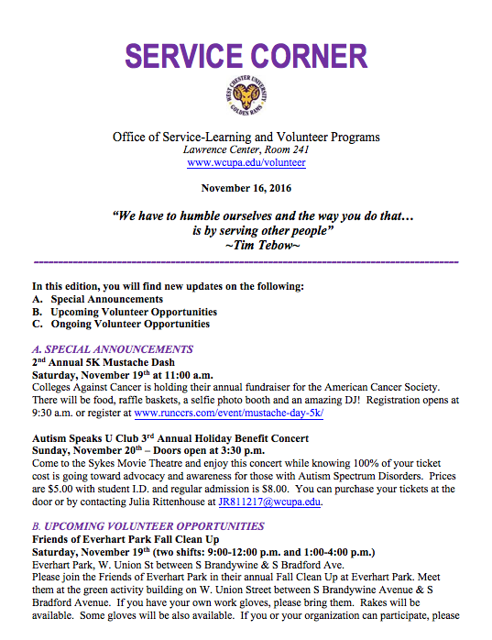
Service Corner
Sign up for our newsletter! www.wcupa.edu/volunteer
Sent via email bi-weekly!

Slide 8
Examples of SL Projects
Projects can be:
One-time or multi-part
Individualized or group-project based
During class-time or outside of class time
Specific Examples:
Launch a voter engagement and registration drive
Create marketing materials for non-profits
Work across generations with seniors
Volunteer at MLK Day of Service or during MLK Legacy Week
Volunteer at the campus gardens and Gordon Natural Area
Be an ELS conversation partner
Use academic content area to solve a community need
Arts/Geography – Creating a mural or map of the US or globe at a local elementary school
Education – Literacy night at a local library/community center/school
STEM – Assist with a science fair for the Girls Scouts

Slide 9
Reflective Assignments
Journals: Writing in journals is widely used by service-learning programs to promote reflection. They're most meaningful when instructors pose key questions for analysis.
Multimedia Class Presentations: Students create a video or photo documentary on the community experience.
Theory Application Papers: Students select a major theory covered in the course and analyze its application to the experience in the community.
Agency Analysis Papers: Students identify organizational structure, culture and mission.
Presentations to Community Organizations: Students present work to community organization staff, board members, and participants.
Group Discussion: Through guided discussion questions, have students critically think about their service experiences.
Reflective Reading: Find articles, stories, or songs that relate to the service experience and create discussion questions that link the reading to the service-learning.
E-Portfolio: Any written assignments or videos could be included in the e-portfolio.

Slide 10
Key Points & Best Practices
Establish partnerships early
Clearly relay expectations to students at the beginning of the semester
Create ample opportunity for reflection that links student service to learning outcomes and community impact

Slide 11
Examples of Student Learning Outcomes
Communication: Students will be able to use verbal and/or written communication skills to address community issues and/or advocate for social change.
Critical and Analytical Thinking: Students will be able to critically reflect on the connections between academic content and community engagement.
Interdisciplinarity: Students will demonstrate the ability to use interdisciplinary knowledge to address community problems.
Diversity: Through community engagement students will develop knowledge of and sensitivity to issues of culture, diversity, and/or social justice.
Ethical Choices: Students will utilize ethical decision-making to meet community needs.

Slide 12
Contact Information
Ashlie Delshad, Ph.D.
Associate Professor, Political Science
Service-Learning Faculty Associate
Ruby Jones Hall, Room 206
610-738-0580
Adelshad@wcupa.edu
Jodi Roth-Saks, M.A.
Director, Service-Learning and Volunteer Programs
Lawrence Center, Room 241
610-436-3379
JRoth@wcupa.edu
www.wcupa.edu/volunteer

