Slide 1
Developing Rubrics for Grading Writing
Margaret Ervin, PhD
WCU English Department
Writing Center Director

Slide 2
Introductions
Name, department, years at WCU
Course(s) in which you assign writing
What you want students to learn from the writing you assign

Slide 3
Most of the benefit of a rubric is for you!
Develop a scaffold for coaching students
Become clear about your objectives
Improve lesson planning
Manage grading workload

Slide 4
Pitfalls of Using Rubrics
Learning doesn’t occur if you don’t slow down and teach the features you grade
Can lead to threat-based grading – “Make sure you follow the rubric. I’m gonna take off a lot for…” (e.g., APA)
Can be impersonal and mechanistic (a justification for the grade you put on the paper, not related to what you taught)
Using one general, all-purpose rubric for all assignments doesn’t work as well as a genre-specific rubric

Slide 5
Basic concepts
Analytic vs. holistic rubrics
Grid vs. list
Categories derive from learning objectives
Teach what you grade
Informal writing can be graded using different criteria from formal writing: consider objectives

Slide 6
Analytic vs. holistic
Analytic rubrics provide a separate point value for each category
Rubrics presented as a list do not specify point values and work best for the holistic method

Slide 7
Grid vs. list
List the categories and features you will assess. This vocabulary is integrated into your comments: recorded or written
Create a grid that you will attach to the paper or integrate using the D2L rubric feature

Slide 8
Recommended Resource
John Bean. Engaging Ideas: The Professor’s Guide to Integrating Writing, Critical Thinking, and Active Learning in the Classroom. 2011
Available via ProQuest as an e-book in our library.

Slide 9
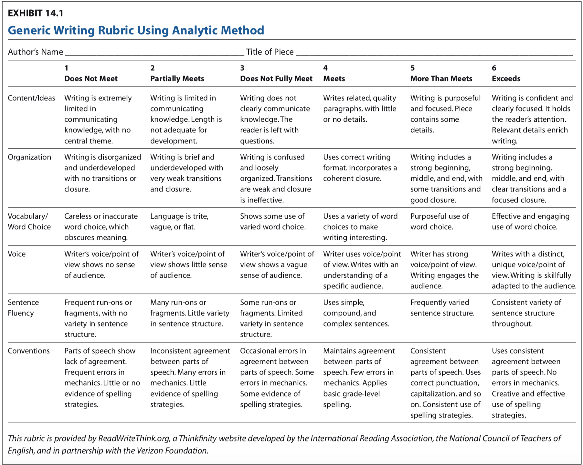

Slide 10
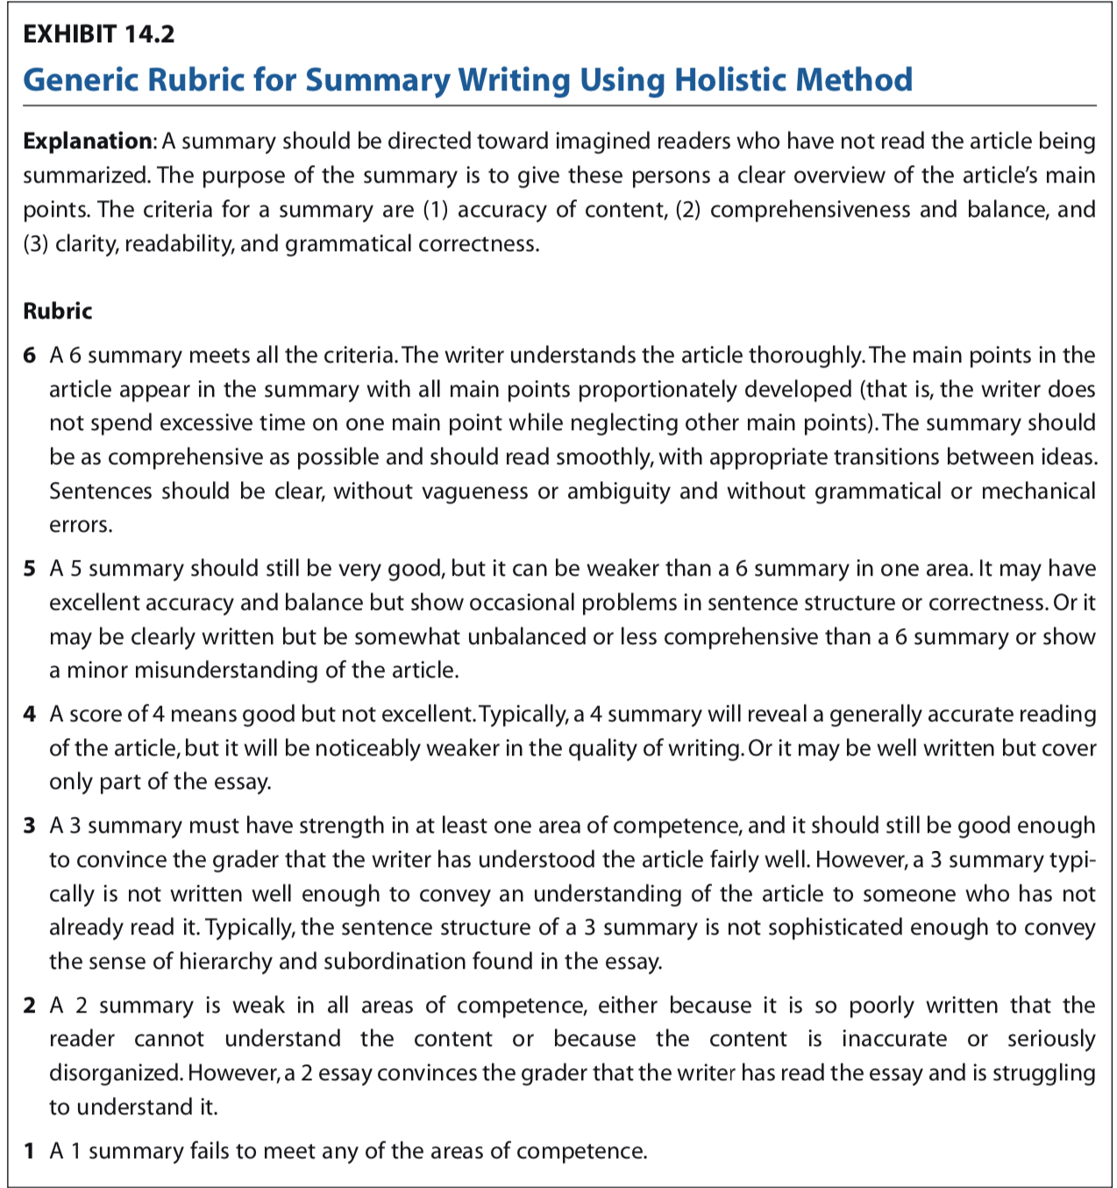

Slide 11
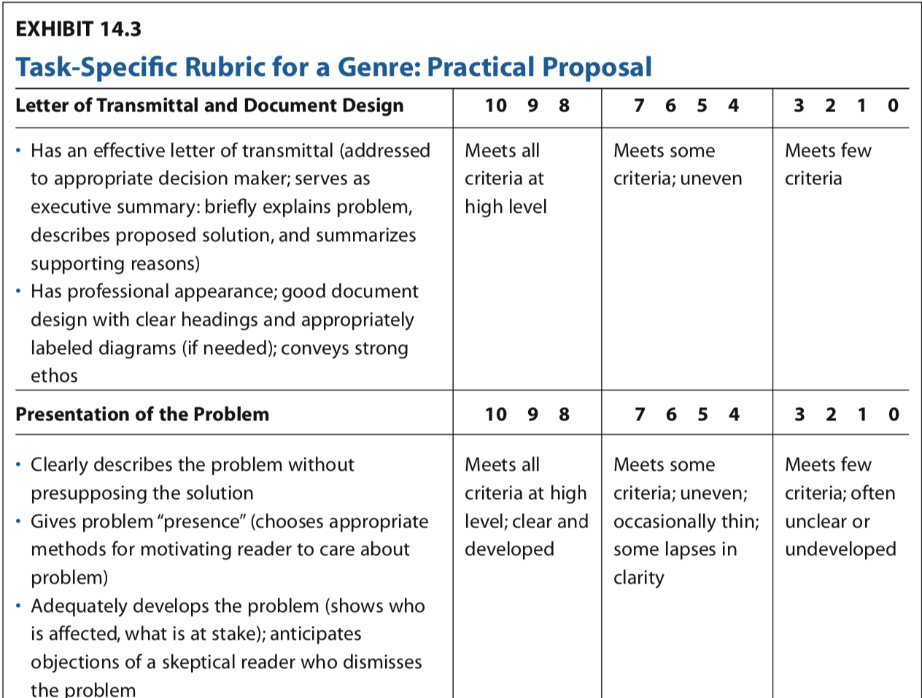

Slide 12
Rubric at the beginning, not just at the end
Spend class time reviewing the rubric and informally assessing students’ understanding
Define the terms you use on your rubric
If you assume certain prior knowledge, specify that in detail (not just “grammar”)

Slide 13
Informal vs. formal writing
Consider the objective of each assignment: to develop ideas, to work with concepts, to integrate research…
Informal writing does not need to be graded the same way you grade formal writing, no one-size-fits-all grading
Short formal assignments can be used to break down the skills identified in the rubric – e.g., methods or literature review

Slide 14
More to consider
Model your grading process:
  Ask students to assess sample writing using your grading criteria
  Teach the concepts you will evaluate using writing samples
Get clear about the learning objectives
Make sure grading criteria are based on objectives
Decide how you will use the writing center
You don’t have to assign a research paper, but if you do, why?
  to learn to find, comprehend, and evaluate sources?
  to demonstrate competence in disciplinary conventions?

Slide 15
What will you try?
What is helpful to you?
What challenges have you experienced in the past when grading?
How can rubrics help you?
How can rubrics help your students?

