Slide 1

WEST CHESTER UNIVERSITY
DEPARTMENT OF NUTRITION
SENIOR/GRADUATE RECOGNITION CEREMONY

Slide 2
Who We Are....
The Things We Do....

Slide 3
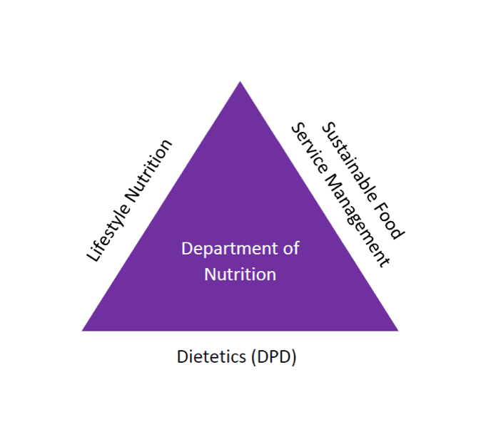
Now We Are Three!
Two New Concentrations!

Slide 4
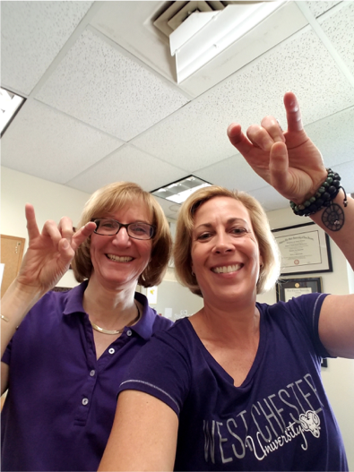
Our Fearless Leaders!
Jana Davis – Department Secretary
Dr. Christine Karpinski – Department Chair
RAMS UP

Slide 5
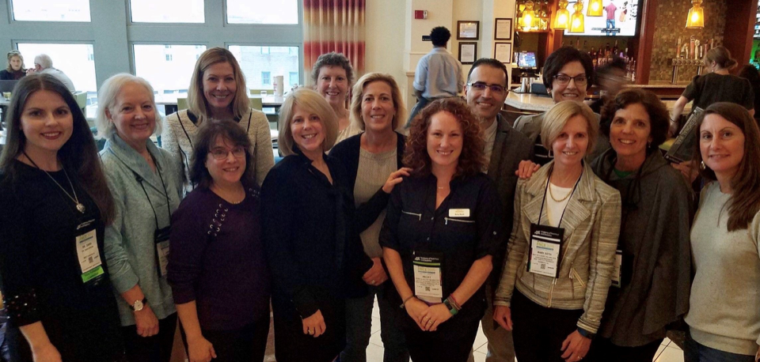
Our Faculty

Slide 6
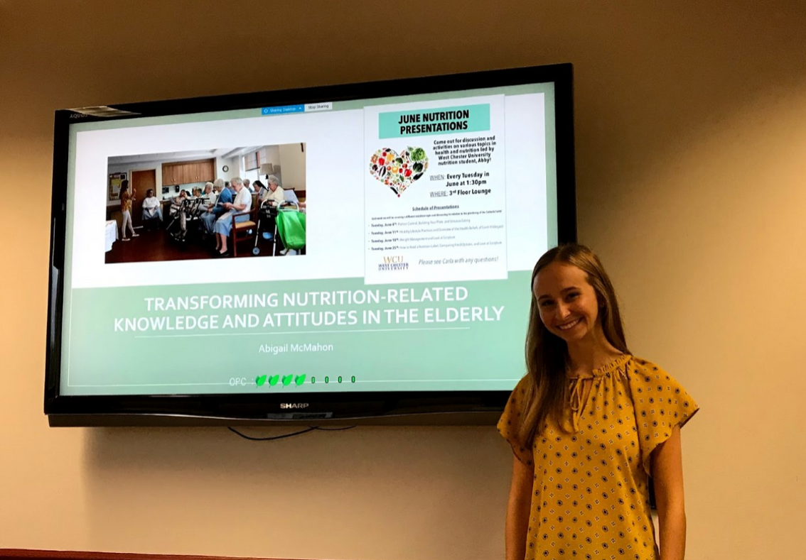
Proud to Present!
Research
day

Slide 7
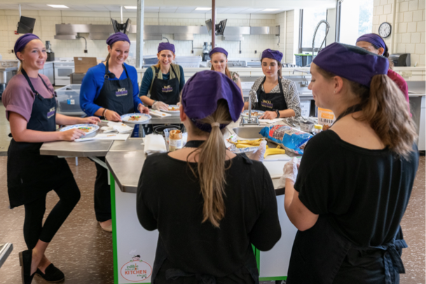
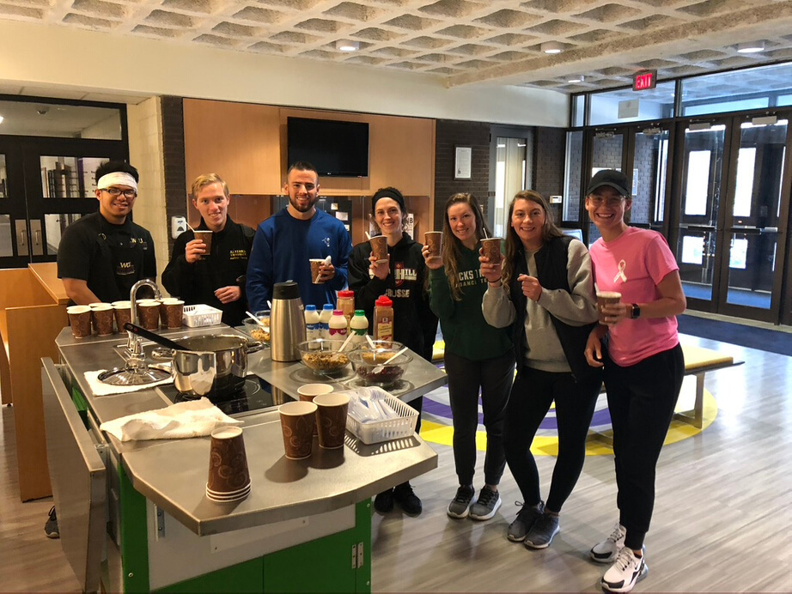
Bringing Nutrition to You!
Mobile Kitchen!

Slide 8
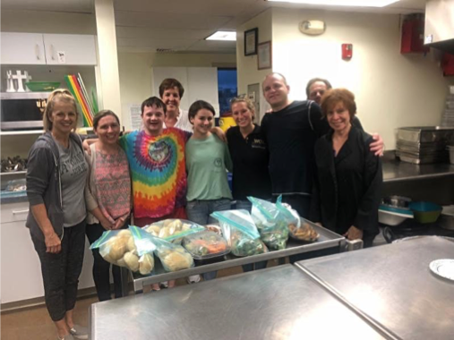
We Work with Persons with Disabilities
emo with athlete
united Methodist church's Wednesday night out

Slide 9
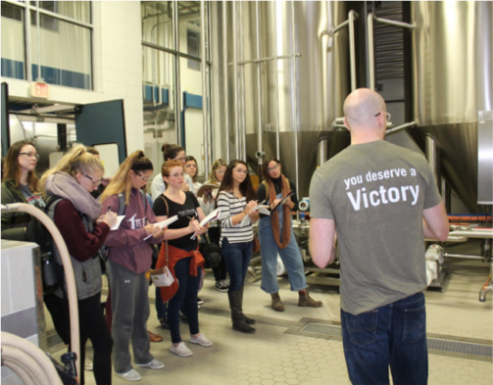
Exploring Food Science in Industry
victory brewing company Excursion!

Slide 10
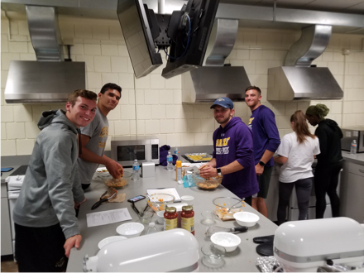
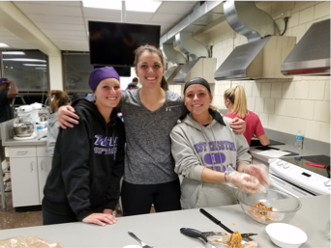
Educating Our Athletes
Cooking demo with athletes

Slide 11
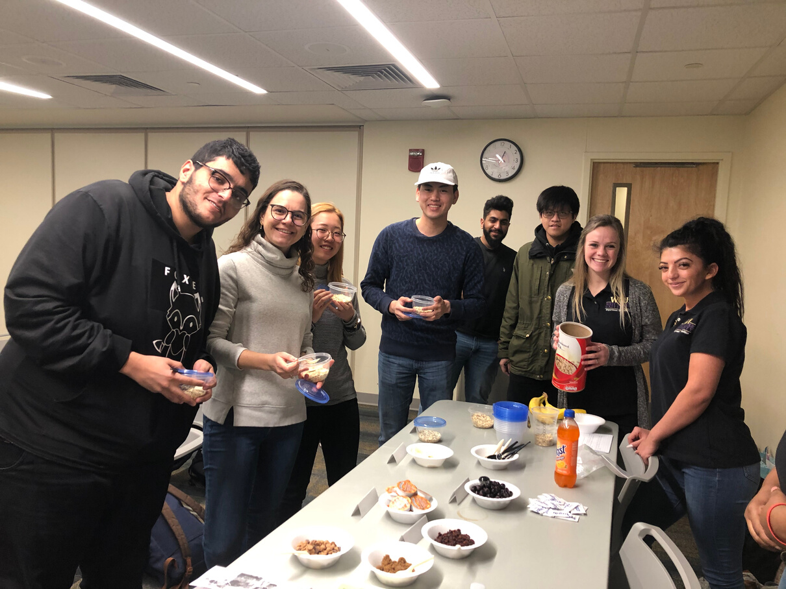
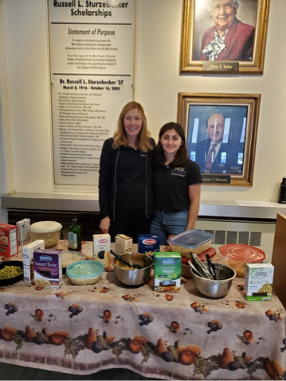
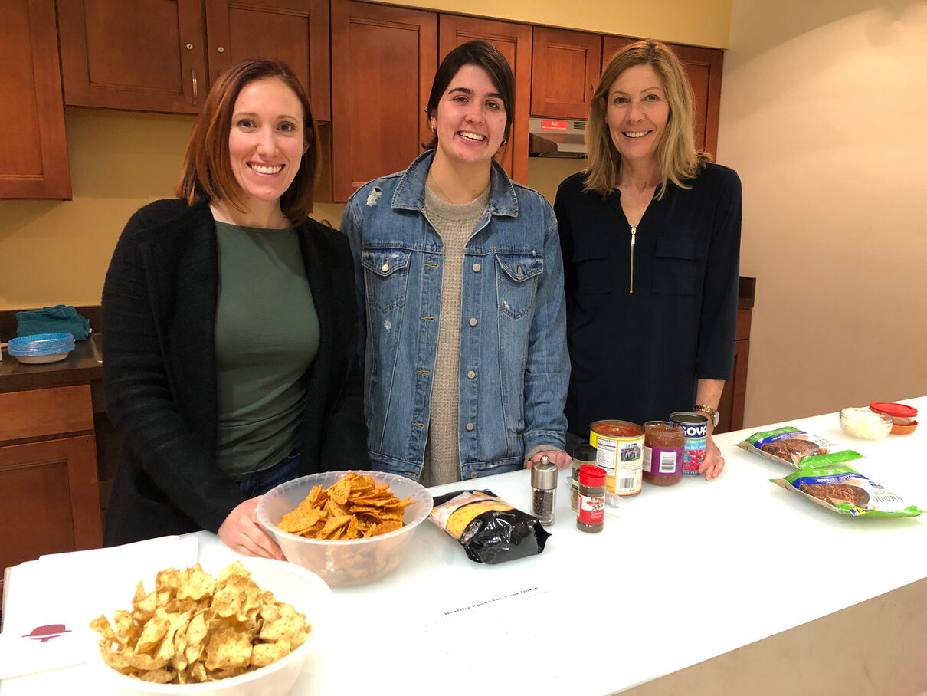
Lifestyle Nutrition Club
W
emo with athlete
emo with athlete
Food
demos!

Slide 12
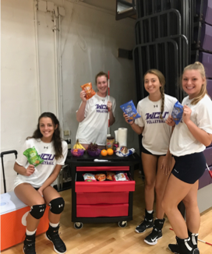
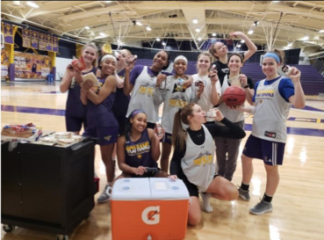
Fueling our Golden Rams!
fueling
stations

Slide 13
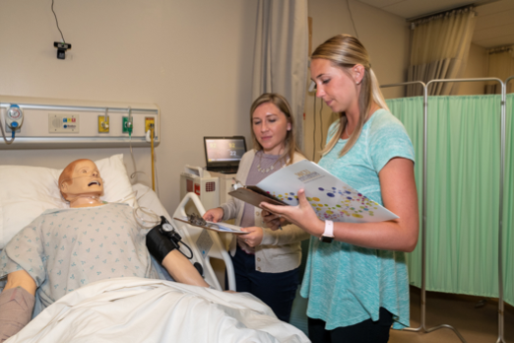
Interns in Action
Simulation Lab

Slide 14
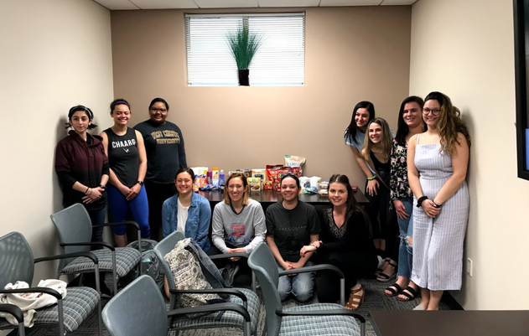
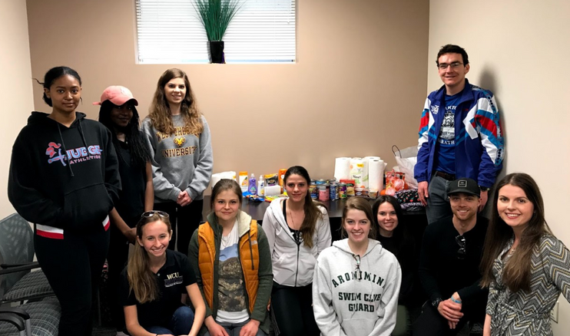
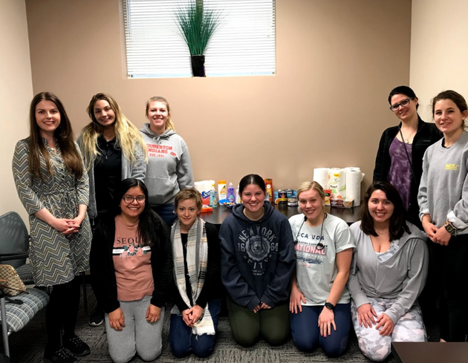
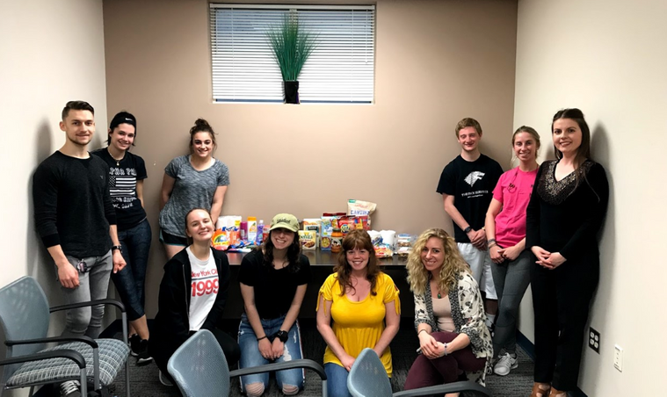
Resource Pantry
Service Learning in practice!

Slide 15
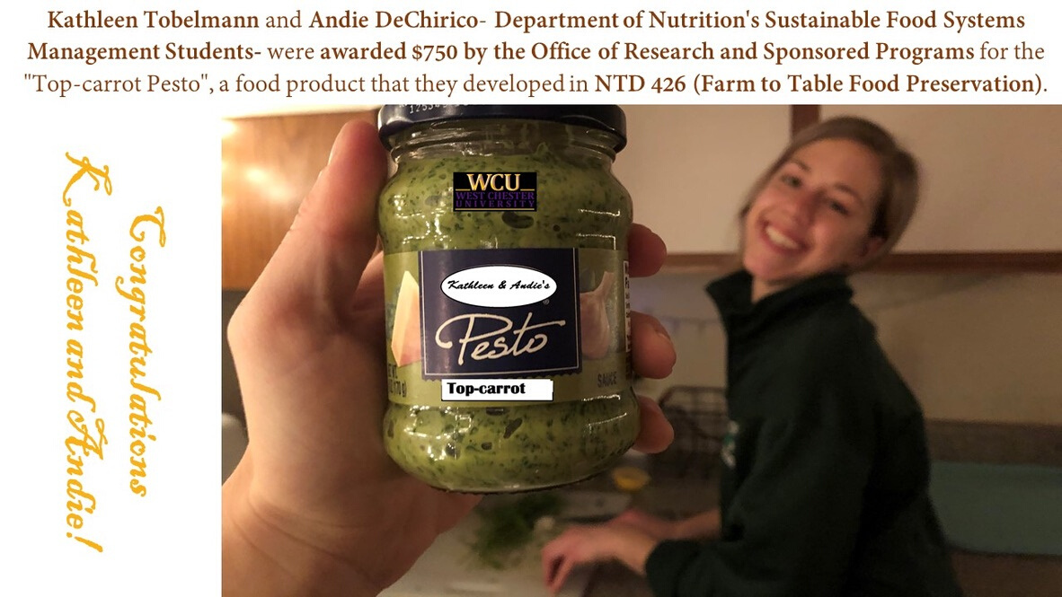
Creating New Foods!
WE HAVE A WINNER!

Slide 16
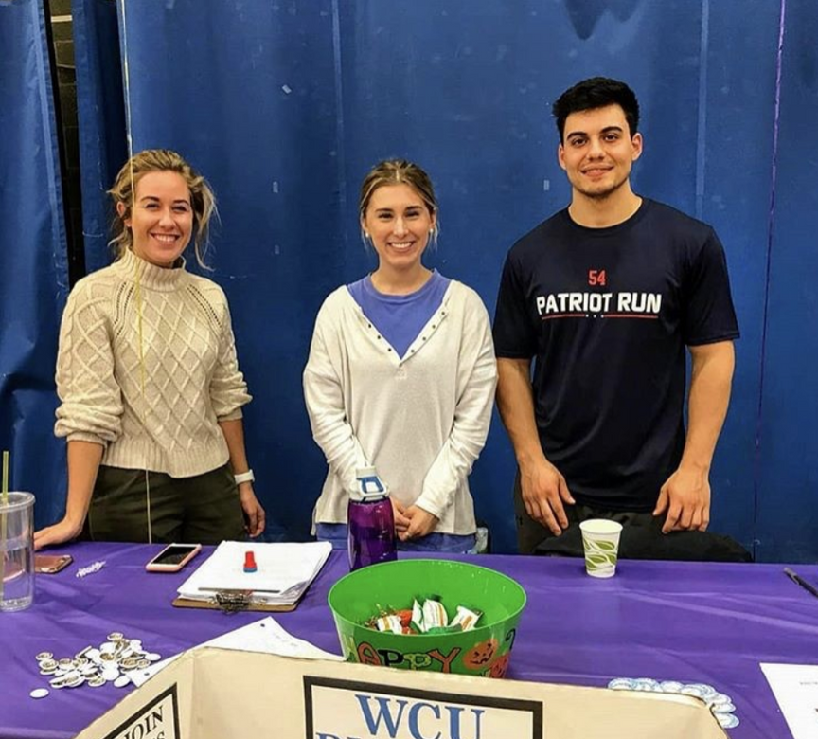
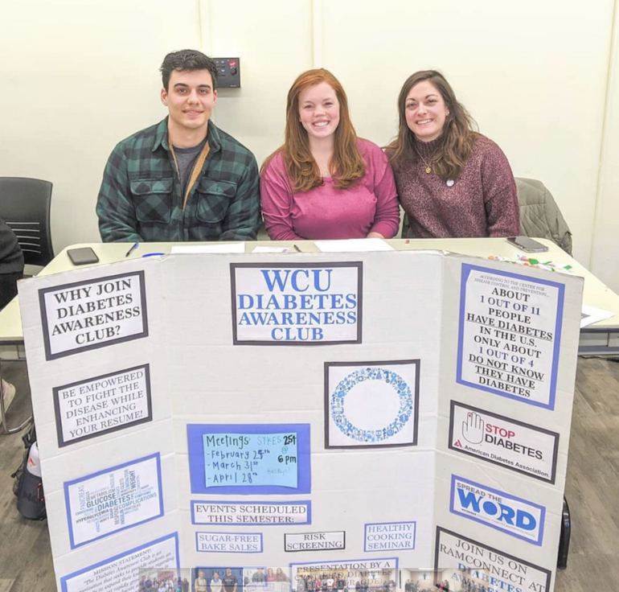
Education in Action!
Diabetes
awareness
club

Slide 17
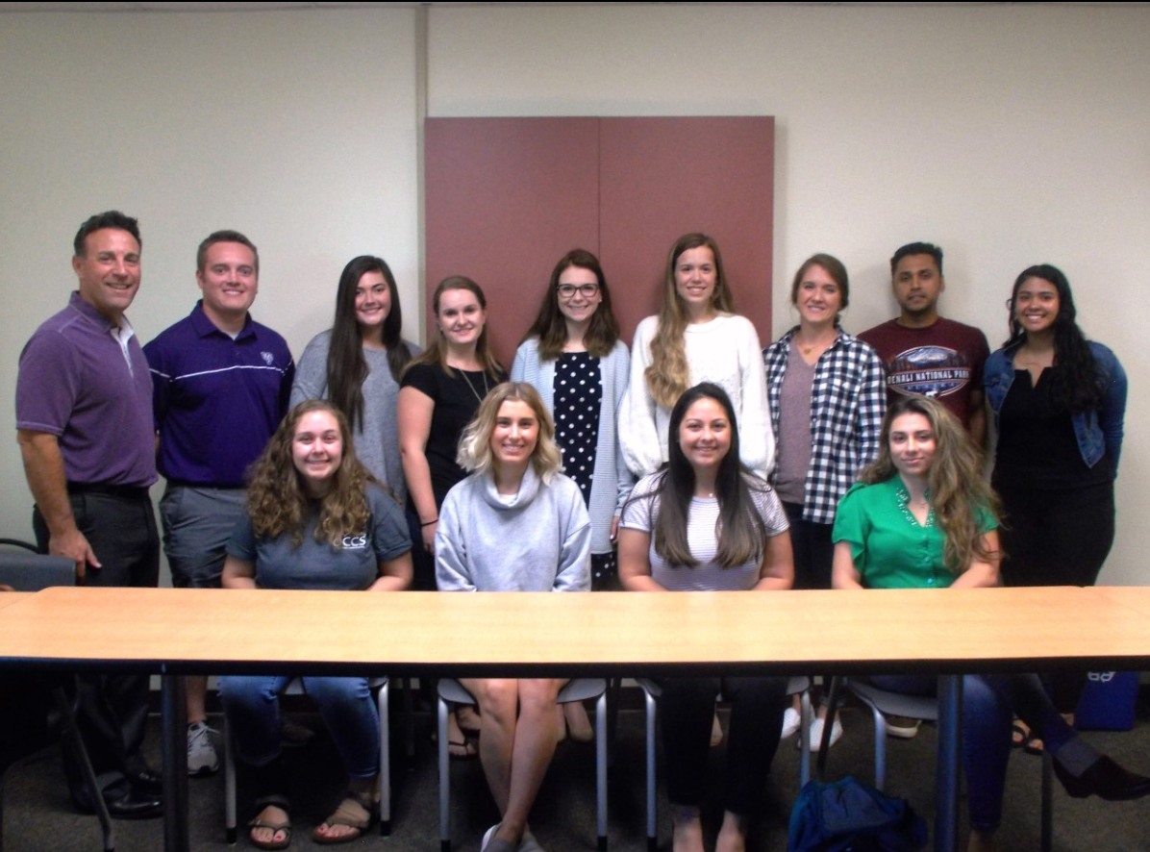
Hanging with the Dean!
W

Slide 18
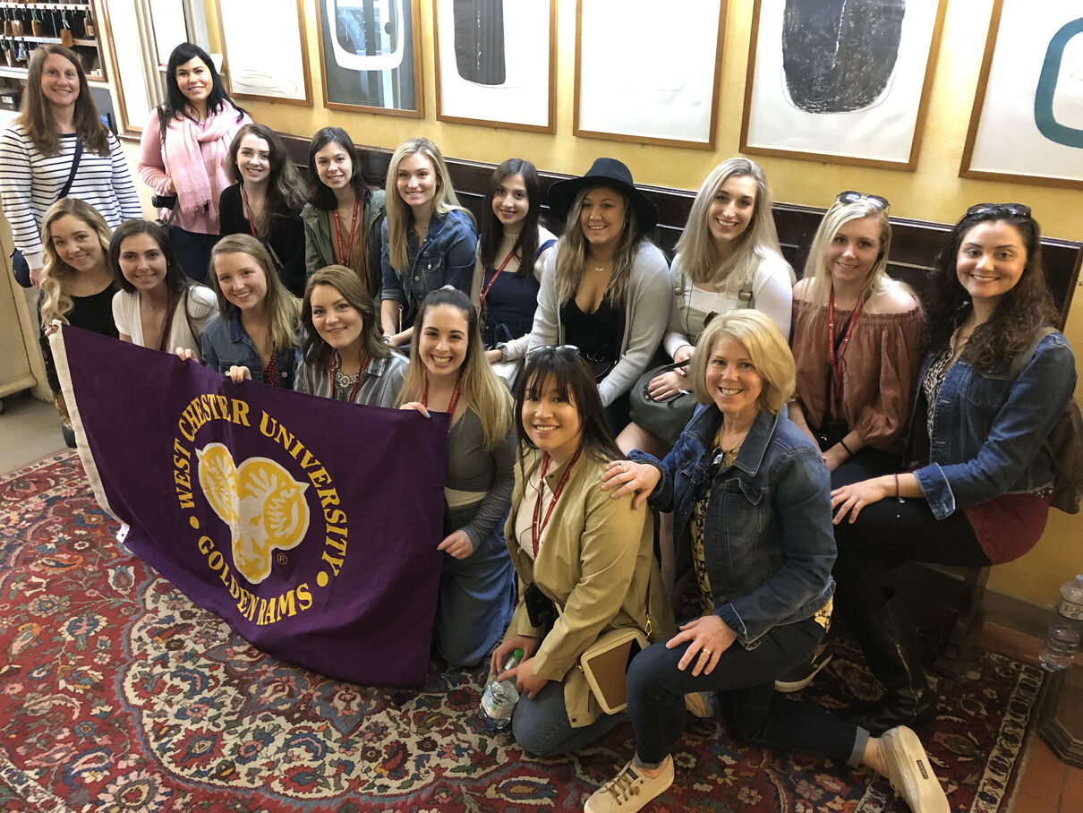
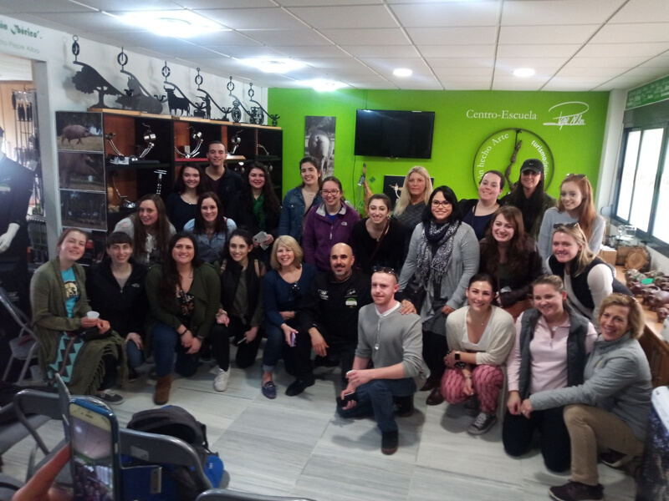
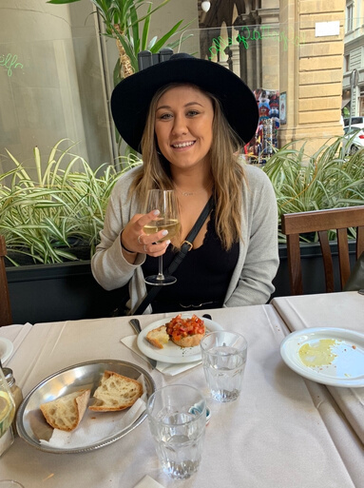
We Travel, Learn, and Eat!
Italy Study Abroad!

Slide 19
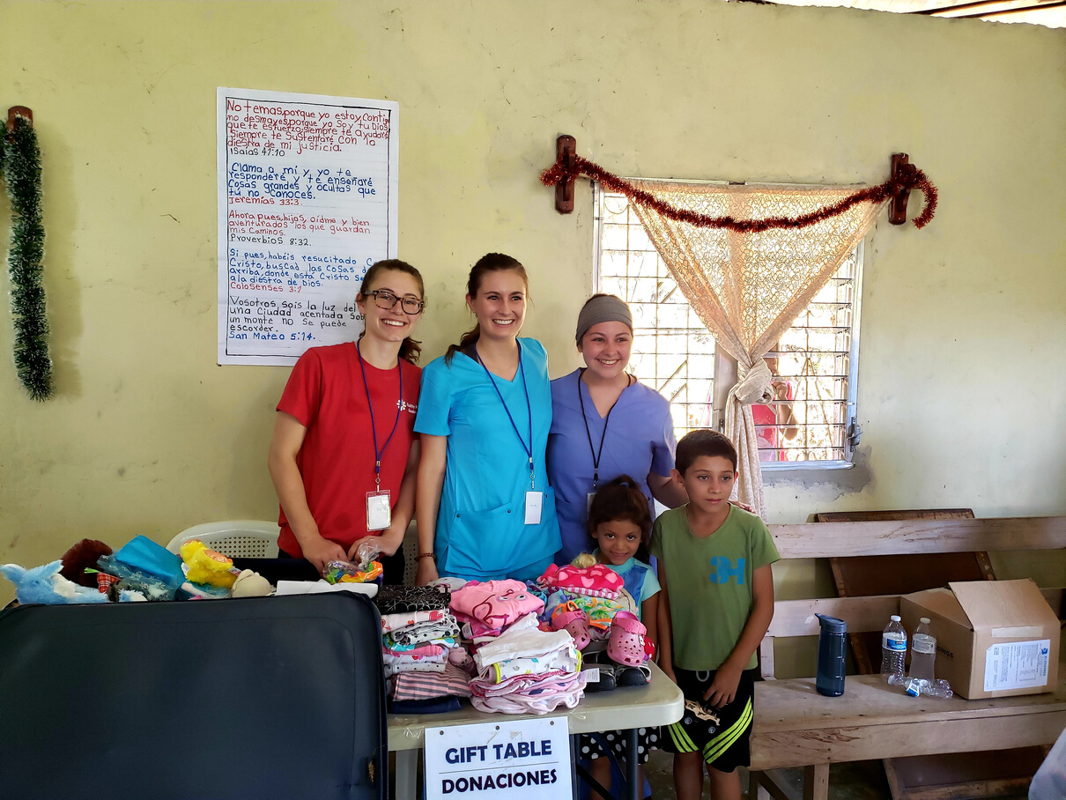
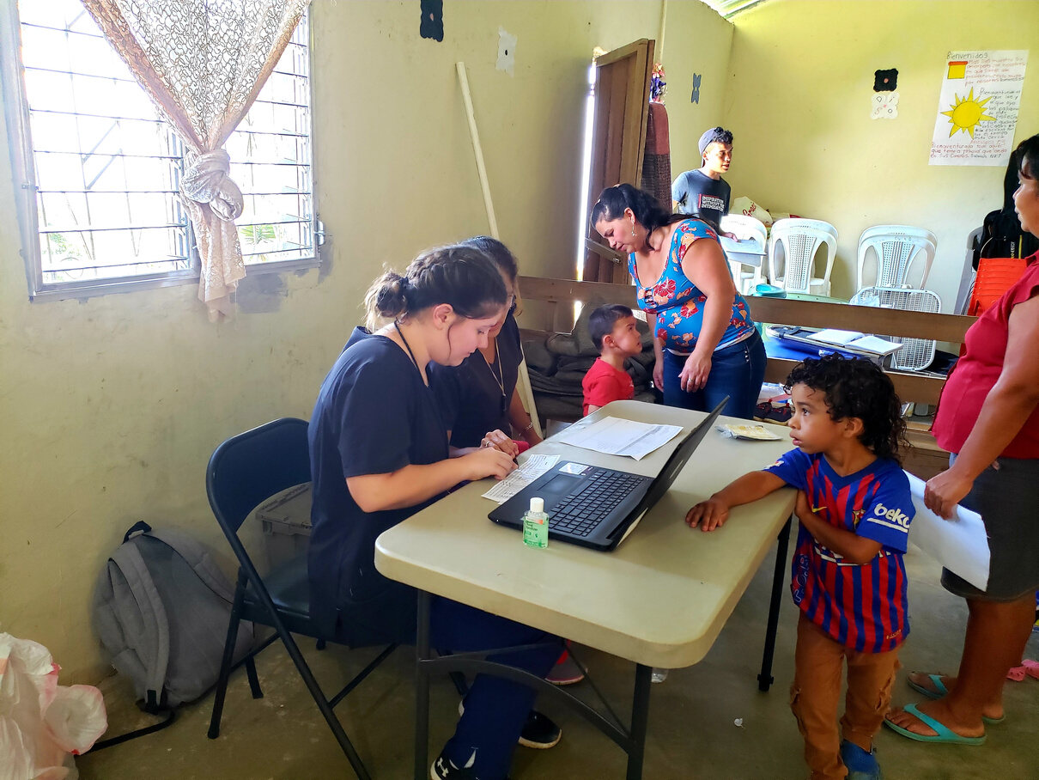
Honduras
Service
Learning

Slide 20
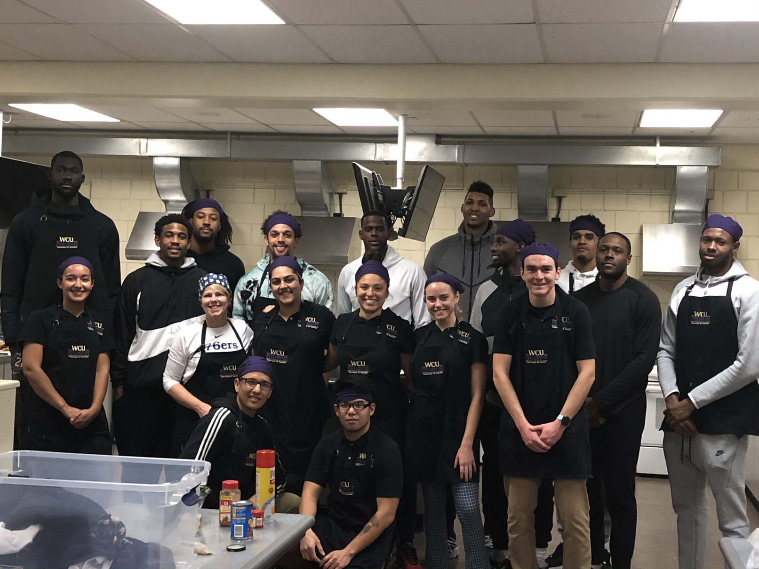
Educating Athletes
Delaware bluecoats food lab

Slide 21
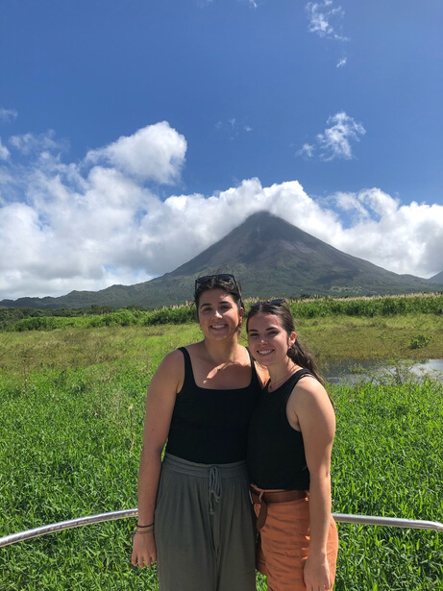
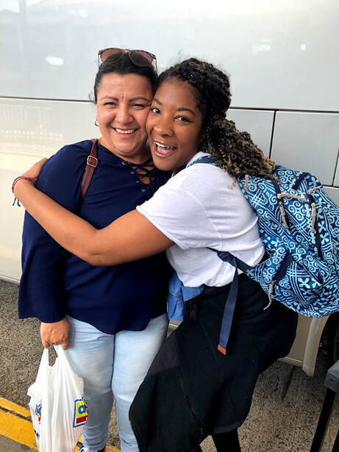
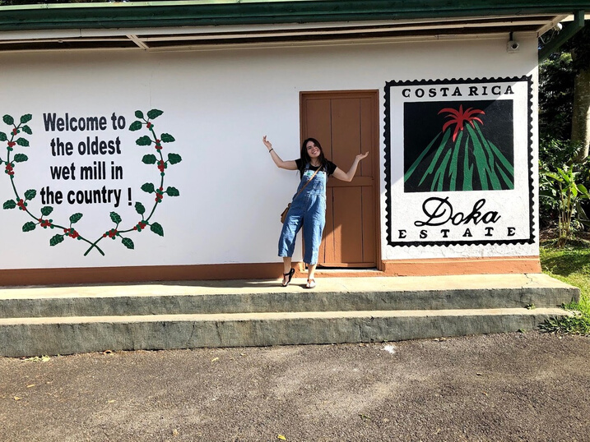
Sustainability Search!
costa
rica

