Slide 1

Exercise Science: Internship Application Process
Dr. Melissa A. Whidden (Exercise Science Coordinator)
Heather Showers (CHS, Administrative Assistant of Clinical Experiences)

Slide 2
Steps Involved in Securing Your Placement in EXS 490 Internship
Find an internship site that is willing to work with you the semester before you intend to graduate
Submit the online internship application (BEFORE the due date)
Be patient and work on collecting your documentation
Submit correct documentation to your MyWCU portal (BEFORE the due date)
Receive an official enrollment email from Dr. Whidden

Slide 3
Step 1: Find an Internship Site
EXS 490 Internship MUST be completed in your last semester
  EXS 490 is your capstone class, a Speaking Emphasis class, and a Writing Emphasis class
  3-credit internship: 125 hours at your site
  4-credit internship: 165 hours at your site
  5-credit internship: 205 hours at your site
  6-credit internship: 250 hours at your site
You must apply for your placement in EXS 490 the semester before you intend to take it
Find an internship site that is willing to work with you
    Approach potential sites dressed professionally and explain your situation correctly. You are an Exercise Science undergraduate student looking for an internship experience.
    Never send an email as your initial outreach, go into the facility or call!

Slide 4
Step 1: Find an Internship Site (continued)
You are required to find your site; we do NOT place you at a facility.
We have a list of sites where students have interned before, but this list is not a guarantee that the site will work with you.
The list is an excellent starting point for you because if the site is listed, that means we have a contract already in place with the facility.
If you want to intern at a site that is NOT ON THE LIST, that is okay too. However, your application process will be longer, so be patient!

Slide 5
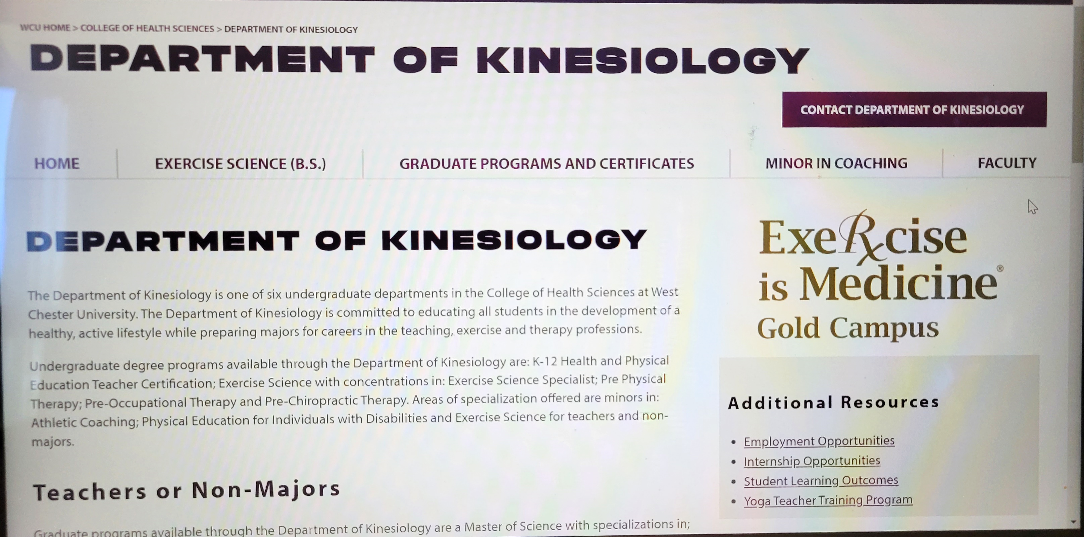
Step 2: Submit Online Internship Application
Go the Kinesiology home page and you will see a gray box on the left. Click on Internship Opportunities

Slide 6
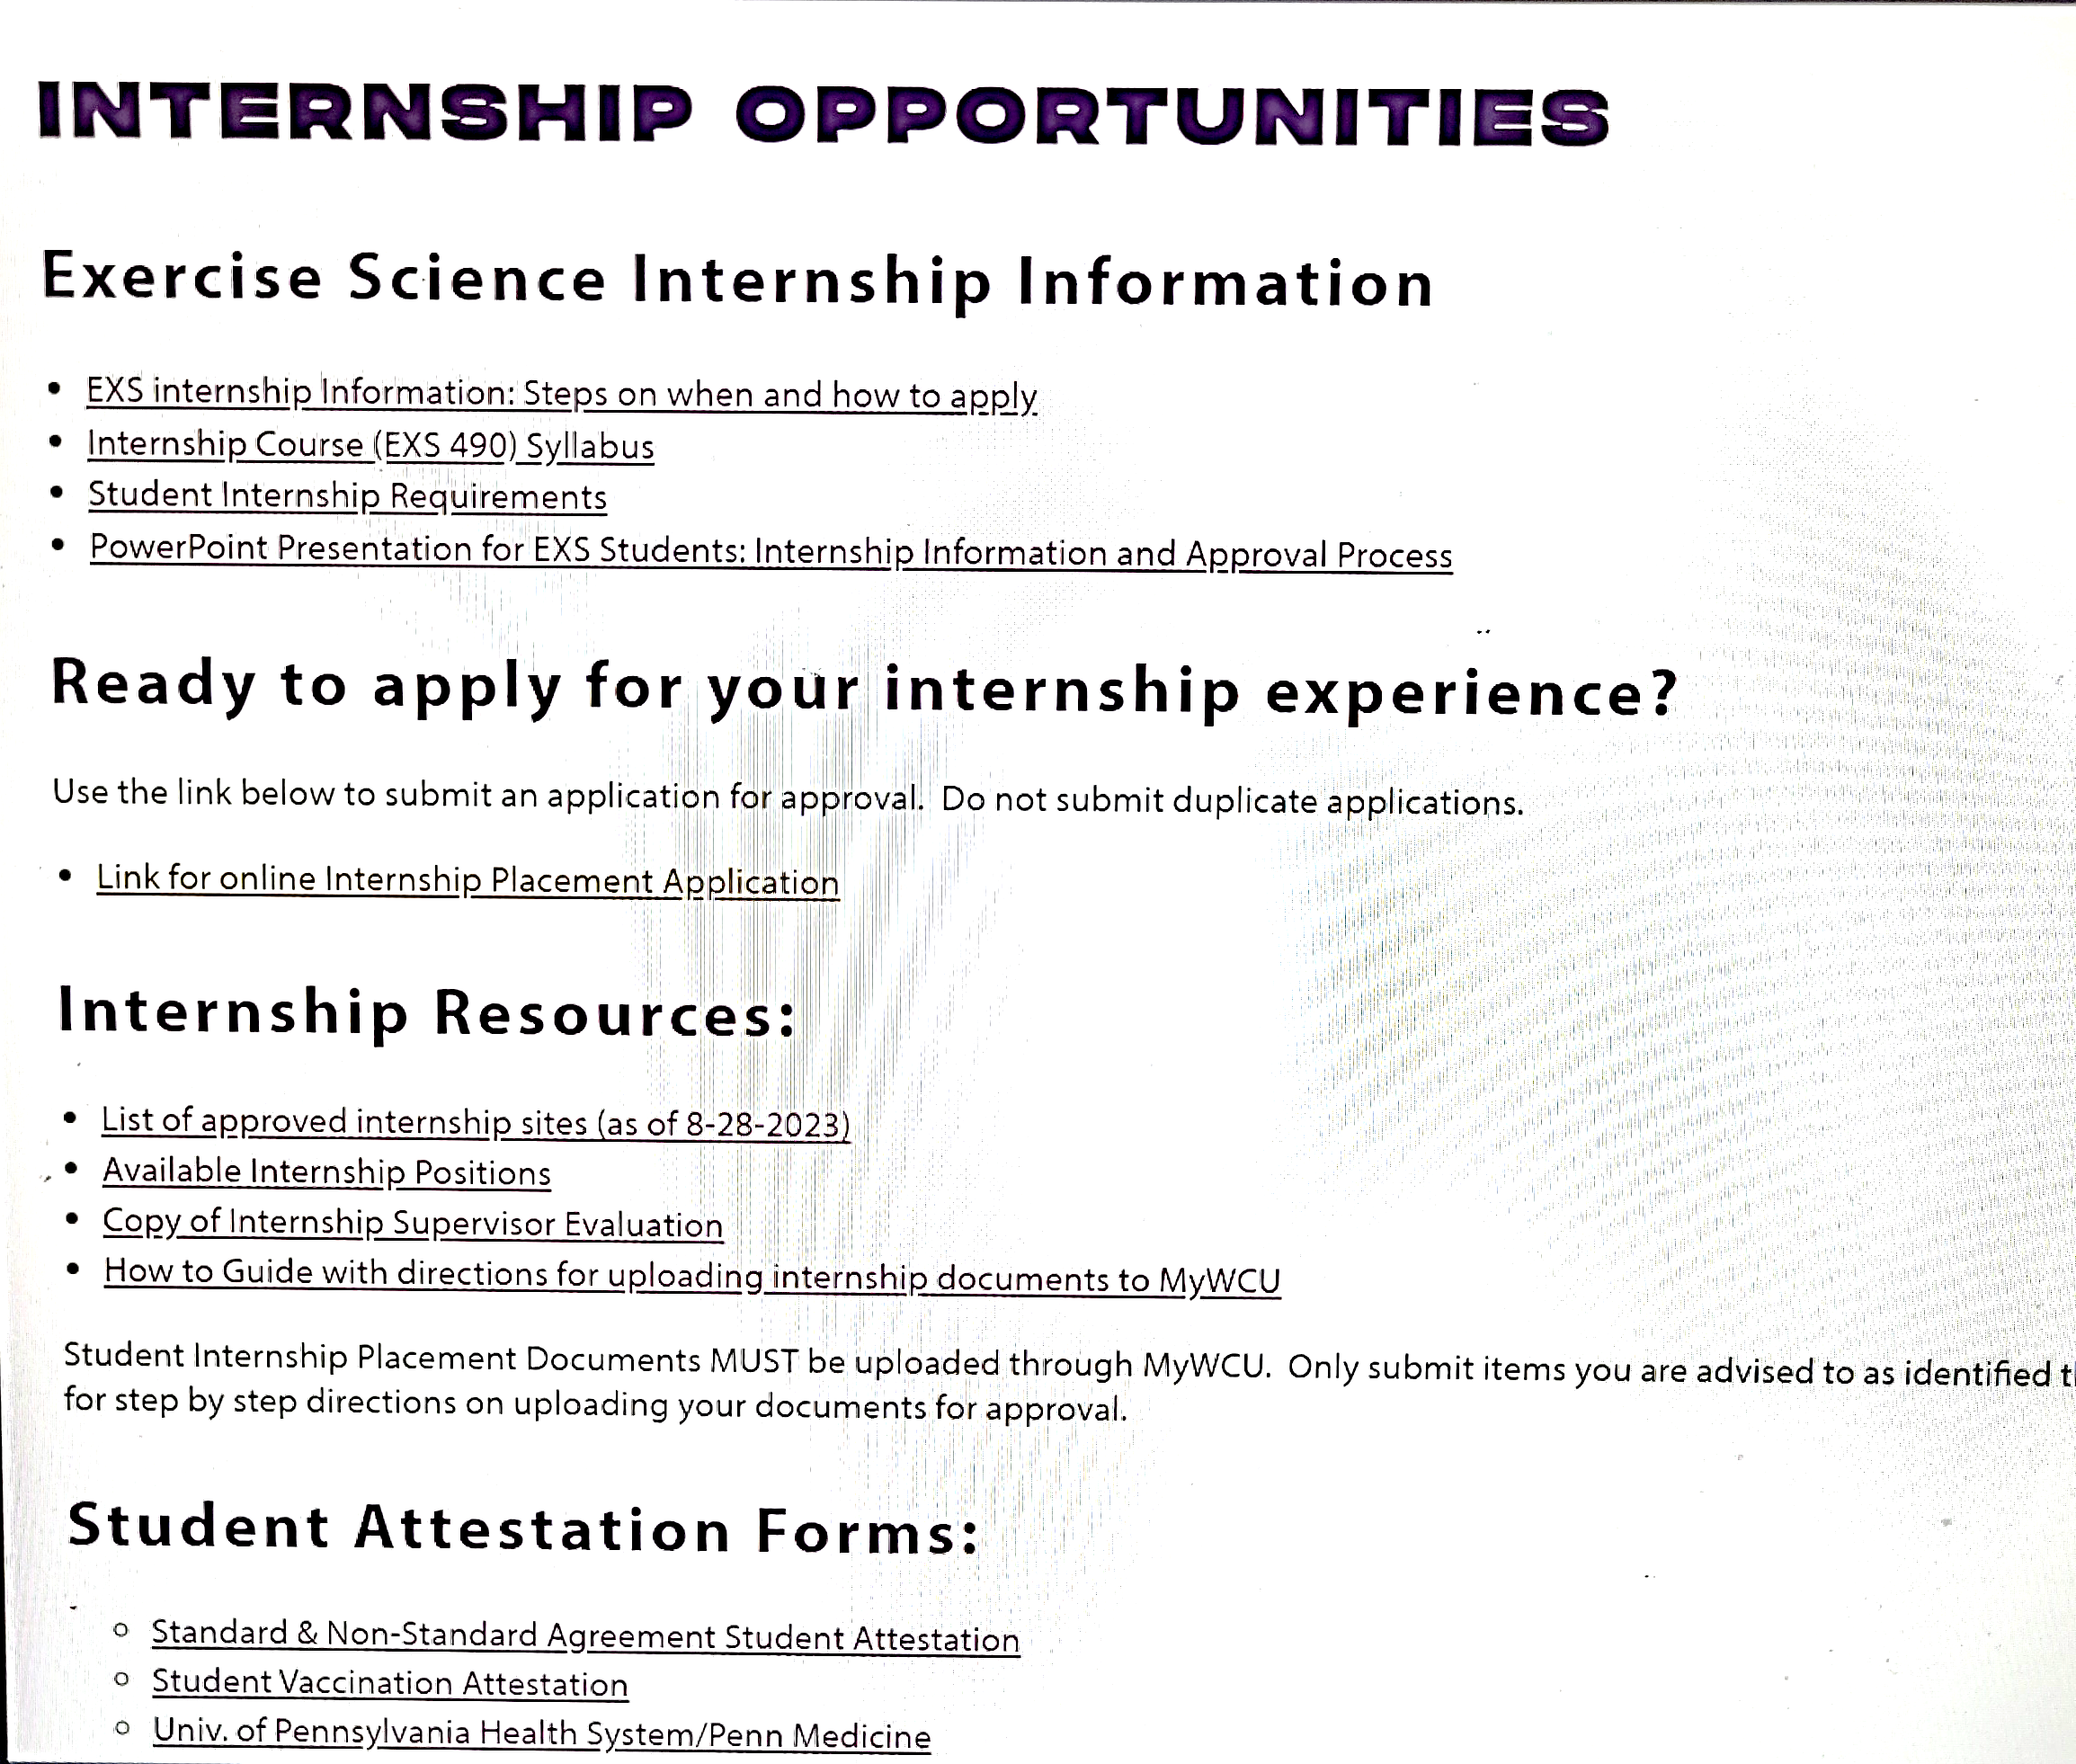
Step 2: Submit Online Internship Application (continued)
Application asks for your basic information
Year and semester that you want to take EXS 490
Credit number
Type of internship; Pre-PT, Pre-OT, Pre-Chiro, EXS, or other
Site information: name of facility, address, phone number, name of supervisor, and email address of supervisor
For a Spring semester placement, applications are due Oct 1st
For a Summer/Fall semester placement, applications are due Mar 1st

Slide 7
Step 3: Be Patient and Collect Documentation
After you submit the application, you will receive a generic email from no-reply@wcupa.edu confirming that we received your application (no action is required on your part)
If we have a contract in place with your site, you will receive another generic email within 1-2 weeks of your application submission
If we DON’T have a contract in place with your site, BE PATIENT. The contract process takes time and Heather is working hard to establish it (can take 1 week-3 months)

Slide 8
Step 3: Be Patient and Collect Documentation (continued)
While you wait for the second generic email, you should gather the following documents (in PDF):
  Professional resume
  CPR certificate (can’t expire during internship semester)
  Professional liability insurance with limits of $1million/$3million (you must purchase a policy)
  Signed attestation agreement
  Signed student vaccination attestation agreement
Once the contract is in place, you will receive the second generic email from no-reply@wcupa.edu that will list the required documents that you must upload for approval (DON’T DELETE THIS EMAIL)

Slide 9
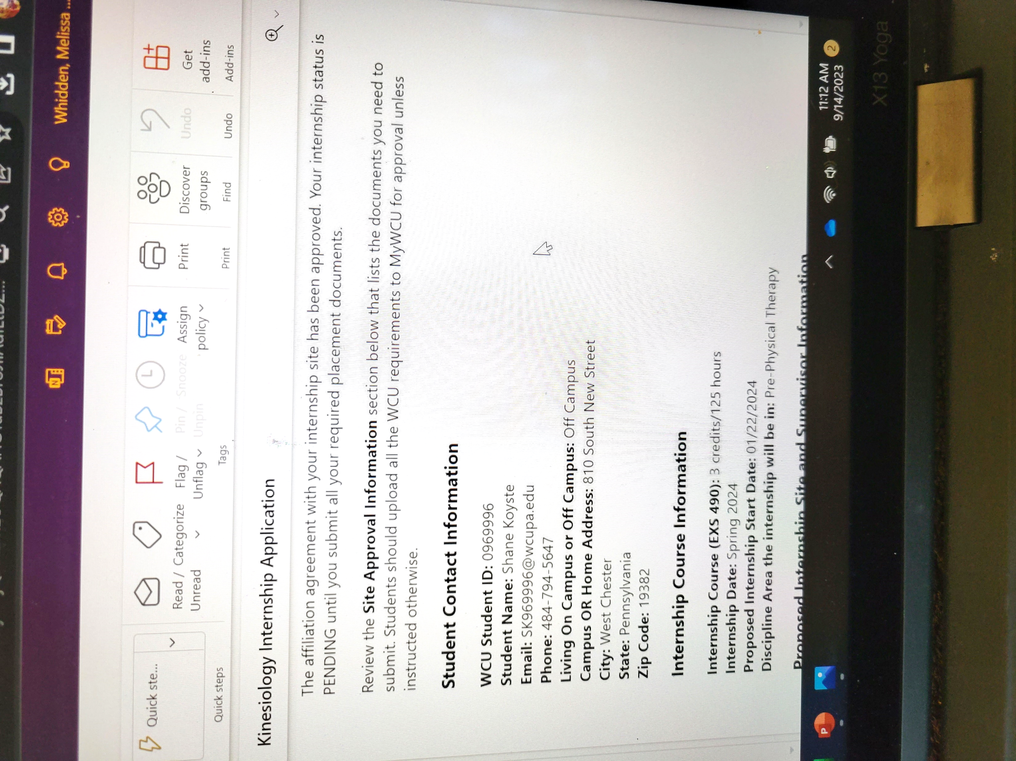
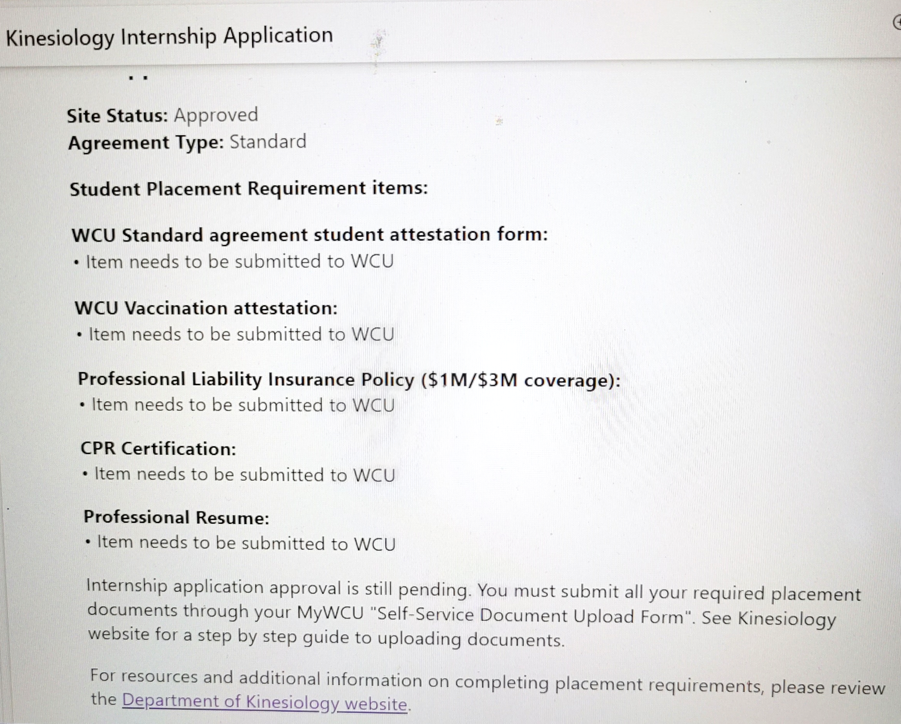
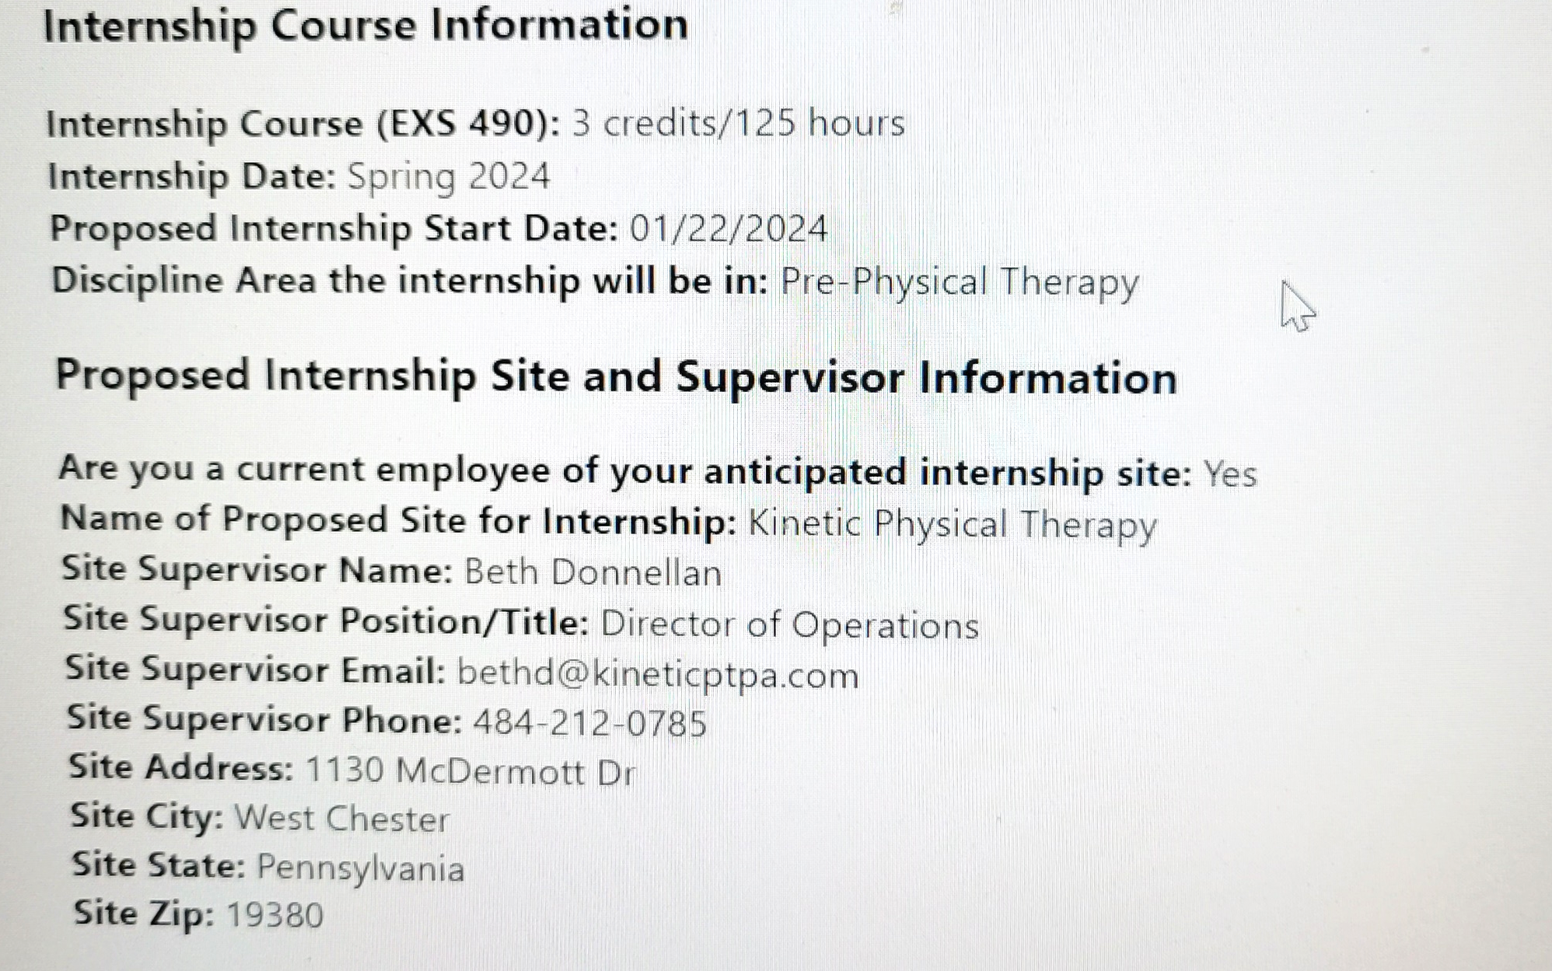

Slide 10
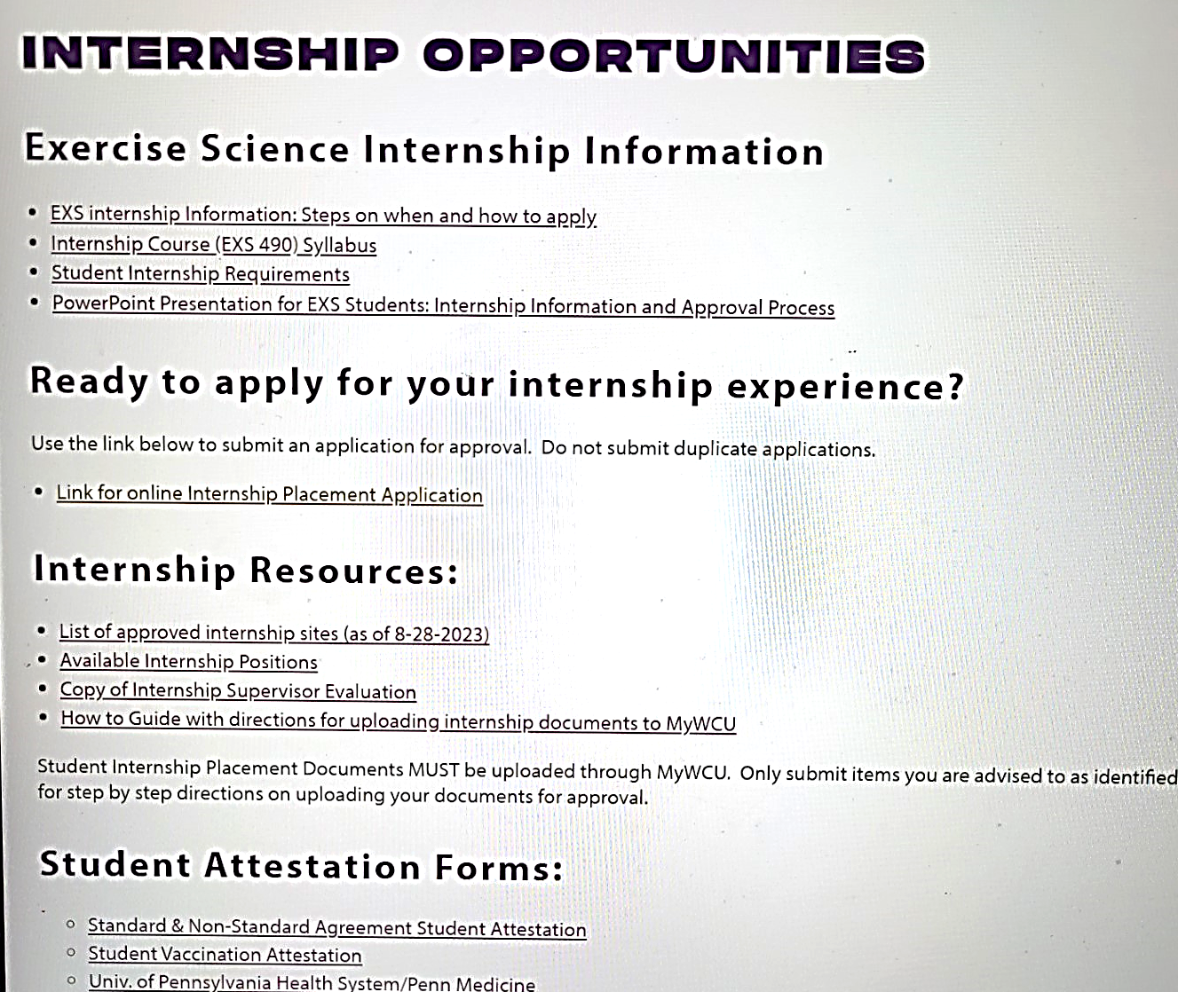
Students attest they understand their responsibilities of the internship experience and agree to comply with all ongoing requirements for placement by WCU and the internship site.

Slide 11
Step 4: Submit Correct Documentation to MyWCU portal
Log into your MyWCU account and click on Academic Records
Click on Useful Links
Select Self-Service Document Upload Form
For a Spring placement, documents are due the third week of November
For a Summer/Fall placement, documents are due the third week of April

Slide 12
Additional Documentation
Most internship sites will require additional documentation. You will be responsible for obtaining that documentation and providing it to WCU (if stated in 2nd generic email) and your site
Additional documentation may include:
    Criminal background check
    FBI fingerprints
    Child abuse clearance check
    Health screenings (physical exam, drug test, TB test, etc.)
    Vaccination documentation (COVID-19, Flu, MMR, Hep B, Varicella, Tdap, etc.)
    HIPAA training/orientation
It is the student’s responsibility to confirm all site requirements with their supervisor prior to beginning on-site hours.

Slide 13
Any Questions?

Slide 14
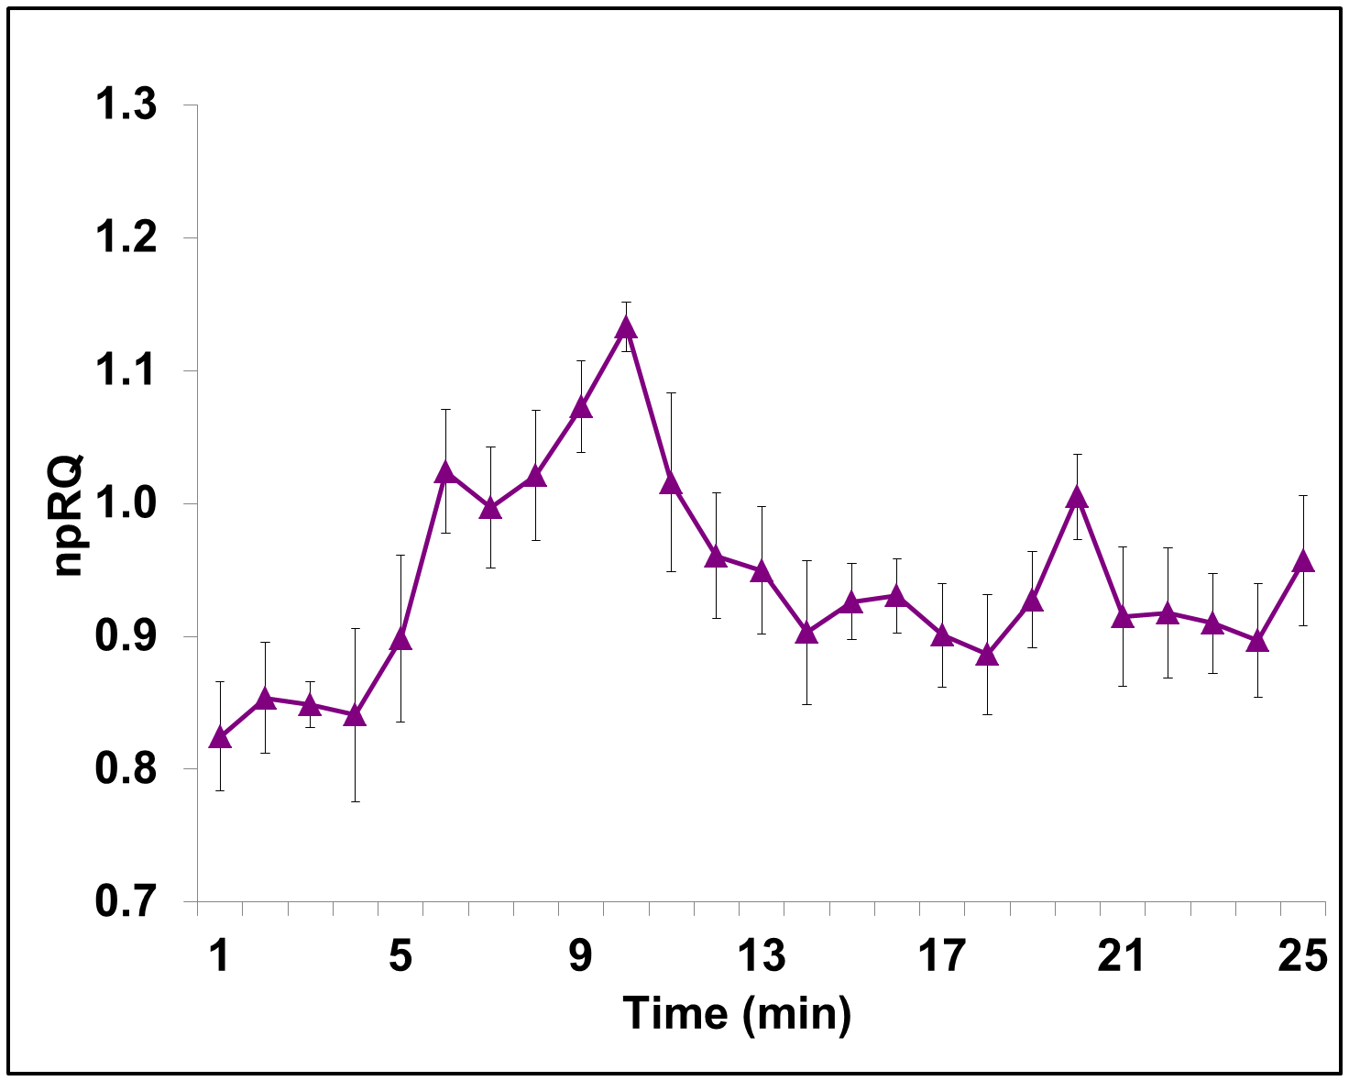
Step 5: Receive Official Approval from Dr. Whidden
When all your documents have been successfully uploaded and verified, you will receive an email from Dr. Whidden
The email will confirm that we will add EXS 490 to your schedule
    Email heading: Approved EXS 490 Internship for ___________ semester
The email will also inform you that you can’t begin to intern at your site UNTIL you have met with your assigned EXS 490 professor to discuss the syllabus
Reminder: You CAN’T add EXS 490 to your schedule!

