Slide 3
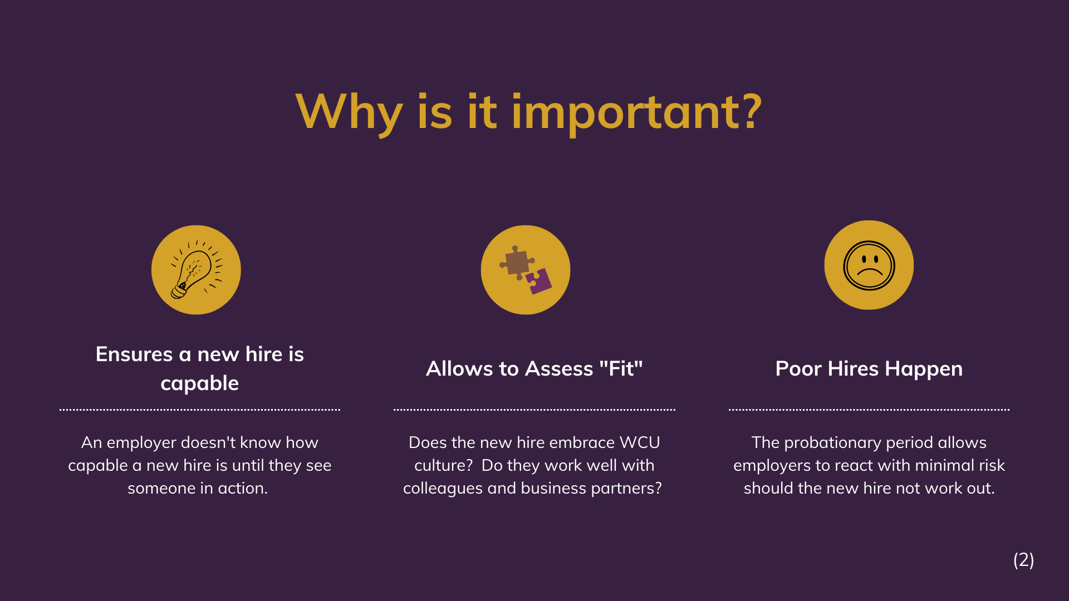

Slide 17
Resources
Employee and Labor Relations is available to answer questions. Call us.
Bill Helzlsouer- x3109
Lauren Krautheim- x3158
Corin Chapman- x3116
Organizational Development is available to discuss performance improvement strategies, ways to have difficult conversations with employees, and to review draft documents before introducing LR into the conversation. Call usl
Jaime Whitcomb- x3370
CLICK to access 3,6,9 month probationary form for SUA employees.
CLICK to access performance standards evaluations for AFSCME, Police and Security, and Nurses
(16)

