Slide 1


EPaDel Fall 2018 Section Meeting
West Chester University
November 3, 2018

Slide 2
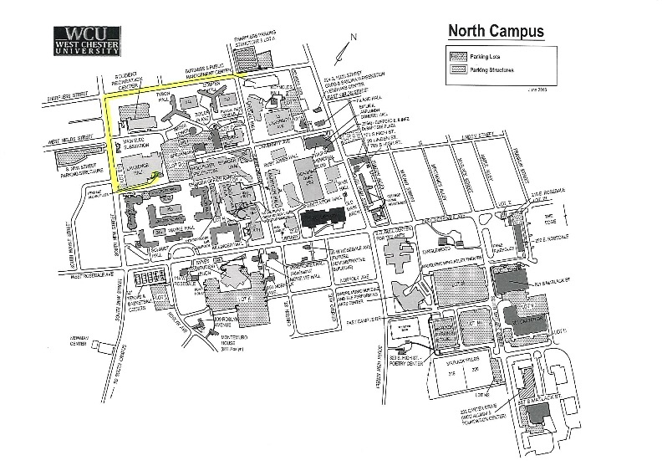

Campus Map

Slide 3

Schedule
Most events take place in the Business and Public Management Center (BPMC).
11:45 - 12:00 | Section Awards & Business Meeting BPMC 101
12:00 | Group Photo BPMC Lobby
12:00 - 1:20 | Lunch & Table Discussions Lawrence Dining Hall
1:20 - 2:15 Concurrent sessions | Faculty Speaker Session Various Locations
 | Student Activity
2:15 - 3:10 | Student Speaker Session Various Locations
3:10 - 4:05 | Deanna Haunsperger, President of MAA A Glimpse at the Horizon BPMC 101
4:05 - 4:30 | Reception & Silent Auction Winners BPMC Lobby
4:30 | End of Meeting
8:30 - 11:45 | Registration BPMC Lobby
8:30 - 9:00 | Light Breakfast Reception (Coffee/tea, pastries) BPMC Lobby
9:05 | Welcoming Remarks Dr. Radha Pyati, Dean of the College of Sciences and Mathematics BPMC 101
9:15 - 10:10 | Alex Nakahara, The Phillies Analytics in Baseball -- It's More Than Just Numbers BPMC 101
10:10 - 10:50 | Coffee Break / Silent Auction BPMC Lobby / Seminar Room
10:50 - 11:45 | Kristin Lauter, Microsoft Research How to Keep your Secrets in a Post-Quantum World BPMC 101
Notes:
Vernon intro slides (2mins)

Slide 4
Invited Speakers
Alex Nakahara (The Phillies)
Talk: Analytics in Baseball -- It’s More Than Just Numbers
Biography:
  Alex Nakahara joined the Phillies in 2017 as a Senior Quantitative Analyst, creating analyses and tools for understanding and visualizing data for the Baseball Operations Department. He previously worked for four years at Northrop Grumman as a systems engineer in a variety of roles including as the lead researcher for several air traffic control research and development projects. Born in Philadelphia, he graduated from the Episcopal Academy in 2006. He received a BSE in Mechanical Engineering from the University of Pennsylvania in 2010 and a MS from MIT in Aeronautics and Astronautics in 2012.

Slide 5
Invited Speakers
Kristin Lauter (Microsoft Research)
Talk: How to Keep your Secrets in a Post-Quantum World
Biography:
Kristin Lauter is a Principal Researcher and Research Manager for the Cryptography group at Microsoft Research. Her research focuses on post-quantum cryptography, algorithmic number theory, elliptic curve, pairing-based, and lattice-based cryptography, homomorphic encryption, and cloud security and privacy, including privacy for healthcare. Her work has been featured in the press in articles in Science, Nature, American Scientist, and PNAS. She has published over 75 research articles and 5 books, her work appearing in venues ranging from the American Journal of Mathematics to the Journal of Biomedical Informatics and the Proceedings of CRYPTO and EUROCRYPT. Lauter has served the mathematical community as President of the Association for Women in Mathematics, and on the Council of the American Mathematical Society. She is a Fellow of the American Mathematical Society and the Association for Women in Mathematics. She was a co-founder of the Women In Numbers Network, a research collaboration community for women in number theory, and she serves on the Scientific Advisory Board for BIRS, the Banff International Research Station. Lauter is also an Affiliate Professor in the Department of Mathematics at the University of Washington. In 2008, Lauter, together with her coauthors, was awarded the Selfridge Prize in Computational Number Theory. She loves to engage audience with accessible lectures highlighting the importance of mathematics in society.

Slide 6
Invited Speakers
Deanna Haunsperger (President of the MAA)
Talk: A Glimpse at the Horizon
Biography:
Dr. Deanna Haunsperger is a professor of mathematics at Carleton College in Minnesota. Since her own undergraduate days, Deanna has been interested in increasing the number of students who pursue advanced degrees in mathematics. That passion has guided her as a former co-editor for Math Horizons (the Mathematical Association of America’s magazine for undergraduates) and as co-founder and co-director of Carleton's Summer Mathematics Program for Women (a successful, intensive four-week summer program to encourage talented undergraduate women to pursue advanced degrees in the mathematical sciences). She has chaired the MAA’s Strategic Planning Committee on Students and the Council on Outreach. Currently Deanna is President of the MAA. Deanna is married to fellow mathematician Steve Kennedy, and together they have two grown children.

Slide 7
Faculty Contributed Paper Sessions
Time | BPMC 208 | BPMC 210 | BPMC 211 | BPMC 212
1:20- 1:35 | Guoan Diao Holy Family University On the sum of squares of consecutive integers | Eva Goedhart Lebanon Valley College Using Continued Fractions to Solve Diophantine Equations | Chuan Li West Chester University Molecules and Proteins by a Differential Equation and Its Application in Biophysics | Samantha Pezzimenti Penn State Brandywine Minimal Lagrangian Capping Genus
1:38- 1:53 | Allison Kolpas West Chester University Engaging undergraduate students in research in mathematical biology at WCUPA | Jocelyn Quaintance University of Pennsylvania The Perfect Polynomial Cryptosystem | Asif Mahmood Penn State York Non-Newtonian power-law fluid flow in deformable porous media | Wing Hong Tony Wong Kutztown University of Pennsylvania On an Unconventional Graph Coloring Problem
1:56- 2:11 | Harry Gingold West Virginia University Prime Numbers and Factorization of Power Series | Lin Tan West Chester University A Hybrid local-global approach to solutions of some recursive relations | Baoling Ma Millersville University A Mathematical Model for an Amphibian Population with Distributed Birth and Metamorphosis Rates | Garth Isaak Lehigh University Voting profiles, Discrete Tomography, Edge Coloring Bipartite Multigraphs, 3-Dimensional Contingency Tables, …

Slide 8
Graduate Student Contributed Paper Sessions
Time | BPMC 204
2:15- 2:30 | Cameron Campbell West Chester University of Pennsylvania Solving the Interface Problem: An Alternating Direction Implicit Approach
2:33- 2:48 | Lane D'Alessandro West Chester University of Pennsylvania Modeling Individual Reproductive Fitness using Resource Allocation leading to a Post-reproductive Life

Slide 9
Undergraduate Student Contributed Paper Sessions
Time | BPMC 205 | BPMC 208
2:15- 2:25 | Grant Fickes Kutztown University of Pennsylvania Maximum proper diameter of 2-connected graphs | Melea Roman Cedar Crest College Representing integers as the sum of two polygonal numbers in the ring Zp, where p is an odd prime
2:26- 2:36 | Alexander Miller Kutztown University of Pennsylvania Extensions on Conway's Wizard Problem | Garrett Bowser Temple University Patterns in Collatz-Mapped Integer Trajectories
2:37- 2:47 | Jacob McCann Kutztown University of Pennsylvania Nagata-Smirnov Metrization Theorem | Alexander Vetter Villanova University Reed-Muller Batch Codes
2:48- 2:58 | Colin Jones Eastern University Vertex-Minimal Planar Graphs With Prescribed Automorphism Groups | Tarang Saluja Swarthmore College Greedy Avoidance of k-term Arithmetic Progressions
2:59- 3:09 | Rachel Chambers Michelle Ly Washington College Cobwebs, Bifurcations and Fractals | Benjamin Warren Swarthmore College Modeling Anyonic Systems: Group Theoreticity in Modular Categories

Slide 10
Undergraduate Student Contributed Paper Sessions
Time | BPMC 210 | BPMC 211 | BPMC 212
2:15- 2:25 | Levi C. Nicklas Shippensburg University of Pennsylvania Chomp: Some Winning Strategies | Bryn Woodling Elizabethtown College Portfolio Theory Analysis | Yinxi Li Franklin and Marshall College Motif Detection and Music Visualization
2:26- 2:36 | Ethan Clever Shippensburg University of Pennsylvania Euclid's Windmill | Magdalena Kalinowska Christopher Williams University of the Sciences in Philadelphia Password Security | Liz Dulac Millersville University of Pennsylvania Modelling a Human Skeleton using Physical Constraints
2:37- 2:47 | Christopher Craig Shippensburg University of Pennsylvania Exploring the USA MTS problem from April 1, 2018 | Ronald Boorman Jr Javonni Banks Natasha Stuckey University of the Sciences in Philadelphia Secrets of Origami | Jeremy Budgeon West Chester University of Pennsylvania Predation Risk's Eect on Snail Survivability and Fecundity
2:48- 2:58 | Vincent Sergi Ursinus College Ghost Series and a Motivated Proof of Bressoud's 4k - 2 Companion to the Andrews- Gollnitz-Gordon Identities | Owen Vazquez Chris Miller University of the Sciences in Philadelphia Keeler's Theorem | Yuqing Liu Ursinus College Equivalence of discrete Morse functions using persistent homology

Slide 11
Student Activity
Student Activity:
A Math Scavenger Hunt!
Clues will be hidden throughout the conference grounds. Logic, analysis, and some smart googling will lead teams to the final clue. The first team to submit the final clue will win amazon gift cards! Come and scavenge your way to a prize!
HINT: Come to Kristin Lauter’s talk for your first clue!

Slide 12
Student Paper Competition

Slide 13
Social Media
Wifi Connection: RamNet-Guest
You can find more detailed information, such as the abstracts of the talks, at the EPaDel website
http://sections.maa.org/epadel/
If you like us, do not forget to take pictures and post them on our Facebook page
facebook.com/MAA.EPaDel/
or twitter them at @MAA_EPADEL

