Slide 1
GENERAL LINEAR MODELS: Estimation algorithms
KIM MINKALIS

Slide 2
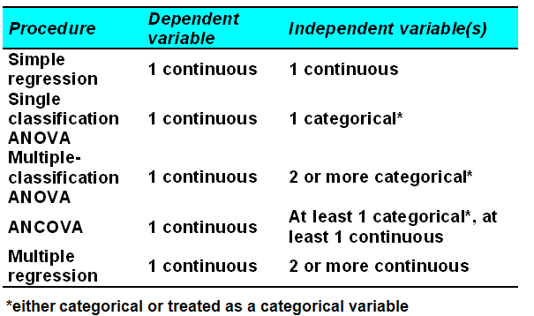
GOAL OF THE THESIS
Notes:
Mixed, Lifereg in words

Slide 3
THE GENERAL LINEAR MODEL
The general linear model is a statistical linear model that can be written
as:
where:
Y is a matrix with series of multivariate measurements
X is a matrix that might be a design matrix
B is a matrix containing parameters that are usually to be estimated
U is a matrix containing errors or noise
The residual is usually assumed to follow a multivariate normal distribution.
The general linear model incorporates a number of different statistical models: ANOVA, ANCOVA, MANOVA, MANCOVA, ordinary linear regression, t-test and F-test.
If there is only one column in Y (i.e., one dependent variable) then the model can also be referred to as the multiple regression model (multiple linear regression).
Notes:
Kim – Highlight X is anything: Continuous or Categorical.

Slide 4
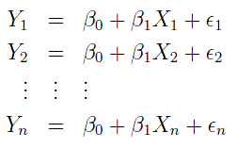
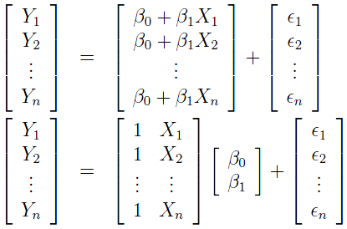
SIMPLE LINEAR REGRESSION
Simple Linear Model in Scalar Form:
Consider now writing an equation for each observation:
Simple Linear Model in Matrix Form:
X is called the design matrix
β is the vector of parameters
ε is the error vector
Y is the response vector
Notes:
When X is one single continuous “predictor”

Slide 5
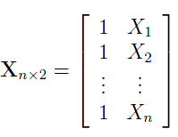
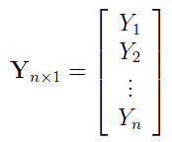
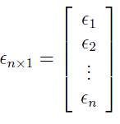
SIMPLE LINEAR REGRESSION
Distributional Assumptions in Matrix Form

Slide 6
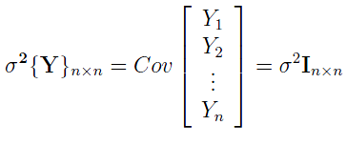
SIMPLE LINEAR REGRESSION

Slide 7
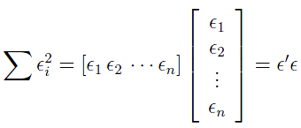
SIMPLE LINEAR REGRESSION
Least squares
ALTERNATE METHODS:
MLE
REML
GEE

Slide 8
SUMS OF SQUARES
TOTAL SUM OF SQUARES = RESIDUAL (ERROR) SUM OF
SQUARES + EXPLAINED (MODEL) SUM OF SQUARES
SST
SSE
SSR
SST is the sum of the squares of the difference of the dependent variable and its grand mean (total variation in Y – outcome variable)
SSR is the sum of the squares of the differences of the predicted values and the grand mean (variation explained by the fitted model)
SSE is a measure of the discrepancy between the data and an estimation model (unexplained residual variation)

Slide 9
SUMS OF SQUARES and mean squares
The sums of squares for the analysis of variance in matrix notation is:
Degrees of freedom
Mean squares

Slide 10
Example 1 simple linear regression
DATA
To read from an existing SAS dataset, submit a USE command to open it. The general form of the USE
statement is:
USE sas dataset <VAR operand> <WHERE expression>;
Transferring data from a SAS data set to a matrix is done with the READ statement.
READ <range> <var operand> <where expression> <into name> ;
READING DATA INTO IML

Slide 11
Example 1 simple linear regression
Number of observations 15
Number of parameters for fixed effects 2
Vector of estimated regression coefficients
Degrees of Freedom 15-2=13
Variance-Covariance Matrix for Beta
Standard Error of Beta (2X1 vector)

Slide 12
Example 1 simple linear regression
A/B means DIVIDE COMPONENTWISE (A and B must be the same size)
t-statistics for tests of significant regression coefficients
Probf(A,d1,d2) is Prob[F(d1,d2) ≤ A] for an F distribution
Recall T(d)² = F(1,d), so that 1-Probf(T#T,1,d) returns two-sided Student-t P-values
SST
SSR
MSR

Slide 13
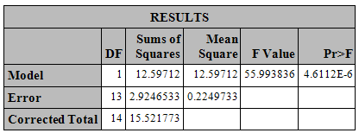
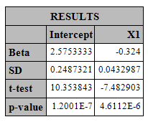
Example 1 simple linear regression
PROC GLM
PROC iml
EXAMPLE
Notes:
Right to SAS. Run GLM then IML

Slide 14
MULTIPLE LINEAR REGRESSION
MODEL
MATRIX ALGEBRA IS EXACTLY THE SAME!
Notes:
Now, if we consider multiple continuous predictors

Slide 15
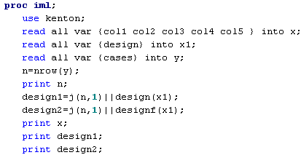
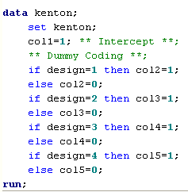
Example 2 SINGLE FACTOR ANALYSIS OF
VARIANCE
DATA
Dataset has a total of 19 observations
(Store-Design Combinations)
Cases (Outcome Variable) = Number of cases sold
Design = 1 of 4 different package designs for new
breakfast cereal
Store = 5 stores with approximately same sales volume
Need to create multiple columns to represent levels within
categorical factor
USE PROC IML
USE DATA STEP
Notes:
But, what if X is a single categorical predictor?

Slide 16
Example 2 SINGLE FACTOR ANALYSIS OF
VARIANCE
DESIGN
FUNCTION
DESIGNF
FUNCTION
The DESIGN function creates a
design matrix of 0s and 1s from
column-vector. Each unique value
of the vector generates a column
of the design matrix. This column
contains ones in elements with
corresponding elements in the
vector that are the current value;
it contains zeros elsewhere.
The DESIGNF function works similar
to the DESIGN function; however,
the result matrix is one column smaller
and can be used to produce full-rank
design matrices. The result of the
DESIGNF function is the same as if
you took the last column off the
DESIGN function result and subtracted
it from the other columns of the result.
DATA STEP

Slide 17
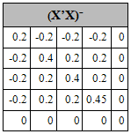
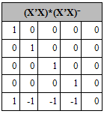
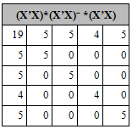
Example 2 SINGLE FACTOR ANALYSIS OF
VARIANCE
MATRIX A
Generalized Inverse
Note that column 5 can be
written as a linear column 1
− column 2 − column 3 − column 4
Matrix does not have a unique inverse
conditional Inverse
pseudo Inverse
Same mathematics as multiple linear regression model
Constructing the design matrix is the only trick
MATRIX G
AG
AGA=A

Slide 18
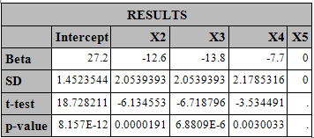
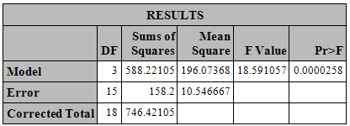
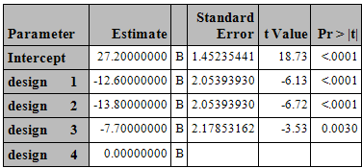
Example 2 SINGLE FACTOR ANALYSIS OF
VARIANCE
PROC GLM
PROC iml
EXAMPLE
Notes:
Go into SAS and Run the example. Show the code only in SAS syntax.

Slide 19
Analysis OF COVARIANCE (ANCOVA)
ANOVA+Regression
Categorical+Continuous
ANCOVA is used to account/adjust for Pre-Existing Conditions
In our example we will model the Area Under the Curve per Week is
adjusted for the Baseline Beck Depression Score Index (Continuous),
the Gender of the Subject (Categorical) and the Type of Treatment
(Categorical).
Some models may only have one covariate representing the baseline
score and the outcome variable represents the final score – it may be
tempting to get rid of the covariate by modeling the difference.
This may be problematic as you are forcing a slope of 1.
We also have to make use of partial F tests to compare two models.
EXAMPLE

Slide 20
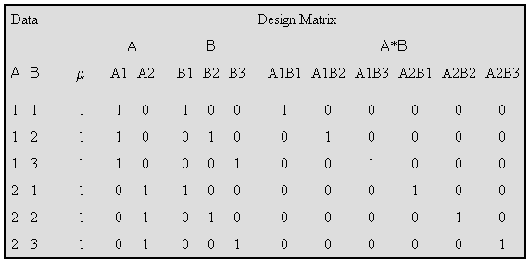
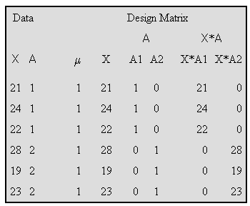
DESIGN MATRIX: Building Interaction terms
Notes:
With regression models we can make the equation on the right hand side as complicated as possible, as long as all predictors are “Linear” terms. Complexity may include interaction terms, which correspond to adding a predictor X1X2 which is the product of continuous predictors X1 and X2, and is included in the model and refered to as the interaction of X1 and X2. For the ANOVA model, we can do the same thing. But the formation of the interaction has an impact on the design matrix if the terms are both factors or one is a factor and one is a continuous measure.

Slide 21
CONSTRUCTION OF LEAST SQUARE MEANS
In PROC GLM what is the difference between the MEANS and the
LSMEANS statement?
When the MEANS statement is used, PROC GLM computes the
arithmetic means (average) of all continuous variables in the model
(both dependent and independent) for each level of the categorical
variable specified in the MEANS statement.
When the LSMEANS statement is used, PROC GLM computes the
predicted population margins; that is, they estimate marginal means
over a balanced population. Means corrected for imbalances in other
variables.
When an experiment is balanced, MEANS and LSMEANS agree.
When data are unbalanced, however, there can be a large difference
between a MEAN and an LSMEAN.

Slide 22
CONSTRUCTION OF LEAST SQUARE MEANS
Assume A has 3 levels, B has 2 levels, and C has 2 levels, and assume
that every combination of levels of A and B exists in the data. Assume
also that Z is a continuous variable with an average of 12.5. Then the
least-squares means are computed by the following linear combinations
of the parameter estimates:

Slide 23
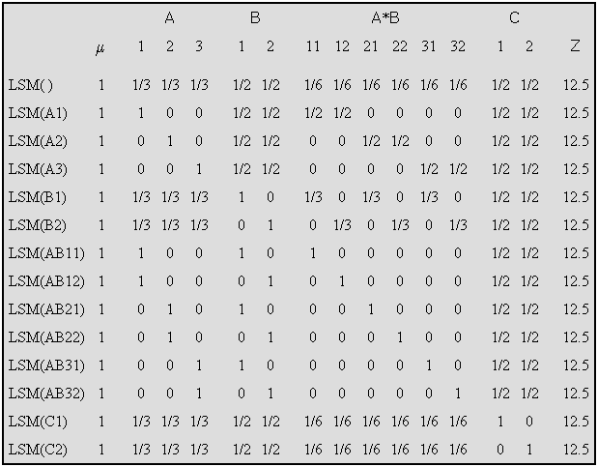
CONSTRUCTION OF LEAST SQUARE MEANS

Slide 24
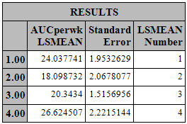
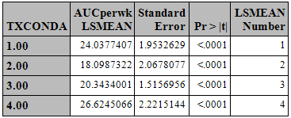
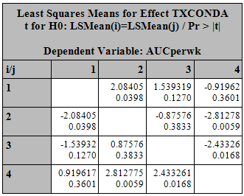
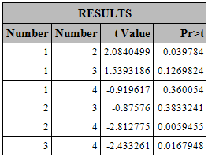
Example LSMEANS
PROC GLM
PROC iml
EXAMPLE
Notes:
HIGHLIGHT THE IML SYNTAX FOR THE LSMEAN ESTIMATE & CONTRAST.

Slide 25
MAXIMUM LIKELIHOOD ESTIMATION
With linear models it is possible to derive estimators that are optimal in some sense
As models become more general optimal estimators become more difficult obtain and estimators that are asymptotically optimal are obtained instead
Maximum likelihood estimators (MLE) have a number of nice asymptotic properties and are relatively easy to obtain
Start with the distribution of our data:
Notes:
While the Least Squares approach works well with regression modeling framework, extending this model to more complex GLM structures we need alternate methods of estimation.

Slide 26
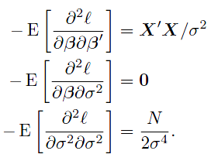
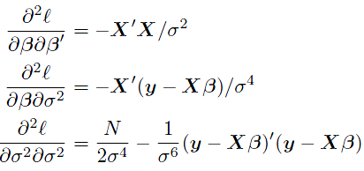
MAXIMUM LIKELIHOOD ESTIMATION

Slide 27
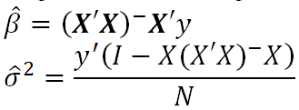
MAXIMUM LIKELIHOOD ESTIMATION
HESSIAN
GRADIENT
GRADIENT
INFORMATION
MATRIX
Regardless of the algorithm used the MLE of the model parameters
remain the same:
Notes:
Change the color on the “Information matrix”

Slide 28
MAXIMUM LIKELIHOOD ESTIMATION
VERSUS Ordinary least squares
FIXED EFFECTS estimation
Independence of Mean and Variance for
Normals
Independence of Estimators
Variance estimation
OLS is an unbiased estimator
ML is a biased estimator
Note that the ML formula differs from the OLS formula by dividing by
N and not N-p
Notes:
Using MLE as compared to OLS in a regression framework

Slide 29
ITERATIVE METHODS
NEWTON RAPHSON
METHOD OF SCORING

Slide 30
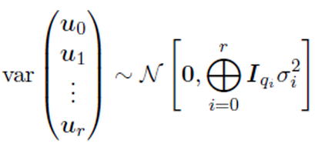
EXTENSION OF THE GENERAL LINEAR MODEL
In a linear model it is assumed that there is a single source of variability. One can extend linear models by allowing for multiple sources of variability. In the simplest case, the combined covariance matrix is a linear function of the variance components. In other cases, the combined covariance matrix is a non-linear function of the variance components. The linear form is typical of the structure encountered in various split plot designs and the non-linear form is typical of repeated measure designs.
MIXED LINEAR MODEL EQUATION

Slide 31
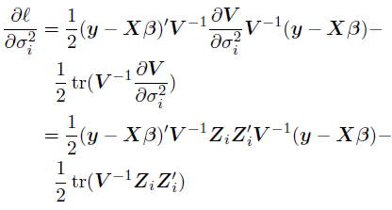
MIXED LINEAR MODELS
Set derivative equal to zero and
solve for β:
Plug β into derivatives with respect to
σ_{i}²

Slide 32
MIXED LINEAR MODELS
Maximum Likelihood solutions equating derivatives equal to zero:
Fixed Effects
Variance
components
We can make an algebraically simpler expression for the second
equation by defining P in the following manner:
Note that sesq(M) represents the sum of squares of elements of M

Slide 33
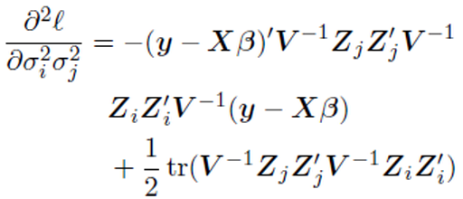
MIXED LINEAR MODELS
Second Partials

Slide 34
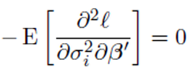
MIXED LINEAR MODELS
FISHER SCORING – EXPECTED VALUES

Slide 35
RESTRICTED (Residual )MAXIMUM
LIKELIHOOD (REML)
Maximum Likelihood does not yield the usual estimators when the data
are balanced
In estimating variance components ML does not take into account the
degrees of freedom that are involved in estimating fixed effects
Estimating variance components based on residuals calculated after
fitting by ordinary least squares just the fixed effects part of the model

Slide 36
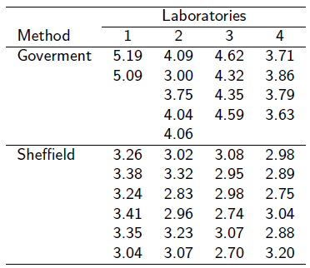
MIXED EFFECTS Example
Actual levels of milk fat in its yogurt exceeded the labeled amount
Outcome Variable = Fat Content of each Yogurt Sample (3.0)
Random Effect = 4 Randomly Chosen Laboratories
Fixed Effect = Government’s VS Sheffield’s Method
6 samples where sent to each laboratory but Government’s Labs had technical difficulties and were not able to determine fat content for all 6 samples.

Slide 37
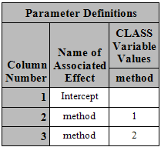
MIXED EFFECTS Example
PROC GLMMOD
The GLMMOD procedure
constructs the design matrix for a
general linear model; it essentially
constitutes the model-building
front end for the GLM procedure.

Slide 38
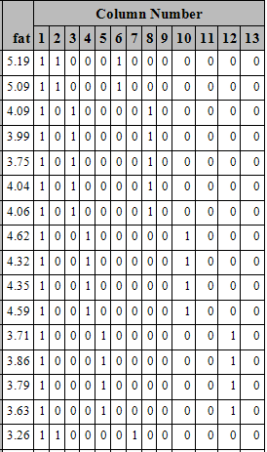
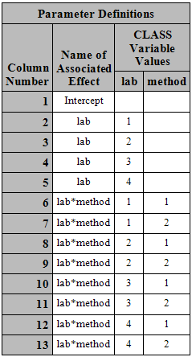
MIXED EFFECTS Example
PARTIAL DATA

Slide 39
MIXED EFFECTS Example
Z Matrix
G Matrix
R Matrix
ZGZ’ Matrix
ZGZ’+R Matrix

Slide 40
MIXED EFFECTS Example
READ DATA INTO PROC IML
RANDOM EFFECTS
Recall that columns 2-5 represent the 4 different labs and columns
6-13 represent the interaction between labs and methods
Need to get rid of column 1 which represents the intercept
FIXED EFFECTS
Recall that column 1 represents the intercept and columns 2 and 3
represent the two different methods
The outcome variable fat is read into the vector y

Slide 41
MIXED EFFECTS Example
Get initial estimates for variance components
Use MSE from model containing only fixed effects as initial estimate
Note: We used biased estimate from ML approach
0.1113189 (ML) instead of 0.11733610 (OLS) for initial estimates
G is a q x q matrix where q is the number of random effect parameters.
G is always diagonal in a random effects model if the random effects are
assumed uncorrelated.
In our example, starting value for G is a 12X12 diagonal matrix
G₀ = 0.0556594* I(12)
R₀ = 0.0556594 *I(39)

Slide 42
MIXED EFFECTS Example
LOG LIKELIHOOD
GRADIENT
RESIDUAL
NOTE: W represents a 39X4 design matrix representing levels of factor
LAB
S represents a 39X8 design matrix representing the levels of the
Interaction between LAB*METHOD

Slide 43
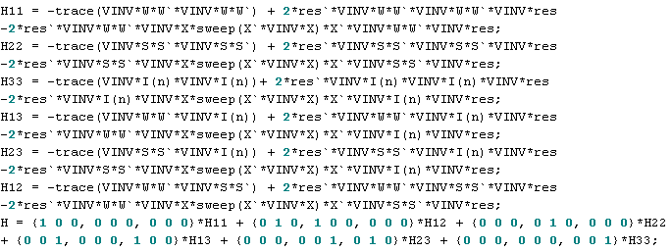
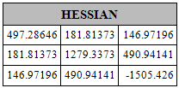
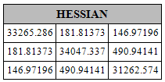
MIXED EFFECTS Example
HESSIAN
NOT POSITIVE DEFINITE
ADD 2¹⁵ TO MAIN DIAGONAL

Slide 44
MIXED EFFECTS EXAmPLE
CALL NLPNRR
USER DEFINED FUNCTIONS AND CALL ROUTINES

Slide 45
MIXED EFFECTS EXAMPLE
HESSIAN
Use PROC IML Nonlinear Optimization and Related Subroutines
Notes:
Move this.

Slide 46
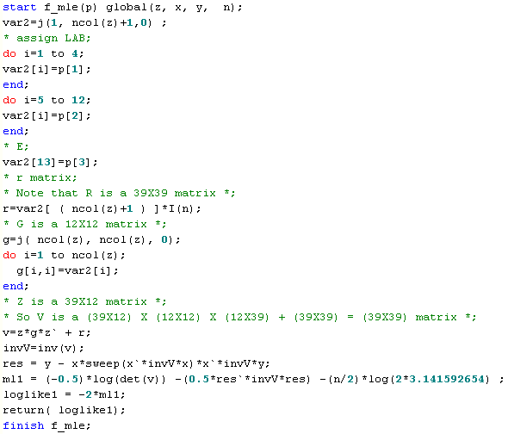
MIXED EFFECTS Example
Variance Components must be positive
Hessian must be positive definite
Use CALL NLPNRR
EXAMPLE

Slide 47
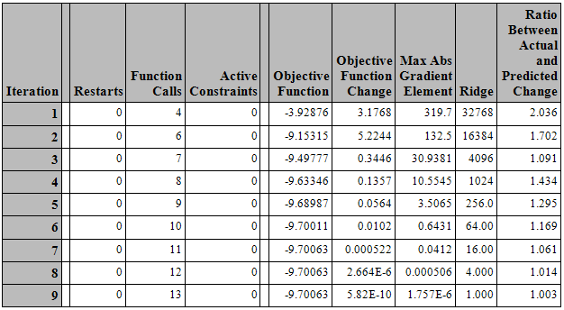
MIXED EFFECTS Example
2¹⁵ = 32768
2¹⁴ = 16384
2¹² = 4096
2⁸ = 256
2⁶ = 64
2⁴ = 16
2² = 4

Slide 48
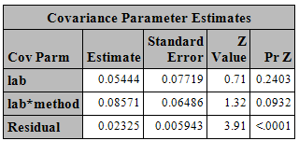
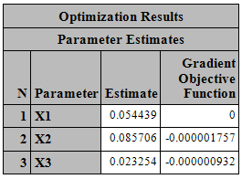
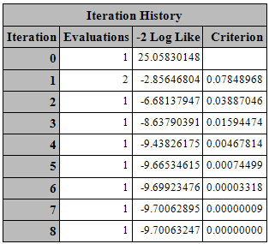
MIXED EFFECTS Example
Variance Components
PROC IML
PROC MIXED

Slide 49
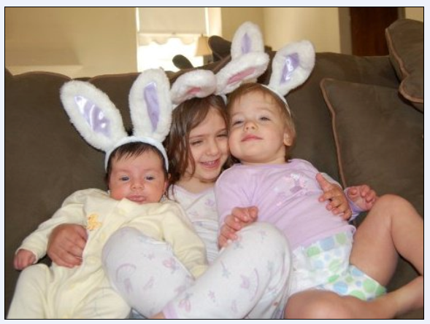
QUESTIONS

