Slide 1
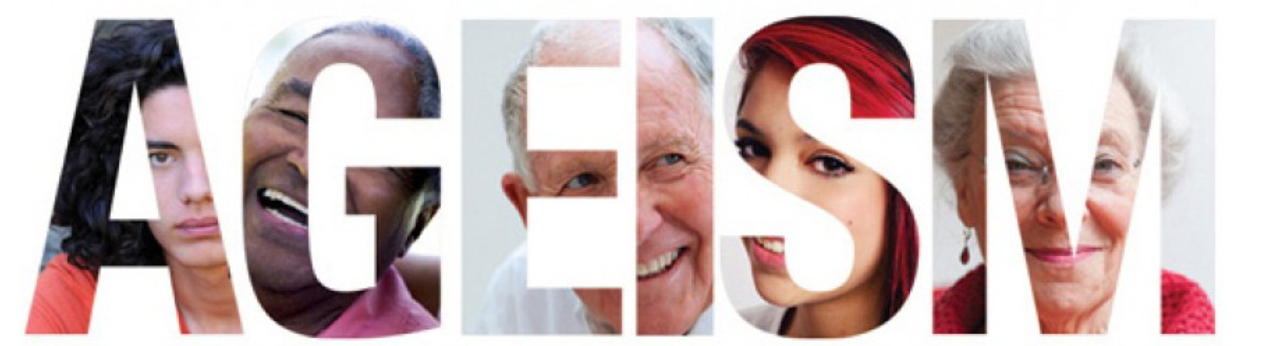
Combating Age Discrimination in the Workplace and Elsewhere
IN THE AGE OF INTOLERANCE
Jasmin Tahmaseb McConatha, Department of Psychology
Frauke Schnell, Department of Political Science
Department of Psychology
West Chester University

Slide 2


What is Ageism?
“The third great ‘ism’ of our society after racism and sexism” (Palmore, 2001).
Act of stereotyping or discriminating against a person or group based on age.
Most universal form of discrimination, as anyone who lives long enough is at risk.

Slide 3
Ageism is Widespread
64% of workers report experiencing age discrimination in the workplace (AARP, 2014).
  Age stereotypes denigrate aging and foster a belief that older workers are less competent than younger workers.
  They are seen as less trainable.
  Less able to cope with technological change.
These attitudes result in fewer work opportunities, training, promotions, and retention for older workers.

Slide 4
Workplace Buzzwords:
Younger Workers
Descriptors of Older Workers
Vs.
Energetic
Unhealthy
Flexible
Stubborn
Innovative
Rigid
Dynamic
Costly
Fresh
Leads to competition between younger and older workers and fear of job security.
Resistant

Slide 5
Double Jeopardy
Older women are subjected to what Susan Sontag (1972) called “double jeopardy”—or the intersectional effect of prejudice - victims of age as well as gender discrimination.
Women are considered “old” at a younger age than men.
Over 80% of women over 50 report having been subjected to some form of ageism (McGuire, Klein, & Shu-Li, 2008).
Older women, particularly, older women of color, are further subjected to the intersecting prejudices of age, ethic, and gender bias (Barrington, 2015).
Intersectional Prejudice
Double Jeopardy

Slide 6
Older Women in Academia
Day to day ageism in an academic setting is both overt and covert (McGuire, Klein, & Shu-Li, 2008).
Studies have found that younger colleagues patronize older faculty, particularly female faculty (Harris, 2005).
Younger female faculty are more likely to be viewed as dynamic, interesting, knowledgeable, and influential (Bronstein, 2001).
Older faculty members are more likely to be excluded or subjected to “mom-ism”.

Slide 7
Studying Ageism in the Workplace and Elsewhere
In our community study – survey results of the experiences of 240 working adults indicated that almost 60 percent experienced ageist treatment in the workplace.

Slide 8
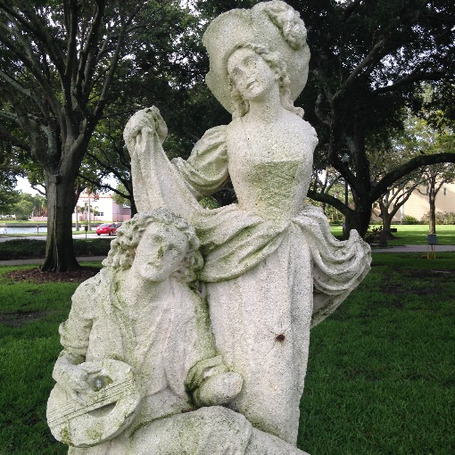
How do we combat ageism?
Institutions which promote diversity, equality, and justice, generally do not address ageism.

Slide 9
How do we combat ageism in the workplace?
There are professional organizations for various groups to come together, very few address issues of identity and age.
  For example: Older women, unlike women of color and lesbian women, have not focused research on their own identities
  They have not been activists fighting against age biases.

Slide 10
Combating Ageism:
Suggestions
Older workers should become visible and vocal.
If possible they should study themselves and write about their own and other elder’s life experiences.
Notes:
Women are more likely to victimized by ageist attitudes and behaviors.
When it comes to technology women are less likely to be perceived as competent and skilled.
Ageist stereotypes projected onto older women lead them to make personal rather than political attributions about ageist treatment.
As women age - they become increasingly invisible. They tend lose power and social status with age.

Slide 11
Combating Ageism: Suggestions from Grey Panthers
Try not to blame old age for fatigue or disorganization or forgetfulness. In our youth, we blame poor planning, lack of sleep, and a bad memory.
Criticize your local news media when a headline or cartoon is offensive.
When selecting a birthday card, keep your sense of humor. Just learn the difference between laughing WITH rather than laughing AT.
Fight ageism with two important weapons -- knowledge and a willingness to approach every person, regardless of age, as an individual with unique strengths, weaknesses, options, and opportunities.

Slide 12
On average there about 20,000 claims of age discrimination each year.
These numbers are nearly equal to the number of race and sex discrimination cases filled with the EEOC.
In an audit study, when applying for a job, where older is defined as over 50, older candidates were 40% less likely to be called be for an interview.
LEGISLATIVE
EQUITY
Notes:
Legislation at the federal level.
Under the ADEA, it is unlawful to discriminate against a person because of his/her age with respect to any term, condition, or privilege of employment, including hiring, firing, promotion, layoff, compensation, benefits, job assignments, and training.

Slide 13
CONCLUSION
Ageism is a critical social problem which needs to be addressed on the personal, social, and political level.
Global aging is a reality. Twenty five percent of the population of the world cannot be marginalized by discrimination.
Notes:
Global aging is a reality.
Twenty five percent of the population of the world cannot be marginalized.

Slide 14
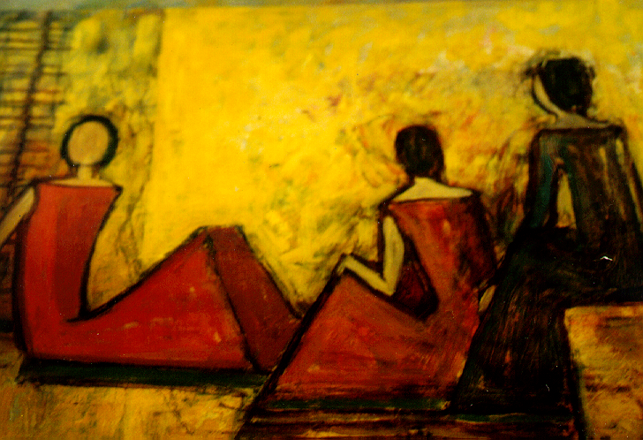
Dr. Jasmin Tahmaseb McConatha
Jtahmasebmcconatha@wcupa.edu
Dr. Frauke Schnell
fschnell@wcupa.edu
  West Chester University of Pennsylvania, West Chester, PA, USA Phone: 610-436-3209

