Slide 1
Finding Opportunities in Industrial/ Organizational Psychology
Information in this powerpoint is compiled from various online resources that are referenced in the slides

Slide 2
What is I/O Psychology?
I/O Psychology is the scientific study of human behavior in the workplace. I/O Psychologists use and apply their knowledge in the following areas (and more) to promote productive and healthy cultures at work :
Organization Development
Organizational Attitudes
Career Development
Human Factors
Behavior
Different Psychological Theories
Job Analysis
Task Analysis
Assessment
Source: Industrial and Organizational Psychology, 2022

Slide 3
Undergraduate Classes to take at WCU to build an I/O Background:
PSY100: Introduction to Psychology
Prerequisite for the following courses
PSY265
Industrial/Organizational Psychology
PSY386
Professional and Practical Skills in I/O Psychology
Note: Non-psychology majors can complete the IO minor
PSY410
Research in Psychology
Look for research lab with I/O faculty
PSY445
Organizational Development
PSY441/442
Field Experience in Psychology

Slide 4
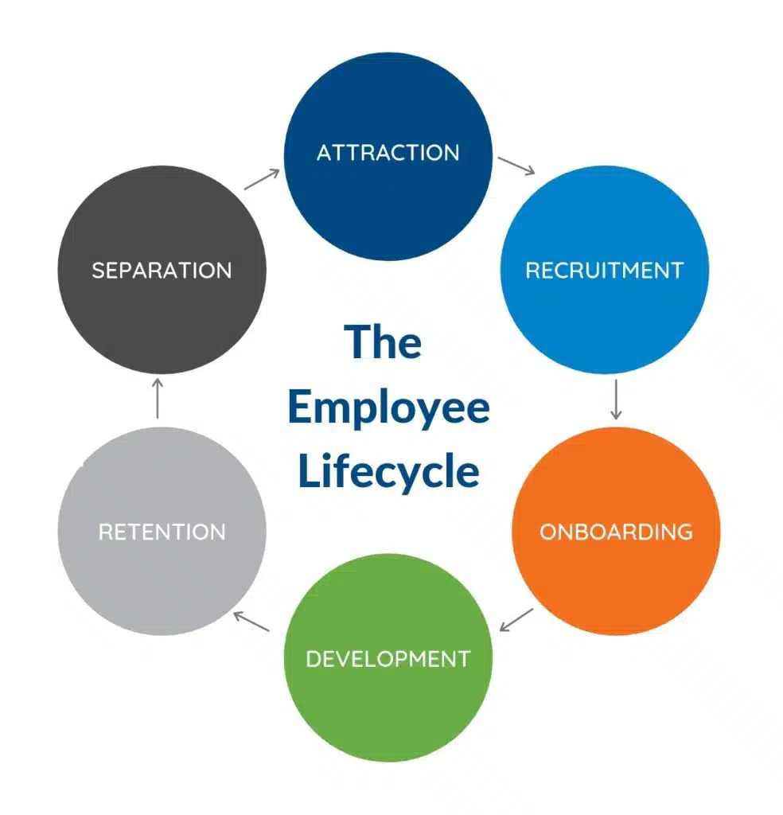
I/O Psychology Skills
I/O Psychologists use various skills to influence all phases of the employee lifecycle, including:
Ability to identify individual, group, and organizational needs in the workplace
Design, develop and implement onboarding/ training programs
Program Evaluation/Effectiveness
Coaching
Development, Administration and Reporting of Workplace Assessments
Verbal and Written Communication Skills
Data Analysis, Interpretation and Reporting
Management
Critical Thinking
Source: Industrial and Organizational Psychology, 2022
Notes:
Find figure of employee lifecycle

Slide 5
Industries I/O Psychologists Work in:
Labor Unions
Government Agencies
Colleges and Universities
Marketing and Advising Firms
Healthcare Facilities
Any company with an HR department
Source: Industrial and Organizational Psychology, 2022

Slide 6
Some Careers Associated with I/O Psychology:
Industrial - Focused
Organizational - Focused
People Analytics
Research Analyst
Personnel Analyst
Data Analyst
Talent Assessment
Talent Management
Training and Development
Performance Appraisal
Consultant
Human Resources, Compensation, Benefits
Employee Relations
Management Consultant
Leadership Coaching and Development
Change Management
Organizational Culture Management
Workplace Stress
Diversity, Equity, and Inclusion
Job functions may overlap between domains
Source: Industrial and Organizational Psychology, 2022

Slide 7
Possible Career Paths | Individual Contributor | Expert Individual Contributor | Manager | Manager of Managers | Executive
Academia | Assistant Professor | Full Professor | Department Chair | Dean | Vice President, Provost, President
Government | Analyst, Associate Consultant | Expert | Case Team Leader, Senior Associate, Consultant | Senior Manager | Executive, Partner, Director
Industry | HR Specialist, Project Assistant, Consultant | Chief Scientist, Principal Consultant | Director of HR. Manager, Team/Program Leader | Area Director of HR, Senior Team Leader, Principal Consultant, Program Director | VP of HR, Chief HR Officer, Global HR Officer, Director, Executive, Senior VP, Consultant
Consulting | Project Assistant, Associate Consultant, Lead Consultant | Senior Consultant, Senior Professional | Manager, Team Leader, Project Manager, Director | Senior Team Leader, Principal Consultant, Program Director | Director, Officer, Executive Consultant, VP, Sr. VP, CEO
Source: Industrial and Organizational Psychology, 2022

Slide 8
Internships and Field Opportunities
Places to Look:
Keywords to Search-
Google search
SIOP
Handshake (WCU)
Attend Career Fair at WCU
LinkedIn
Indeed
ZipRecruiter
A specific organization's website
HR Internship
Human Resources
Recruitment
People Analytics
Data Analytics
Training, Learning and Development
Consulting
Talent Management
Look for part time opportunities as well

Slide 9
Organizations within PA region
Deloitte
SAP
Comcast
Vanguard
Target
QVC
Cencora

Slide 10
Preparing for an Internship/Field Experience/Job Step 1: Create a Resume and Cover Letter

Slide 11
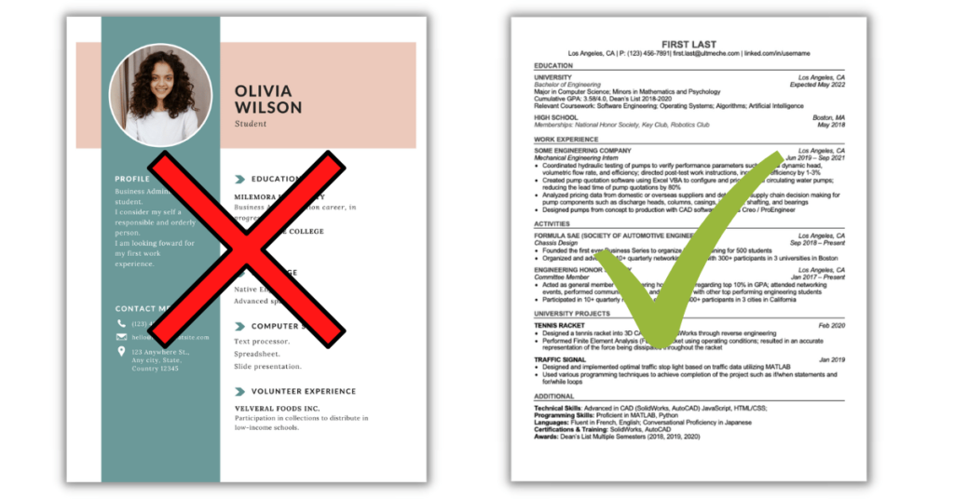
Resume Tips
Highlight your relevant work/course experiences, education, and skills-- recognition
Keep resume concise, consistent and relevant
Resume should be 1-2 pages in length
Start with a blank Word document, and then go back and make format changes
Reminder: Font can be as small as 10 point and margins as small as .5.
Use simple font styles, i.e., Cambria, Times New Roman, Garamond, Arial, and Calibri
Don't include any headshots or professional photos on your resume
CROGERS@wcupa.edu. (2021, August). Undergraduate. Resumes and Cover Letters - West Chester University.

Slide 12
Cover Letter Tips
Your cover letter gives you the opportunity to discuss your experience and skills in more detail
Make sure your cover letter is revised for each new role you apply for
Address the letter to a specific person in the organization
Use the same font as your resume to remain consistent
Make sure your cover letter is a separate document from your resume
CROGERS@wcupa.edu. (2021, August). Undergraduate. Resumes and Cover Letters - West Chester University.

Slide 13
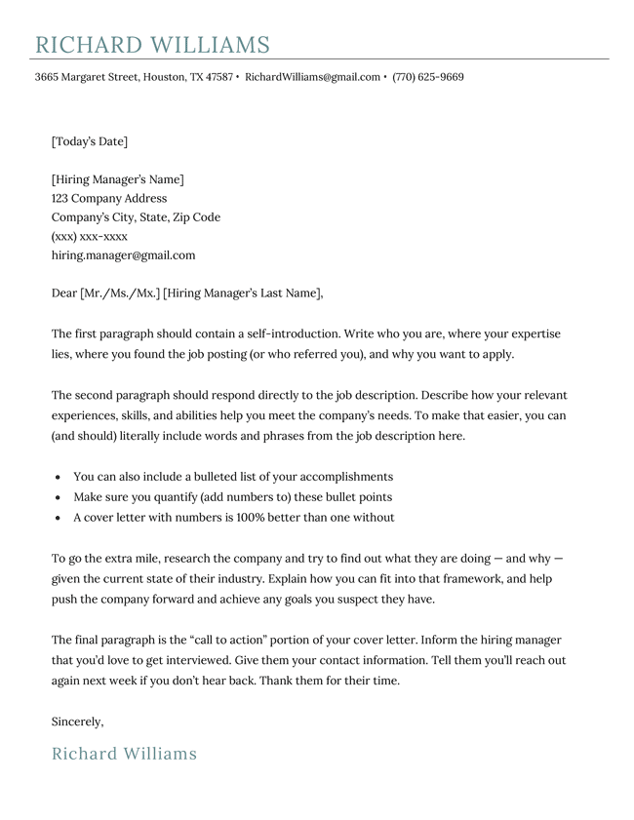
Cover Letter Tips
When writing your cover letter, split the body into 3 paragraphs:
Opening Paragraph
Mention the role you are applying for and how you came across it. Make sure to discuss why you are interested in the particular role with the organization and how your skills will be applicable to it. This will show you've done research on the organization.
Middle Paragraph
Give a brief overview of your background and how it relates to the position. Discuss any achievements, skills, and experiences that would show you are suited for the position. Make sure you pay attention to keywords used in the job description and emphasize those in your skillset.
Closing Paragraph
In this paragraph, summarize a specific situation which shows why you are a perfect fit for the role. Here, you can talk about any transferable skills you have from previous positions (if you did an internship, this is a good place to talk about it) or any experiences that are of value.
Source: Indeed

Slide 14
Step 2: Prepare for the Interview

Slide 15
Interview Tips
Interview Structures
Structured
A formal, scripted interview with set questions for EVERY candidate and is scored similarly across all candidates
Unstructured
An informal interview with changing questions based on the flow of the conversation typically nor structured scoring format is used
Interview Medium
Over the phone
In-person
Virtual
Zoom, Teams, Etc.

Slide 16
Interview Tips
Interview Preparation:
Confirm details of interview with interviewer
Research the company, the position, and your interviewer
Practice general interview questions
Identify key skills and points in your background that match with the job description and requirements -
Relevant coursework, labs, work experience, skills, certificates, statistical training, etc.
Come up with questions to ask the interviewer at the end of the interview
During the Interview:
Arrive 10-15 minutes early
Dress professionally
Avoid speaking negatively about previous employers
Bring a copy of your resume, portfolio, and something to take notes on
Eliminate distractions to prevent disruption during the interview (turn off or silence electronics)
Ask the interviewer any questions you have about the role

Slide 17
Interview Question Examples:
"Tell me a little bit about yourself and your background."
"What are your biggest strengths?"
"What would you say is your biggest weakness?"
"Tell me about a challenge you faced and how you overcame it?"
"Why are you interested in this role and this organization?"
"What are your goals for the future?"
"How would people describe you?"
"Tell me about your proudest professional accomplishment."
"Tell me about a time you had a conflict with a coworker. How did you handle it?"
"Describe a time you had to deal with a difficult client or customer. How did you handle it?"
"Describe a time your company was going through a change and how you handled it."
"How do you handle managing numerous responsibilities?"
Source: The Muse

Slide 18
Answering Interview Questions
Use the STAR method to answer questions–
Situation: Where and When?
Share context about the situation
Task: What did you do and Why?
What was your responsibility/role in the situation? What was the task or goal?
Action: What did you do and How?
Explain what you did in the situation and what skills you used to handle it.
Result: Explain the end results, what you accomplished, etc.
Explain the end result and what you learned from this situation.

Slide 19
Networking Tips
Why should you network?
Networking provides you with the opportunity to share ideas, receive advice, gain industry knowledge, and possibly set you up with access to career opportunities
Where to Network:
Build up your LinkedIn connections
See this website for tips on building a LinkedIn Profile
For alumni – check out your alma mater's alumni network
WCUPA Alumni
Look for conferences – these provide great opportunities for networking
Getting Started:
Ask yourself why you want to make a certain connection and what you hope to gain
Make a list of people you would like to connect with
Classmates or colleagues, professors and staff members, alumni, friends, family, family friends, teammates or club members
List some questions you would like to ask and then reach out to the person you would like to connect with –
Ask questions about their typical day on the job, choice of career, or just learning about the organization…
Make sure to follow up and thank them for their time

Slide 20
Career Development Center
Twardowski Career Development Center
Visit the career development website to explore the different majors offered at WCUPA, get assistance developing your resume and cover letters, practice your interviewing skills, and explore career options in your area of interest
To schedule an appointment with a Career Counselor about your career needs, go to Handshake and login with your WCU ID.
Select the 'Career Center' button ---> Select option labeled 'Appointment' ---> Select a time and day that works best for you

Slide 21
I/O Related Graduate Education Opportunities at WCU

Slide 22
Graduate Certificate in I/O Psychology
Overview:
Admissions Requirements:
100% online
12 credits required
Advanced Industrial Psychology
Advanced Organizational Psychology
Ethics and Professional Skills in Organizational Practice
Introduction to People Analytics
Completed application
Official transcripts
A personal statement outlining professional and educational goals
Two letters of recommendation
Certificate in I/O Psychology Website

Slide 23
M.S. In I/O Psychology
Overview:
Admission Requirements:
27 semester hours of core classes
12-15 semester hours of I/O related elective courses
Choice of Applied Track or Thesis Track
Completed application
Official transcripts
Minimum overall GPA of 3.0 and minimum Psychology GPA of 3.25
Three letters of recommendation
A personal statement outlining professional and educational goals
M.S. in I/O Psychology Website

Slide 24
For more Information:
Dr. Vipanchi Mishra, Graduate Coordinator
Phone: 610-430-5942
Email: vmishra@wcupa.edu
Website: wcupa.edu/programs/grad/psychology
The Graduate School
102 W. Rosedale Avenue, West Chester, PA 19383
Phone: 610-436-2943
Email: GradAdmissions@wcupa.edu
Website: wcupa.edu/grad

