Slide 1
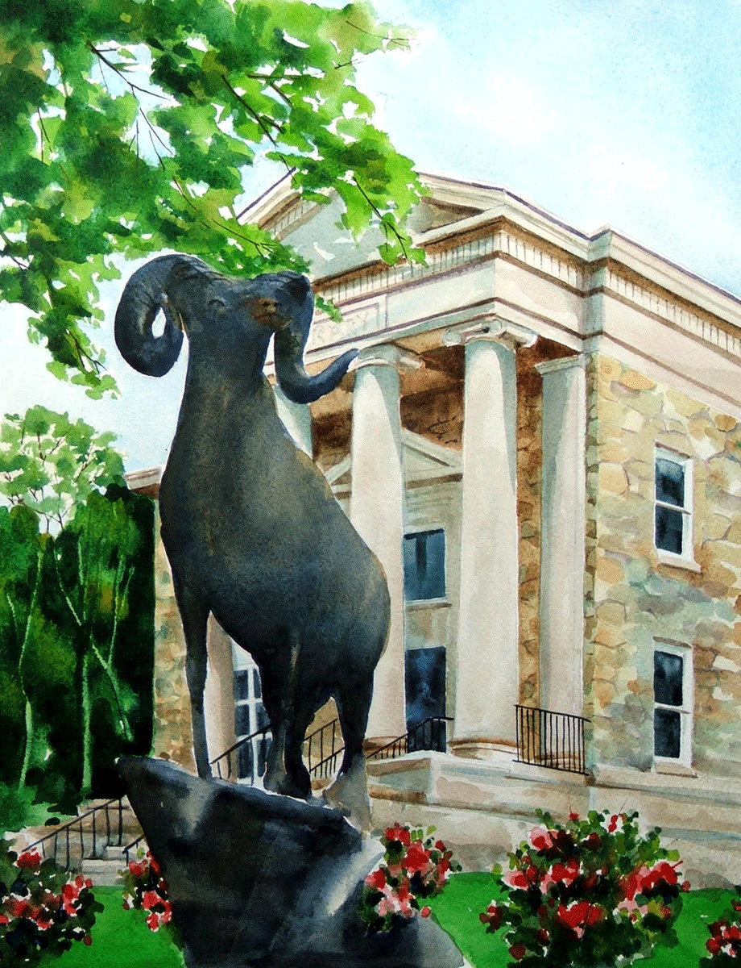
The Office of Service-Learning and Volunteer Programs
New Faculty Orientation
Put what you are discussing here: and : and

Slide 2


National Recognition
President's Higher Education Community Service Honor Roll
The Carnegie Foundation
Community Engagement Award
Awarded to colleges and universities that foster students’ lifelong civic engagement
Recognizing institutions that achieve meaningful, measureable outcomes in the communities they serve.
West Chester University is one of only 6% of universities who received this award.
Focused on community engagement, with an exchange of knowledge and resources between local communities.
WCU is currently going through a reclassification process

Slide 3
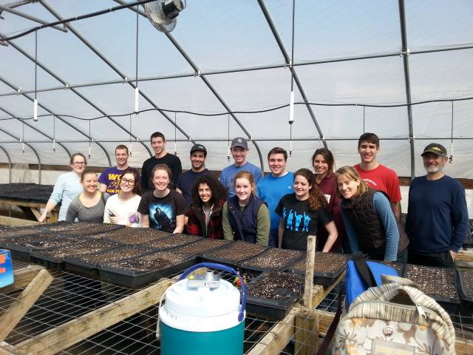
Creating a Culture of
Service-Learning
Faculty
Staff
Departments
Colleges
Student Clubs & Organizations
Student Leaders

Slide 4
Service-Learning is…
a teaching method.
includes community service that addresses a community need.
enhances curricular goals and meets learning outcomes.
includes critical, reflective thinking.
develops students sense of civic responsibility and commitment to the community.
*Soon becoming a larger part of the WCU curriculum through a certificate pathway and incorporation into the new general education curriculum.

Slide 5
Examples of Service-Learning Courses
Political science
MARKETING
PSC 356: US Public Policy
through partnerships with numerous community agencies, students confront social stereotypes of the poor by working as tutors/mentors, providing/serving meals, and coordinating housing assistance
MKT 330: Customer Behavior
students help community non-profit organizations conduct research to better understand consumers needs and develop marketing suggestions.

Slide 6
Benefits of Service-Learning
For Students
Increases understanding of the class topic
Provides hands-on experience
Develop critical thinking and problem-solving skills
Assists with career exploration and networking
Exposes students to diverse populations
Teaches active citizenship
For Faculty
Enhances teaching ability
Retains students
Inspires research ideas
Encourages interactive teaching and reciprocal learning between students and faculty
Great for tenure and promotion process
Adds new insights and dimensions to class discussions

Slide 7
Benefits of Service-Learning
For the Community
Gains access to university resources
Contributes to the educational process
Helps solve pressing community needs
Develops a pool of potential employees
For the University
Enhances teaching, research and outreach activities
Engages faculty and students in local and state community issues
Better prepares university graduates for today’s world

Slide 8

Faculty Support
Faculty Consultations
  Creating an integrated SL curriculum
  Finding community partners
  Connecting your teaching to research and scholarship
Community Engagement Scholars
Service-Learning Faculty Work Group
Assistance with:
  academic clubs and organizations interested in public service
  risk management
  financial needs
  recording service-learning hours
  building international or domestic service immersion trips (Alternative Breaks)

Slide 9
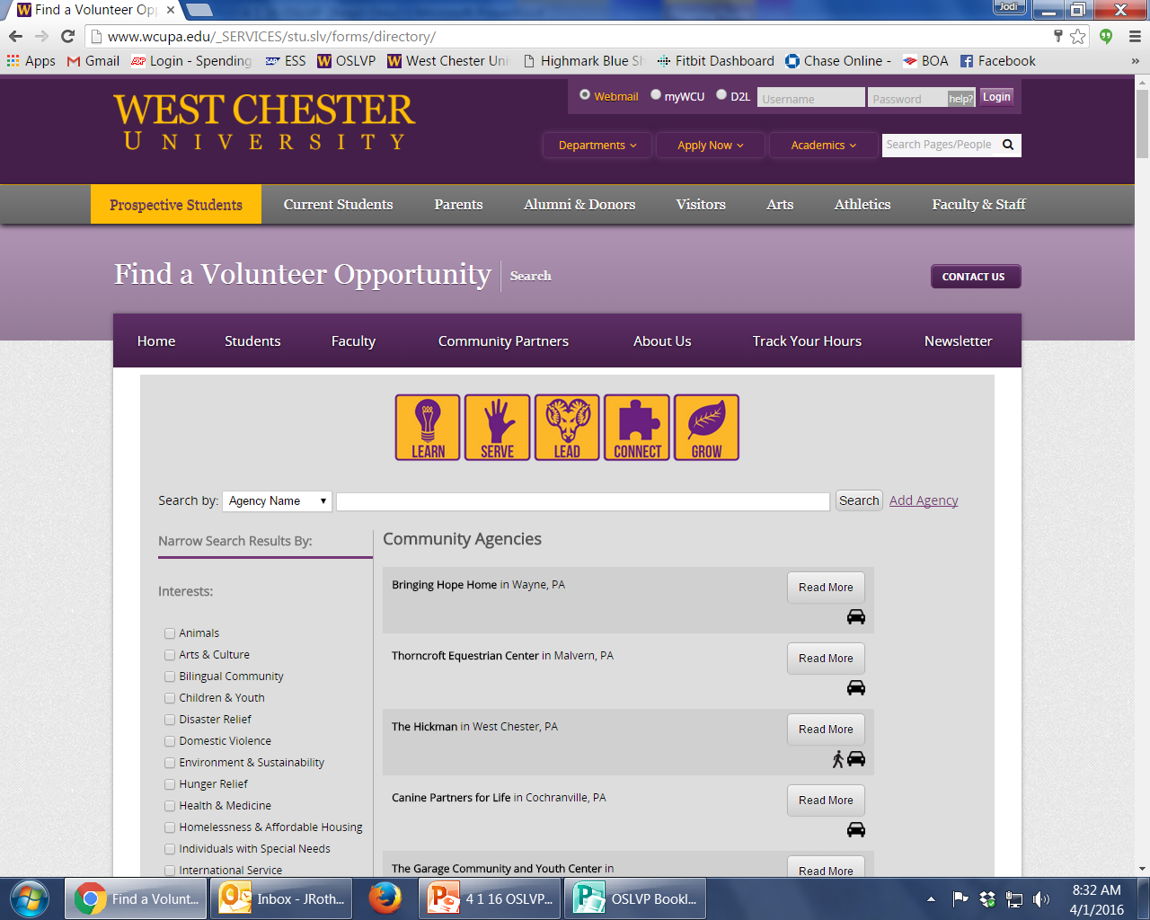
www.wcupa.edu/volunteersearch
Search for community agency by:
Name
Interest/Mission
Proximity to WCU (Walkable, Bike-able, Accessible by Public Transit, etc.)

Slide 10
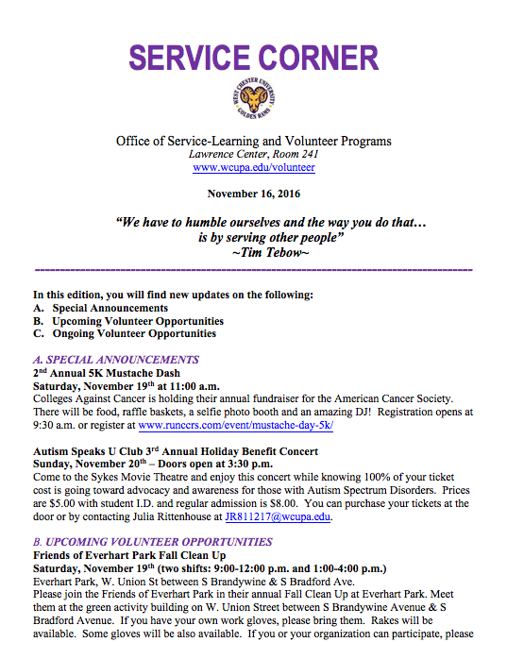
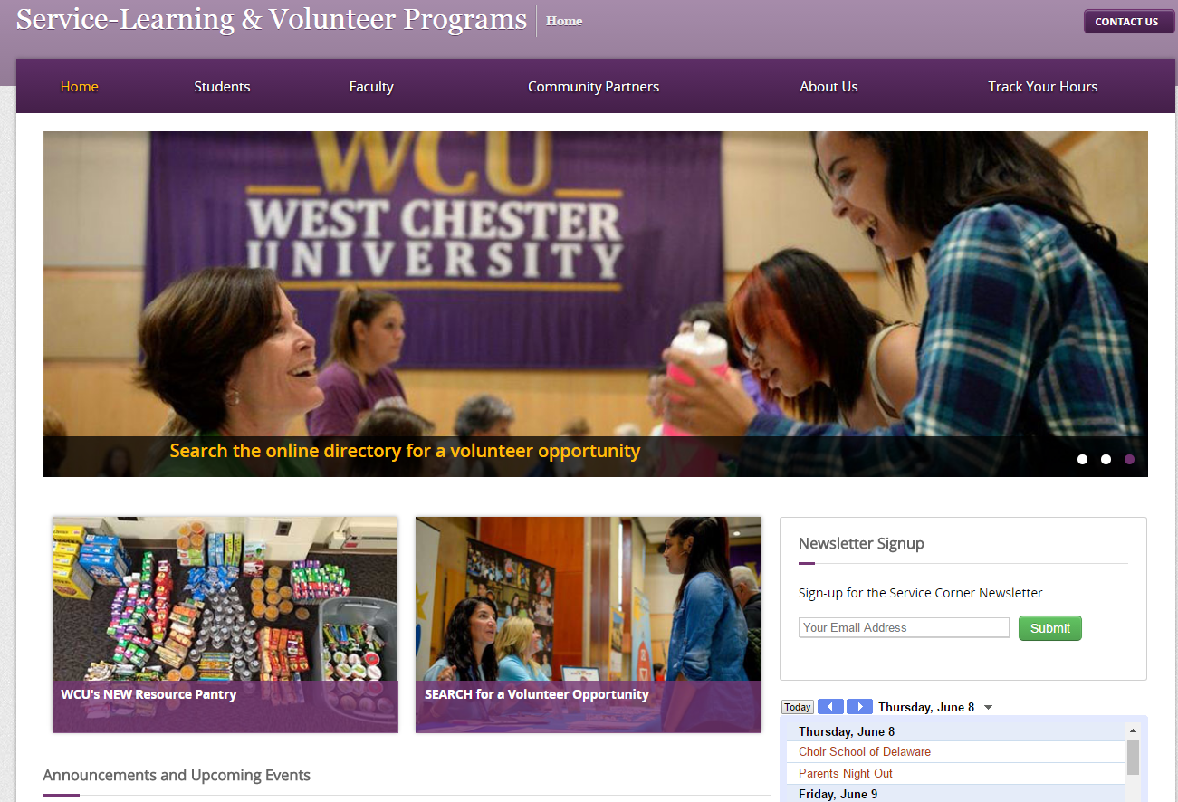
Service Corner
Sign up for our newsletter!
www.wcupa.edu/volunteer
Sent via email bi-weekly!

Slide 11
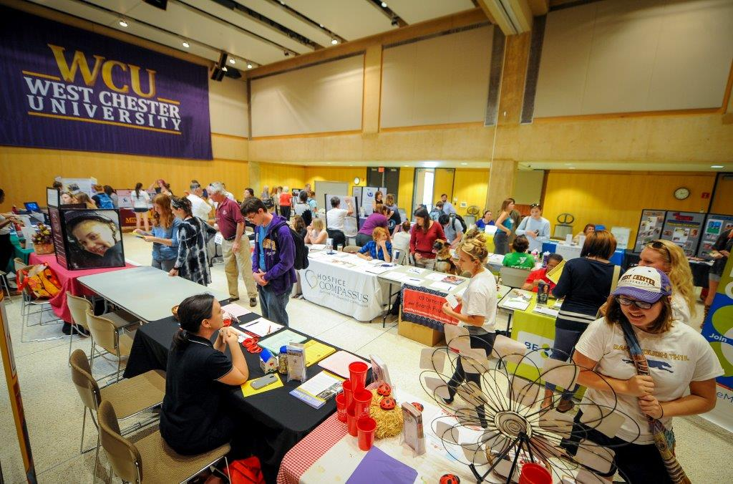
Volunteer Fair
October 2nd, 2019
60 Community Agencies
~500 Students
11:00am-2:00pm
Sykes Ballrooms

Slide 12
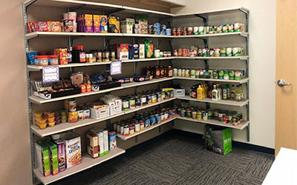



Resource Pantry
Open to ALL undergraduate and graduate students facing
financial hardships & food insecurity
  Non-perishable food items
  Personal care items
  School supplies
  Professional & winter attire
  Organic produce
  Career and financial workshops
Commonwealth Hall, Lower Level
www.wcupa.edu/pantry
Follow us on social media!
WCU Resource Pantry
@Dub_cpantry
Dub_cpantry

Slide 13
Contact Information
Ashlie Delshad, Ph.D.
Associate Professor, Political Science
Service-Learning Faculty Associate
318D Anderson Hall
610-436-0580
ADelshad@wcupa.edu
Pam Frontino, M.A.
Associate Director,
Service-Learning and Volunteer Programs
Commonwealth Hall
610-436-3379
Pfrontino@wcupa.edu
www.wcupa.edu/volunteer

