Slide 1
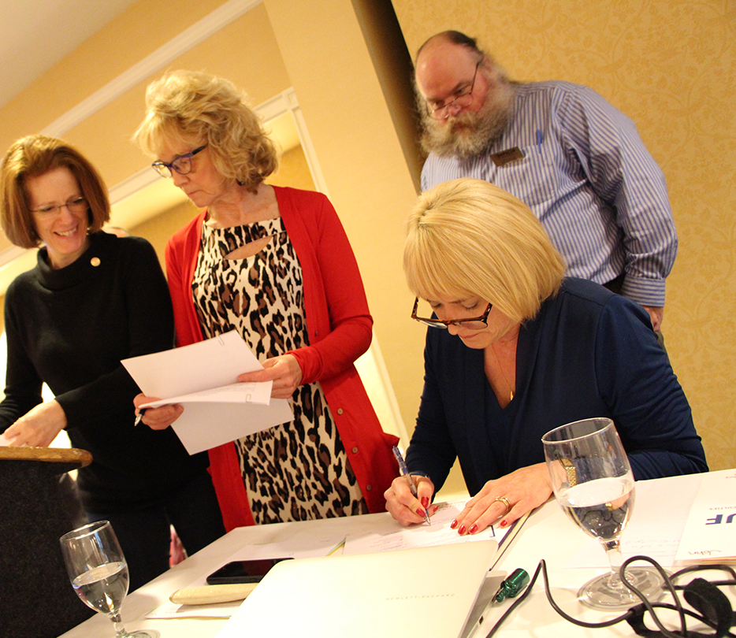
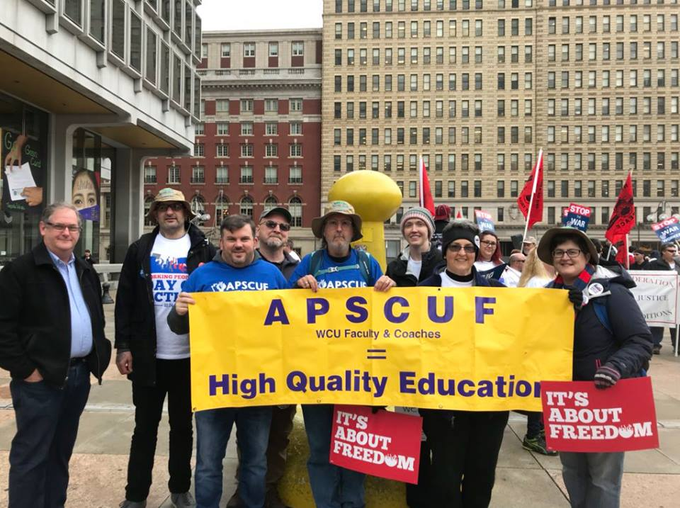
New Faculty Orientation 2019, Pt 1: YOUR UNION and CBA
Notes:
August 9 2018 hearing at Temple University with House Democratic Planning Committee, incl. Reps. S. Kinsey, Sturla, J. Rosebuck, S. McCarter, et. al.

Slide 2
What is the APSCUF mission?
APSCUF works on behalf of student and faculty interests to provide the highest quality education at the most reasonable cost by ensuring a diversity of programs are available, taught by first-class professors who strive for the pursuit of educational excellence.

Slide 3
The movement: UNION STRONG!
APSCUF is the largest of several campus unions (AFSCME, SCUPA, etc.)
After JANUS decision, our chapter increased membership.
Successful strike APSCUF in 2016 (our first!).
Membership chair: Dr. Victoria Tischio vtischio@wcupa.edu

Slide 4
APSCUF Advocacy
Local:
Articles 42, 3, and #metoo
Safe working conditions
Shared governance and agreements
Representation on managerial searches
Polices for specific initiatives
Statewide
Appropriations
Tuition (Frozen this year)
PAPromise legislation
PASSHE redesign involvement
Side letter committees

Slide 5
Contract Negotiations (ongoing)
Contract covers 14 campuses (CBA)
Interest-Based Bargaining (IBB)
Member-driven process
Challenges

Slide 6
What does apscuf do for me (CBA)?
Salary and benefits, retirement
Grievance
Rights for disciplinary procedures
Evaluation procedures
Tenure and promotion guidelines and policies
Sabbatical leave policy
Personal days, sick leave, leaves of
Absence, family sick leave
Curriculum committee
Lobbying state lawmakers
Support pols that Support Public Higher Ed
Overload Summer teaching/Winter pay
Faculty Health and Welfare

Slide 7
Other CBA protection and Fringe Benefits
Suitable office space
Academic freedom
Breadth of scholarly activity
Sick leave bank
APSCUF faculty development grants
Tuition benefits
Intellectual property rights
Adjunct-specific rights (11-G, I)
Faculty hiring, other CBA votes
Retrenchment rights, transfers

Slide 8
What ifs? (handout)
Q: I have been told conflicting things about an official process and believe it is related to the contract. Where do I find correct information?

Slide 9
What ifs? (Handout)
Q: My chair or another evaluator asks for something ahead of the published deadline or in a form not required. What do I do?

Slide 10
What ifs? (Handout)
Q: I am asked to add another service credit or extra responsibility when I feel I am doing more than my fair share.

Slide 11
What ifs? (handout)
Q: A more experienced colleague told me that I should/could hold online office hours or office hours by appointment. Is this correct?

Slide 12
WHAT IFS? (Handout)
Q: I disagree with the findings of an evaluator. What are my rights?

Slide 13
What ifs? (handout)
Q: My Dean or another manager (not faculty) has asked me to do something I am uncomfortable with, takes advantage of my time, etc.

Slide 14
What ifs? (handout)
Q: I have been told about a student complaint against me. What happens next? What are my rights?

Slide 15
What ifs? (handout)
Q: A colleague is acting in bad faith in my evaluation process. What can I do?

Slide 16
What ifs? (handout)
Q: Someone in my evaluation process forgot to do their job and evaluate my classes or order SRIS for a course(s). Am I sunk?

Slide 17
What ifs? (handout)
Q: I receive a letter informing me I am being investigated for wrongdoing. How can APSCUF help?

Slide 18
What ifs? (Handout)
Q: My Dean or another administrator (or in some cases, Department Chair) is calling me into a meeting and I am concerned. What are my rights?

Slide 19
What ifs? (handout)
Q: I feel I have been denied one or more of my contractual rights

Slide 20
What ifs? (handout)
Q: A colleague or administrator has treated me inappropriately (e.g., insulted me, demeaned me in front of others, harassed me sexually or otherwise, etc.). What should I do?

Slide 21
What are the highlights of our Benefits? How do we obtain them?
APSCUF Office Manager:
Monika Mayer mmayer@wcupa.edu 811 Roslyn Ave
(Monika is joining Wednesday at 3:30 pm)

Slide 22
How can I support APSCUF?
Become an member and recruit a member
Contribute to CAP (campaign for action in politics)
Attend all-member meetings, rallies, events!!!
Read the local and state newsletters & emails & discuss with colleagues
Wear your APSCUF bling, use door hangers, flyers, etc.
Become a department representative
Run for local executive council (eventually)
Run for state delegate or alternate state delegate

Slide 23
Who is the union?
WE ARE THE UNION

