Slide 1

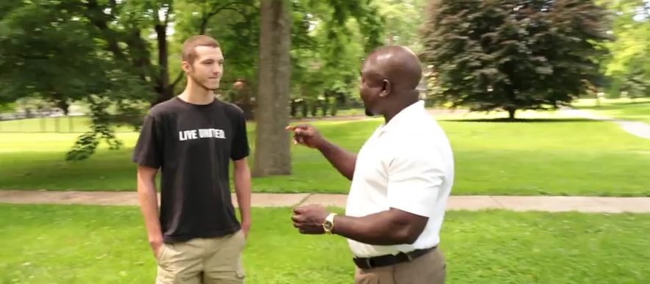
Welcome to West Chester University 2017

Slide 2
TODAY’s Agenda
Overview of the organization
Historical and economic perspective
Current state of our contract (CBA)
Invitation to participate
Answering your questions

Slide 3
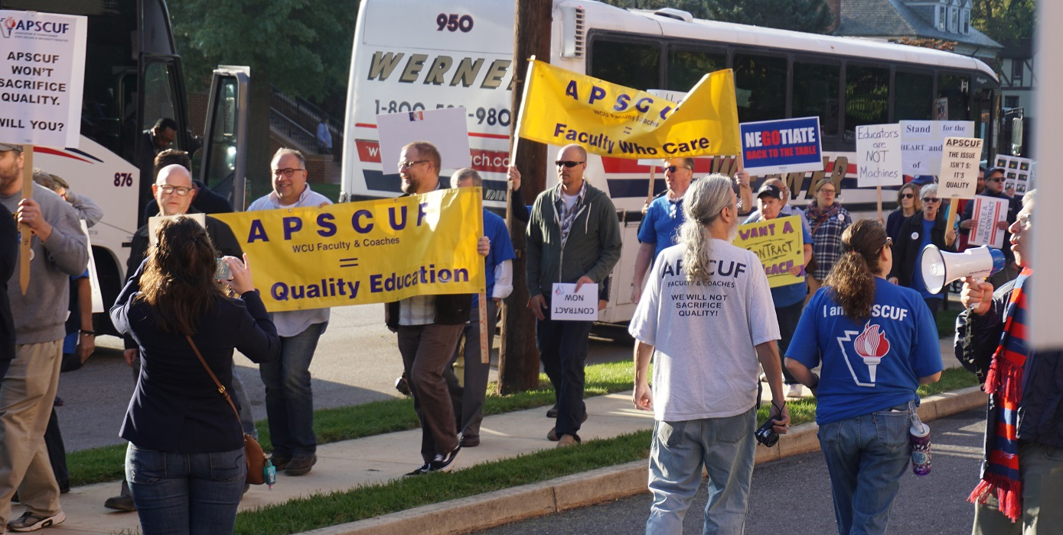
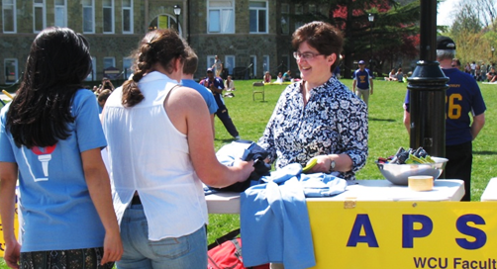
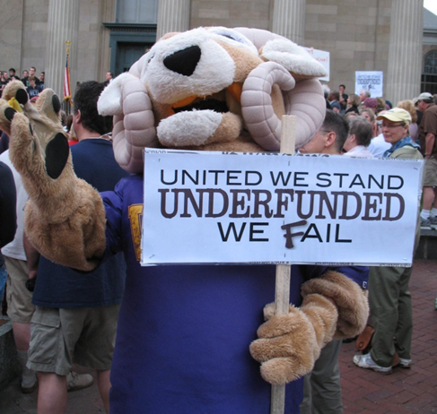
Our Union at work…
Negotiate/monitor contract
Address adjunct faculty, non-classroom/ classroom faculty, coaches’ issues
Student coalitions, scholarships
Legislative advocacy
Social justice advocacy
Media relations

Slide 4


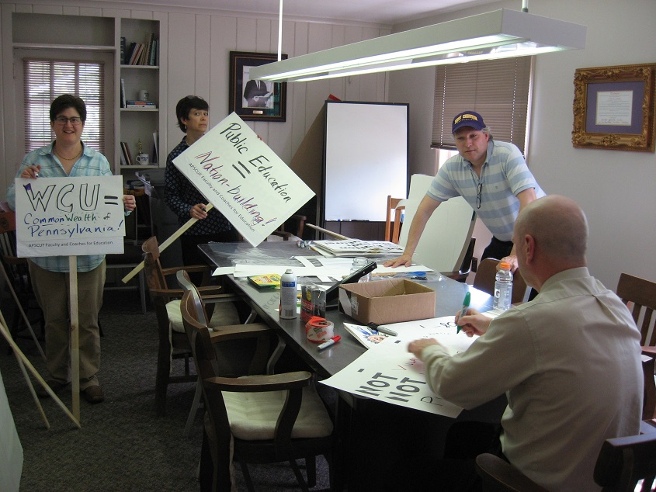
Contract = compensation, benefits, evaluation (P & T), curriculum oversight, due process, intellectual property, terms of employment, working conditions, dept self-governance

Slide 5

A Brief History…

Slide 8
1871

Slide 9
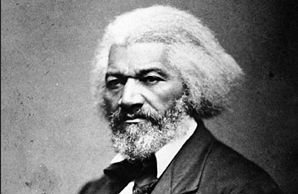
1895
1871

Slide 10
1913
1895
1871

Slide 11
Fighting for an Inclusive Economy
We’ve struggled over the economic rules throughout our history
Who Chooses the
Rule-Makers
DETERMINES
Who Benefits
From the Rules
1776: Only white men with land
1792–1856: Any free white man
1870: Free black men
1920: Women
1924: Native Americans
1971: 18- to 21-year-olds
Who is free or slave
Who can own land
Who has access to what jobs
Whether working people have the right to join a union without fear of violence or loss of job
1871-1913
1934
Notes:
We have struggled over economic rules since the beginning of our nation.
In a democracy, we choose who makes the rules. And who votes determines what the rules are and who benefits from them.
As we expanded the right to vote, through protest and pressure, we changed the rules, and more people got work that could sustain a family.
In 1776 the U.S. Constitution said that only white men with land or property could vote or hold office.
It took another 64 years before all white men without property could vote.
Black men couldn’t vote until 1870.
Women did not have a voice in electing the rule-makers until 1920.
Native Americans—the first people on the continent—couldn’t vote until 1924.
It wasn’t until 1971 that the nation decided that if 18-year-olds could be drafted to fight and die for their country, then they should be able to decide whether or not we GO to war.
As the electorate grew, working people helped change the rules—slavery was abolished, land ownership opened up, it became illegal to limit access to jobs because of a person’s race or gender, and laws were established to protect workers who join unions.

Slide 12
great Depression - Time for a New Deal
Working people demanded economic rules that worked for everyone
The right to form and join a union
40-hour workweek, minimum wage
Unemployment insurance, social security
Rules on banks and the stock exchange
Government agencies to enforce the rules
Notes:
Working people demanded new rules for the economy and the Roosevelt administration responded by creating rules that changed the power dynamic between employees and employers:
The right to join a union—without getting fired, beaten up or killed.
40-hour workweek—with mandatory overtime and an end to child labor.
A national minimum wage.
Social Security—providing public income support for the elderly, widows and orphans.
Rules on banks and the stock exchange—to prevent reckless bankers and traders from gambling with other people’s money.
Unemployment insurance—with mandatory contributions from employers.
Government agencies—to ensure the rules were enforced.
The nation raised taxes on the wealthy to pay for enforcement.
What do you think the top tax rate was in 1937?
In 1937, the wealthy paid 79% of every dollar over $5 million—the equivalent of 79% of every dollar over $81 million today.
What do you think the top tax rate is today?
39.6%

Slide 13


Apscuf began to organize -- 1937

Slide 14

The Virtuous Cycle
More profits, broadly shared, increased wages & investment
Investments
in Research, Transportation
and Infrastructure
Investment in Public Structures & Institutions
Investment in Business Grows
More Tax Revenue
Technology Advances
An Economy That Works for Everyone
Demand Increases
Productivity Rises
Wages Rise
Wealth Increases
Investor Profits Rise
Notes:
Together we created rules that ensured the profits from productivity and growth were broadly shared.
As the United States started mobilizing for World War II, our national government invested millions in research and munitions. The war effort mobilized both public and private investments, rapidly growing jobs and the economy.
When the war ended, the new rules, coupled with strong unions, ensured that wages and benefits increased along with productivity, giving working people more money to spend on goods and services. This increased demand drove investment in new businesses.
The rules of the economy created a virtuous cycle—higher wages increased demand, demand stimulated new investments, technology advanced, productivity rose, tax revenue increased and we had more wealth to invest in public infrastructure, public education, research and other things important to our communities.

Slide 15
Productivity and Wages Rise Together
From 1948 to 1973 employers and working people benefit
120%
100%
80%
60%
40%
20%
0%
Cumulative Change (%) Since 1948
1948 1953 1958 1963 1968 1973
Source: Economic Policy Institute
Notes:
For 25 years, wages (the red line) and productivity (the blue line) rose together—both nearly doubled between 1948 and 1973.

Slide 16
Organizing for Change: 1940s-1970s
1940s–1950s Ending Segregation
1950s–1960s Expanding Civil Rights
1950s–1970s Expanding Voting Rights
1960s–1970s Expanding Women’s Rights
Notes:
Then, as now, working people came together to fight for change:
African Americans led civil rights marches to protest segregation and political exclusion.
Latino and Asian communities fought for equal access to education, immigration reform and an end to job discrimination.
Women demanded equal pay and equal treatment in the workplace, and an end to sexual harassment and discrimination.
The movements for lesbian, gay, bisexual and transgender rights worked to end discrimination based on sexual orientation, gender identity or expression.
Through collective action, we changed the rules to build a more inclusive democracy and economy.
CIVIL RIGHTS:
1957 – The Civil Rights Act was passed, allowing the federal government to investigate abuses.
1964 – President Lyndon Johnson signed the Civil Rights Act of 1964. Title VII of the act banned discrimination based on sex, race, color, religion or national origin.
VOTING RIGHTS:
1964 – 24th Amendment ratified; prohibited poll taxes used to prevent African Americans from voting.
1965 – Voting Rights Act passed; prohibited voting test requirements for African Americans and established federal election supervision in places where African Americans had been prevented from voting.
1975 – Voting Rights Act expanded to require language assistance at polling stations.
WOMEN’S RIGHTS:
1963 – The Equal Pay Act made it illegal to pay men and women different wages for equal work.
1972 – Title IX of the Education Amendments prohibited discrimination based on gender in federally assisted educational programs.
1974 – Equal Credit Opportunity Act prohibited discrimination in granting credit based on race, sex, age, national origin or marital status.
If time permits, ask participants about their personal knowledge or experience with the impact of these rule changes.

Slide 17
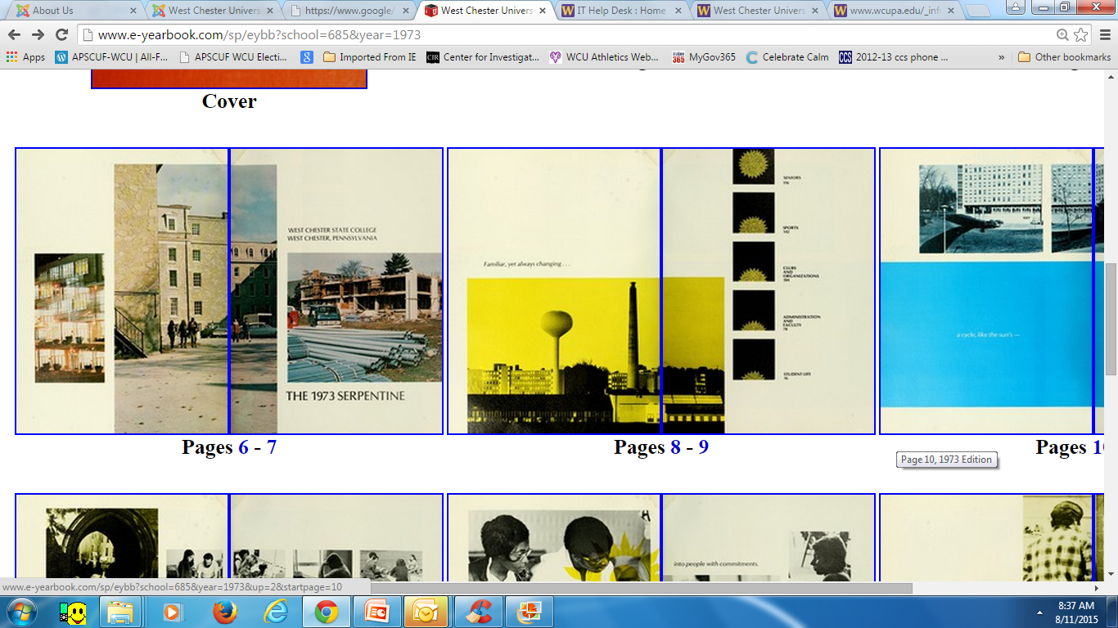
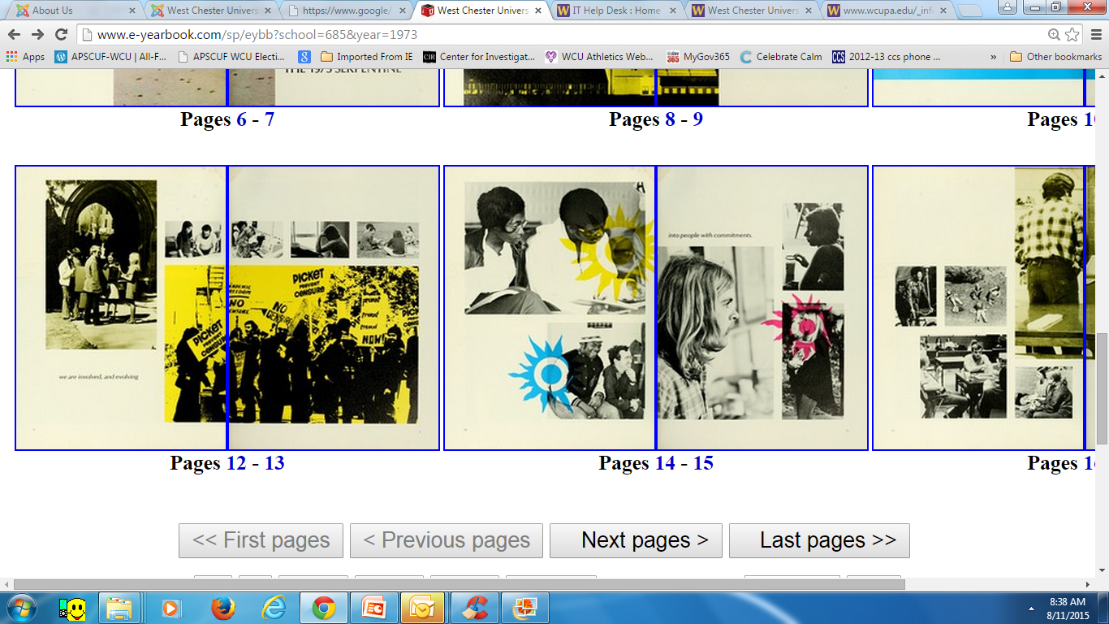

1973 Unionization occurs
WE Are

Slide 18
Productivity and Wages:
300%
250%
200%
150%
100%
50%
0%
Cumulative Change (%) Since 1948
1948 1953 1958 1963 1968 1973 1978 1983 1988 1993 1998 2003 2008 2013
Source: Economic Policy Institute
Notes:
We looked before at how productivity and wages rose together from 1948 to 1973.
Looking at this graph, what starts to happen in the early ’70s? What do you think caused this change?
[Take a few responses from participants. Responses might include trade, attacks on unions, corporate influence, etc.]
As we can see from the slide, from 1973 on productivity continued to rise, but employers refused to pay higher wages.
The wealthy and powerful changed the rules of the economy to keep wages low and make it harder for working people to make a living.

Slide 19
Union Membership and the Economy
As union membership declined,
the share of income going to the top 10% increased
60%
50%
40%
30%
20%
10%
0%
Share of income going to top 10%
Union membership
1917 1927 1937 1947 1957 1967 1977 1987 1997 2007 2012
Source: Economic Policy Institute
Notes:
What has been the result of these changes to the rules of the economy?
When unions are strong, they act as a check on corporate power and provide a way for working people to exert economic and political power to set and enforce rules that work for everyone.
This graph shows union membership rates (the blue line), and the share of income that goes to the top 10% of our country (the red line). What do you notice about these lines?
[Take a few responses from participants.]
We can see the relationship between union membership and income—as union density declined, the share of income going to the top 10% increased substantially. When unions represented 30 to 40% of the workforce, they influenced all wages.
As it became harder to form and join unions, and to speak up together, it became harder to demand our fair share of economic growth and the wealth we all create.

Slide 20
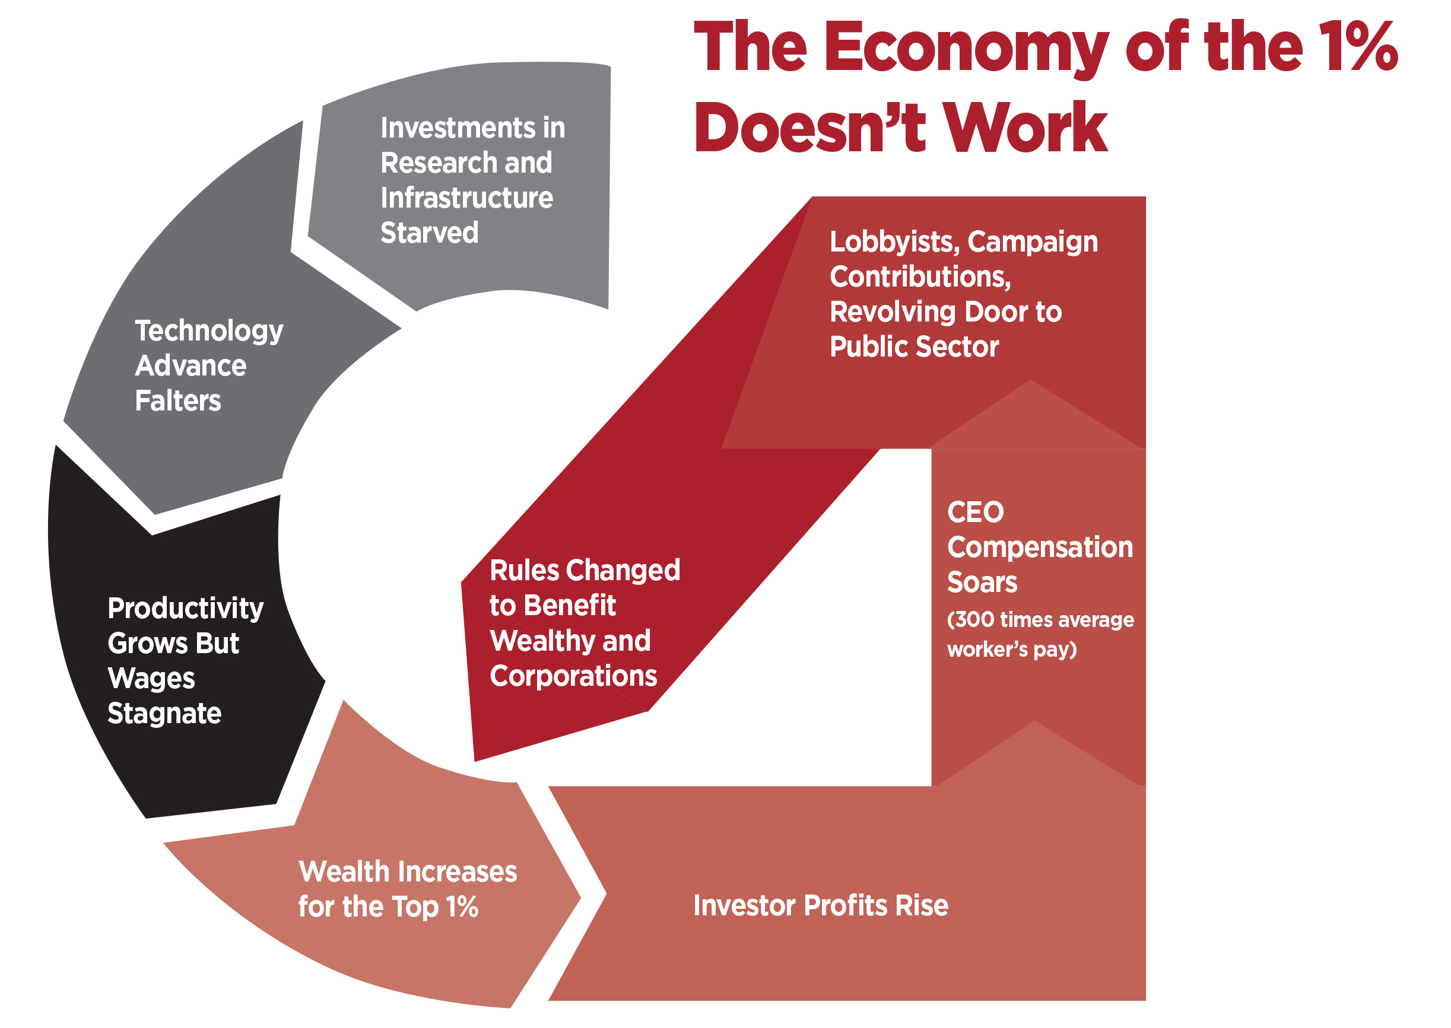
The Vicious Cycle
Wages Flat, Profits Hoarded, No Investment
Lobbyists, Campaign Contributions, Revolving Door to Public Sector
CEO Compensation Soars
(300 x average workers pay)
Rules Changed to Benefit Wealthy and Corporations
Notes:
The rules of the economy have changed to benefit the top 1% and keep us in a vicious cycle of low-wage work and communities starved of resources. Low wages mean no customers, no growth and no business investment.
Instead of the wealth of our country being invested in research, infrastructure, education and other things important to our communities, the increased wealth is going into the pockets of the top 1% of our country. This starves the public sector and undermines the institutions that built the middle class—public colleges and universities, good government jobs that protect public health, build and maintain our infrastructure and provide valuable public services.
CEO pay has skyrocketed. Investor profits are on the rise. Contributions to lobbyists and political campaigns are at an all-time high.
The attacks on unions have made it harder for working people to negotiate together to demand a fair share of the wealth they create.
The economy of the 1% doesn’t work for most of us.

Slide 21
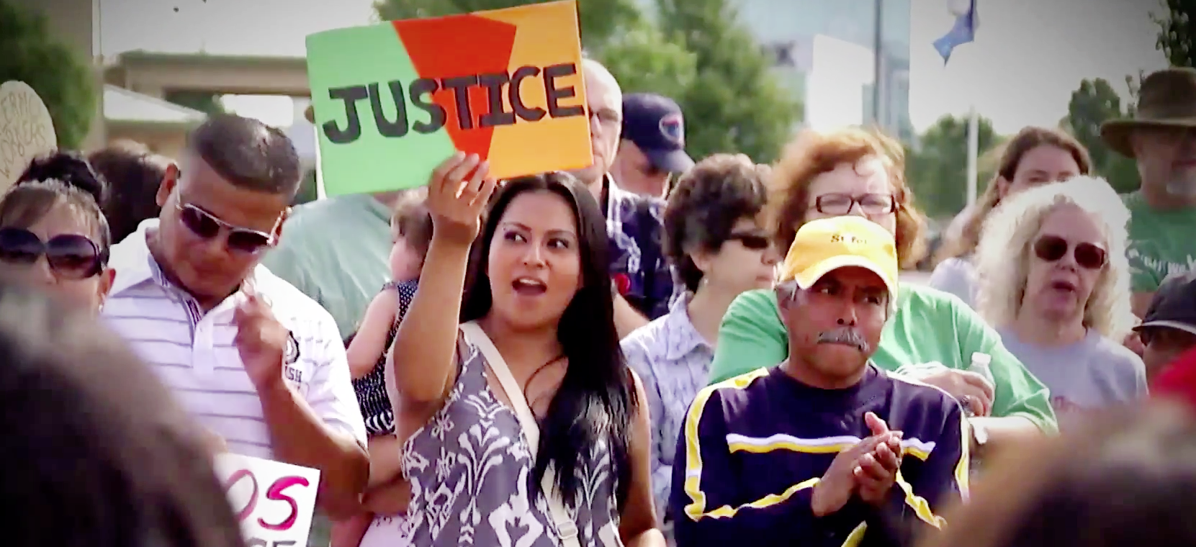
Unions are exercising power
To fight for an economy that works for everyone
Protecting OUR jobs, our children’s future, our students’ futures, the ability of our students’ children to afford higher education.
Notes:
This is our choice—fight for an economy that works for everyone, or watch our democracy and our families’ future collapse.
That’s why we’re here today—to take action.
What can we do change the rules?
[Take a few responses from participants.]

Slide 22
Apscuf at the State and Local level
Elected State Officers
Legislative Assembly,
Statewide Committees
Harrisburg Staff
14 Sister Schools in State System
Field Staff
Elected WCU Officers
Office Manager
Dept Reps, Searches, Comittees, Task Forces

Slide 23
Many Opportunities to serve APSCUF
(full Members)
*Department Representative
*Local standing committees:
  Membership
  Legislative
  Committee for Action in Politics (CAP)
  Nominations and Elections
  PR
  External Organizing
  Building Safety & Working Conditions
  Adjunct Faculty
  Social Justice
APSCUF Officers (incl. at-Large)
Meet and Discuss
State Delegate and Alternate State Delegates
APSCUF State Committees, Officers
Negotiations Team
*Move-in day
*Voter Registration drives
*Member events
*Rallies & Marches

Slide 24
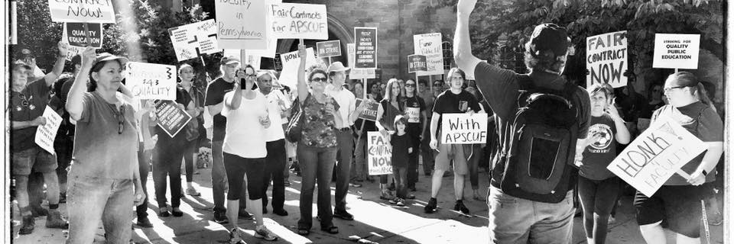
On October 19, 2016, apscuf had its first-ever job action: a three-day strike on fourteen campuses.

Slide 25
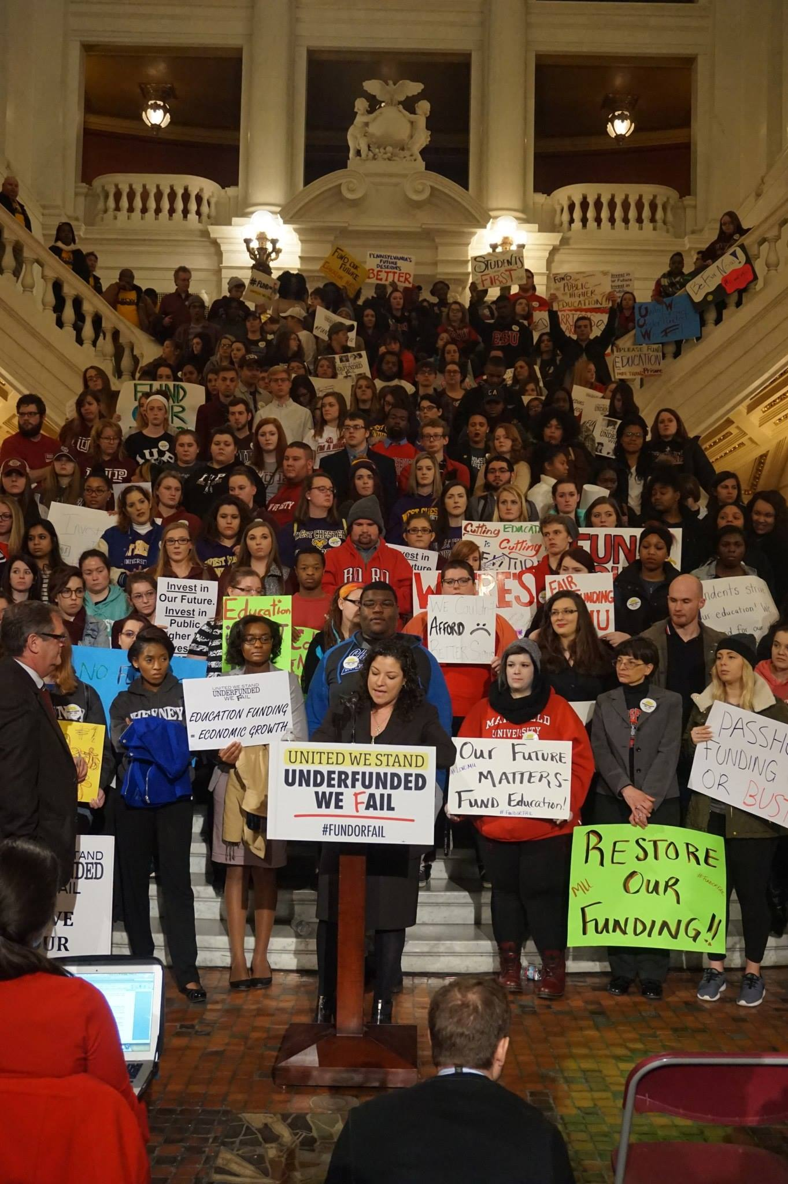

What we achieved through solidarity
Swept non-economic changes off the table.
Kept adjunct faculty whole, with gains.
Modest raises including retroactive pay raises in 2016-2017.
Healthcare givebacks were moderated.
The Chancellor retired this August.
Better connection with Students.
Solidarity: Fewer than 20/900 scabs.
APSCUF is stronger as a result.

Slide 26

The PA State System faculty Contract is the NATIONAL GOLD standard CBA

Slide 27
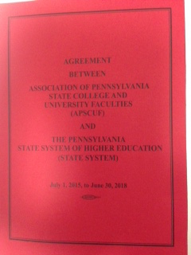
contract expires June 30, 2018
We are in the last year of a 3-year contract
Negotiations are hopefully about to begin
We have an interim chancellor
Political decisions will have an impact.
Look for surveys &
focus groups…

Slide 28
Stay informed & involved
Membership survey and focus groups
All-member contract updates
Results of Side-Letter Committees
Fallout from NCHEMS report
Bluster from PA system, legislators
Activism: rallies, lobby days, member events, etc.
Battles over allocation & tuition increases (Spring, Summer ‘18)

Slide 29

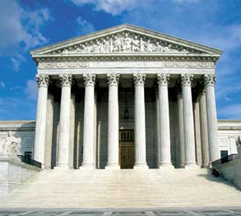

BEYOND THE SYSTEM
SCOTUS: AFSCME vs. CHICAGO
vs. FAIR SHARE, for RIGHT TO WORK
LESS SUPPORTIVE NLRB?
PA BUDGET CRISIS
MIDTERM ELECTIONS
GOVERNOR’S RACE
DEMOGRAPHIC CHANGES
SECRETARY DEVOS’ RADICAL AGENDA
(TITLE IX, LOAN FORGIVENESS

Slide 30
What you can do --
Become a member
Participate: Move-In Day, Voter Registration
Attend APSCUF meetings, events and rallies
Join an APSCUF committee
Find and talk to my department APSCUF Representative
Engage in political action

Slide 31
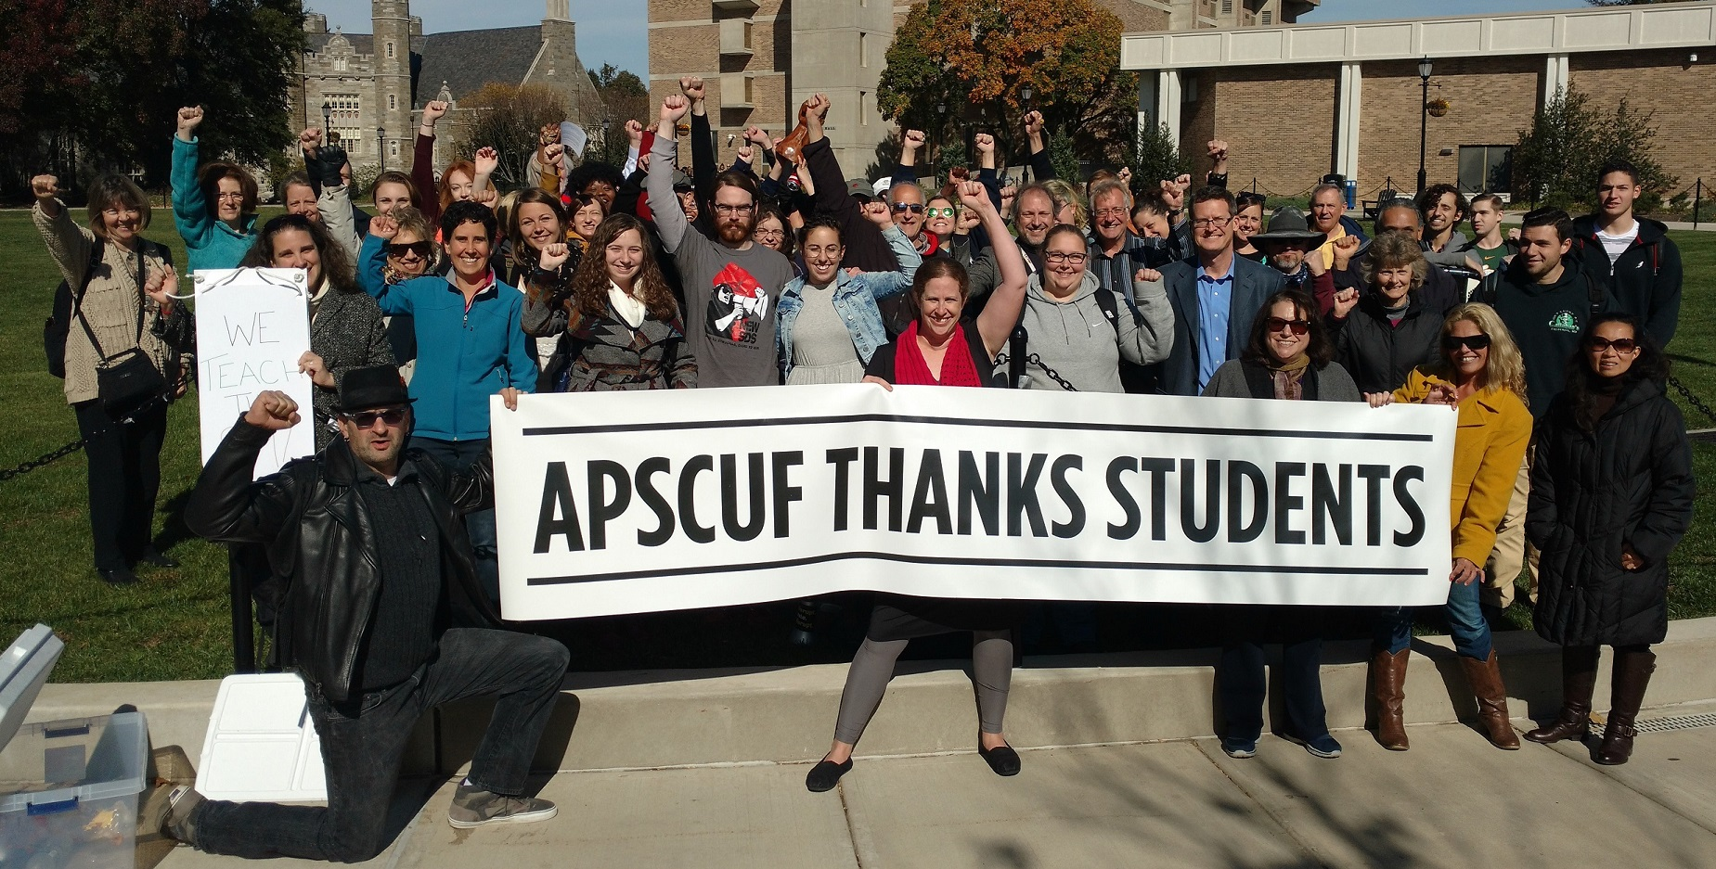
WE Are
NEXT TIME: A brief tour of our contract

