Slide 1

University College
Moderator: Dr. Tabetha adkins
associate provost & Dean, university college

Slide 2
Student Support Services
Academic Development Program (ADP)
Learning Assistance Resource Center (LARC)
Exploratory Studies
Office of Services for Students with Disabilities (OSSD)

Slide 3
Academic Development Program (ADP)
John Craig, Ed.D. – director
Contact: Lawrence Center Room 231
Phone: 610-436-3274

Slide 4
What is ADP
ADP is a special admissions program for students who may not meet the university’s set admissions requirements.
Students must successfully complete a 5-week summer program.
During the summer program, students take 6 credits (2 classes). The classes taken depend on the students’ placement results in math, reading and English.
During the summer program, there are several activities and workshops which are designed to help the student become acclimated to West Chester University.

Slide 5

Who Are Our Students?
There are two “Admit types” which make up ADP students.
F2 – *ACT 101 Students
F3 – Non ACT 101 Students
ADP students are culturally and socioeconomically diverse
What separates these two admit types is verified household income.

Slide 6
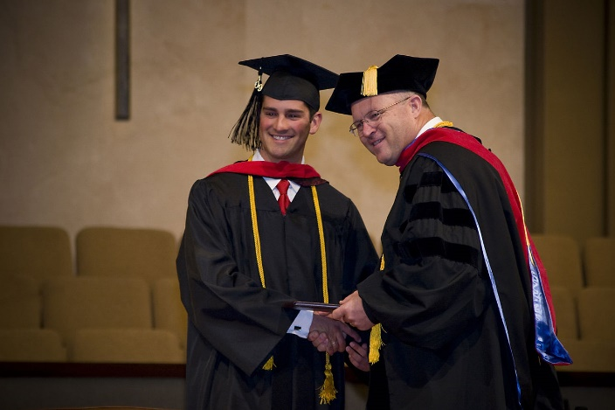
What Are the Goals of our Students?
Earn a degree from WCU
Graduate/Professional School
Enter a Rewarding Career

Slide 7
Support Services
Tutoring Support through the LARC and Writing Center
CDC (Career Development Center)
Mentoring/Success Coaching
Financial Aid
Priority Registration for first year students
Academic Advising
*ACT 101

Slide 8

Impact
The 2017 Fall to fall first year retention was 80.25% compared to 82.9% of the Non-ADP/Non-ACT 101 students.
Retention rates traditionally to mirror the university’s overall rates for non-ADP students year-over-year

Slide 9
Exploratory Studies Academic Advising
Francis Atuahene, ph.d - director
Contact: Lawrence Center Room 222
Phone: 610-436-3505

Slide 10
Who are our students?
Three category of Exploratory Students:
  Exploratory Decided students
  Exploratory undecided students
  Students with multiple majors in mind
Students are required to declare by 45 credits
Role of Faculty Advisors

Slide 11
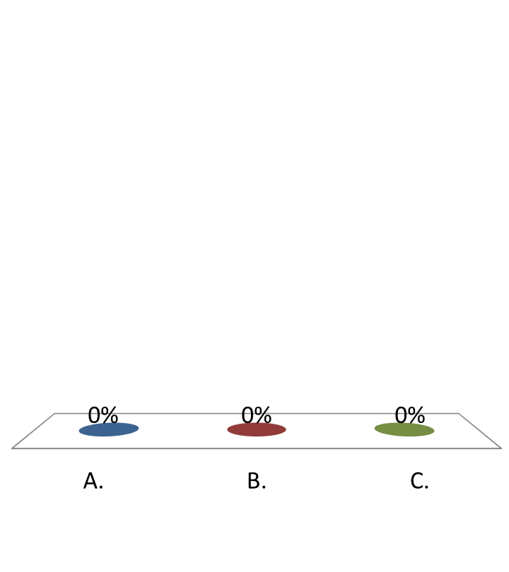

A student comes to you and says that he no longer wants to be enrolled in the major he is in. What would you tell him to do?
Tell him you can't help him because you only know about the curriculum in your discipline.
Tell him to follow the general education requirements in the catalog and that should be OK.
Send him to the Exploratory Studies Academic Advising Center.

Slide 12
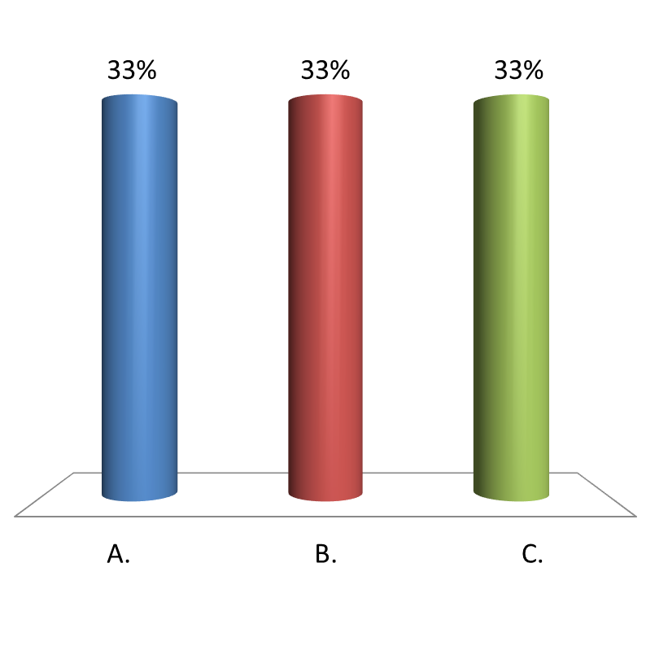
A student drops by the departmental office and you are the only person around. She says that she wants to just take a class and she doesn't want to be a full time student. What do you advise her?
Tell her to go to Exploratory Studies Academic Advising Center.
Tell her to go to Admissions
Send her to the Registrar’s Office.

Slide 13

A student in your major entry level class states that she is Undeclared or Exploratory. What would you tell her?
Welcome her and ask about her interest in your discipline
Tell her the class is only for people who knew what major they wanted
Tell her to go to Admissions

Slide 14
The Learning Assistance and Resource Center (LARC)
Jocelyn Manigo, Ed.D - director
Contact: Lawrence Center Room 224
Phone: 610-436-2535

Slide 15
Mission Summary
Provide quality academic support services
Develop active, independent learners
Teach skills necessary for academic and personal success

Slide 16
Programs & Services
Tutoring
Supplemental Instruction *for chemistry and biology courses
ADP Support
The Achieve! Program
Academic Success Workshops
Basic Skills Testing Workshops
Smarthinking (online)
Partnerships

Slide 17
How Can Faculty Help – Your Role
Utilize Early Alert
Recommend tutoring/other services
Recommend tutors

Slide 18
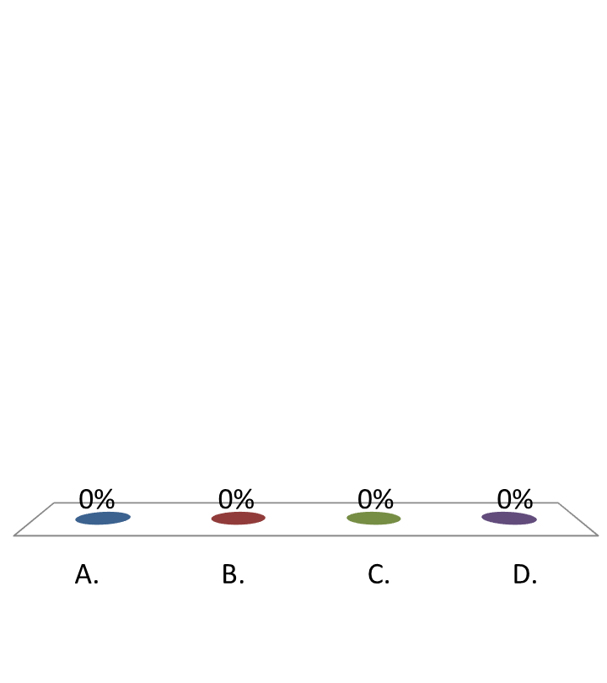
The goal of the Early Alert Program is to promote academic success for students by
Identifying students having trouble with targeted course material
Providing students timely support and direction to appropriate campus resources
Making the college transition process more enjoyable by providing more opportunity for academic success
All of the above​

Slide 19
You have a student in need of help in your class, but it's not just about the course content. The student may need other skill development, such as how to take notes, how to participate more effectively in class, or how to manage time in order to successfully complete assignments. Which series will help your student develop these skills?
Supplemental Instruction for high-risk biology and chemistry courses
Academic Success Workshops
Basic Skills Test Workshop
The Travel Adventures Film Series (a series you should definitely check out for yourself)

Slide 20
Office of Services for Students with Disabilities (OSSD)
Dr. Martin Patwell – Director
Location: Lawrence Center Room 223
Phone: 610-436-2564

Slide 21
Students Served by OSSD
Percentage by Disability Pie Chart
900 Students

Slide 22
Student’s Registered with OSSD G.P.A.

Slide 23
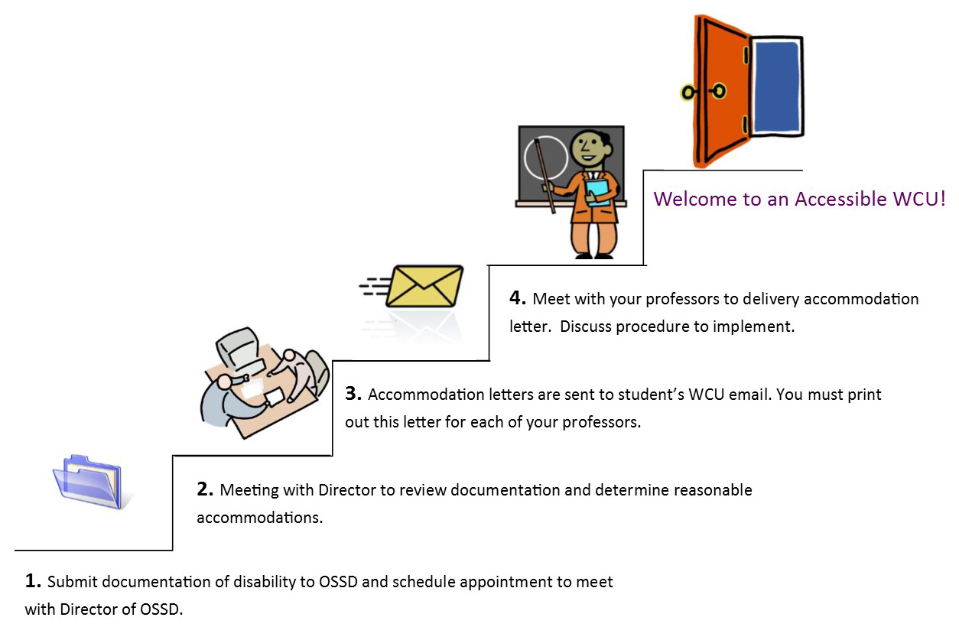

Slide 24

Closed CAPTIONING Policy
West Chester University is committed to adhering to the requirements of Sections 504 & 508 of the Rehabilitation Act of 1973 and the Americans with Disabilities Act of 1990, by providing reasonable accommodations to qualified individuals with disabilities. In addition to individuals who are deaf or have a hearing loss, other individuals with documented disabilities may require accommodations and/or modifications to course materials and/or other University communications.
Closed Captioning - for information, please refer to the Accessible Software Applications dropdown link on the Information Technology Accessibility webpage.

Slide 25

Types of Accommodations
Extended Time for Test Taking
http://www.wcupa.edu/viceProvost/ussss/ossd/proctoringCenter.aspx
Alternative Textbook Format
Note-taking Assistance
Alternative Testing Locations
Adaptive Classroom Technology
Student is only entitled to the accomodations stated in the Letter of Accomodation(LOA) If the wish to discuss additional accommodations they need to go to OSSD
Accommodations are not retroactive they begin when the LOA is presented to the faculty member

Slide 26

Encouraging Student Disclosure of Disability
“I see you are struggling, have you tried other supportive services here on campus such as LARC, Writing Center Counseling, Career Services, Women's Center, OSSD…”
DO NOT directly ask or assume a student’s disability
Ensure confidentiality and self disclosure
OSSD is not a Counseling Center it is for Academic Accommodation
If a student self discloses, then refer them to OSSD

Slide 27
University College

Slide 28

Questions?
TAdkins@tamuc.edu
JCraig@wcupa.edu
FAtuahene@wcupa.edu
JManigo@wcupa.edu
MPatwell@wcupa.edu

