Slide 1
Welcome
OFFICE OF RESEARCH AND SPONSORED PROGRAMS (ORSP)
6th floor Wayne Hall
(610) 436-3557
http://www.wcupa.edu/research
Research@wcupa.edu

Slide 2
Who are we?
Dr. Nicole S. Bennett; Wayne 616 Vice Provost for Research and Creative Activity nbennett@wcupa.edu 610-436-3592 | M. Holly Jackson; Wayne 611 Administrative Assistant MJackson2@wcupa.edu (610) 436‐3557
Laura Vassallo, Wayne 614 Grants Development Specialist LVassallo@wcupa.edu; (610) 430‐5606 Supports Colleges of the Sciences & Mathematics and Health Sciences | Catherine Spaur, Wayne 612 Grants Development Specialist; CSpaur@wcupa.edu; (610) 436‐3060 Supports Colleges of Arts &Humanities, Business & Public Management, and Education & Social Work
Kristel Buschan; Wayne 627- Student Ambassador Graduate Research Assistant KB896589@wcupa.edu | Colin Mancini; Wayne 627- Student Ambassador Graduate Research Assistant CM877119@wcupa.edu
E-mail us at research@wcupa.edu

Slide 3
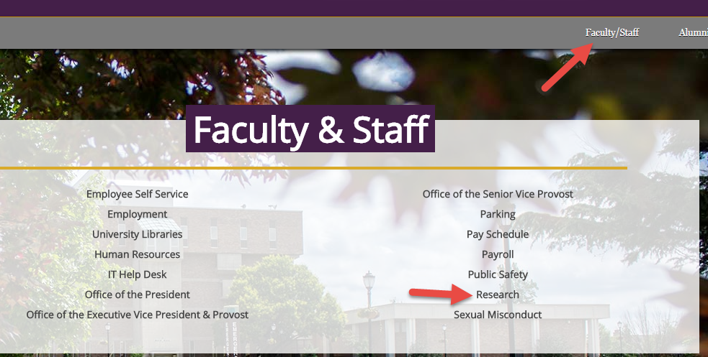
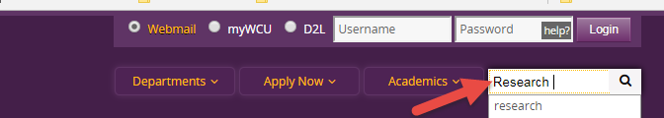
How Do I Find ORSP: www.wcupa.edu/research
Or

Slide 4
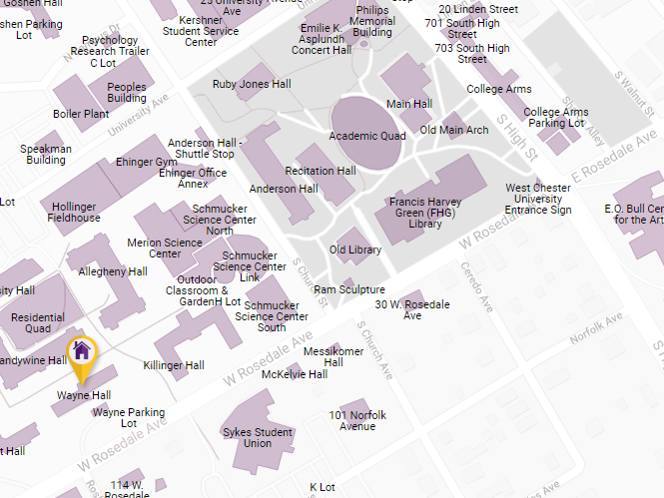
We are located on the 6th Floor of Wayne Hall

Slide 5
What does WCU ORSP do?
The Office of Research and Sponsored Programs (ORSP) Facilitates, coordinates and safeguards the research environment at WCU. We accomplish this by supporting faculty and staff in the entire grant application development and submission process.
From identifying potential funding sources, to proposal development, budget formation, review of proposals, and finally grant submission, ORSP is here to support your grant proposals.
All grants or contracts that support your research must be coordinated with ORSP.
We are here to support you as you attempt to secure external or internal funding to support your research and creative activity!
To learn more about the specific services that our office provides, please visit: https://www.wcupa.edu/_admin/research/services.aspx

Slide 6
What should my first steps be if I need funding to support my research?
E-mail research@wcupa.edu in order to set up a one-on-one meeting with your grants specialist. At this meeting you and your grant specialist will discuss your current research interests as well as your future research agenda in order to come up with a long term plan to secure internal and/or external funding to support your research. If you add your name to the sheet on the table, your ORSP representative will reach out to you.
Create an account with PIVOT. PIVOT is a subscription database that contains funding opportunities from over 11,500 sponsors and provides the ability for WCU faculty, student and staff to identify and connect to the most comprehensive source of Federal, State and private sector funding opportunities.
Visit www.wcupa.edu/research to learn about the entire proposal submission and award process.

Slide 7
INTERNAL FUNDING OPPORTUNITY OPEN TO ALL FACULTY
Provost Research Grants (PRG) FY 2020
The purpose of the PRG grant is to support faculty research, scholarship, and the production of
scholarly/creative outputs; all of which must demonstrate student impact.
Call for proposals will be announced late summer or early fall 2018. All projects will start July 1, 2019.
A PRG Proposal Development Workshop will be held on October 23rd and 24th, at 12PM in Sykes 210
STATE SYSTEM FUNDING OPPORTUNITY OPEN TO ALL FACULTY
Pennsylvania State System of Higher Education Faculty Professional Development Council Annual Grant Program
The Annual Grant Program provides professional growth opportunities for individual faculty and teams of faculty. The applicant will have to address how their professional development will contribute to or impact student success. Call for Proposals will be released in November 2018
For each program funds can be requested for (list is not exhaustive):
Faculty Salary  Participant incentive payments
Student Wages  Supplies
Consultants  Contractual work (transcription, data analysis…)
Travel (for research purposes only)

Slide 8
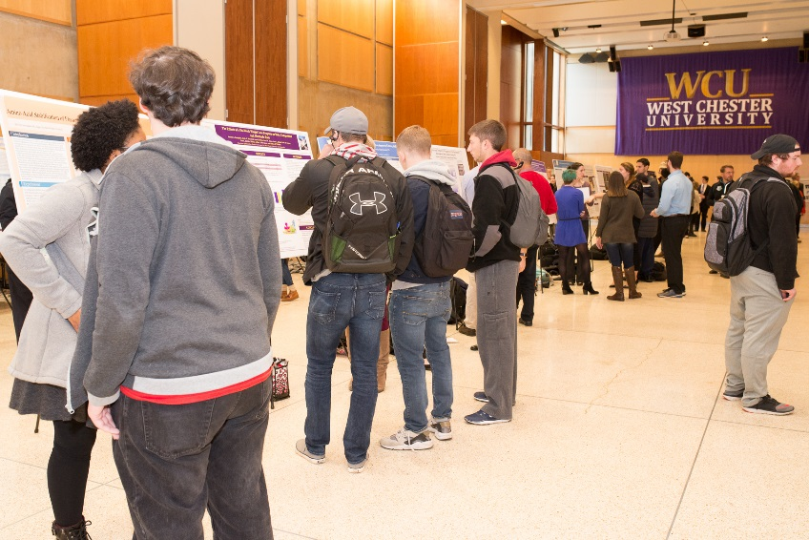
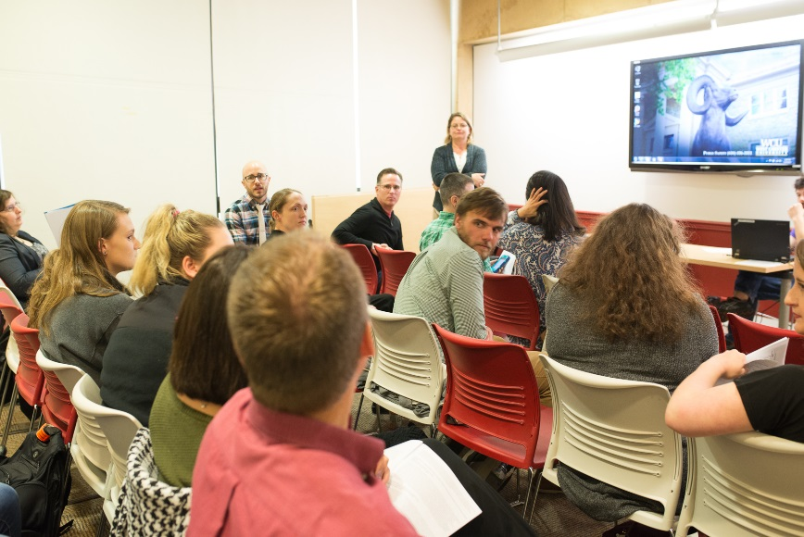
JOIN US FOR FALL RESEARCH DAY- NOVEMBER 8TH, 2018
West Chester University Research Day provides a venue for all our students, faculty and administrators to present, discuss, and highlight their research and scholarship outcomes.
There is the opportunity to present research in a poster and/or oral session. It also serves as a valuable forum for students to practice their presentations prior to upcoming regional and national conferences.
All events take place in Sykes Student Union
Call for Abstracts will be released in September 2018

