Slide 1
ACTIVE READING
Academic Success workshop presentation

Slide 2

PRE-READING QUESTIONS:
Is the book print or online?
Can you highlight in it?
What does the structure of the chapters look like?
How much do you have to read and how long do you have?

Slide 3
ONLINE TEXTBOOKS
Does this format work for you?
Do you get easily distracted while on your computer?
Can you print pages?

Slide 4
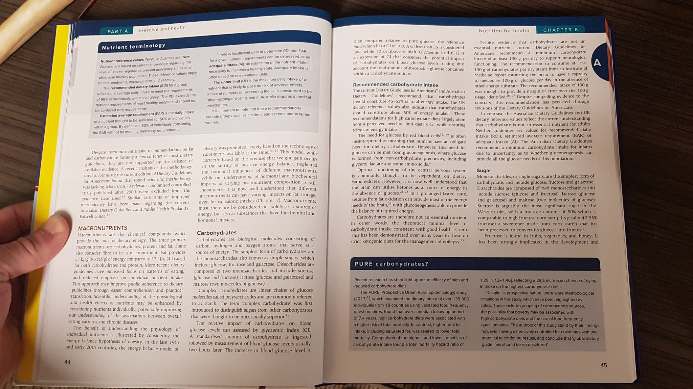
CHAPTER STRUCTURES
How long are the chapters?
What do the headings and subheadings look like?

Slide 5

PACING
How many chapters do you have to read and for how long?
Post it notes on the first and last page of each chapter
Reward yourself!

Slide 6
SQ3R
Survey
Question
Read
Recite
Review

Slide 7
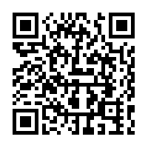
THANKS FOR WATCHING
Own your knowledge- don’t lease it!
Sign up for a SSC via the QR code or MyWConline

