Slide 1

Going Back To class
From online to in real life

Slide 2

Before we start
Take a moment to think about this…
  What is the biggest challenge of going back to in-person classes?
Notes:
Before we start, It’s good to take some time to yourself to try and determine what you have struggled with when returning to in-person classes. Upon seeing my list of challenges, you may see that we have some things in common. So, take a minute or two, pause the video and reflect on what you have struggled with so far.
OK, let’s continue.

Slide 3
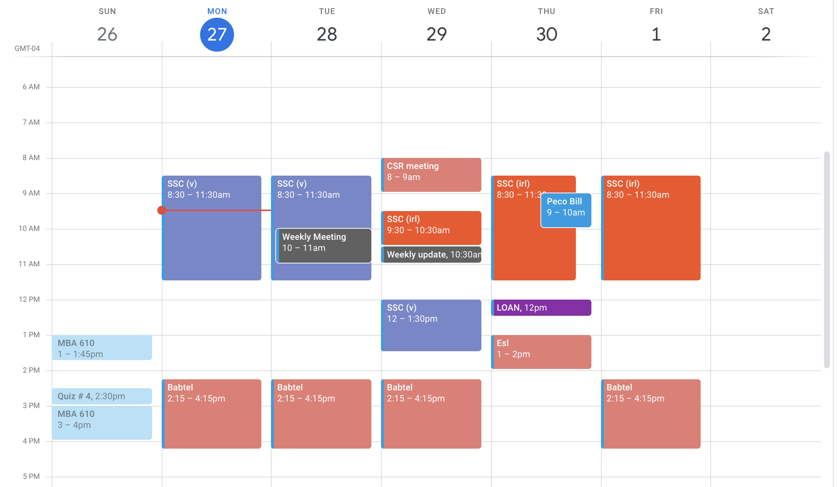
Challenges
Getting back into a routine… ie getting out of bed in the morning
Friends… they can go either way
Time management…
Notes:
Here are some of the main areas I have been challenged upon my return to in-person classes.
First of all, I find myself struggling to just get out of bed. I mean it was like this before we went online, but now it’s at a whole new level. I was so used to just sleeping until 5 minutes before my class started. Now, I have to get up, get ready, and get there on time. It’s about a 1 hour process, minimum.
Second, lets talk about friends and socializing. It’s great to get to spend time with my friends again, but often it eats into the time I need for productivity. So, I’m sure I’ll need to find a way to address that.
Both of these items may seem like they are just part of time management, that’s because in many ways they are. That doesn’t mean we can’t come up with unique ways to handle each of these items and then incorporate them into our time management strategy.

Slide 4
Getting back into a routine
Start your day with something you enjoy.
  “I always get up to drink my coffee. The rest of the day just seems to tag along.” – Unknown genius
Establish your ideal times for each activity
  Then stick to them…
Notes:
One of the best things to do is reward yourself. Some people, foolishly, think this only works for kids. Everyone’s brain works on a system of rewards, you just need to know what yours are. For example, I love eating. So, I use delicious treats to reward myself.
I always need a reason to get up, so I just focus on getting up for an instant reward. Honestly, I was the author of the quote. I really do get up to drink a coffee. You may not like coffee, I used to dislike it as well. Back then, I got up so that I could eat my favorite breakfast sandwhich. You just need one good thing to get yourself out of bed in the morning.
It should be noted, that it’s a lot harder to get out of bed when you didn’t get enough sleep. Getting to sleep can be a way bigger challenge than getting up. There always seems like there are so many things to do at night. The only way to justify your sleep is to establish your ideals. For example, I need my 8 hours of sleep. So… If I’m due in class by 8am, I need to be up by 7am. That means I need to be asleep by 11pm – at the latest. So, how do I make sure that happens?… We’ll get to that when we talk about time management. One key thing to avoid, if you want to get your beauty rest like me, is late night social engagements. I think we all recognize that if you start chatting before you want to sleep, you could easily talk for hours. There’s nothing necessarily wrong with that, unless you have to wake up early in the morning.

Slide 5
friends
They’re OK I guess
Pros:
  Can be fun
  Can help with specific classes
  Study groups
Cons:
  - Can be fun … and take up all my time, and then I’m stressed because they want to go get breakfast and I need to get my work done, but I’m also hungry and need food
Notes:
It’s obviously important to have friends. They are usually a big part of our lives and can help us in a lot of ways. For one, I love being in a class with my friend and doing better than them. I became really proficient in chemistry because my friend was in my class. He kept getting 98s, so I had to start getting 100s. But, that’s probably one of the worst ways to benefit from a friendship.
It’s important to try and have at least one friend or acquaintance in each class. It’s really useful when you forgot to write down the prof’s assignment, then you can text your buddy ”hey cool friend, what was that assignment I forgot about which you potentially wrote down?” Also, if that is a class that requires discussion, you really need someone that can talk over the material. For example, I took a philosophy class and my little brother was also in the class. We argued constantly about the material and both got good grades.
Friends can also be start of study groups. These can be really helpful for difficult classes. Just having someone with different strengths in your group can help much more than you anticipate. For example, there was a stat class where I needed to know how to use excel. I once struggled for hours trying to apply something, only to have my friend know the exact way to plug-in the data and achieve instance results. I never wasted time on that again. Speaking about wasting time, weren’t we going to discuss other ways to avoid that?

Slide 6

Time management
Find the system
that works for you
  Digital calendar - physical calendar - a combination?
Notes:
Yes, we were, and here it is. The penultimate topic. Time management is a skill, just like riding a bicycle or knowing how to use Microsoft excel. Also, you should know, it’s something that is unique to each person. The way I manage my time, may not work for you. So, I’ll just share some tools and tips that seem to be pretty universally applicable.
Use a physical and digital schedule!
If one works, that’s fine. I use both for different things
I use the digital calendar to setup a general schedule and incorporate specific due dates for important items
Setup reminders using your digital schedule for when to get started and when to finish your activities
Use the physical schedule to help you day-to-day, make to do lists for immediate tasks
Find techniques to help use your allotted time correctly. For example, I take a break every 40 minutes to play 5 minutes of arcade games on my phone.
If you still need some guidance, go to the ASW homepage. I have whole presentation about how to manage your time. We also have plenty other resources available to ensure your success here at WCU…

Slide 7
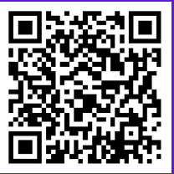
WCU has so many resources for you
Success Coaching
http://www.wcupa.edu/larc
Tutoring (Link in description)
Office Hours: Ask your professor!
Counseling (Link in description)
There are so many more…
Notes:
Here are some resources that may be relevant to this specific topic, but it’s really only the tip of the iceberg. Obviously, you should never forget your student success coaches.
Tutoring: https://www.wcupa.edu/universityCollege/larc/students.aspx
Counseling: https://www.wcupa.edu/_services/Stu/ramsEyeView/counseling.aspx?gclid=Cj0KCQjw18WKBhCUARIsAFiW7JyhQGpC9Hyz9_xoeLKqOdYupI7Nxot10CInNrdu7wsNZpTdCv_Vl84aArdZEALw_wcB

