Slide 1
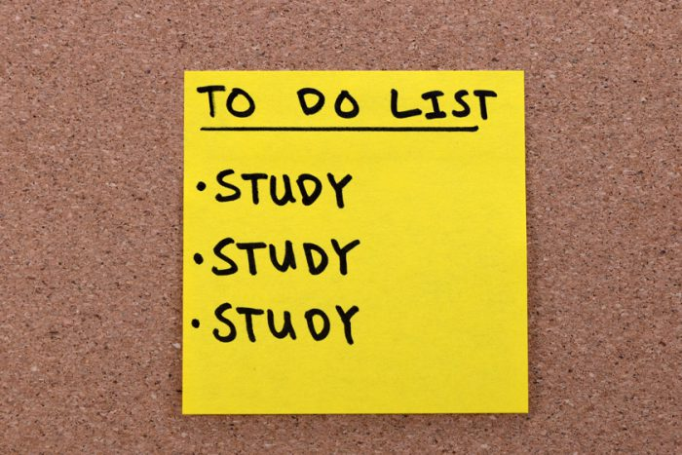
Finals Preparation
Academic Success Workshop
Fall 2020
Presented by Stefan Martyniak

Slide 2
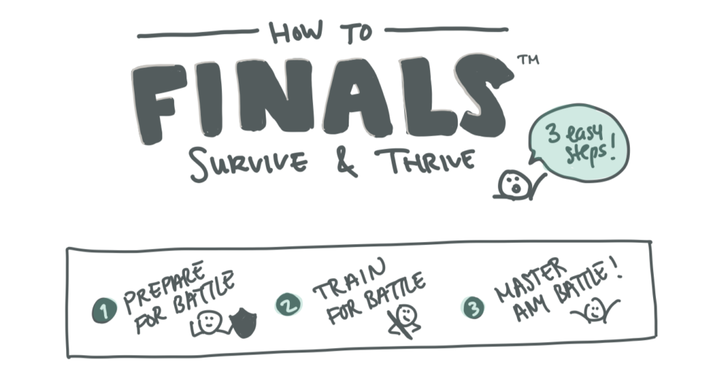
Tip #1: Think Ahead
“At the beginning of the semester, look up the final exam schedule.”

Slide 3

Tip #2: Review and Organize
“If you have a test, find all of your previous study materials and try to combine them. For projects, you should outline when due dates are as well as what components are required.”

Slide 4

Tip #3: Coping with Stress
“Engage in self-care like getting a good night's sleep or doing something that brings you joy.”

Slide 5
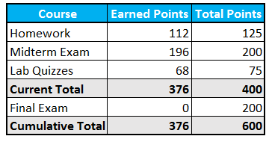
Tip #4: Assess Value
“Going into the final with knowledge of where you are in the class can help you know what your priorities need to be.”

Slide 6
Thanks for Watching!
For more information, check out the LARC website https://www.wcupa.edu/universityCollege/larc/
To make an appointment with a tutor or success coach, use this link https://wcupa.mywconline.net/

