Slide 1




Self-Care
Academic Success Workshop
Presented by: Emma Billingsley

Slide 2

Tip #1: Treat Yo-Self
"...Plan Motivating or relaxing treats that you get periodically, especially in times where you are extremely stressed."

Slide 3
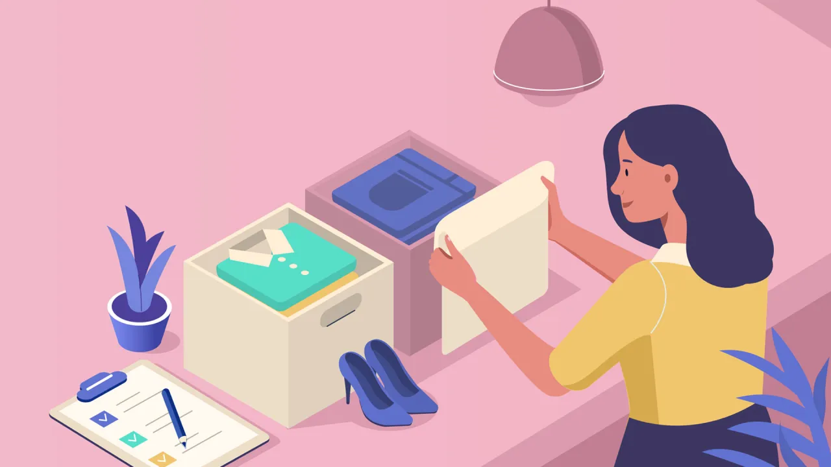

Tip #2: Organize
"By organizing your school, work, and social schedules, you are able to better budget your time and decrease your stress."

Slide 4

Tip #3: Forging a Healthy Lifestyle
"Having a good diet and exercising can positively affect your physical and mental health."

Slide 5

Tip #4: Meditation
"Meditation is a way to put your thoughts and problems aside, where you can focus on just being."
z

Slide 6


Tip #5: Developing a Positive Mindset
"If you focus on being positive about yourself, and letting go of negative thoughts, you can change your brain's default."

Slide 7
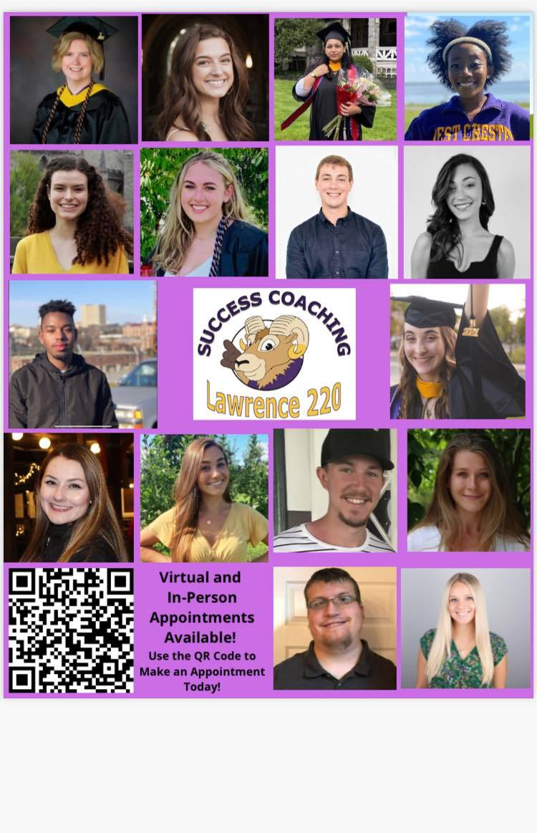
THANK YOU FOR WATCHING
For more information, check out the LARC's website: https://www.wcupa.edu/universityCollege/larc/
To make an appointment with a tutor or success coach, use this link: http://wcupa.mywconline.net/

