Slide 1
Self-Care Presentation
Success Coaching
Academic Success Workshop

Slide 2
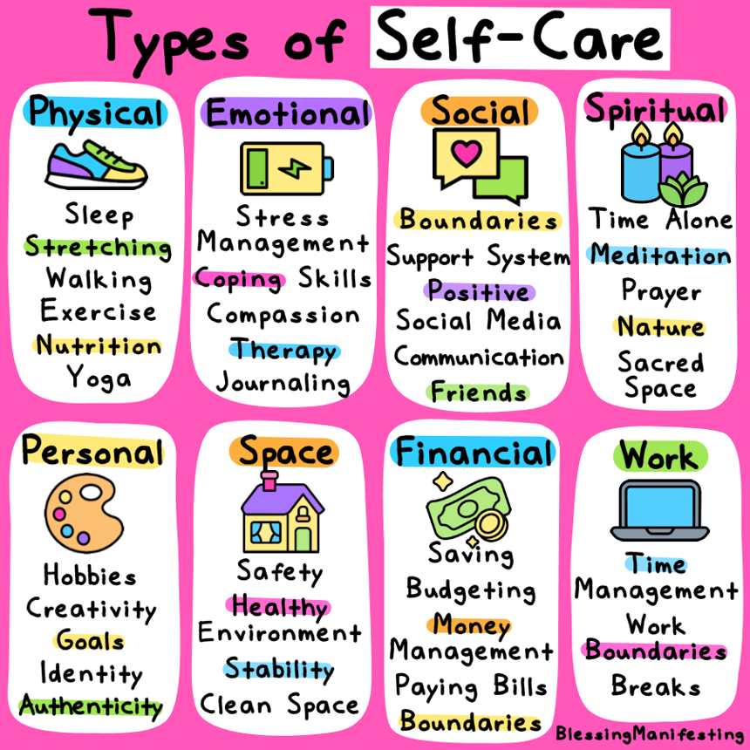
What is Self-Care?
The PRACTICE of taking care of your
physical, mental, and emotional health
No right or wrong way to practice
Self-Care! Self-Care is based on
what gives you peace of mind and
joy.
Self-care can look different for everyone!
What is something you do to relax and
have fun?

Slide 3
Types of Self-Care
Physical:
Eat a healthy meal
Drink water
Engage in exercise
Take a shower or bath
Sit in the sunlight
Emotional:
Journal
Practice mindfulness
Spend time with loved ones
Practice gratitude
Take up a hobby

Slide 4
Types of Self-Care
Social:
Spending time with family and friends
Calling or texting a friend
Volunteering with new people
Joining a group or taking a class
Setting healthy boundaries
Spiritual:
Prayer
Appreciating art
Yoga
Spending time in nature
Finding a spiritual community

Slide 5
Types of Self-Care
Personal:
Make a vision board
Set goals
Hydrate
Schedule in a time for your hobbies every day/week
Space:
Clean up your work desk at the end of each day
Add decorations and greenery
Set up a candle or diffuser
Display artwork

Slide 6
Types of Self-Care
Financial:
Budget your money
Learn about money management
Plan for retirement
Set financial goals
Create an emergency fund
Work:
Create a comfortable workspace
Set boundaries
Take stretch breaks
Prioritize tasks
Wear clothing that makes you feel confident

Slide 7
Management of Self-Care
Boundaries:
Communication is key
It's okay to say 'no'
Practice self-awareness
The Three R's of Self-Care
Reflection
  Recognition of emotions, patterns, and energy
  Planning out time for self-care
Regulation
  Response to stress & utilizing coping strategies
Relaxation
  Implementing self-care activities

Slide 8

Self-Care:
School Edition

Slide 9

Keeping a Schedule
Helps with organization of schoolwork and personal obligations
Sets boundaries and expectations for yourself and others
Be realistic and maintainable
Applicable life skills
  Accountability
  Responsibility
  Work-life balance

Slide 10
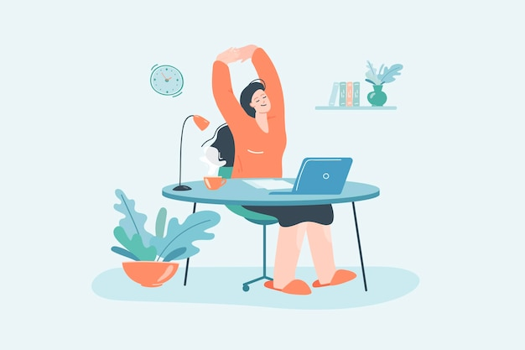
Taking Breaks
It is important to step away from material once in a while so brain can process info
Can be a fun game, restful, or just something to help take your mind off work briefly
  Helps maintain motivation and stamina
Cramming doesn't allow for processing
Reward system based on personal preferences. Be realistic! (25/5 system)

Slide 11
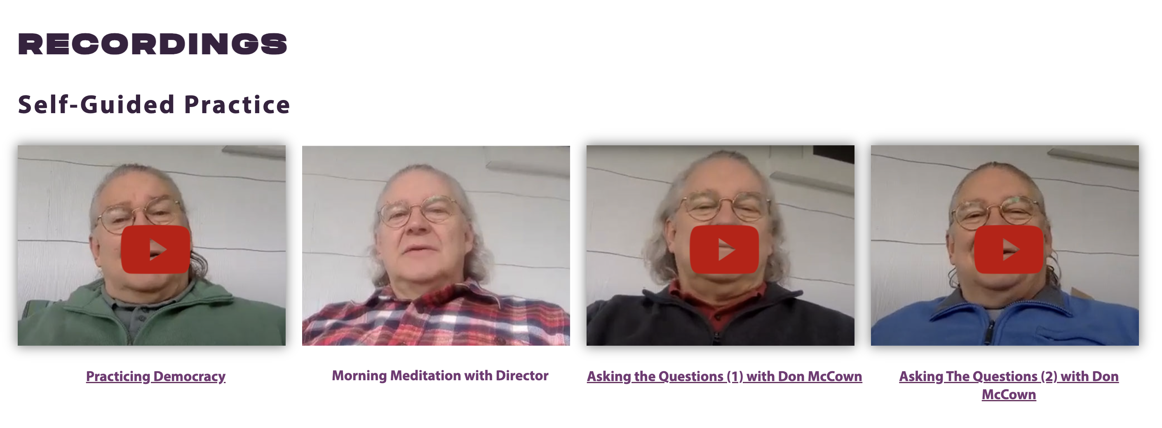
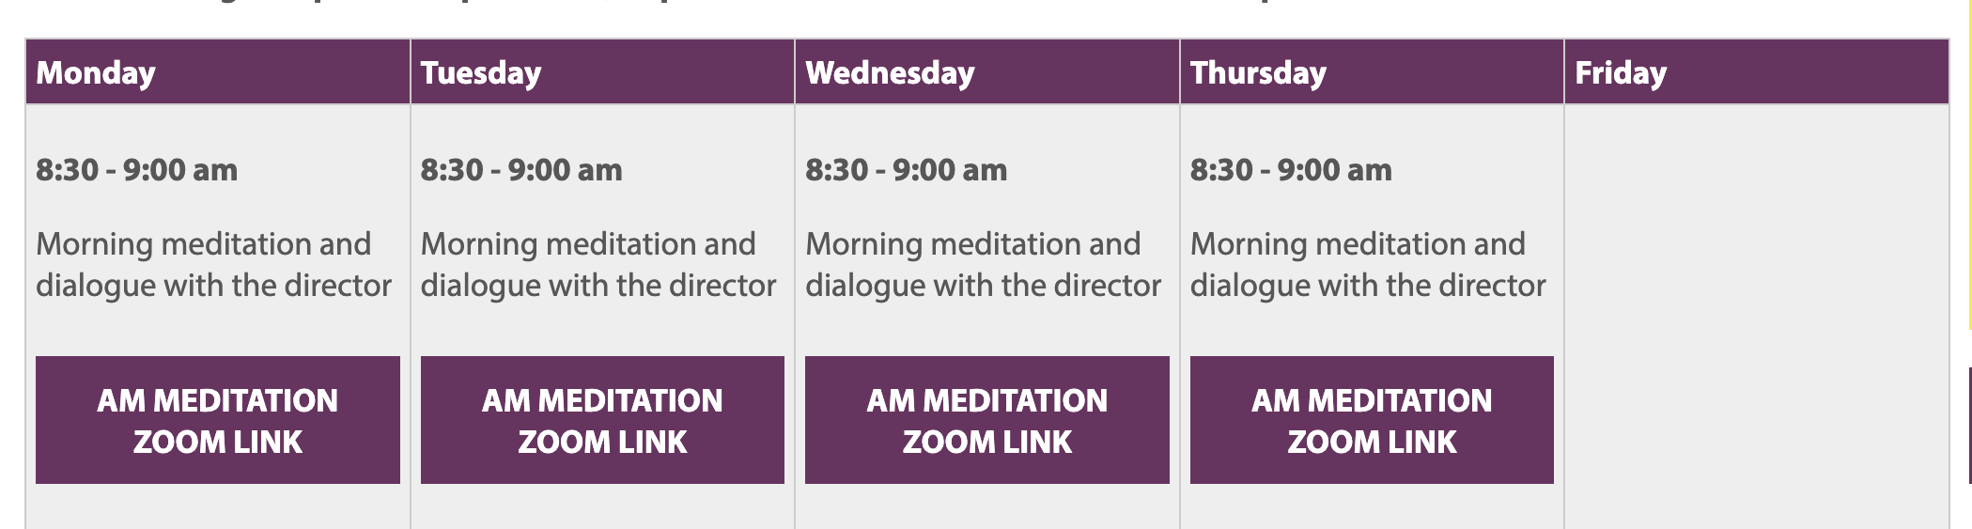
Center for Contemplative Studies
Located on 700 South Church Street
Holds daily morning group meditations on Zoom
Pre-recorded meditations are also available on their website!

Slide 12
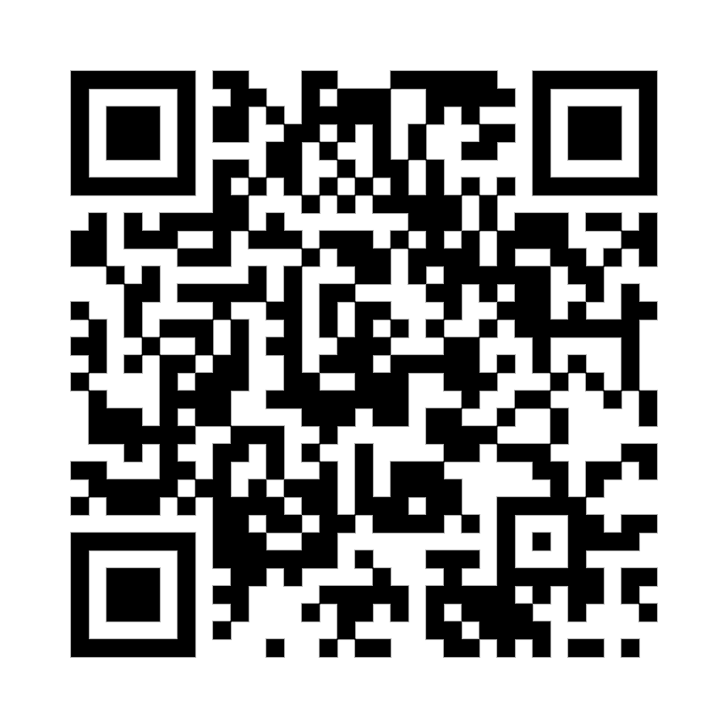
Thank You!
To receive more individualized Self-Care Tips,
Schedule with a Success Coach!
Location: Lawrence 220
Phone: (610)436-1067
Email: Successcoaching@wcupa.edu

