Slide 1
How to avoid procrastinating
In this academic success workshop we will discuss a strategy to curb your activities away from procrastination.
Notes:
In this ASW we will discuss a method to avoid procrastination. Often, it is difficult to use time effectively. Many people struggle with procrastination and varying degrees. It is important to know some techniques to avoid this behavior, even for people who don’t see themselves as bad procrastinators.
But before we do that, we must try to understand a little bit about why we procrastinate.

Slide 2
The question you should answer
How is the current digital learning environment different?
Notes:
This is an important question, as it sets the scene. We need to be aware of how our environment con encourage procrastination.

Slide 3
The Questions we will answer
Does the current environment allow for more procrastination?
How can we avoid procrastinating?
Notes:
I’m using the word ”avoid/curb” because procrastination is an emergent behavior. Basically, we don’t generally decide that we want to procrastinate -we just end up doing it. In that sense, procrastination is similar to boredom; it’s a state that emerges when we are trying to do something else. These states aren’t necessarily the “wrong”– they just doesn’t help you succeed. That’s why it is easy for us to allow them.
From a personal standpoint, allowing yourself to procrastinate or become bored never appears fundamentally wrong. That’s why it is important to not depend on your rational for allowing these states, it is more important to learn rules to avoid the behavior that encourages them.
But before we do that, we must try to understand a little bit about why we procrastinate.

Slide 4

The problem
The online learning climate generally offers less opportunity and incentive for student engagement…
Notes:
Procrastination has become a more prominent issue in the current learning climate. The online learning climate generally offers less opportunity and incentive for student engagement in classes. I have noticed that most students that struggle with procrastination also mention having anxiety.
Upon some research, I discovered that the link between anxiety and procrastination has been established. Procrastination was linked with interpretation anxiety, which is basically a fear of asking for help. (1) Combine this form of anxiety with the reduced engagement in an online learning environment, and you can see that a student that previously may have had minor issues with procrastination may now be really struggling with it. Many students have asked me for ways to avoid procrastinating, and these techniques may provide some help.

Slide 5


The impact
Anxiety
Notes:
The main impact of the digital environment is the increase in procrastination and anxiety. These two issues play of off of each other. Anxiety can cause one to procrastinate and procrastination can cause you to feel anxious about your work.

Slide 6

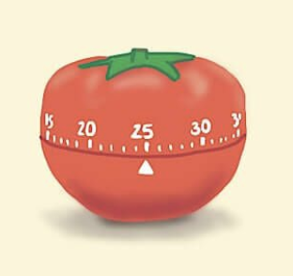
A solution
Before you do anything, make sure you have a well organized calendar/planner/schedule
The Pomodoro Technique
Notes:
It is very important to, first of all, be sure that you have a schedule in place. You se tup your schedule, but really your schedule is your boss. Your schedule makes it very clear -what to do and when. If you follow your schedule you are really just obeying your own orders. Nobody likes to have their orders ignored, so why should you ignore your own? Nonetheless, we often ignore our best set schedule. So, it is important to find ways to make yourself follow it.
Once you have a schedule in place, you can experiment with various techniques that help you obey your past-self that set up a wonderful schedule. The technique we will discuss is the pomodoro technique.

Slide 7
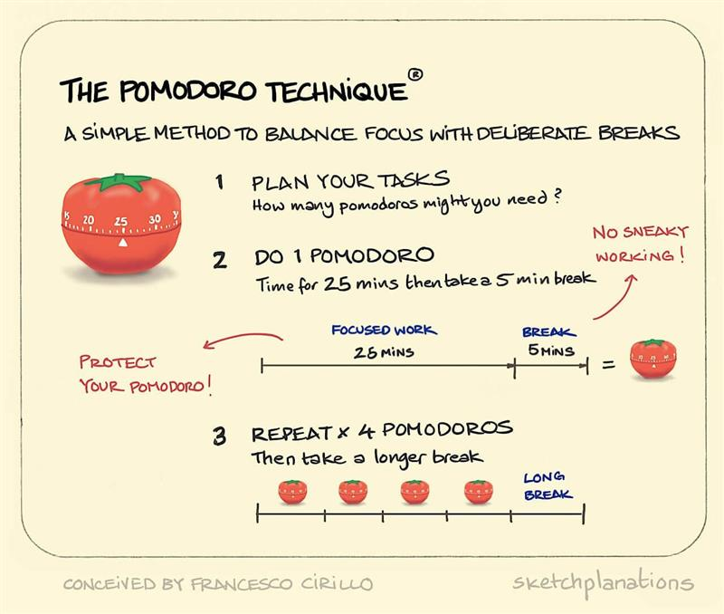
Notes:
Simply read slide

Slide 8

How to start
Go through your course syllabi and find the major items associated with each course.
Create a list that includes:
  exam dates and major assignments
  or the most pressing tasks you have
Notes:
Go through your course syllabi and find the major items associated with each course. Create a list that includes exam dates and major assignments. If you want to just focus on the immediately pressing tasks, that’s also fine.

Slide 9
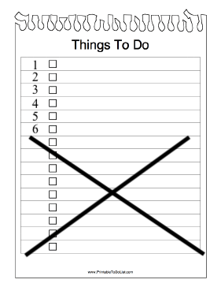
Get organized
Create a prioritized list of at most 6 items
The most important at the top
Breakup each item into smaller and simpler tasks
Notes:
Once you have a good idea of what is expected of you, you should prioritize the items in the list by level of difficulty and demand on your time. The most challenging items should be near the top of the list.
Now that you have a prioritized list, write (at most) the top 6 items on a note-card or separate sheet of paper.
Break up the 6 major items into smaller tasks. Write out a brief over-view of all the smaller components of each major item as bulleted lists on their own sheets of paper.

Slide 10
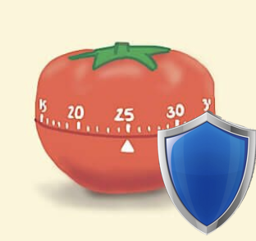
Make sure your Pomodoro is safe!
Set your phone to Airplane mode
Let everyone know you will be unavailable
Make a promise to yourself: “ I will only work on the chosen task for this time.”
If any other tasks come to mind during this time, simply write them down on a notepad to think about later.
Don’t forget to take a break!

Slide 11
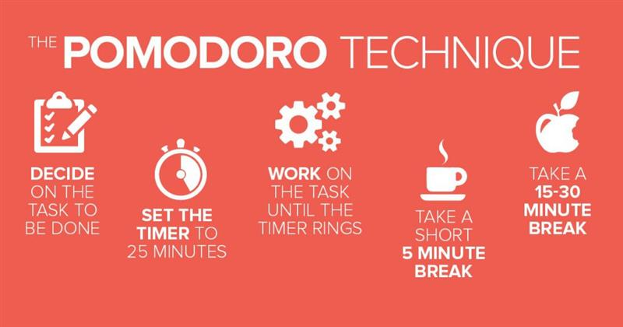
Get Started
Notes:
Begin devoting small chunks of time to the first item on your top 6 list. Devote 3, 25-minute time slots. Do not devote more than 25 minutes of time for a given time slot. After any given 25-minute slot, provide at least a 5-minute break. Put these times into your planner/calendar.
After 4 consecutive pomodoros, take a longer break.

Slide 12
Meet with a Success Coach
If you have other questions or think you could work on this skill, set up a meeting with a Success Coach by going to https://wcupa.mywconline.net/. Register an account and sign up to meet with an available Success Coach! We hope to see you soon!
Notes:
References:
Walsh J, Ugumba-Agwunobi G. Individual differences in statistics anxiety: The roles of perfectionism, procrastination, and trait anxiety. Personal Individual Differ. 2002;33(2):239–51
https://biasharathreesixty.com/overcome-procrastination-and-achieve-your-goals/ (The over-all system)
https://francescocirillo.com/pages/pomodoro-technique (The pomodoro technique)

