Slide 1
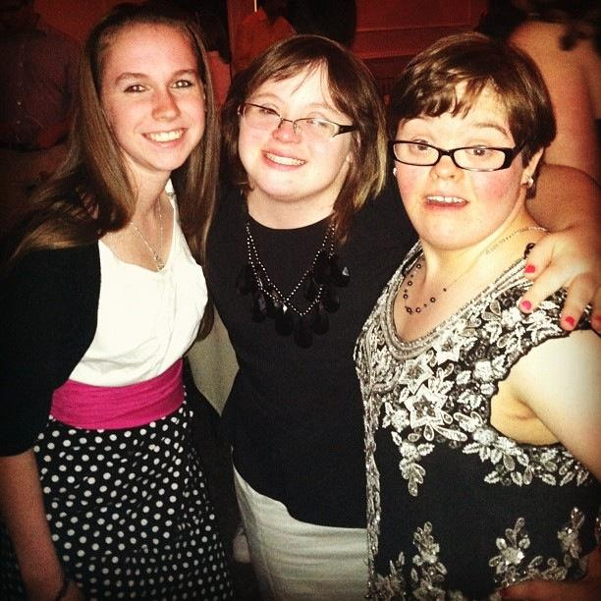

RAM Initiative
Welcome to West Chester University RAM Initiative where Real
Achievement Matters!
Who? What? Why? When? Where?

Slide 2

What are YOU excited about?
Think about these questions…
  Do you want to come to West Chester University to learn and grow? To prepare for a job?
  Would you like to attend and participate in college classes and complete college class work, projects, and homework with a little bit of assistance?
  Are you excited to participate in “college life?” Joining clubs? Working out at the fitness center? Independently and safely walking around campus? Going to the library? Taking the bus and public transportation? Going to basketball games and other sporting events with your friends?

Slide 3



If the answer is YES, then you might be…a Golden Ram someday!

Slide 4

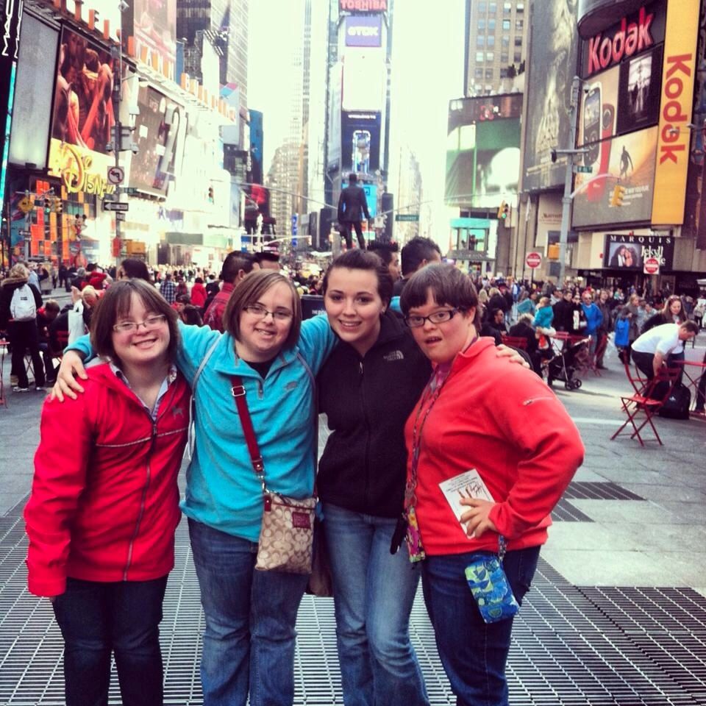
Hi! My name is Maggie and I was a student in the CILLS Program at East Stroudsburg University. I am a member of the WCU RAM initiative Team as a consultant.

Slide 5

What is the RAM Initiative
The RAM Initiative is a program for individuals with Intellectual Disabilities who, at the start of the program, are between the ages of 18-24.
It is a 2 year, fully inclusive, educational experience in which students are completely immersed into all aspects of campus life
  Students will typically audit classes as non-credit students
  The classes will be the same taken by WCU students as part of the university curriculum.
  Students accepted this fall will be day students for the 2018-2019 academic year.

Slide 6

Areas of study include:
  Academics: Functional and Personal Interest
  Career Skills: On and off-campus employment, internships.
  Wellness/Personal Development
The RAM Initiative IS a Comprehensive Transition Program!
The RAM Initiative leads to a 2 year “Recognition of RAM Program Completion.”

Slide 7
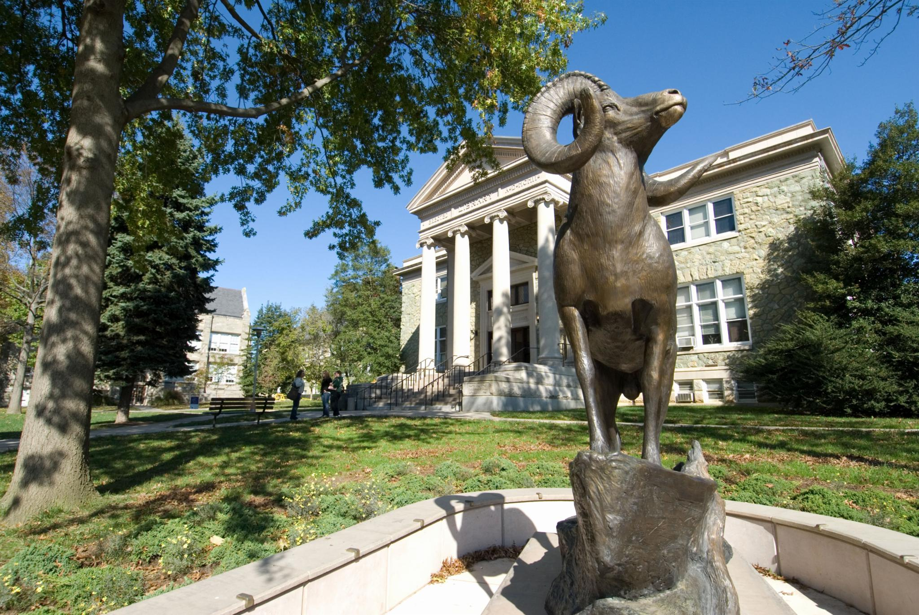
WHERE will it take place?
On-campus
Community-based instruction including area businesses, organizations, and service agencies.
In classrooms, recreation spaces, federal financial student worker placements
EVERYWHERE!

Slide 8

When will this take place?
1-2 students will be admitted in the Fall of 2018.
  Pilot Program
3-4 students admitted each fall.

Slide 9
Why RAM Initiative?
A generation of IDEA students
The Higher Education Opportunity Act of 2008http://www.thinkcollege.net/topics/opportunity-act
New financial aid for individuals with Intellectual Disabilities
Federal creation of new model demonstration programs and a coordinating center for this initiative
  <http://www2.ed.gov/programs/tpsid/index.html>
  U.S. Department of Education. Transition programs for students with intellectual disabilities coordinating center <http://www2.ed.gov/programs/coordinatingcenter/index.html>

Slide 10


Slide 11
Skills you need to be successful
Reading
  Reading level and comprehension concurrent with ability to read class materials, handouts, signage, menus, bus and room locations, emergency procedures.
Math
  Math skills equal to functional, daily living including paying for meals and campus necessities, and understanding of time for meetings, etc.
Self-management and sociability
  As gleaned from references and interviews
Responsibility
  As gleaned from references and interviews

Slide 12
Skills you need to be successful
Communication
  Written as expressed in writing sample
  Oral/Sign Language as expressed in interview and references.
Listening Skill
  As evaluative through interview, school records (IEP) and references
Safety and Travel Skills
  As evaluated through application, interview, and school records.
Reasoning and Problem Solving Skills
  As gleaned from references, interviews, and school records

Slide 13
Enrollment https://www.wcupa.edu/viceProvost/interdisciplinaryStudies/professionalStudies/ramInitiative.aspx
Application
  Must have ALL materials in one envelope by MARCH 15, 2018!
Select few for interview
Full-time student/Full-time tuition
Typical Enrollment: For audit (special rubric for pass/fail)
Peer- to- peer mentor
Access to all campus amenities

Slide 14

Admissions
Student Application Packet Checklist
General Student Information Form
General Family Information Form
Personal Support Information Form
Student questionnaire
Student typed 500 word essay/statement of intent: How will college help fulfill my goals? Why will I be successful in college?

Slide 15
3 letters of recommendation from persons who have known the applicant for year or longer. The recommendations should represent two of the following:
      Education (current or former teacher)
      Vocational/employment (a current or former employer including volunteer supervisor)
      Community involvement (a coach, director, mentor, etc.)
Official High School transcript and most recent IEP, Re-evaluation, and final summary of performance (and any post secondary program record(s)).
Release/Exchange of Information form

Slide 16
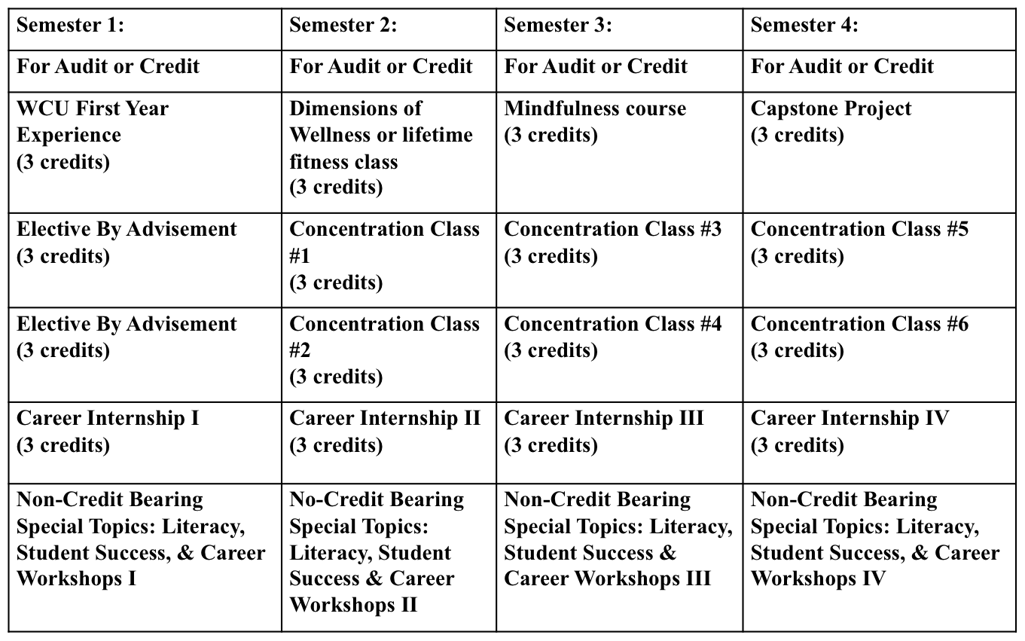
Curriculum

Slide 17
Think College!
https://thinkcollege.net

Slide 18
Contact information
raminitiative@wcupa.edu

