Slide 1
Request for Certification
How to complete the RFC

Slide 2
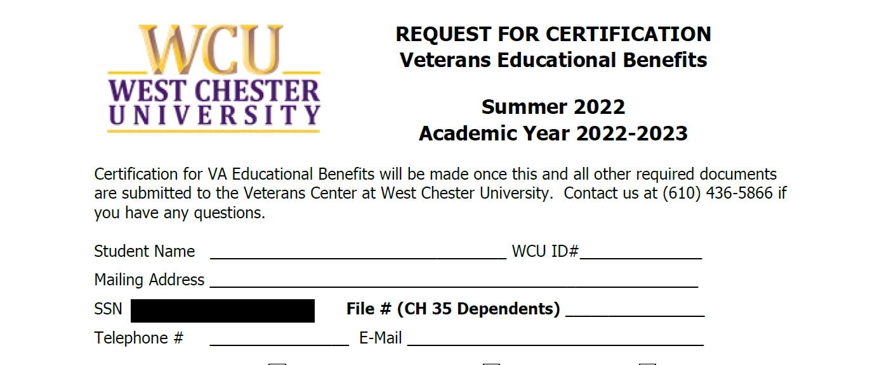
RFC Part One Personal Information
Fill in your name as it appears on your VA benefit application.
WCU ID Add your ID here.
Your mailing address, home or off campus address, where do you want your mail to go to?
SSN – We do not need this nor do we need your File number. We can get that elsewhere.
Phone number – Where can we reach you? E-Mail – Where can we reach you?

Slide 3
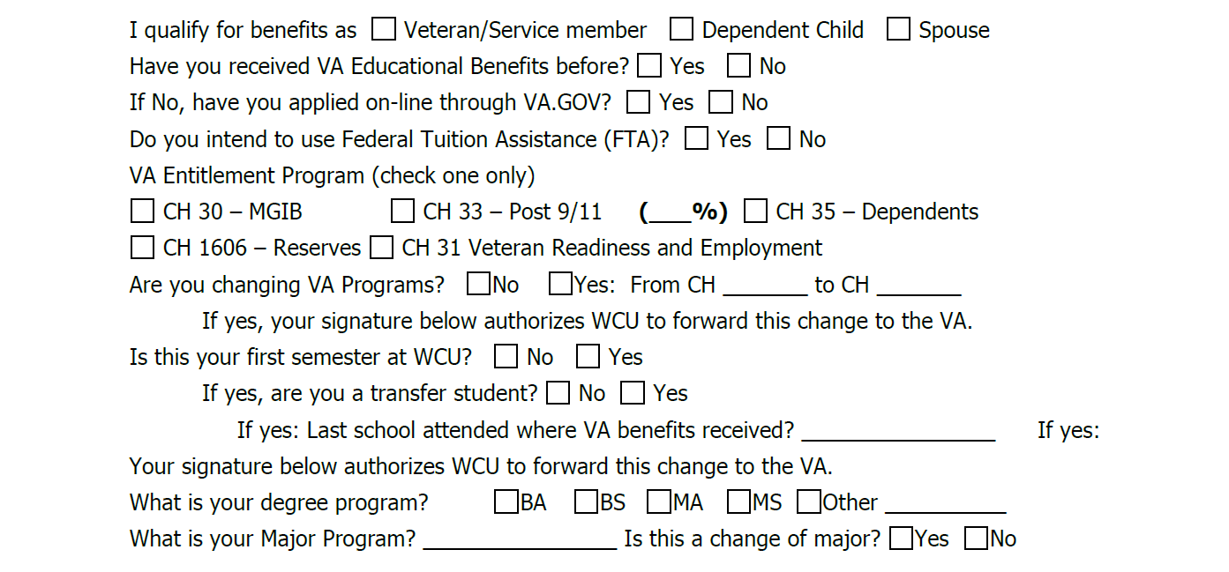
Veteran Info and Educational Program Part 1
Qualify: Are you (check one) Veteran/Service Member? Dependent of a Veteran? Or Spouse of a Veteran?
Have you received VA Ed Benefits before? Y/N
  If No, have you applied at www.va.gov? Note- you may have to wait up to 30 days for your COE. – Certificate of Eligibility.
VA Entitlement Program
  CH30 – Rare, for Active-duty Rev/Guard
  CH33 Post 911 Common for Veterans and Rev/Guard who qualify, and Dependents whose Veteran parents who gave them their benefits.
  CH35 for Dependents only. CH1606 Rev/Guard All Branches,
  CH31 Rare – VR& E (Veterans Readiness & Employment) -special program for Veterans.

Slide 4
Veteran Info and Educational Program Part 2
4. Changing Programs: Some Vets, Rev/Guard, and Dependents change from program to program.
Example:
Guard goes from 1606 to CH33 due to qualifying time while called up on active duty.
Dependent switches from CH33 parent benefits to CH35 when 33 Benefits are exhausted.
5. Additional questions: First semester at WCU?
You need to complete an RFC each year, or each semester if you apply on-line.
If you are a transfer, what school did you attended where you used VA Benefits, we may need to coordinate.
6. Ed program: We need this to report to VA. If you change your Major, we need that info as well.

Slide 5
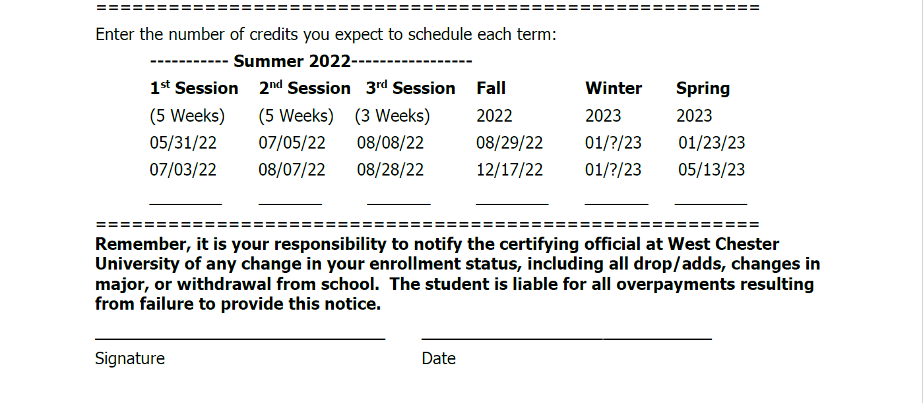
RFC Completion and Signature
1. If you complete the hardcopy version RFC (from the Veterans Center), you can request certification for the entire school year! You can email the Veterans Center for an RFC to complete and email it back to us.
2. If you apply on-line, you will have to fill one out every semester.
3. Finally, Sign and date. Your signature will allow the Veterans Center to process your benefits with the VA.
4. Do not hesitate to reach out if you have any questions.
Thank you, your VA Ed Center Team!

